Slide 1
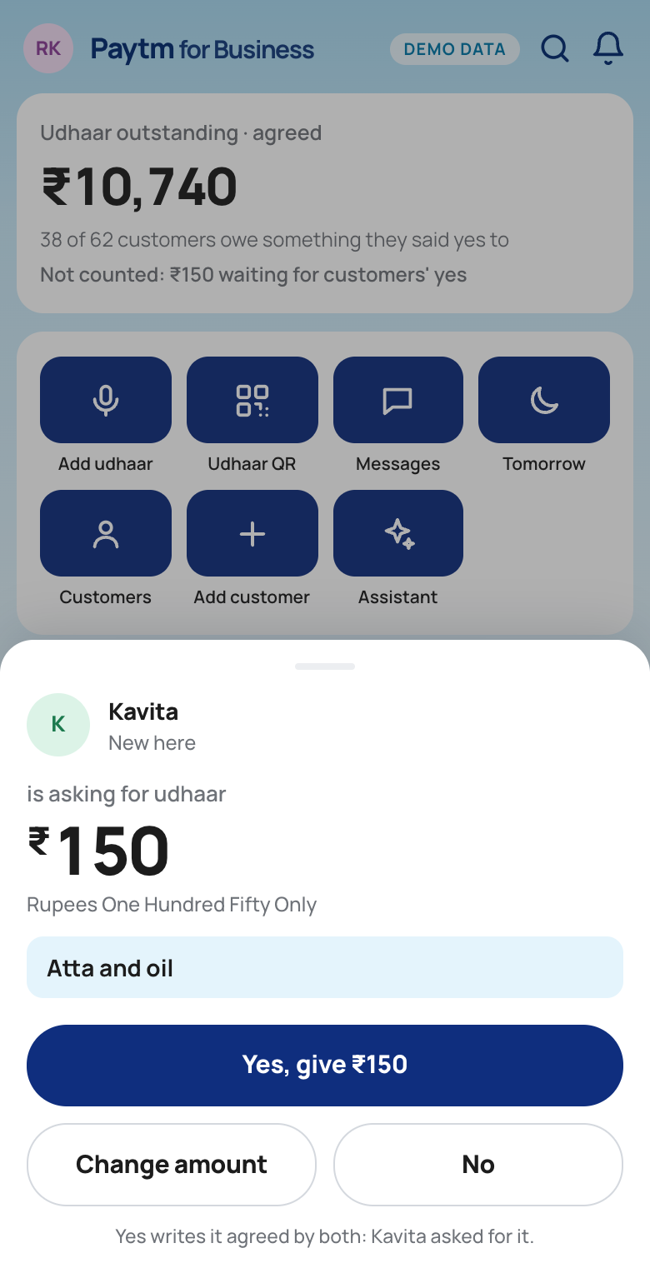
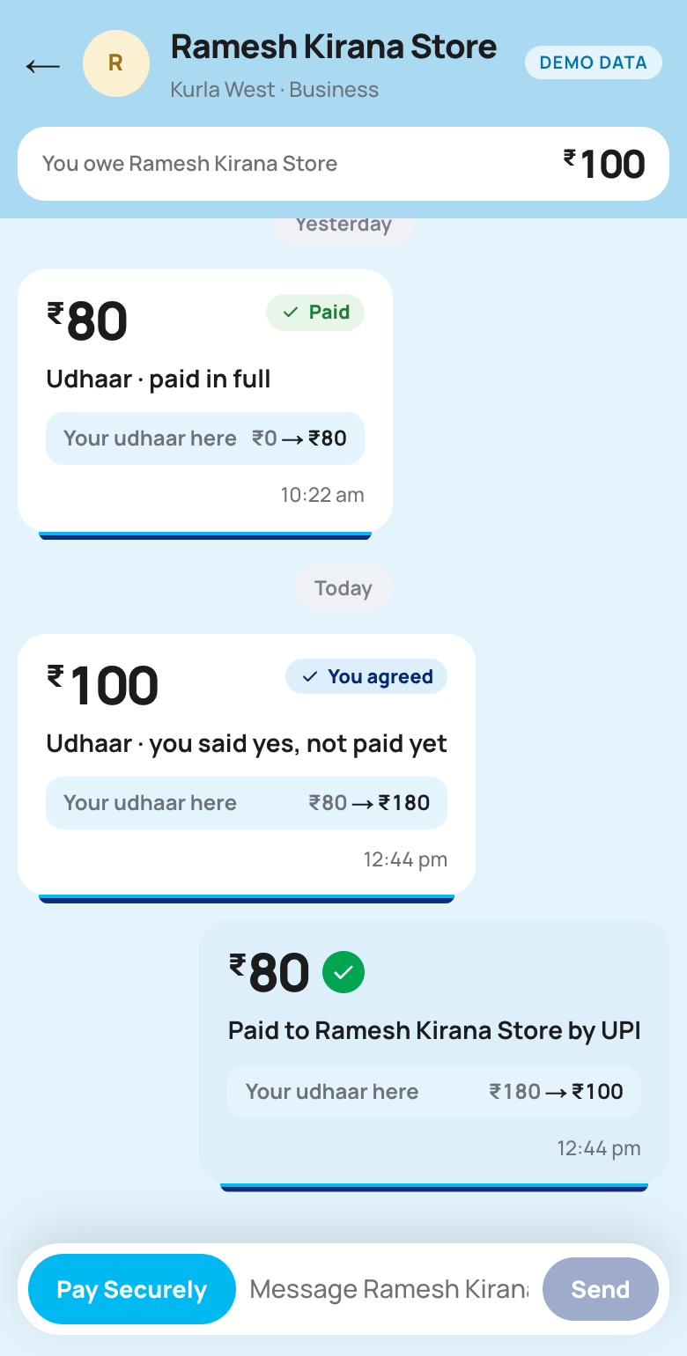
This idea was selected in the top 10 at the Paytm Build for India AI Hackathon, Mumbai
BAHI
The khata both sides can see.
The customer scans the shop’s udhaar QR, or asks for udhaar on her own phone. The shopkeeper tells his AI munshi the amount, and nothing is written until both sides say yes. Every night, plain code decides who actually needs a reminder.
Paytm Build for India AI Hackathon · Mumbai, 3 October 2026
Track 2: AI-Powered Financial Journeys
Team Hustlers · picked by the Paytm panel as a top 10 project
Shopkeeper · Customer · our working app, demo data

Slide 2
WHAT PAYTM GETS
More revenue from merchants and customers Paytm already has.
Customer acquisition is already done
1.57 Cr storefronts run a Paytm Soundbox, and their customers pay with Paytm. BAHI is sold to people Paytm has already won.
₹9
a month, added to the Soundbox plan the merchant already pays.
The customer pays nothing. There is no new device to ship and no new app to install.
1
Paytm Business Khata, made two-sided
Business Khata already keeps the shop’s udhaar. BAHI adds the customer’s own copy, the AI munshi and the Soundbox voice.
2
Udhaar moves from cash to Paytm UPI
Every repayment is a tap in the customer’s chat with the shop, paid by Paytm UPI.
3
Our proposed price. The numbers behind it are on slide 14.
Sources: Paytm Q1 FY27 earnings release (1.57 Cr Soundbox storefronts); business.paytm.com/business-khata, checked 23 Sep 2026.
2 / 16

Slide 3
THE PROBLEM
The udhaar book has one author. The customer never sees it.
Shopkeeper
writes every entry
The udhaar book
a notebook, or a ledger app
Customer
no copy · no total · no proof
writes
an SMS, at best
He can’t see patterns
Someone who always pays on day 9 and someone quietly drifting away look the same in a notebook. So everyone is chased the same way.
The customer has no record
He can’t see what he owes across shops. If the book says ₹500 and he remembers ₹300, he has nothing to show.
Apps went digital on one side only
Khatabook alone has 5 Cr+ downloads. Its customers still get only an SMS — no app of their own, and no say in the entry.
Source: Khatabook on Google Play (5 Cr+ downloads) and khatabook.com, checked 23 Sep 2026.
3 / 16

Slide 4
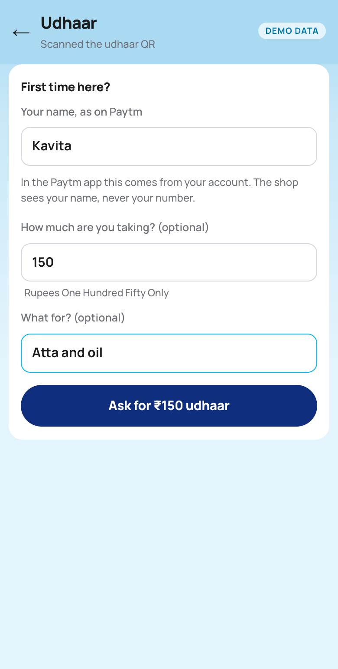

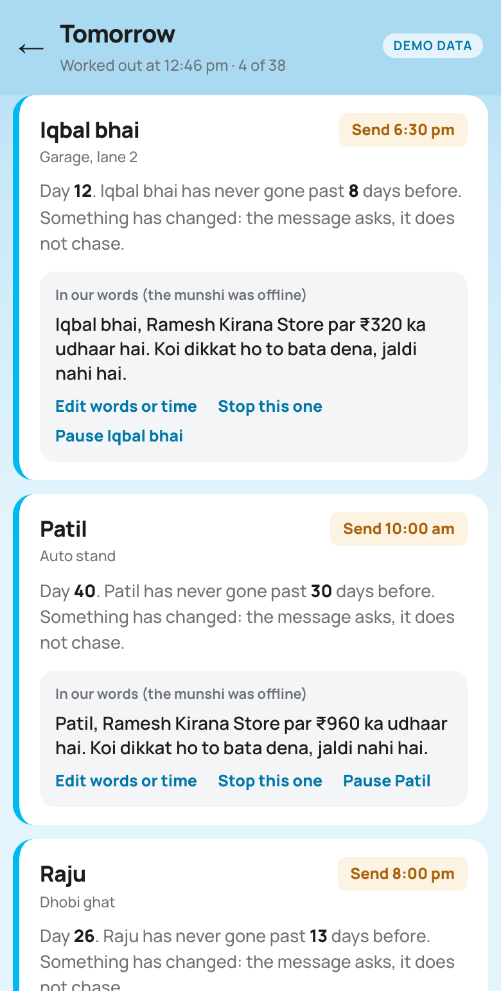
THE SOLUTION
One entry, agreed by both sides, inside the Paytm they already use.
1
She scans, and can ask
A separate udhaar QR. She may say how much, and what for.
2
The shop says yes
Or says the amount to the munshi. Nothing is written before his yes.
3
In both books
Her ask was her yes. Otherwise: “Yes, I owe ₹200” on her phone.
4
A chat like a passbook
Every udhaar and payment shows the total before and after it.
5
Code picks who hears
Only people past their own longest gap. Everyone else is held, with why.
Screens captured from our working app. Names and amounts are demo data.
4 / 16

Slide 5
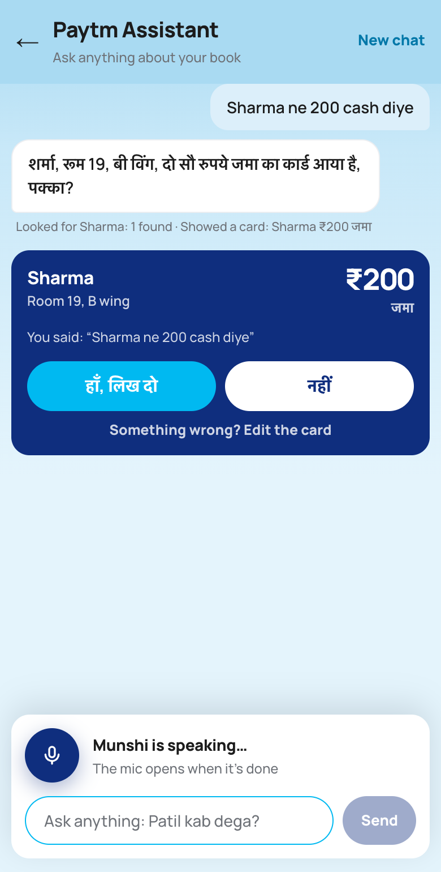
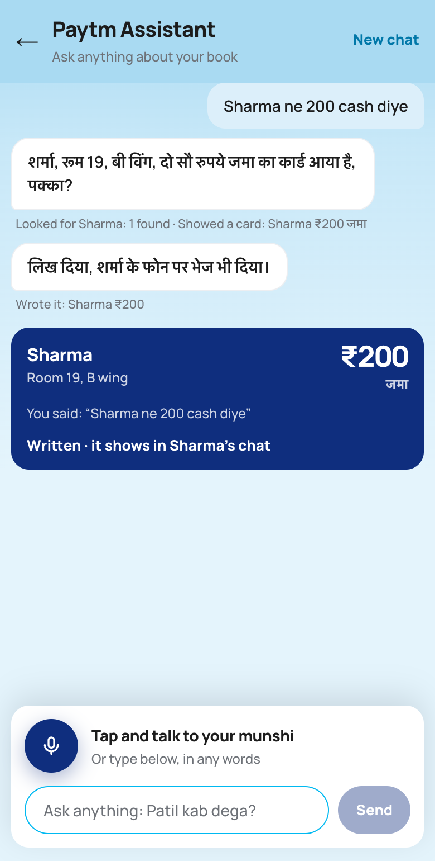
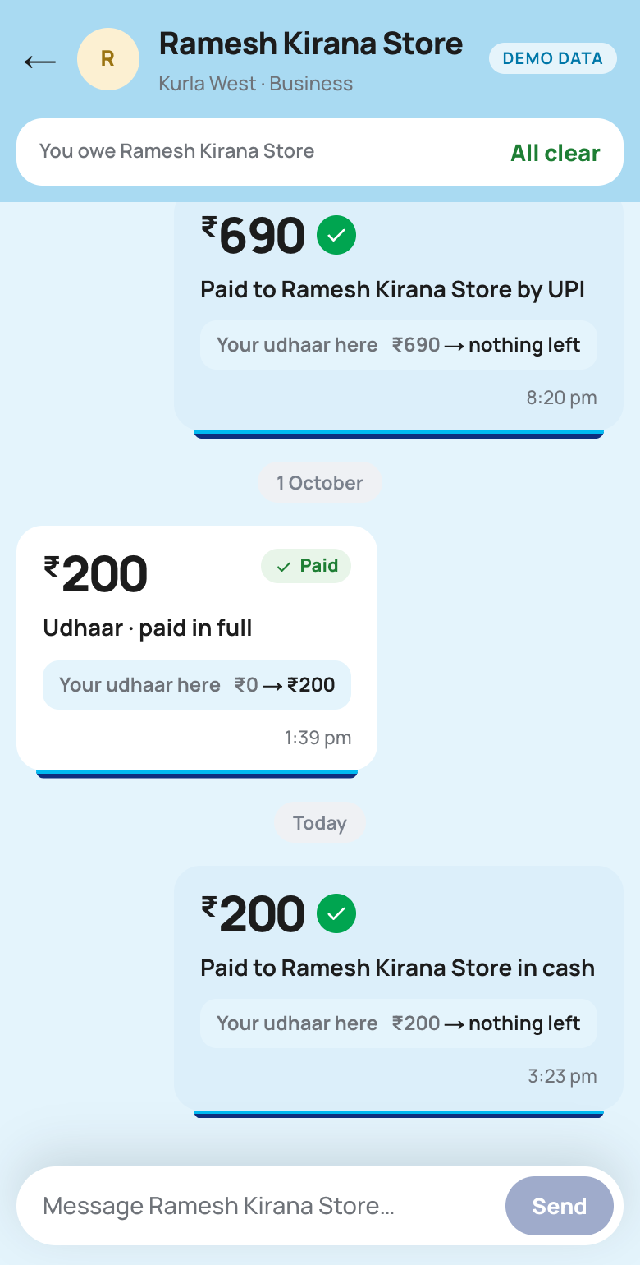
THE SOLUTION / PAID IN CASH
Paid in cash? He says so, and that udhaar is gone.
1
2
3
He says it
“Sharma ne 200 cash diye.” The munshi finds Sharma and puts up a जमा card for ₹200.
His yes writes it
The cash clears Sharma’s oldest open udhaar first. The munshi says it is written and sent.
Gone on both sides
Sharma’s own chat shows “Paid in cash”, and his udhaar goes from ₹200 to nothing left.
Screens from our working app, with the munshi live on Sarvam. Only money the customer handed over is जमा; a mistake is taken back, never cleared with a जमा.
5 / 16

Slide 6
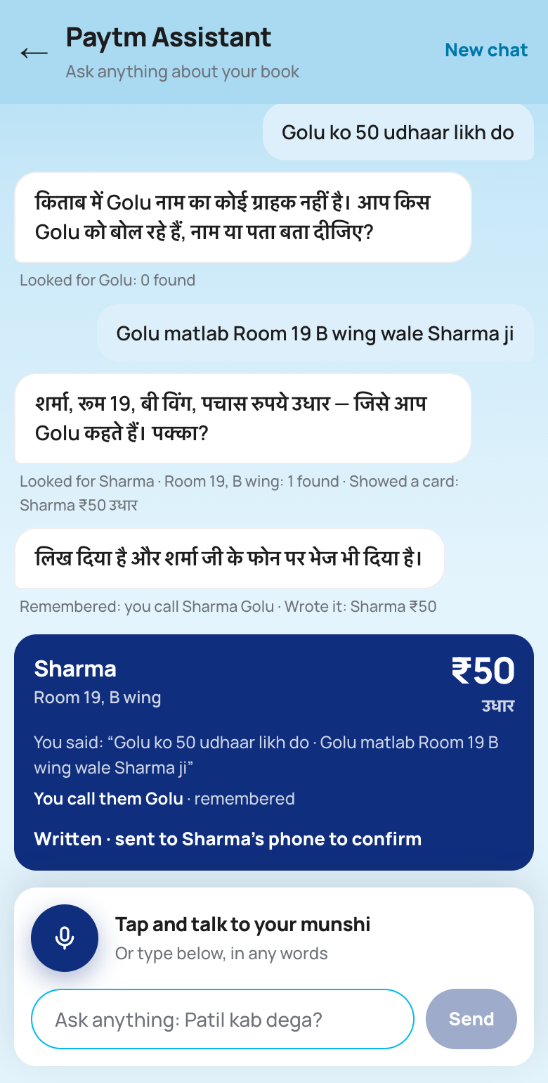
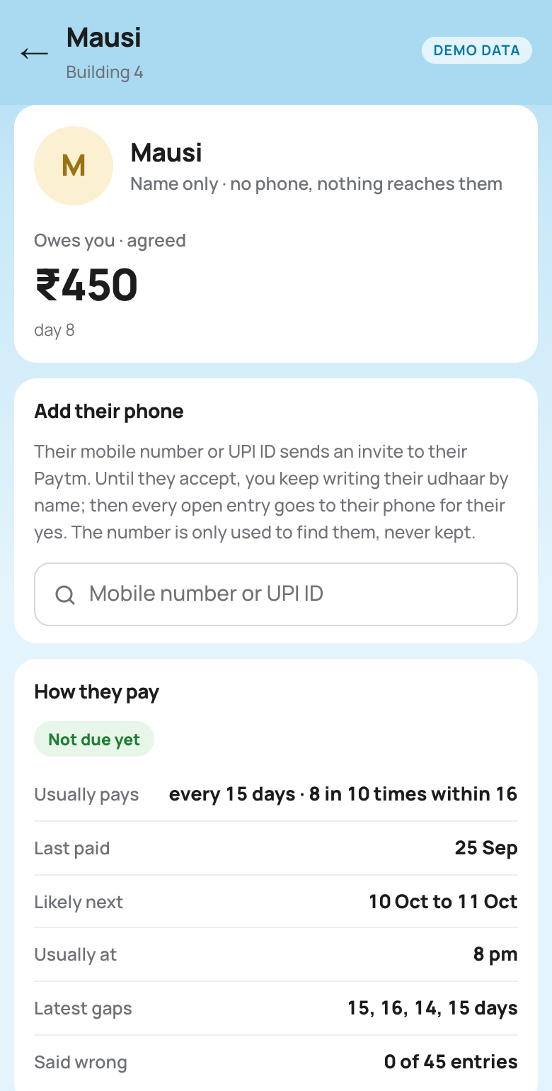
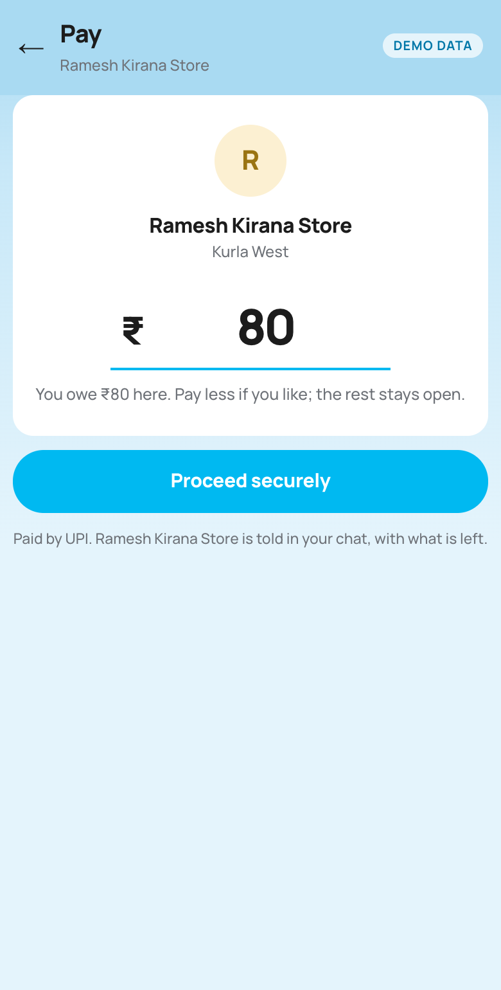
THE SOLUTION / MORE THAT A NOTEBOOK CAN’T DO
Nicknames, customers with no phone, and paying without cash.
1
2
3
Nicknames
He says “Golu”. The munshi asks who that is, and remembers. Next time, “Golu” finds Sharma straight away.
No phone needed
A customer with no phone is kept by name, like the notebook. Add their number later and every open entry goes to them for a yes.
Cashless
The customer pays from her chat by UPI, all of it or part. The shop is told what is left.
Screens captured from our working app. Names and amounts are demo data.
6 / 16

Slide 7
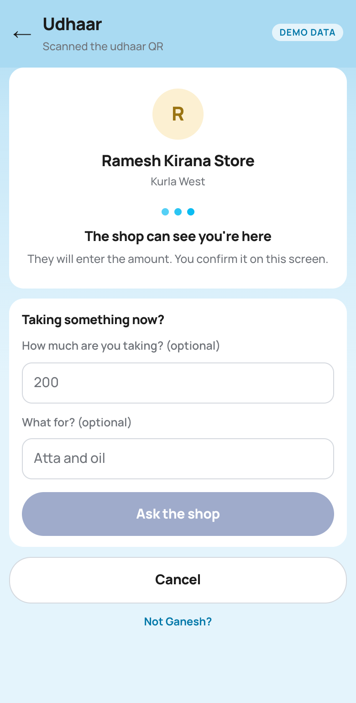
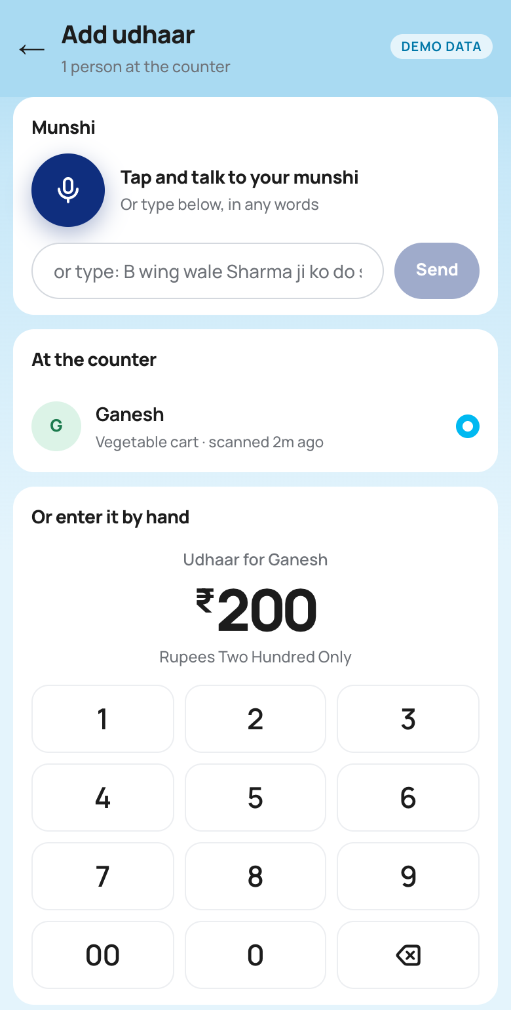
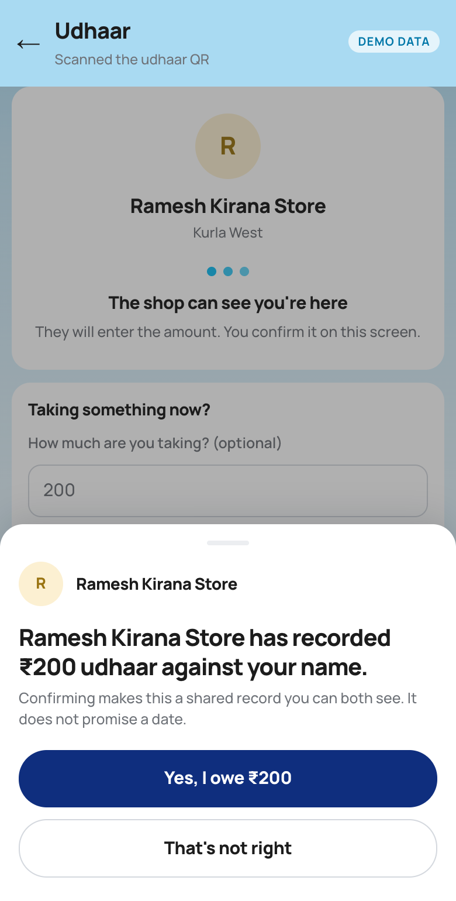
THE SOLUTION / THE COUNTER
Scan the udhaar QR, and you’re at the counter, first in line.
1
2
3
She scans
The udhaar QR puts her on the shop’s counter list for three minutes. Her phone tells her the shop can see her.
Top of his screen
People at the counter come first. With one there, she is already picked: he says or types ₹200 and sends.
Her yes, on the spot
Her phone asks “Yes, I owe ₹200” at once, before she leaves the counter.
When he says a name, people at the counter are checked first: “Ganesh ko do sau” goes to the Ganesh standing there. With two or more there, nobody is picked until he taps one.
7 / 16

Slide 8
AI IN BAHI
Five jobs for AI: hear, understand, speak, remember, predict.
THE JOB
MODEL
WHAT IT DOES
WHERE YOU SEE IT
Hear
Sarvam Saaras v4
Speech to text in whatever language is spoken, with the shop’s customer names as hints.
Add udhaar by voice, the munshi
Understand
Sarvam-105B
The munshi: works out what he meant and calls our tools to find a customer, put an entry on a card or look something up.
Paytm Assistant, voice entries
Speak
Sarvam Bulbul v3
Says amounts on the Soundbox and reads the munshi’s replies aloud.
Soundbox, Assistant
Remember
Cognee + pgvector
Turns notes, promises and nicknames into a knowledge graph per shop, and recalls them by meaning.
“Salary on the 7th”, “Pappu is Prakash”
Predict
Pattern engine + Sarvam-105B
When each customer will likely pay, and who is drifting. The munshi says it as a guess.
Customer card, Tomorrow, “इस हफ़्ते कौन देगा?”
Prediction is arithmetic on the customer’s own ledger, so every figure can be checked by hand; no model ever produces a number. Cognee runs in our local build and is off in the hosted demo.
8 / 16

Slide 9
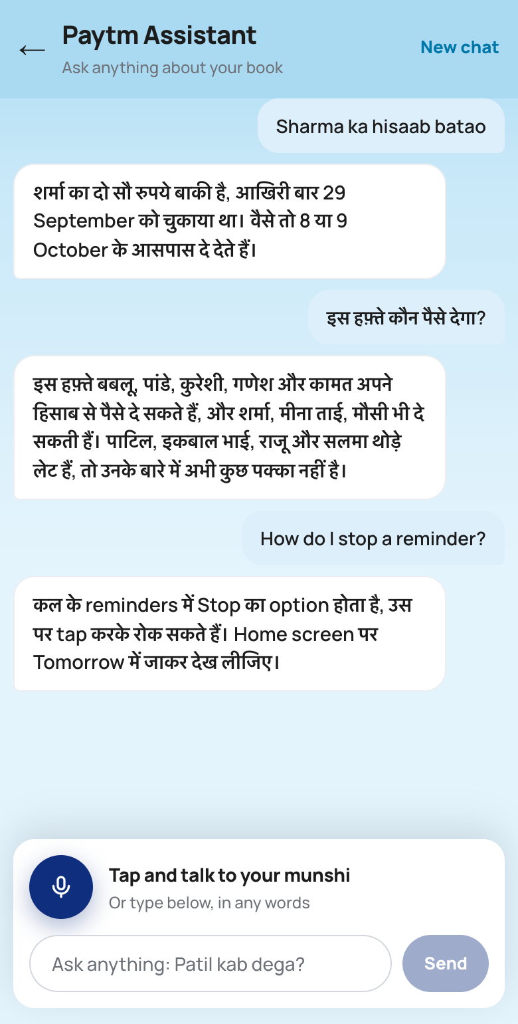
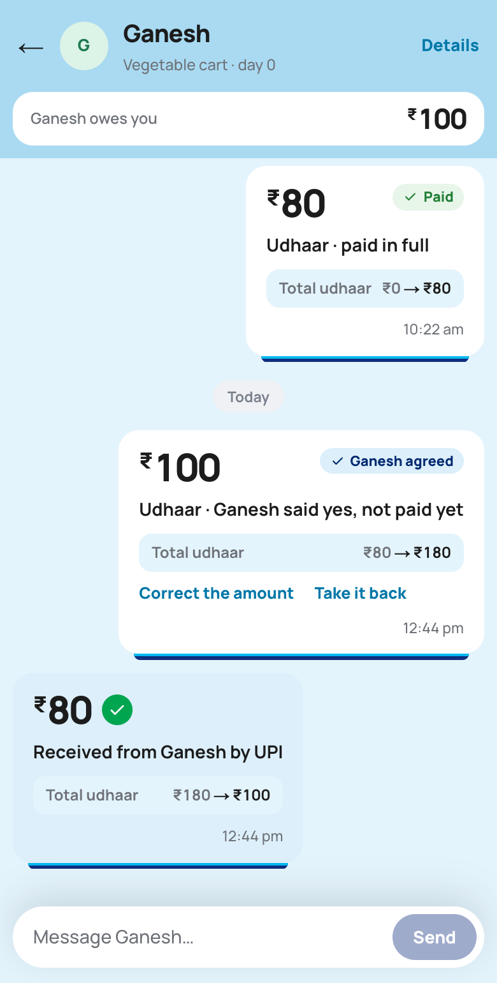
AI IN BAHI / THE MUNSHI
An AI munshi that does the work, and never writes without a yes.
What it does
— Talk or type, in Hindi, English, Marathi or a mix. Sarvam hears any of them.
— Finds the customer by the sound of a name, or how the shop describes them.
— Asks before reading names; then says only the names.
— Puts every change on a card: an entry, a payment, a correction, taking one back, new details, a message. Only his yes writes it.
— Paytm Assistant: ask anything about the book. The chat is kept.
Its tools are our code
find_customer · counter · customer_card · propose_entry · propose_correction · propose_removal · propose_details · propose_message · remember · recall · expected_payments · tonight
Replies shown are from our live test with Sarvam. An ordinary card goes in 3 s unless he says no; a close-sounding name, ₹5,000+ or 3× his usual waits for a clear हाँ.
9 / 16

Slide 10
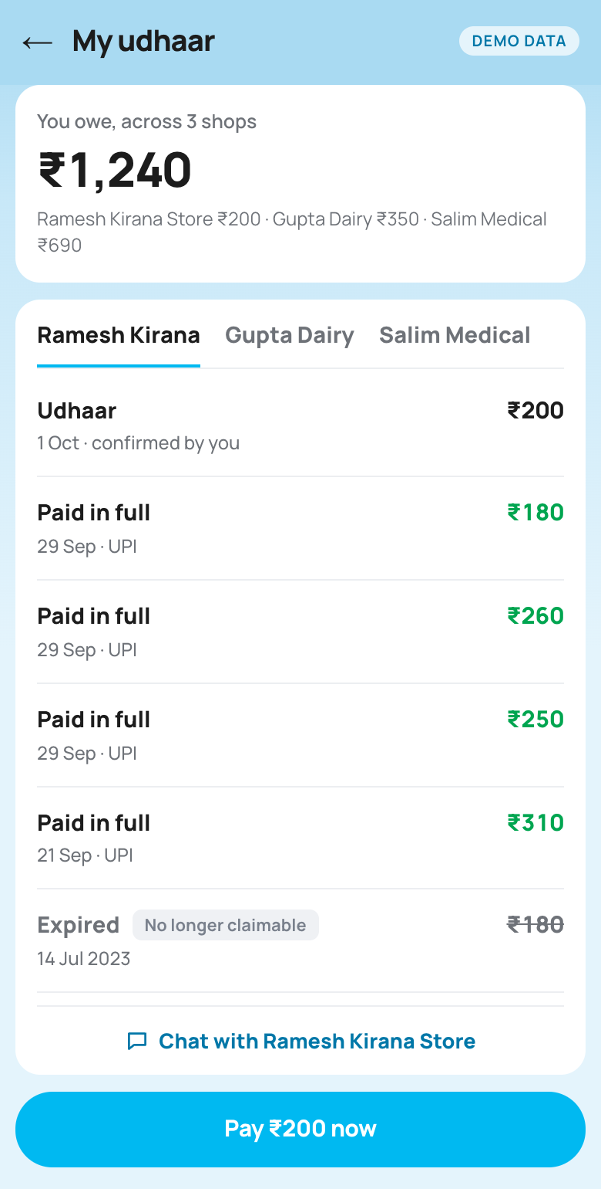
FOR THE CUSTOMER
Her own copy of every udhaar, inside the Paytm app she already has.
What the customer can do
— Scan the shop’s udhaar QR. Nothing to download: it is Paytm.
— Ask for udhaar herself: how much, and what for.
— Say yes to each entry, or tap “Not mine” or “Wrong amount”.
— A chat with each shop that reads like a passbook: the total before and after every entry.
— See what she owes across every shop, and pay by UPI, all or part.
— Reminders come privately, in her language, with no due date and no interest.
Ask · Agreed · My udhaar
Screens captured from our working app. Names and amounts are demo data.
10 / 16

Slide 11
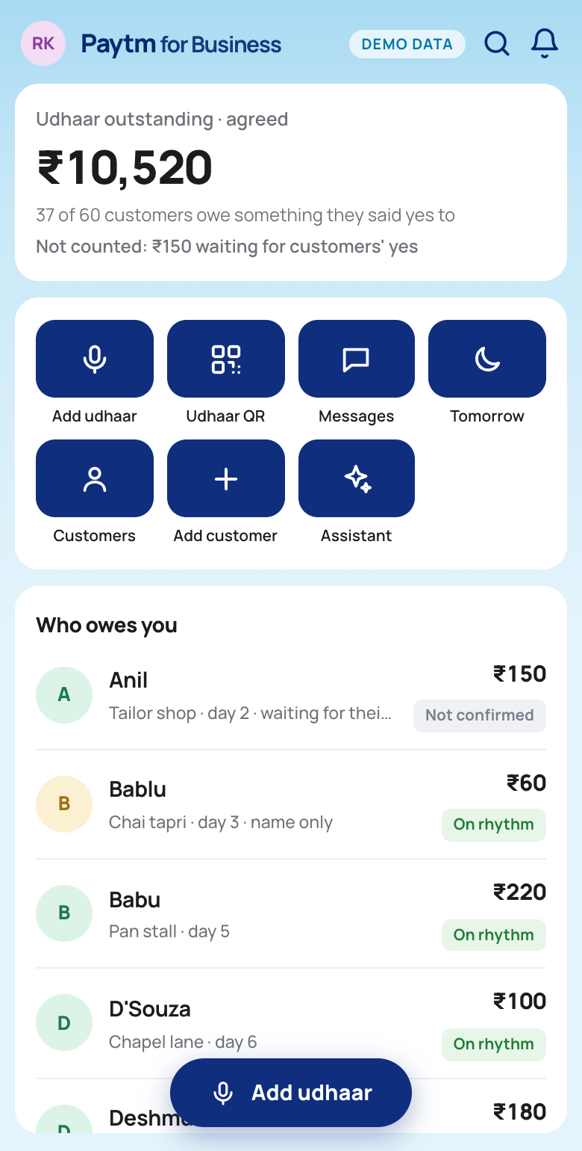
FOR THE SHOPKEEPER
He says it once. The munshi, the Soundbox and the code do the rest.
What the shopkeeper can do
— Say the amount to the munshi in any language, or tap the keypad.
— A customer’s ask pops up on his screen: Yes, No or Change amount.
— The Soundbox says the amount aloud, and never a name.
— Correct an entry or take it back, in the open.
— Ask anything: “कितना बाकी है?”, “इस हफ़्ते कौन देगा?”
— BAHI remembers promises and notes, and holds a reminder for them.
— Only people late by their own pattern get a reminder. He can rewrite, move, stop or pause it.
Home · A customer asks · Tomorrow
Screens captured from our working app. Names and amounts are demo data.
11 / 16

Slide 12
TECHNOLOGY
AI understands the words. Plain code decides every number.
DURING THE DAY — RECORDING AN ENTRY
Shopkeeper speaks
“Kavita ko do sau”
AI
AI
CODE
Sarvam Saaras v4
speech → text, any language
The munshi
Sarvam-105B calls our tools
Our checks
finds by sound; the rupees match the words
Two yeses
his, then hers, then the ledger
EVERY NIGHT — DECIDING WHO HEARS FROM US
CODE
CODE
AI
CODE
Timing engine
each customer’s own longest gap
What was said
a promise or a note holds it
The munshi writes
the words, in her language
Our check
the only figure is her balance
How we prove it: a test fails the build if the core logic imports anything outside Python’s standard library. The model only ever returns words.
STACK
Next.js 16
React 19
FastAPI
Python 3.13
PostgreSQL
Sarvam Saaras
Sarvam-105B
Bulbul v3
Cognee
Vercel · Render · Supabase
12 / 16

Slide 13
UNIQUE SELLING PROPOSITION
Every udhaar app serves the shopkeeper. We add the customer.
DOWNLOADS
CUSTOMER HAS AN APP
CUSTOMER CONFIRMS ENTRIES
Khatabook
5 Cr+
No — SMS / WhatsApp
No
OkCredit
1 Cr+
No — “They don’t need the app”
No
Paytm Business Khata
Inside Paytm for Business
No — SMS with a pay link
No
BAHI
—
Yes — inside the Paytm app
Yes — one tap
Two-sided
An entry becomes a fact only when the customer confirms it.
Scan, then speak
The QR says who, his voice says how much. Nothing to type.
Timed per person
Reminders follow each customer’s own repayment pattern.
Sources: Google Play listings, okcredit.in, khatabook.com and business.paytm.com, checked 23 Sep 2026.
13 / 16

Slide 14
BUSINESS MODEL
No new hardware, and ₹9 more a month from each merchant.
₹90 → ₹99
a month from the same merchant, with no hardware delivered. Paytm’s Soundbox plan earned about ₹90 a device a month in Q4 FY24.
Easy to build and sell
— Software only. No new hardware: the Soundbox already says amounts aloud.
— Built on what Paytm has: the Paytm app, its chats, UPI, the Soundbox and Business Khata.
— Sold as an add-on line on the merchant’s existing Soundbox bill, through the Paytm for Business app and the field team.
— A standalone ledger app lost ₹116 Cr in FY24 (Khatabook). BAHI needs no app of its own and no new customers.
— We built it working, end to end, during the hackathon.
Our guesstimate: merchants who add BAHI
Out of 1.24 Cr merchants paying for a Paytm device, at ₹9 a month.
TAKE-UP
MERCHANTS
NEW REVENUE A YEAR
5%
6.2 lakh
₹6.7 Cr
10%
12.4 lakh
₹13.4 Cr
25%
31 lakh
₹33.5 Cr
Not counted: udhaar repayments moving from cash to Paytm UPI.
Our estimate, not a forecast. ₹90/device/month: Paytm, Q4 FY24 (Business Standard, May 2024). 1.24 Cr device subscribers: Paytm FY25 Annual Report.
14 / 16

Slide 15
IMPACT
Fewer reminders, sent only to people who are actually late.
4 of 38
customers who owe get a reminder tonight.
The other 34 are not late by their own pattern, so they hear nothing.
For the shopkeeper
Stops chasing people who always pay.
Spots the ones who are drifting.
Records by voice, so the queue keeps moving.
For the customer
Sees his total across every shop.
Has proof of every entry.
Is reminded privately, not at the counter.
For Paytm
Udhaar settled in cash moves to UPI.
A daily reason to use the Soundbox.
A new reason to open the Paytm app.
Our demo shop: 60 customers, six months of synthetic data.
These are the outcomes we expect; a pilot would measure them. “4 of 38” is computed from our synthetic demo shop.
15 / 16

Slide 16
PROOF
We tested the voice on 1,338 recordings. It gets it right, or it asks.
73%
right the first time
The right person and amount, from the words alone.
How we made the 1,338 recordings
— We wrote 42 things a shopkeeper says, like “Sharma ko do sau” or “B wing wale Kamat ne 300 diye”.
— 12 voices spoke them: 10 Sarvam voices and 2 Mac voices.
— Each was played three ways: in a quiet shop, over street noise, and with a second customer talking.
— The test book had 68 customers, 20 of them named Anubhav, so picking the right person was hard.
— Every recording went through the app’s own path: Sarvam turned it into text, and our checks decided the entry.
17%
one tap
Two people fit, so it asks “Kaunse Anubhav?” and he taps the right one.
8%
said again
It wasn’t sure, so it asked him to repeat it.
2%
wrong
And even then, the customer still has to say yes on her phone before it counts.
Run again any time with make voice-eval. Code: github.com/Uchiha-Itachi0/PAYTM-BAHI
16 / 16

