Slide 1
BAHI
The udhaar book both sides can see.
A kirana shopkeeper records credit by speaking to his Soundbox. The customer confirms it on his own phone, sees what he owes across every shop, and clears it in one tap. Every night the agent works out, per person, when a reminder should go — and, far more often, when it should not.
Paytm Build for India AI Hackathon · Mumbai · 3 October 2026
Track 2 — AI-Powered Financial Journeys
Team Bitzlab

Slide 2
1 · PROBLEM STATEMENT
The notebook has one author and two people’s money in it.
About 1.3 crore kirana shops in India run a credit book by the till. It is written by one person, held by one person, and read by one person. The other party to every entry — the person whose debt it is — has no copy, no record and no way to disagree.
The scale, and what nobody knows
What the shopkeeper cannot see
What the customer cannot see
How it is enforced today
~1.3 crore kirana stores in India. 88% of retail is unorganised and 95% of kirana transactions are under ₹200 (Invest India).
A shop of 400 customers typically carries 30–60 on udhaar at any time.
No credible figure exists for udhaar volume. Not from RBI, not the NSS, not any major consultancy — we looked hard. The largest pool of informal credit in the country is unmeasured.
That absence is itself the finding.
Who is about to pay, and who is drifting away. They look identical in a notebook, so he treats them identically.
Sharma has paid on day 9 for two years. Asked on day 4, he hears an accusation — and the relationship is the collateral.
Patil has quietly reached day 40 — but he stopped coming in, so he is out of sight and gets asked nothing.
The one who needs chasing is invisible; the one who doesn’t gets chased.
His own total. He owes at three shops and could not tell you the sum within ₹500.
Any evidence. If the book says ₹500 where he remembers ₹300, there is no entry, no date, no timestamp. He simply loses the argument.
When he will be asked, and how loudly.
The record is one-sided, so the argument is one-sided too.
In public. Being asked for money in front of other customers is the enforcement mechanism — and it works, which is why it persists.
Collecting the money costs the customer something that is not money.
The software makes it worse. One live Indian product sells shopkeepers “instant community alerts when a chronic non-payer enters your neighborhood”.
Under BNS s.308 that is close to extortion. It is also the state of the art.
Sources: Invest India (store count, ticket size); Google Play listings and company sites for competing products. Named merchants throughout this deck are synthetic demo data.

Slide 3
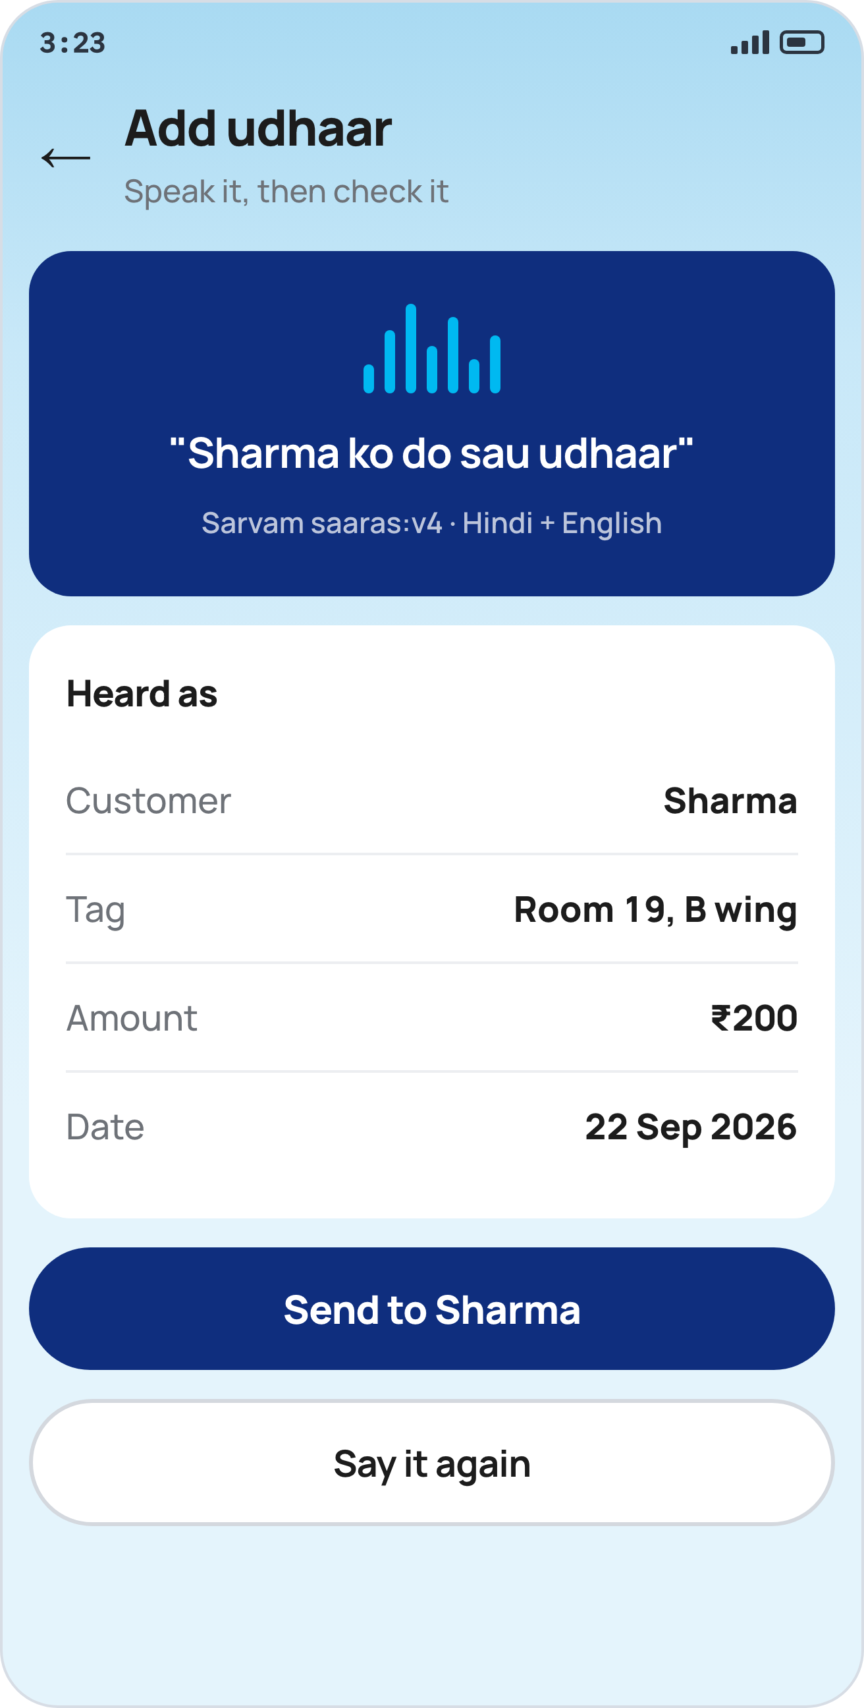
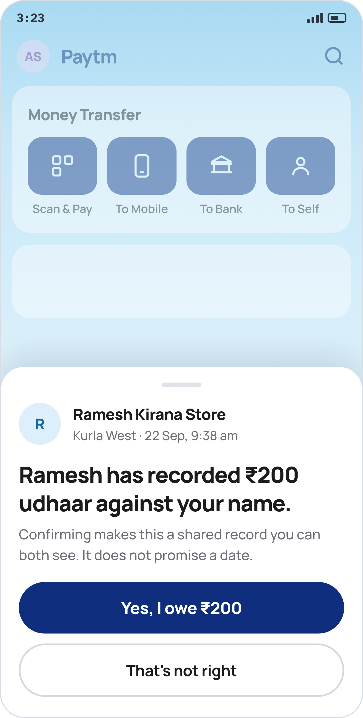
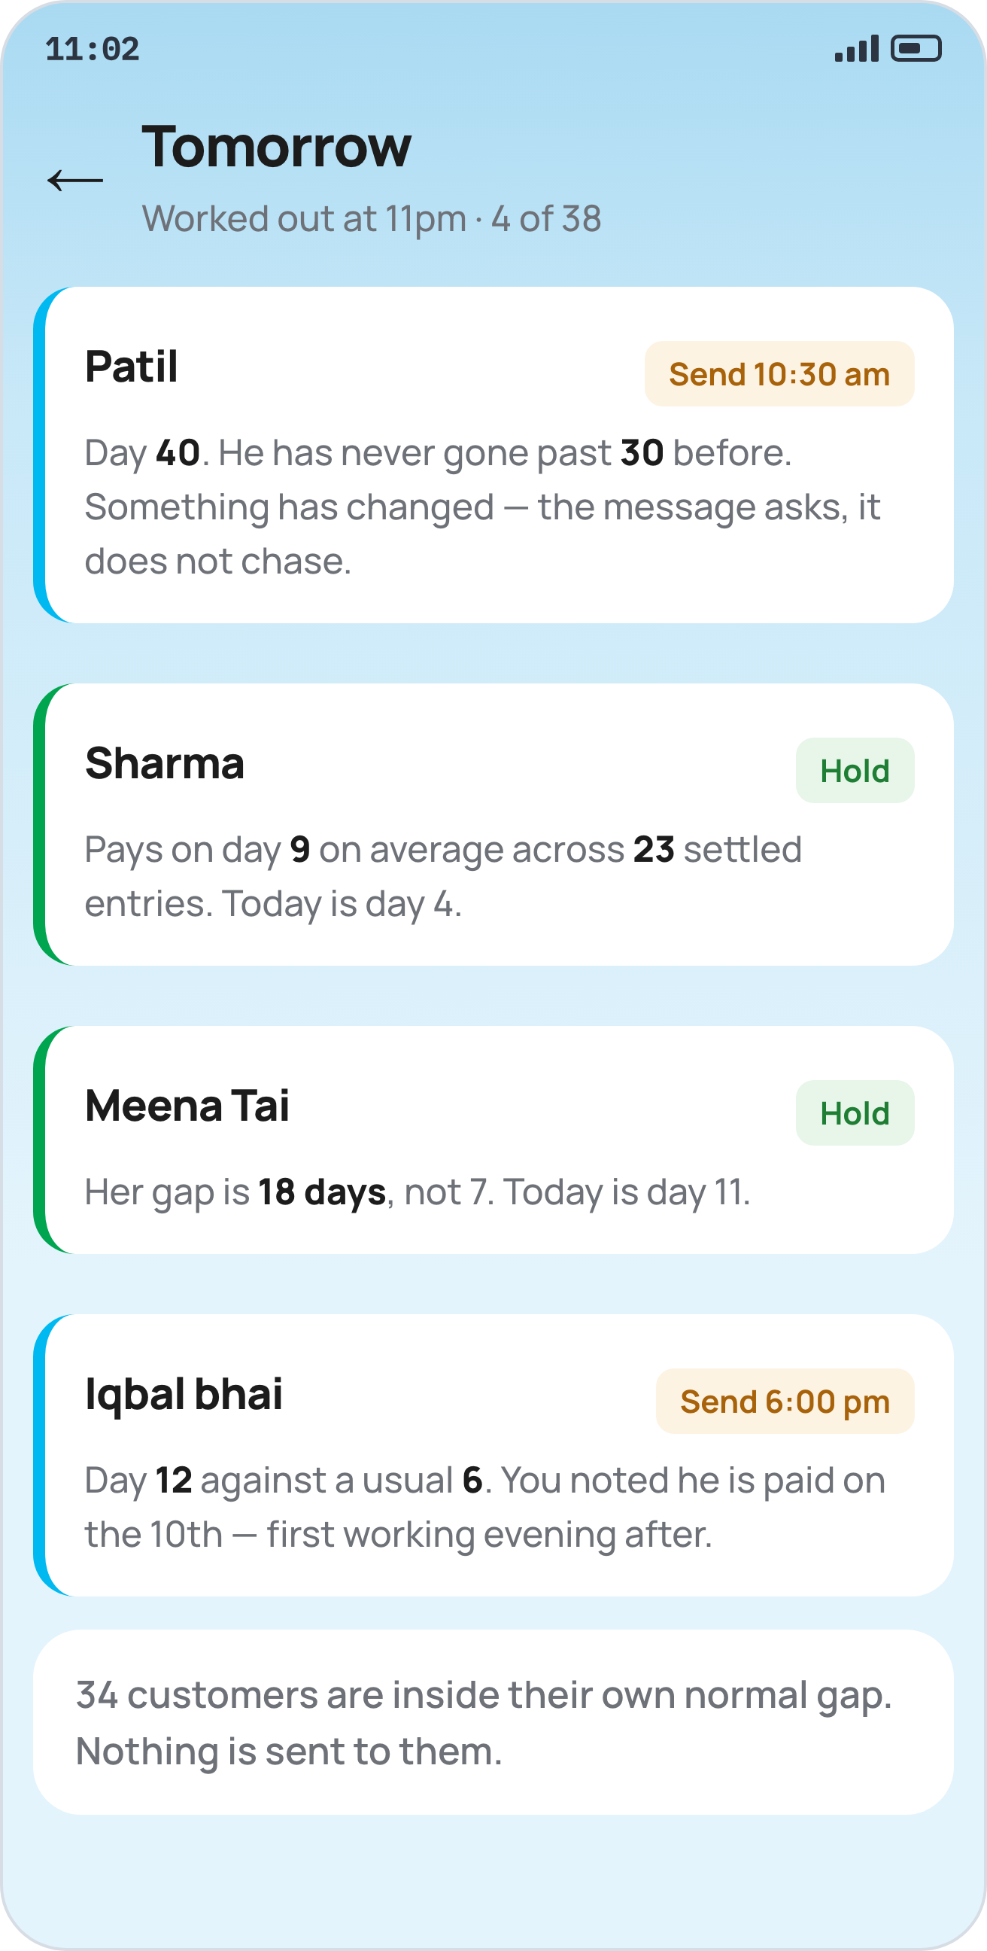
2 · PROPOSED SOLUTION
The same notebook, with a second reader.
Five steps. Only one of them asks the shopkeeper to do anything he is not already doing — and that one he does by speaking, because his hands are full and there is a queue.
He speaks it
“Sharma ko do sau udhaar.” Sarvam hears it; a rule — not the model — extracts ₹200. The parsed fields are shown for checking before anything is sent.
The customer confirms
A sheet inside his own Paytm app. Confirming turns a private claim into a mutual record. Declining opens a chat, and the entry stays in the shopkeeper’s book marked unconfirmed.
The agent picks the day
Arithmetic over that one person’s own history. Sharma is on day 4 and pays on day 9, so nothing is sent. Four of thirty-eight get a message.
Step 1 — he joins by scanning a QR at the till, so the shopkeeper never types a stranger’s number. Step 5 — the reminder carries a UPI button; one tap closes the entry on both sides at once.

Slide 4
3 · TECHNOLOGY / TECH STACK USED
Every figure is computed. None is generated.
Our central claim is that no language model ever produces a number. A promise is worthless, so the architecture is shaped to make it provable in ten seconds — by running one test, in front of you.
The architecture
The stack, and why
How the model is kept out
The three sponsor tools
Ports and adapters, four layers.
domain/ — pure. Frozen dataclasses and functions. No database, no HTTP, no model. Money in, money out.
store/ — the only module importing psycopg.
speech/ — the only module calling Sarvam.
service/ — the only module importing FastAPI.
One test enforces it: an AST check fails the build if anything in domain/ imports outside the standard library. That is how we prove the model cannot reach the arithmetic.
FastAPI — validation is declarative via Pydantic, and the OpenAPI spec is generated from the same type hints, so the frontend contract is derived from the implementation. No schema drift.
Sync handlers, deliberately — async pays at thousands of connections; we have two. It would cost function colouring and a class of missing-await bugs for throughput we cannot use.
Postgres 17 — SQLite lives on the container’s ephemeral filesystem, so a restart mid-demo would erase a judge’s confirmation.
Raw SQL, no ORM — the rhythm query is the product, and we want it readable.
Sarvam returns a string. A rule returns the number.
speech/asr.py gets back the text “Sharma ko do sau udhaar”.
domain/parse.py turns that text into 20000 paise, by rule.
The model never sees the amount field and cannot influence it.
So the worst case is visible, not silent. If it mishears, the merchant sees the wrong words on screen and taps “Say it again”. There is no path where a wrong number is recorded quietly.
Every spoken line is cached to disk; the demo runs with the wifi off.
Sarvam — saaras:v4 for speech in mixed Hindi-English over shop noise, bulbul:v3 to read a balance back. Pinned deliberately: v2 of both was retired and now returns 400.
Cognee — holds each customer’s rhythm and the shopkeeper’s standing instructions (“Patil is a daily wager, he pays after the 10th”). The rhythm is arithmetic; Cognee remembers the instructions.
n8n — the 11pm schedule. Honestly: a cron line would do the same job. What n8n buys is that the schedule becomes a canvas you can look at. The logic stays in Python.
Postgres 17 · psycopg 3 · FastAPI · Python 3.13 under uv · ruff · mypy strict · pytest · Next.js 16 · React 19 · mobile-first web, deployed publicly so a judge’s phone reaches it over its own data.

Slide 5
4 · UNIQUE SELLING PROPOSITION
Every ledger app in India is one-sided. On purpose.
Khatabook has 5 crore shopkeepers and no customer app. OkCredit advertises the absence — “Customer ko app ki zaroorat nahi.” Paytm’s own Business Khata shipped in 2020, one-sided, and now sits orphaned off its product nav. We are proposing the half none of them built.
Two-sided, by consent
Voice, where it is necessary
Timing, not blacklisting
Built legal-first
The customer confirms the entry. That single change turns a private assertion into a mutual record.
An unconfirmed entry is a claim. A confirmed one is a fact. The shopkeeper keeps both — he never loses his own book.
It is also how a platform discharges DPDP s.8(3), the duty to ensure data used to make a decision about a person is complete and accurate, which binds from May 2027.
Every competitor sends a one-way notification instead.
Paytm’s AI Soundbox grew a microphone in October 2025 and already takes spoken questions in 11 languages.
Three companies are building on that rail — Paytm, ToneTag, Razorpay with Sarvam. Nobody has pointed it at credit.
The hardware is already on the counter, already paid for, and idle for this purpose.
This is the one place in the product where voice is not decoration: his hands are full and there is a queue behind the customer.
“Sharma pays on day 9. Do not chase before day 7.”
Per-customer repayment timing exists in formal collections — TrueAccord’s cadence optimizer, Credgenics — and nowhere in informal credit, anywhere in the world.
What exists in the Indian long tail instead is the shared defaulter list. We are the humane inverse of a product that already ships.
The measure of success is how few messages go out. Four of thirty-eight, not thirty-eight of thirty-eight.
Recording a debt and then reminding someone about it walks into four separate Indian statutes.
We read them before we built, and each became one implementation constraint — enforced in the schema and the API, not in the UI.
That is why there is no due-date field, no fee column, and no endpoint that lets a merchant demand money in one tap.
No competitor in this category has done this. See slide 8 — it is the most defensible thing we have.

Slide 6
5 · IMPACT & BENEFITS
Three parties, and none of them loses.
The shopkeeper keeps his money and his customer. The customer gets a copy of his own obligations for the first time. Paytm gets settlement volume that is currently paid in cash and is therefore invisible to it.
The shopkeeper
The customer
Paytm
Stops chasing the people who were always going to pay — and notices the ones who have genuinely changed.
On our seeded shop that is 4 messages instead of 38.
Keeps his record intact whether or not the customer confirms.
Recovers money without spending the relationship, which today is the real price of asking.
Records by speaking, so nothing slows the queue down.
A dispute becomes a two-minute conversation with a timestamp, instead of his word against theirs.
Sees his total across every shop he owes — for the first time. A number he genuinely does not have today.
Holds evidence. A disputed amount stops being his word against a notebook.
Is reminded privately on day 7 instead of publicly on day 15.
His debts are allowed to expire, rather than being kept alive indefinitely by our own prompts.
And a year of reliable repayment becomes the only evidence of creditworthiness he will ever have.
Udhaar is settled in cash today. Every entry cleared through BAHI is a UPI transaction that did not previously exist — new volume and MDR, not cannibalised volume.
Soundbox retention. The device stops being a payment announcer and becomes the place the credit book lives. Churn on that subscription is the metric this moves.
A reason for the consumer app to be opened by people who currently only scan and pay.
Record it, never fund it. The moment the platform finances the udhaar, CICRA s.2(f)(vi) turns it into a credit institution.

Slide 7
6 · BUSINESS MODEL
The ledger is not the product. The settlement is.
We are not going to pretend this category monetises by subscription, because it demonstrably does not — and a judge who knows Indian fintech will know that before we finish the sentence.
What the category proved
What we charge
Where the money actually is
What it defends, and unlocks
OkCredit: 10 crore downloads → ₹23 crore revenue. Monetises at ₹30/month. Last equity round 2019.
Khatabook: $187M raised, $600M valuation in Aug 2021, no round since. FY24 revenue ₹102.7 crore against a ₹116 crore loss.
Lummo (Indonesia): 6.3 million merchants, $25.9B annualised volume — 2.2% of Indonesian GDP — and $140M from Tiger, Sequoia and Bezos. Voluntarily liquidated in 2023 and returned $70M.
The ledger has never been the business. Anyone selling one as a business is not reading the record.
Nothing. Not the shopkeeper, not the customer, and — critically — nothing on the reminder itself.
That last one is a legal constraint rather than generosity: the CCPA’s “nagging” dark pattern requires repetition and commercial gain. A reminder cadence supplies the repetition inherently, so we refuse to supply the gain.
No subscription, no per-message fee, no lending upsell riding on a debt reminder.
This also removes the incentive to send more messages than necessary — which is the failure mode of every collections product.
Udhaar settles in cash. It is one of the largest pools of payment volume in India that has never touched a rail.
Every entry cleared in-app is incremental UPI volume and MDR on transactions Paytm does not see at all today. Not moved from elsewhere — created.
A 400-customer shop carrying ~₹14,000 of udhaar at any time, settling monthly, is ~₹1.7 lakh a year of newly-visible volume from one store.
Multiply by a device base already installed.
Soundbox subscription retention. A merchant whose credit book lives in the device does not churn off the device. That is a line Paytm already sells and already measures.
Consumer app engagement from a cohort that currently only scans a QR and leaves.
Later, deliberately later: a repayment record for people with no bureau file. Recording sits outside CICRA; financing does not, so this is a data asset and not a lending product.
We would rather say that plainly than overclaim it.

Slide 8
HOW WE DESIGNED IT — FOUR RULES FROM FOUR STATUTES
Recording a debt is easy. Recording it safely is the product.
Every product in this category walks into the same four Indian statutes. We read them first, and each one became a single implementation constraint rather than a disclaimer at the bottom of a screen.
Rule 1 — acknowledge, never promise
Rule 2 — never a rupee above the price
Rule 3 — let debts die
Rule 4 — never shame, never charge
IT Act 2000, s.4 and First Schedule
The button says “Yes, I owe ₹200”. It must never say “I’ll pay by Friday”.
An acknowledgment of debt is recognised electronically. A promise to pay a fixed sum is a demand promissory note — a negotiable instrument, First Schedule entry 1, which puts the record outside the IT Act entirely.
In the schema: there is no due-date column on an acknowledgment. Not unused — absent, so nobody adds it later as a convenience.
State Money-Lenders Acts
No late fee, no convenience charge, no interest, ever.
All four state Acts define a loan as an advance “at interest”, of money or in kind. Maharashtra catches “any sum, by whatsoever name called, in excess of the principal”.
Karnataka and Delhi have no trade-credit exclusion — one ₹10 late fee makes the shopkeeper an unlicensed money-lender there.
In the schema: no fee, charge or interest column exists anywhere.
Limitation Act 1963, s.18
Every acknowledgment restarts a fresh three years, with no cap on restarts.
So an app that keeps prompting converts a ₹200 debt from 2023 into one that is legally immortal. The paper diary let it die; we would be taking that away.
We stop prompting before the clock runs out, mark the entry expired, and show it struck through to both sides.
Nobody else in this category shows a debt ending.
BNS 2023 s.308 · CCPA Dark Patterns 2023
BNS s.308, Illustration (a): threatening to expose someone unless they pay is the textbook definition of extortion. Seven years.
That is our nearest competitor’s entire business model.
So: no defaulter list, no blacklist, no leaderboard, no sorting by who owes most.
In the API: no endpoint lets the merchant demand money. The customer gets a pay button; the shopkeeper gets a text field.
Also cleared: RBI’s Digital Lending Directions 2025 bind Regulated Entities only (para 3) — a shopkeeper is not one. CICRA does not apply either.

Slide 9
THE FIELD — WHAT ALREADY EXISTS, AND WHAT IT CHOSE NOT TO DO
The gap is not an oversight. It is a decision everyone made.
Tens of millions of shopkeepers already use a free digital udhaar ledger. Not one of them gives the customer a say. The consent step is the product.
SCALE
CUSTOMER APP
CONFIRMS?
TIMING
WHAT IT CHOSE
Khatabook
5 crore users
No
No
No
Pivoted to loan distribution; ledger is the funnel
OkCredit
1 crore installs
No — by design
No
No
“Customer ko app ki zaroorat nahi”; ₹30/month
Paytm Business Khata
Since Jan 2020
No
No
No
Orphaned — absent from Paytm’s own product nav
BukuWarung (ID)
8M merchants
No
Notification only
No
Warns that the notification gets misused for fraud
DukanWala
Small
No
No
No
Shared defaulter alerts — the adversarial inverse
“Done” app
100+ installs
Yes
Yes — OTP/PIN
No
Built the mechanic. No distribution, so nobody saw it
BAHI
—
Inside Paytm
Yes
Yes
Both halves already installed on both phones
Read from Google Play listings, company sites and FAQ pages, September 2026. Splitwise declined the same confirmation mechanic in 2015 as “a hassle” — for splitting dinner bills. For a debt someone else recorded against your name, the calculation is different.

Slide 10
WHAT RUNS ON 3 OCTOBER
Forty seconds, zero typing, and a loop that closes.
Built inside the eight hours, on synthetic data that is labelled synthetic on every screen, and designed to keep working when the venue wifi does not.
The demo
What is real
What is mocked, and labelled
How it survives the room
1. The shopkeeper speaks an entry to the Soundbox.
2. A real phone on the judges’ table buzzes.
3. A judge taps Confirm.
4. Both ledgers update in front of them, inside one 2-second tick.
5. “Do not chase Sharma before day 7 — he has paid on day 9 for two years. Four of thirty-eight get a message tomorrow.”
No typing at any point. The judge holds one half of the product.
The voice capture and the rule-based parse.
The confirmation round-trip between two devices.
The ledger, the state machine, and the dispute path.
The rhythm arithmetic — median gap per customer, from that customer’s own settled history.
The expiry rule, including refusing to prompt past the limitation line.
Every figure on every screen is computed from the data. None is written into the copy.
One shop, 60 udhaar customers, six months of entries and repayments with believable per-person rhythms. Generated the night before, deterministically.
No real UPI. No real Soundbox hardware — a browser microphone stands in, and we say so.
No auth, no second shop.
Every screen carries a synthetic-data label. We would rather declare it than be asked.
Deployed publicly before the day, so the judge’s phone reaches us over its own mobile data and never touches venue wifi.
Every spoken line cached to disk. SARVAM_OFFLINE defaults on.
Frozen at hour five, with a backup video recorded while it still works.
No hardcoded shortcuts. Change a repayment date in the database and the reminder day moves. We will hand you the laptop and let you try it.

