Slide 1













Women in Tech:
Breaking Barriers in Digital Age

Slide 2
Team members
Name of team member | Id of team member | Topic name
Ovik Ghosh | 0242310005101295 | Introduction
Abrar Hasnat | 0242310005101269 | Why does it matter in current world?
Tasnia Ahmed Era | 0242310005101465 | Barriers
Hafiza Shadaf Rimi | 0242310005101366 | Barriers solution
Md. Mahidul Islam | 0242310005101289 | Example

Slide 3
Contents
Introduction
Why does it matter in current world?
Barriers
Barriers solution
Example

Slide 4

Introduction
Technology shapes every aspect of our modern lives. Women have been key contributors in tech history, from programming pioneers to modern innovators. The digital age presents new opportunities for women to lead, create, and inspire. Encourages awareness about gender diversity in technology. Highlights contributions of women in various tech fields. Sets the stage for understanding the challenges and solutions.

Slide 5
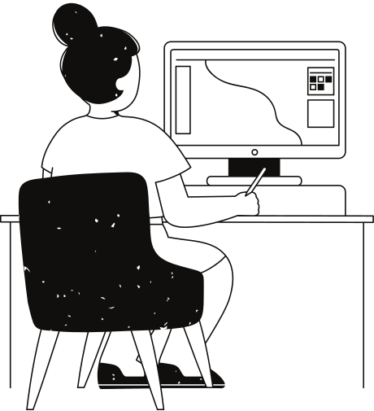
Why does it matter in current world?
In this current world focus on :-
The global relevance of tech diversity
Impact on innovation and economy
Social equality and representation
Why Women in Tech : -
Innovation Boost: Diverse teams bring unique perspectives, leading to more creative and effective solutions.
Economic Growth: Increasing women’s participation in tech can add trillions to the global economy.
Representation & Equality: Women in leadership inspire future generations and reduce gender bias.
Addressing Talent Gaps: The tech industry faces a shortage of skilled professionals; women can help fill this gap.
Better Products for Everyone: More diversity ensures technology serves all sections of society.

Slide 6
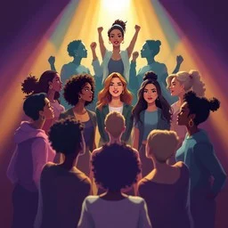
Women in Tech: Barriers
Breaking Barriers in the Digital Age
Tech is shaping our future
Women remain underrepresented
Barriers are social, cultural, and workplace-based

Slide 7
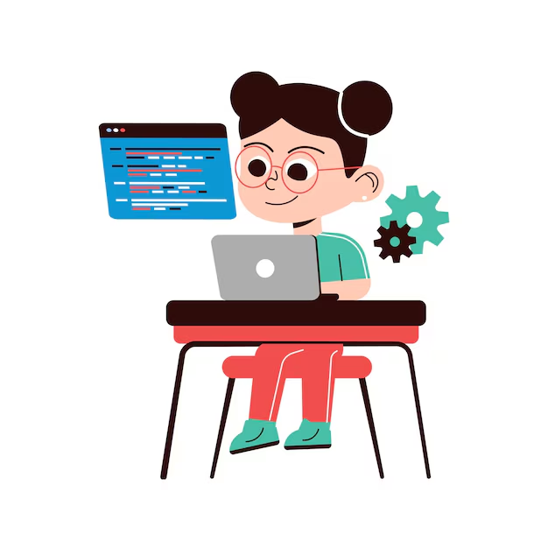
Barrier 1:
Stereotypes & Bias
Tech seen as a 'male field'.
Early discouragement in schools.
Skills underestimated due to gender.
Example: Ada Lovelace — told math wasn’t 'ladylike', yet became the first computer programmer.

Slide 8
Few women in leadership roles
Limited mentorship opportunities
Harder to navigate career growth
Example: Reshma Saujani — founded Girls Who code to inspire young girls in tech
Barrier 2:
Lack of Role Models
'Boys’ club' networking
Rigid schedules, exclusion
In extreme cases, harassment
Example: Ellen Pao — spoke out about exclusion in tech workplaces while at Reddit
Barrier 3:
Workplace Culture

Slide 9
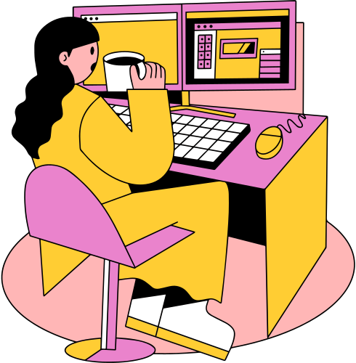
Barrier 4:
Pay Gap & Opportunities
Women earn less for same work
Slower promotion rates
Fewer leadership chances
Example: 2023 Dice Tech Salary Report — women in tech earn ~16% less than men
•Barriers hold back innovation
•Breaking them = fairness + better tech
•Recognize barriers → Remove them → Create change

Slide 10

Barrier Solution
1. Mentorship & Role Models
Pair women with experienced tech mentors.
Showcase success stories to inspire newcomers.
2. Equal Opportunities & Pay Transparency
Promote fair hiring and promotion practices.
Regular salary audits to ensure equity.
3. Inclusive Workplace Culture
Conduct diversity & bias-awareness training.
Provide safe channels to report discrimination.
4. Flexible Work Policies
Remote work and flexible hours to balance career and family.
Paid maternity and parental leave.
5. Skill Development & Education
Sponsor training in emerging tech fields.
Encourage participation in hackathons, workshops, and coding bootcamp.

Slide 11
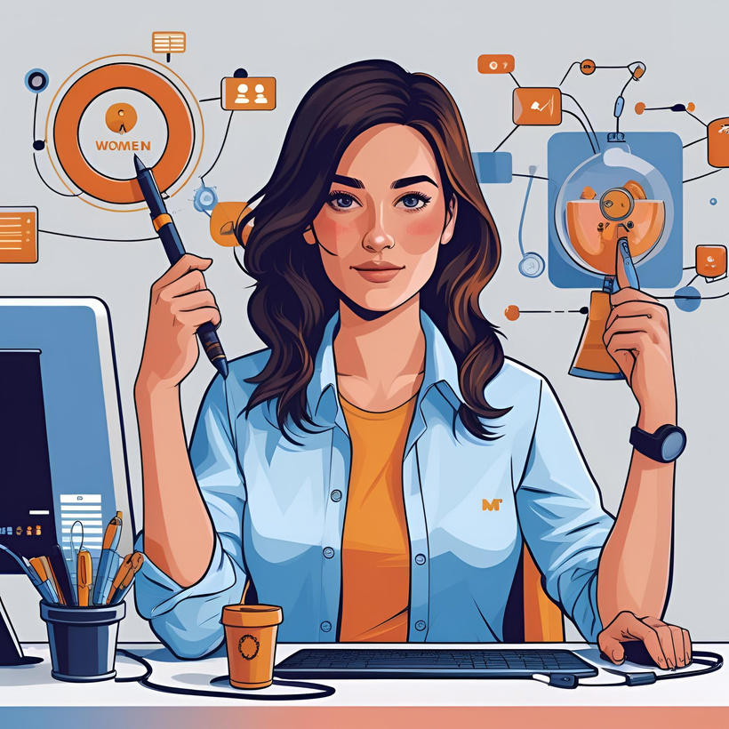
6. Networking & Community Support
Join/support women’s tech networks.
Attend conferences and meetups.
7. Policy & Legal Protections
Enforce anti-harassment laws.
Strong workplace safety policies.
8. Early STEM Exposure
Coding programs for girls in schools.
Scholarships for women in tech.
9. Visibility in Leadership
Promote women to leadership roles.
Showcase achievements of female leaders.
10. Continuous Feedback & Improvement
Regular surveys to identify barriers.
Actively implement employee suggestions.

Slide 12
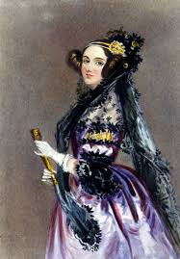
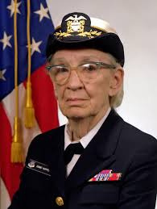

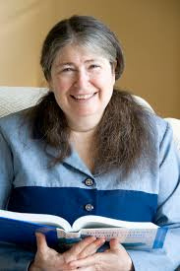
Ada Lovelac
Developed the first algorithm intended for a machine also called ‘The Analytical Engine’.
The first person to recognise that the machine had applications beyond pure calculation.
Historical Contribution
Grace Hopper
Invented the first compiler also known as A-0.
Key figure in the development of COBOL programming language.
Radia Perlman
An American computer programmer and network engineer.
Developed the Spanning Tree Protocol (STP), crucial to modern network switching.

Slide 13
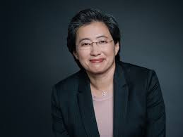
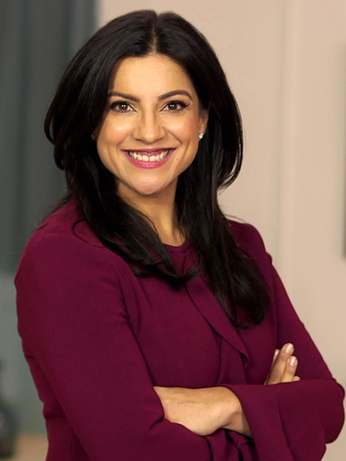

Present Contribution
Lisa Su
Reshma Saujani
An Electrical Engineer & The CEO of AMD.
One of the most influential women in tech, known for breaking barriers in the semiconductor industry
Founder of ‘Girls who Code’.
Working to close the gender gap in entry-level tech jobs by 2030.
Fei-Fei Li
Co-director of Stanford's Human-Centered AI Institute.
Created ImageNet, a major breakthrough in computer vision and deep learning.

Slide 14
Reference
Women in Tech
2. Forbes
3. Wikipedia
4. Global App Testing

Slide 15
Thank you very much!

Slide 16


