Slide 1
CAROLINA
Abi is physically at ICSE 2019 and is planning which sessions to go to. (It’s Tuesday night in her hotel room.)

Slide 2
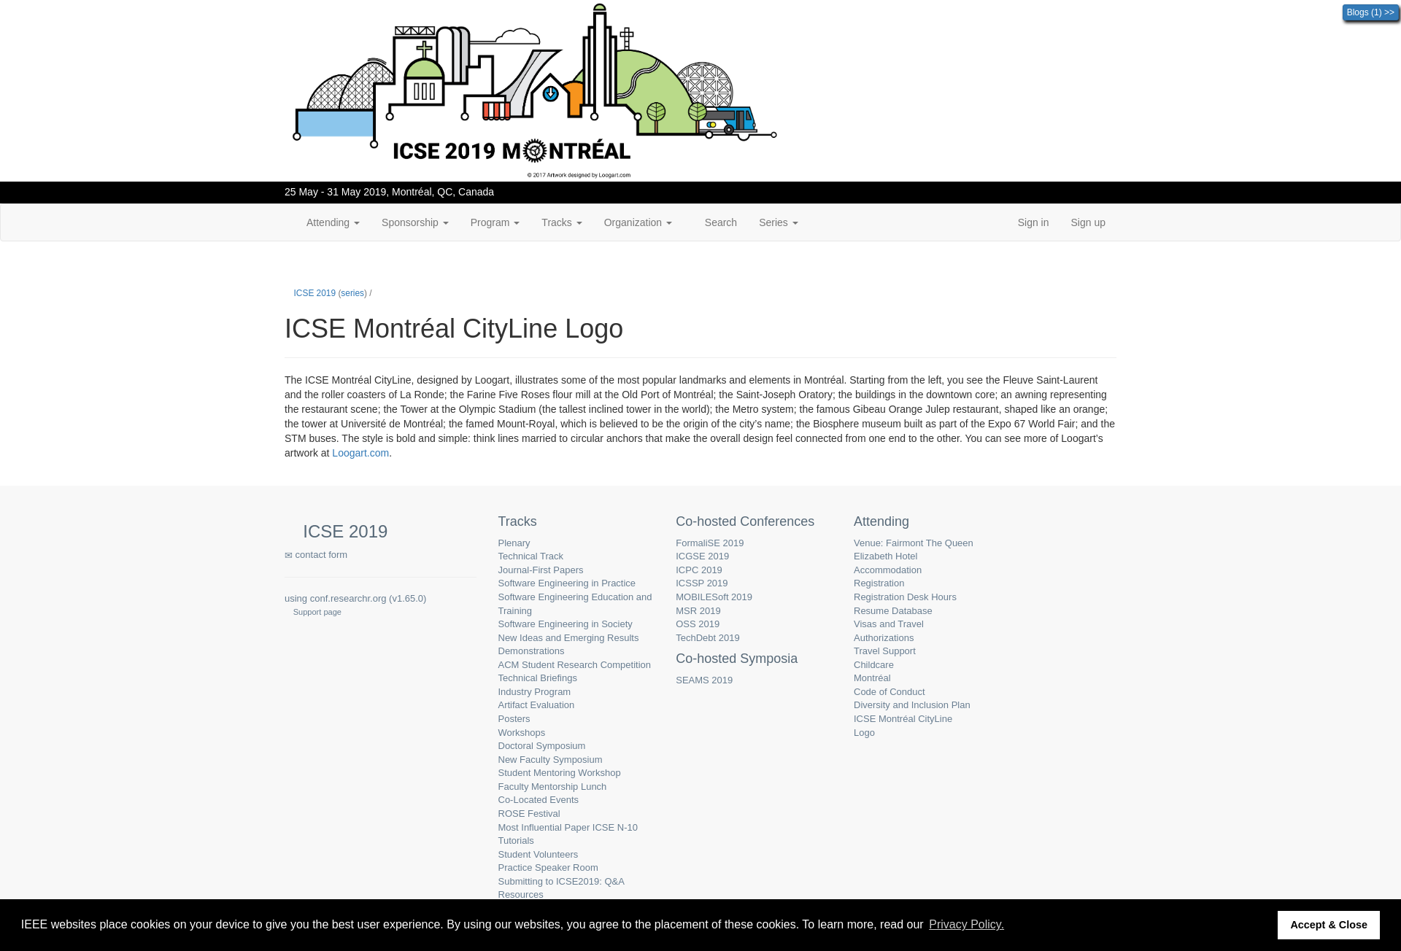
Subgoal 1: What sessions I should go to tomorrow
Will Abi have formed this sub-goal as a step to their overall goal?
Answer
Click here to view the full image

Slide 3
Action 1: Click on the program menu item(Before)
Will ABI know what to do at this step? Why?
Answer
Click here to view the full image

Slide 4
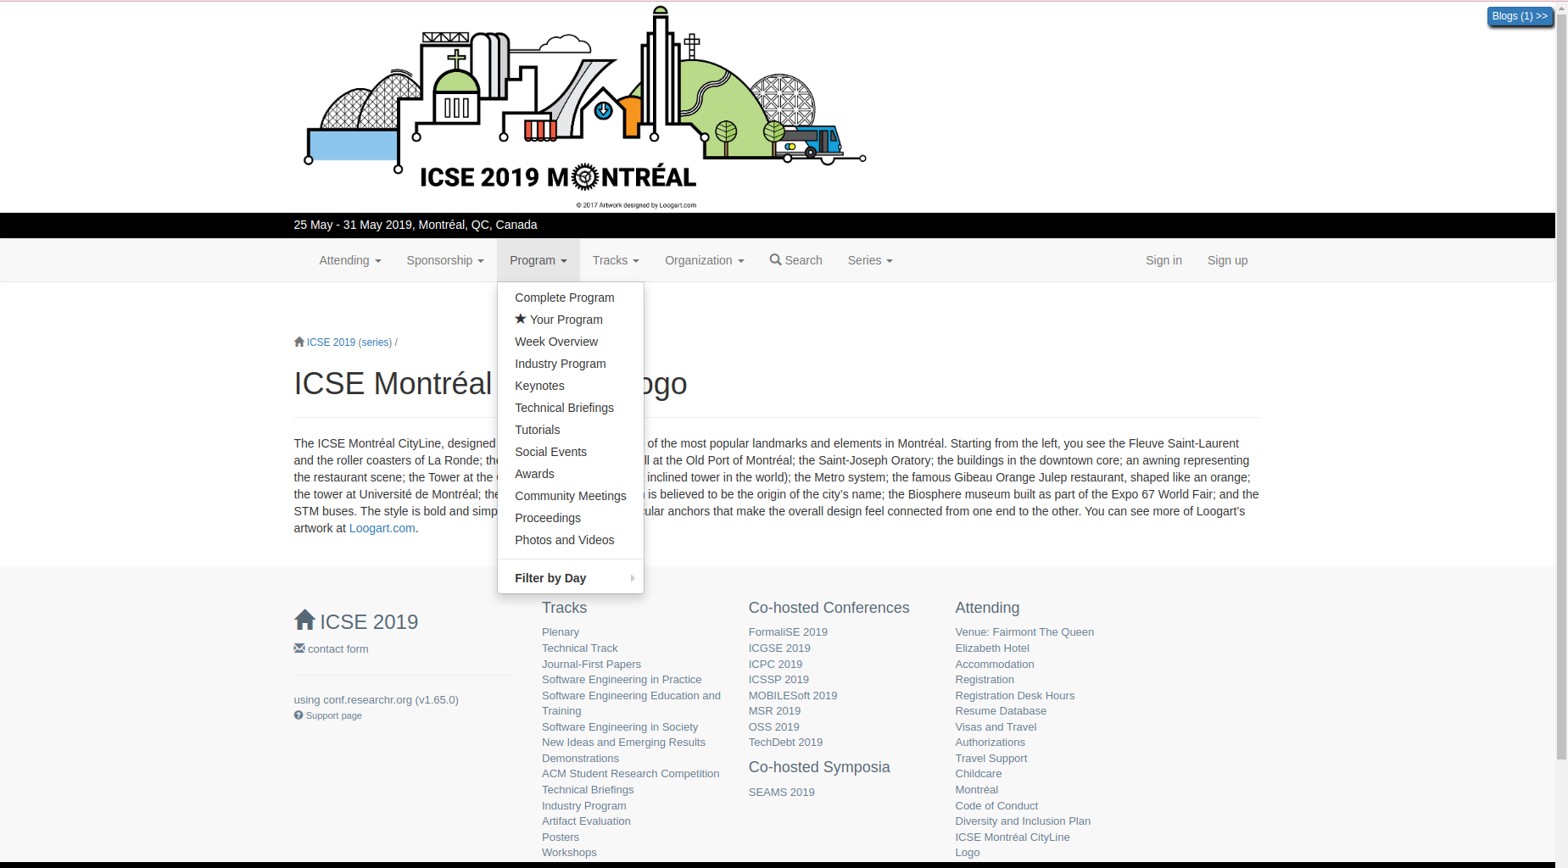
Action 1: Click on the program menu item(After)
If Abi does the right thing, will s/he know that s/he did the right thing and is making progress toward their goal? Why?
Answer
Click here to view the full image

Slide 5
Action 2: Click at complete program(Before)
Will ABI know what to do at this step? Why?
Answer
Click here to view the full image

Slide 6
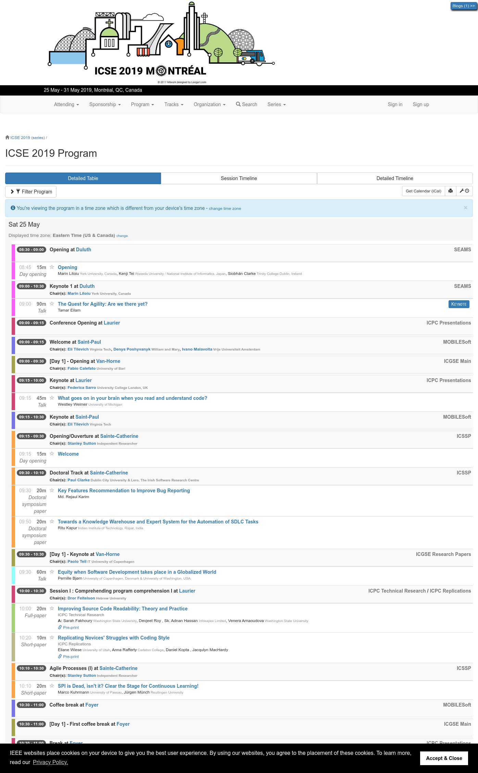
Action 2: Click at complete program(After)
If Abi does the right thing, will s/he know that s/he did the right thing and is making progress toward their goal? Why?
Answer
Click here to view the full image

Slide 7
Action 3: Click on session timeline(Before)
Will ABI know what to do at this step? Why?
Answer
Click here to view the full image

Slide 8
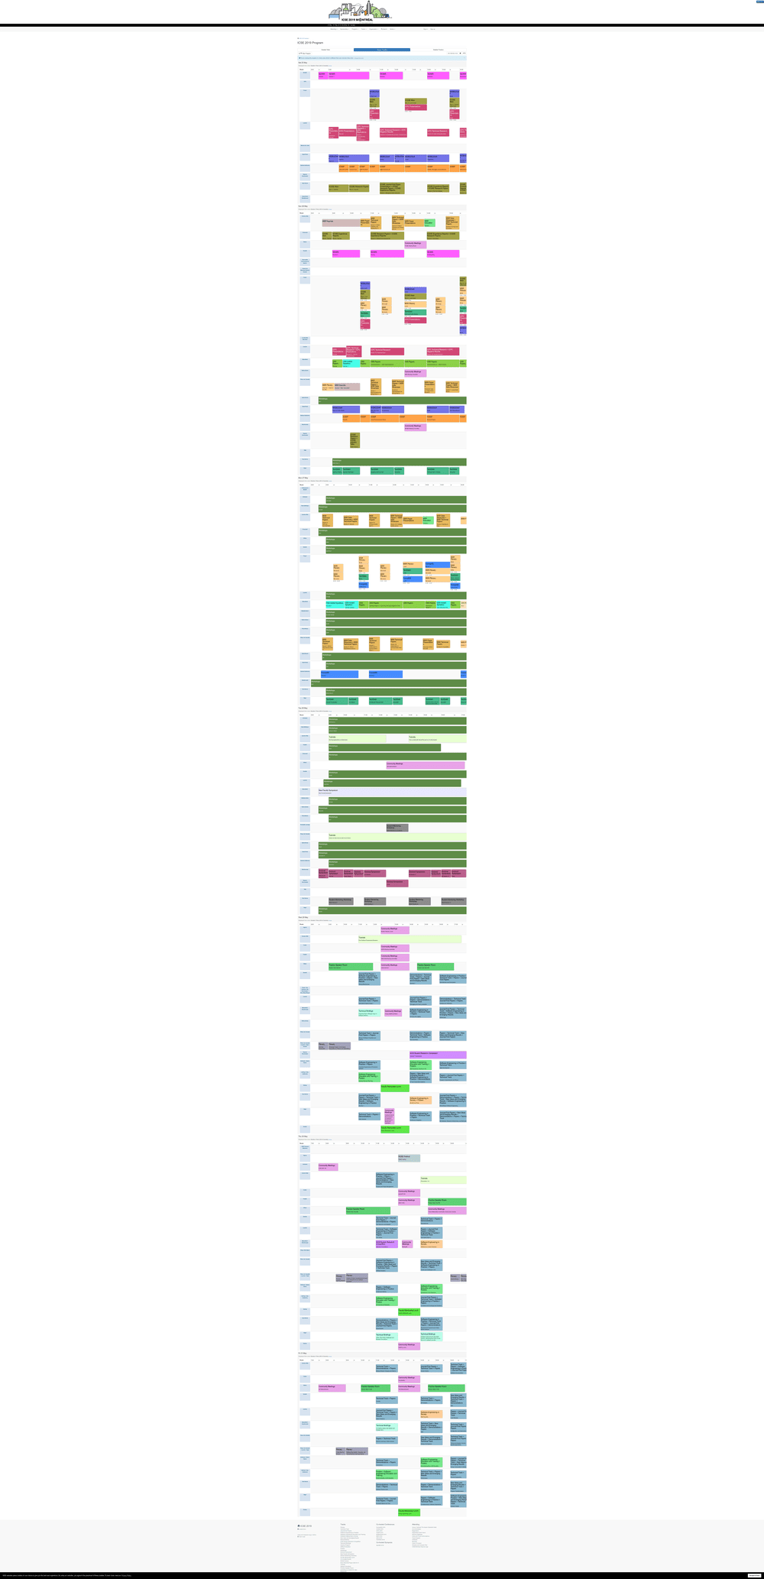
Action 3: Click on session timeline(After)
If Abi does the right thing, will s/he know that s/he did the right thing and is making progress toward their goal? Why?
Answer
Click here to view the full image

Slide 9
Action 4: Click on the tutorial(R for software Engineering Research)(Before)
Will ABI know what to do at this step? Why?
Answer
Click here to view the full image

Slide 10
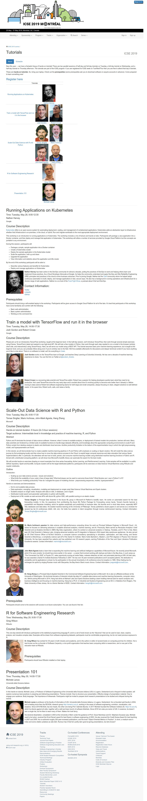
Action 4: Click on the tutorial(R for software Engineering Research)(After)
If Abi does the right thing, will s/he know that s/he did the right thing and is making progress toward their goal? Why?
Answer
Click here to view the full image

