Slide 1
CORVALLIS
Make a documentation contribution

Slide 2
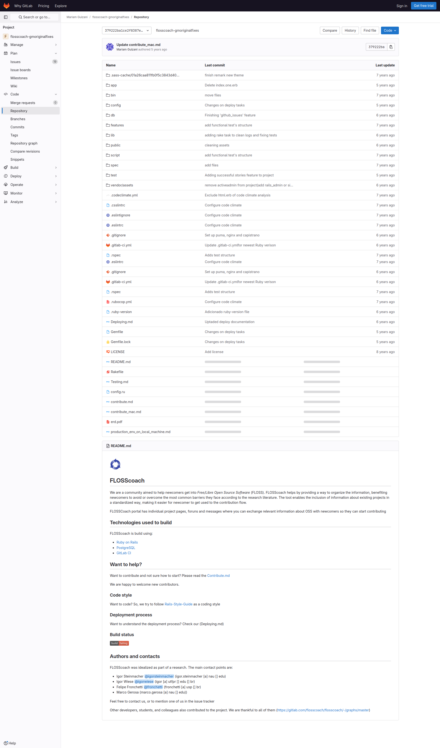
Subgoal 1: Find information about documentation contributions
Will Abi have formed this sub-goal as a step to their overall goal?
Answer
Click here to view the full image

Slide 3
Action 1: Search for documentation(Before)
Will ABI know what to do at this step and is the page good enough for abi to take this action? Why?
Answer
Click here to view the full image

Slide 4
Action 1: Search for documentation(After)
If Abi does the right thing, will s/he know that s/he did the right thing and is making progress toward their goal? Why?
Answer
Click here to view the full image

Slide 5
Subgoal 2: Make a documentation contribution to the first .md file
Will Abi have formed this sub-goal as a step to their overall goal?
Answer
Click here to view the full image

Slide 6
Action 1: Click on the first .md file (Before)
Will ABI know what to do at this step and is the page good enough for abi to take this action? Why?
Answer
Click here to view the full image

Slide 7
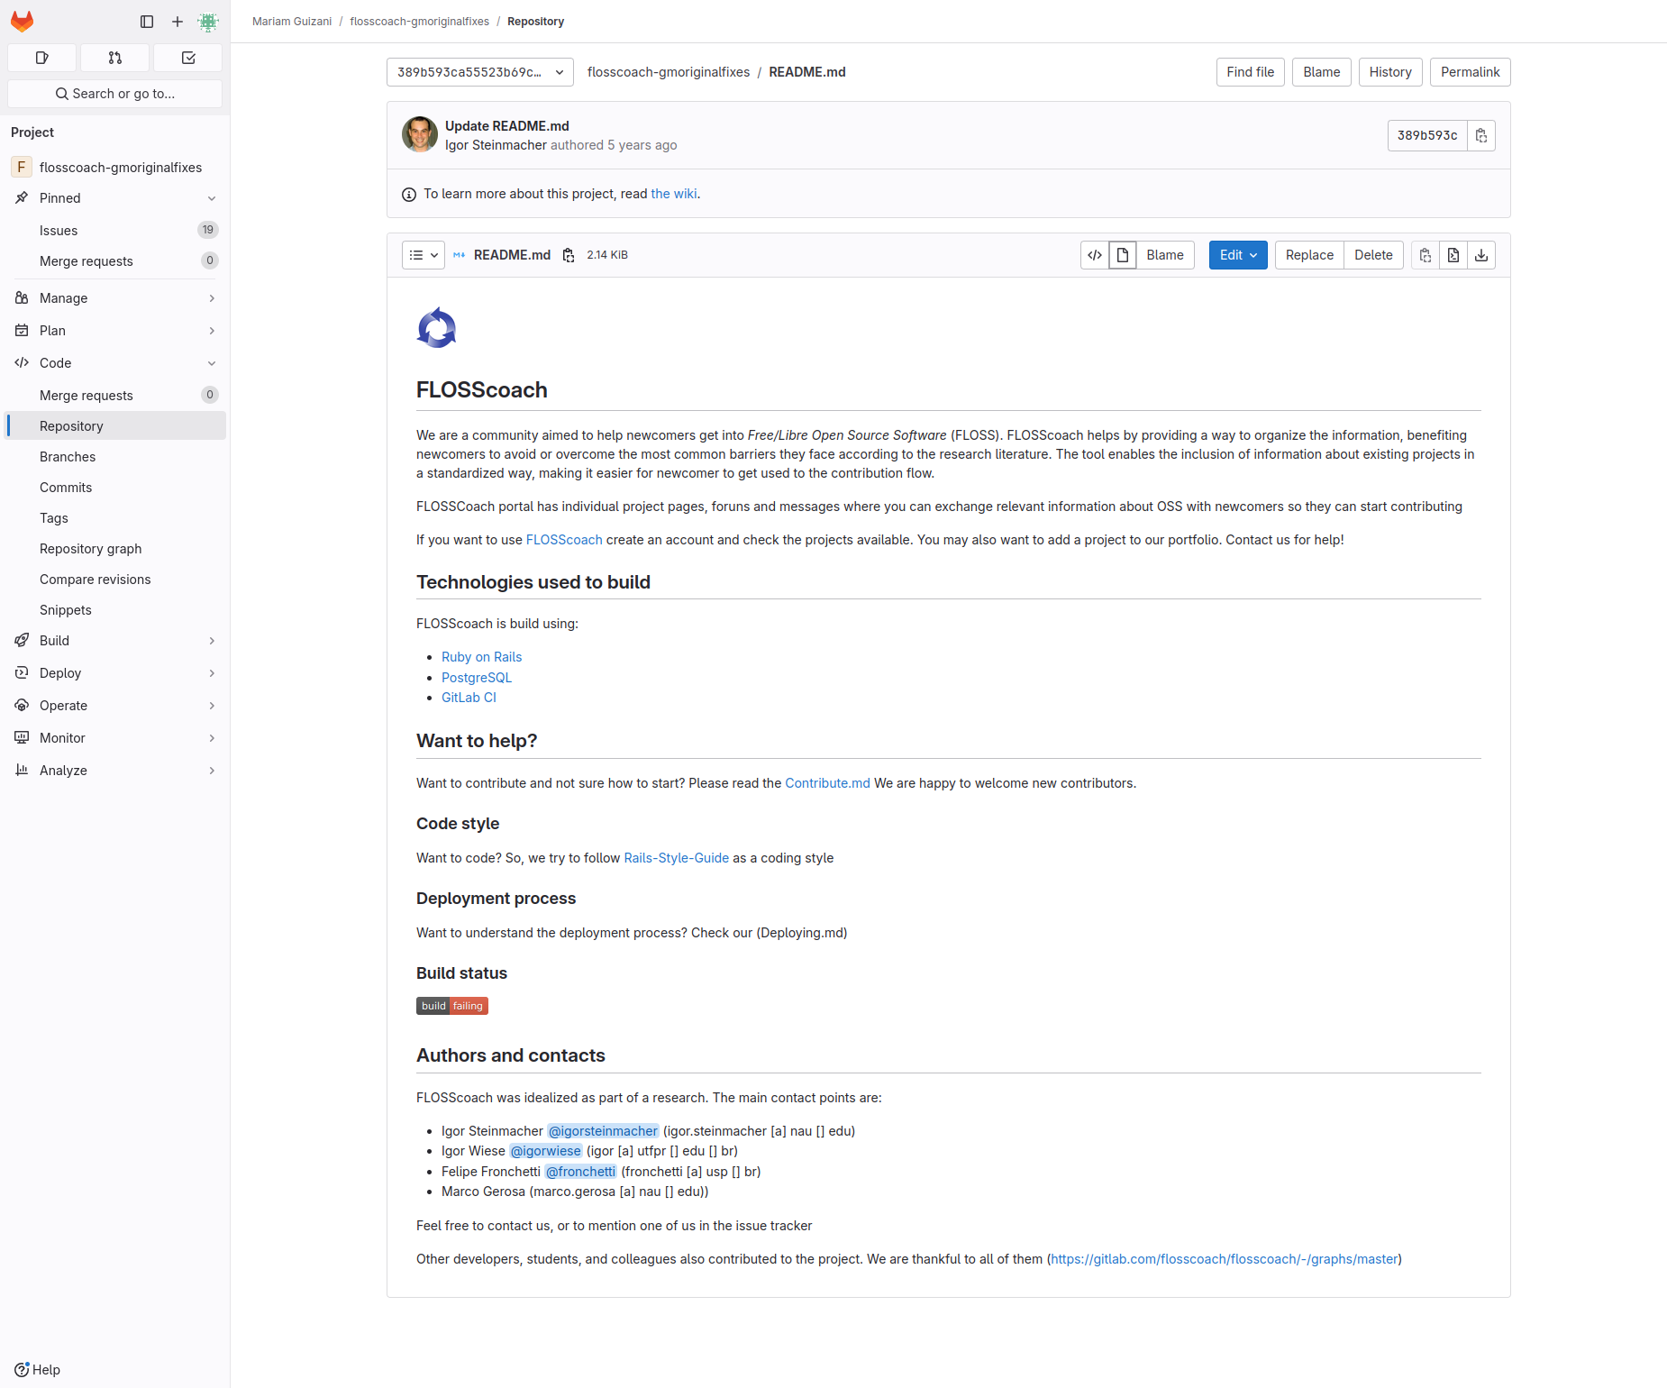
Action 1: Click on the first .md file (After)
If Abi does the right thing, will s/he know that s/he did the right thing and is making progress toward their goal? Why?
Answer
Click here to view the full image

Slide 8
Action 2: Click on edit button(Before)
Will ABI know what to do at this step and is the page good enough for abi to take this action? Why?
Answer
Click here to view the full image

Slide 9
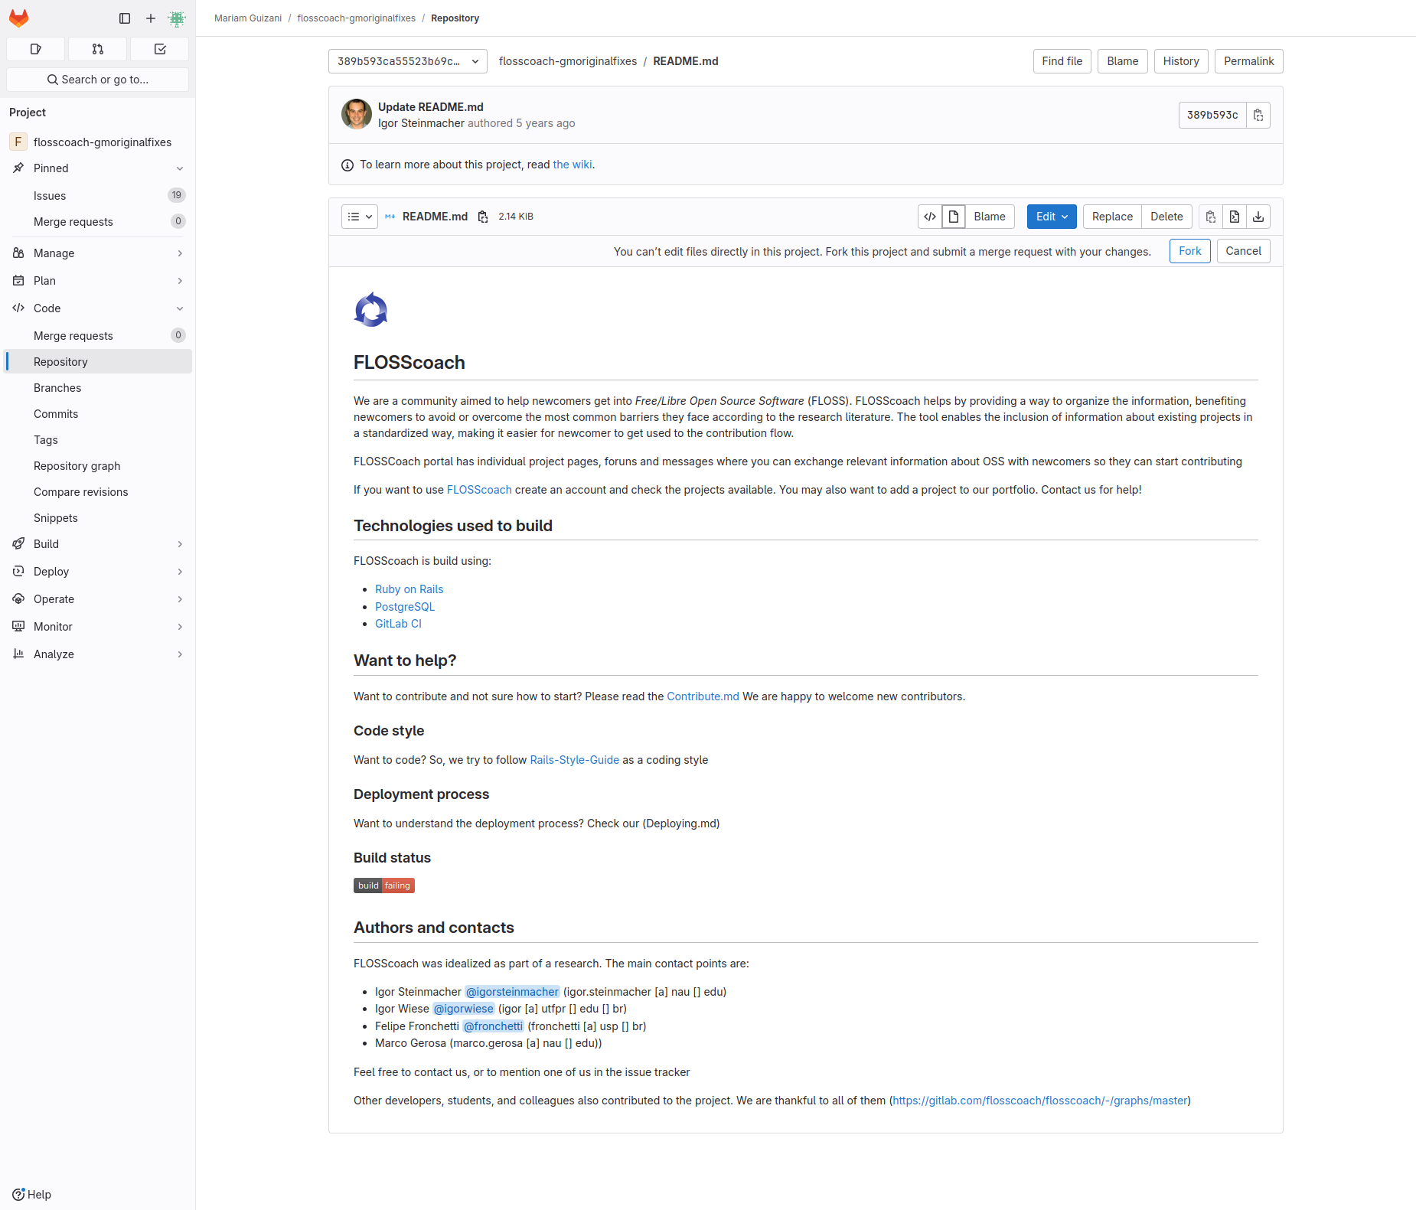
Action 2: Click on edit button(After)
If Abi does the right thing, will s/he know that s/he did the right thing and is making progress toward their goal? Why?
Answer
Click here to view the full image

