Slide 1
DELHI
Find something to contribute to Jabref

Slide 2
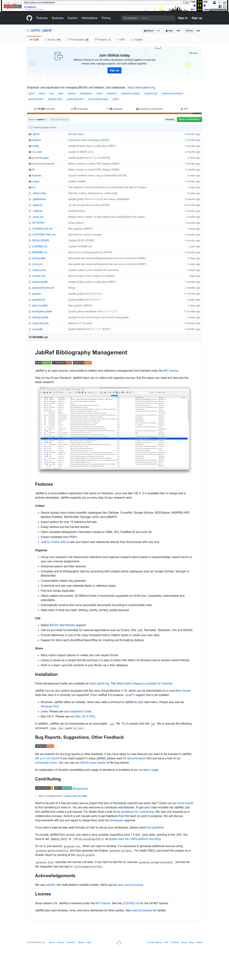
Subgoal 1: Read the available information
Will Abi have formed this sub-goal as a step to their overall goal?
Answer
Click here to view the full image

Slide 3
Action 1: Read the available information(Before)
Will ABI know what to do at this step and is the page good enough for abi to take this action? Why?
Answer
Click here to view the full image

Slide 4
Action 1: Read the available information(After)
If Abi does the right thing, will s/he know that s/he did the right thing and is making progress toward their goal? Why?
Answer
Click here to view the full image

Slide 5
Action 2: Clicking 'Learn how to help.'(Before)
Will ABI know what to do at this step and is the page good enough for abi to take this action? Why?
Answer
Click here to view the full image

Slide 6
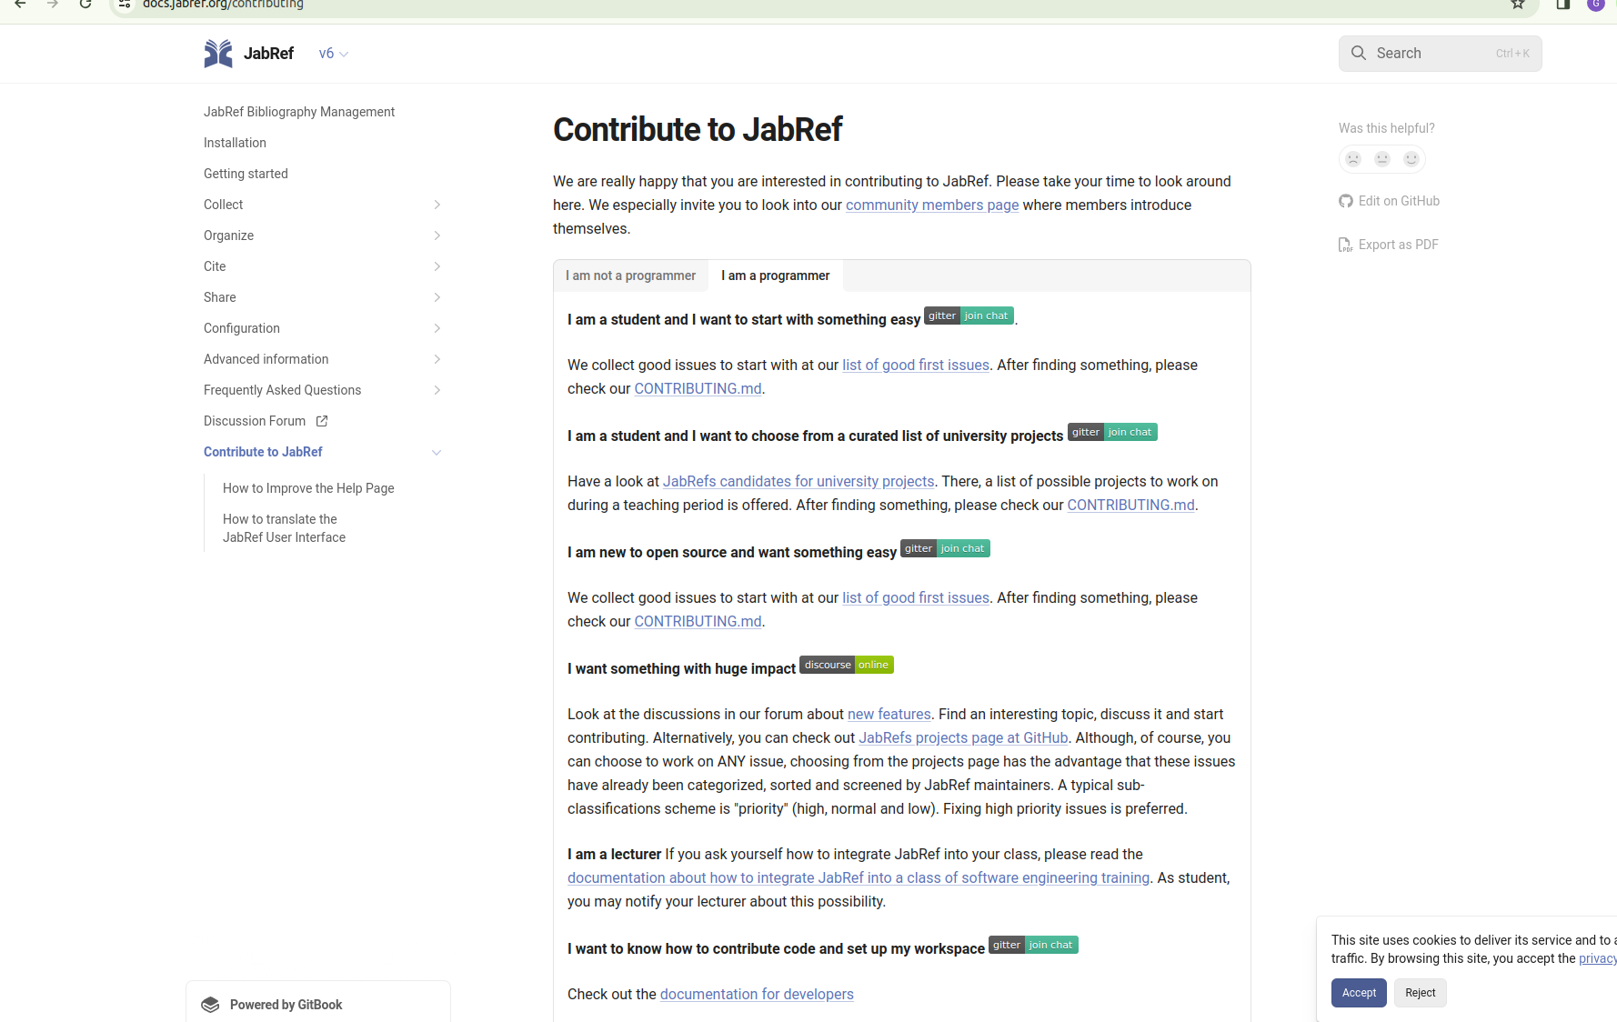
Action 2: Clicking 'Learn how to help.'(After)
If Abi does the right thing, will s/he know that s/he did the right thing and is making progress toward their goal? Why?
Answer
Click here to view the full image

Slide 7
Action 3: Read the page(Before)
Will ABI know what to do at this step and is the page good enough for abi to take this action? Why?
Answer
Click here to view the full image

Slide 8
Action 3: Read the page(After)
If Abi does the right thing, will s/he know that s/he did the right thing and is making progress toward their goal? Why?
Answer
Click here to view the full image

Slide 9
Action 4: Click ON list of good first issue(Before)
Will ABI know what to do at this step and is the page good enough for abi to take this action? Why?
Answer
Click here to view the full image

Slide 10
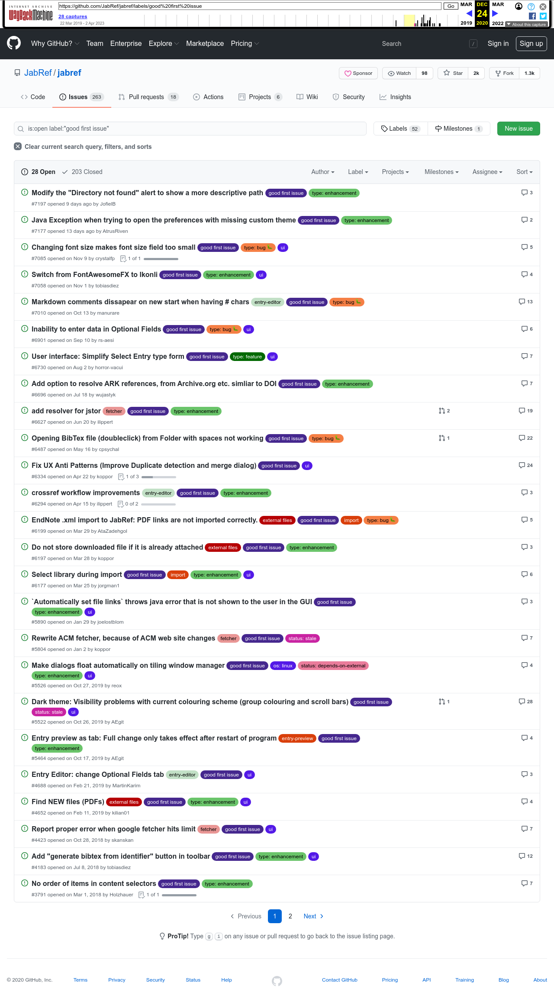
Action 4: Click ON list of good first issue(After)
If Abi does the right thing, will s/he know that s/he did the right thing and is making progress toward their goal? Why?
Answer
Click here to view the full image

Slide 11
Action 5: Read the options and click something she wants to know more about(Before)
Will ABI know what to do at this step and is the page good enough for abi to take this action? Why?
Answer
Click here to view the full image

Slide 12
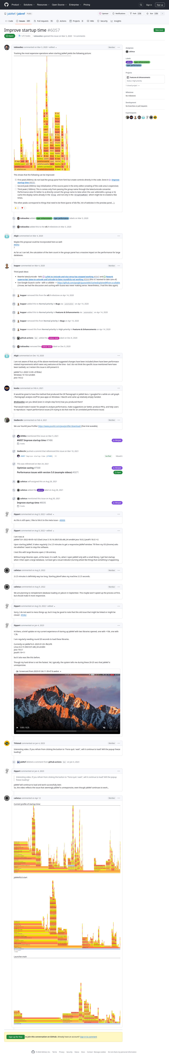
Action 5: Read the options and click something she wants to know more about(After)
If Abi does the right thing, will s/he know that s/he did the right thing and is making progress toward their goal? Why?
Answer
Click here to view the full image

