Slide 1
DHAKA
Create a new issue

Slide 2
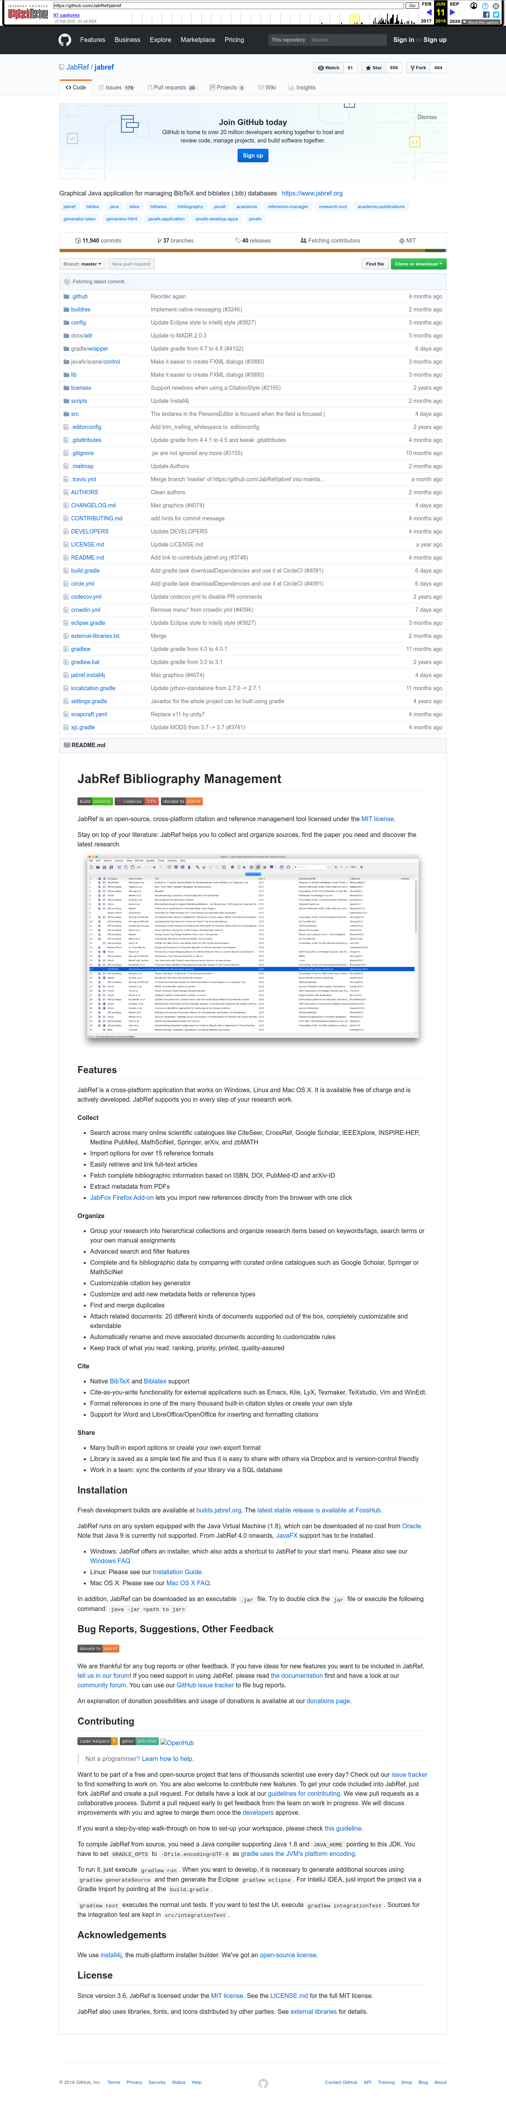
Subgoal 1: Find issue tracker
Will Abi have formed this sub-goal as a step to their overall goal?
Answer
Click here to view the full image

Slide 3
Action 1: Click on 'Issues' link(Before)
Will ABI know what to do at this step and is the page good enough for abi to take this action? Why?
Answer
Click here to view the full image

Slide 4
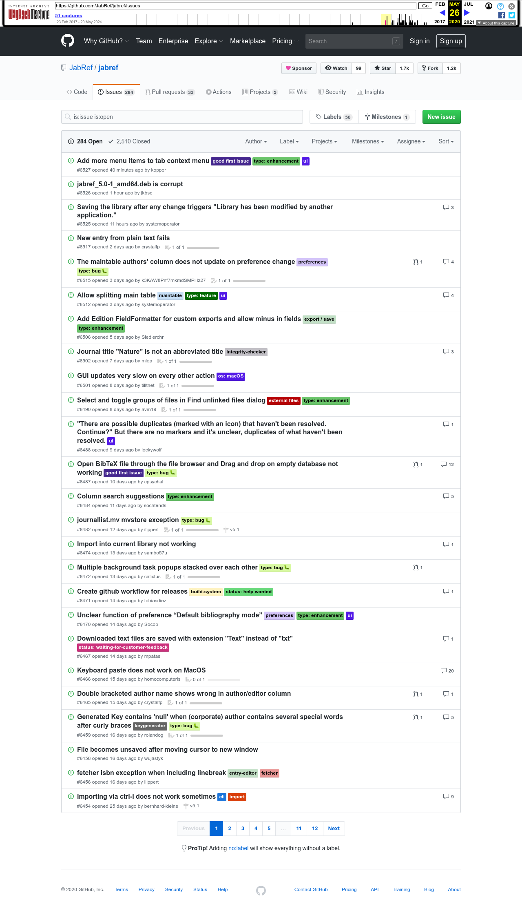
Action 1: Click on 'Issues' link(After)
If Abi does the right thing, will s/he know that s/he did the right thing and is making progress toward their goal? Why?
Answer
Click here to view the full image

Slide 5
Action 2: Click the 'New Issue' button(Before)
Will ABI know what to do at this step and is the page good enough for abi to take this action? Why?
Answer
Click here to view the full image

Slide 6
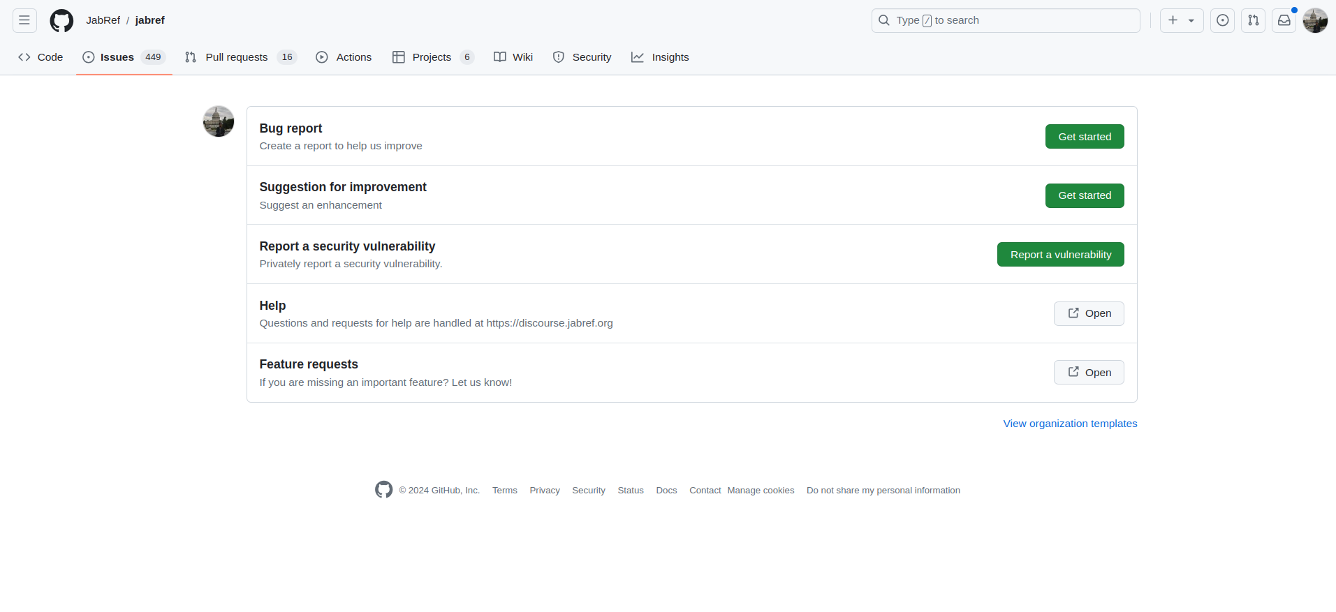
Action 2: Click the 'New Issue' button(After)
If Abi does the right thing, will s/he know that s/he did the right thing and is making progress toward their goal? Why?
Answer
Click here to view the full image

Slide 7
Action 3: Click the button 'Get Started' for 'Bug Report'(Before)
Will ABI know what to do at this step and is the page good enough for abi to take this action? Why?
Answer
Click here to view the full image

Slide 8
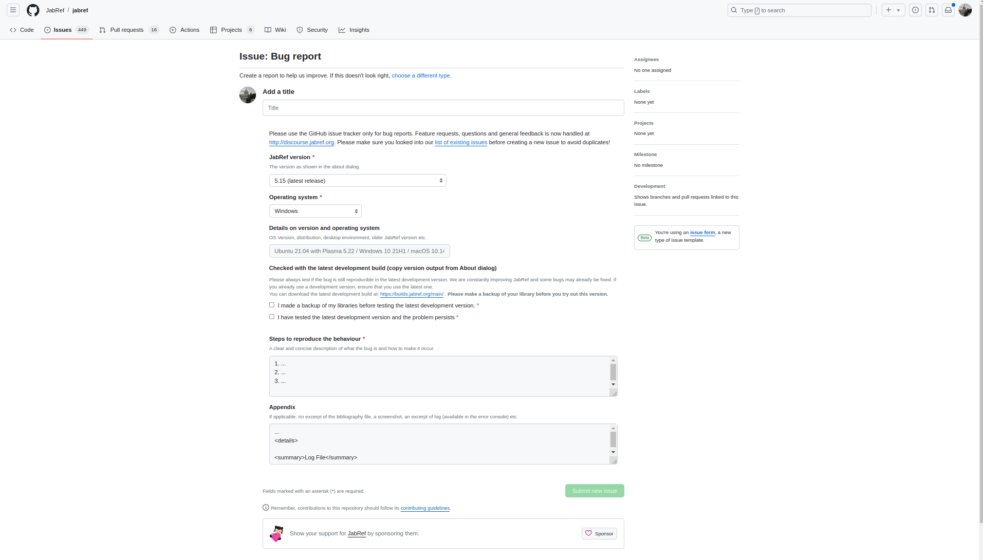
Action 3: Click the button 'Get Started' for 'Bug Report'(After)
If Abi does the right thing, will s/he know that s/he did the right thing and is making progress toward their goal? Why?
Answer
Click here to view the full image

Slide 9
Action 4: Fill out the Bug Report form(Before)
Will ABI know what to do at this step and is the page good enough for abi to take this action? Why?
Answer
Click here to view the full image

Slide 10
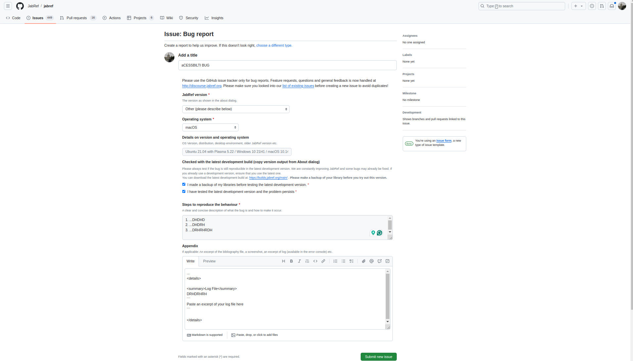
Action 4: Fill out the Bug Report form(After)
If Abi does the right thing, will s/he know that s/he did the right thing and is making progress toward their goal? Why?
Answer
Click here to view the full image

Slide 11
Action 5: Click the button 'Submit new issue'(Before)
Will ABI know what to do at this step and is the page good enough for abi to take this action? Why?
Answer
Click here to view the full image

Slide 12
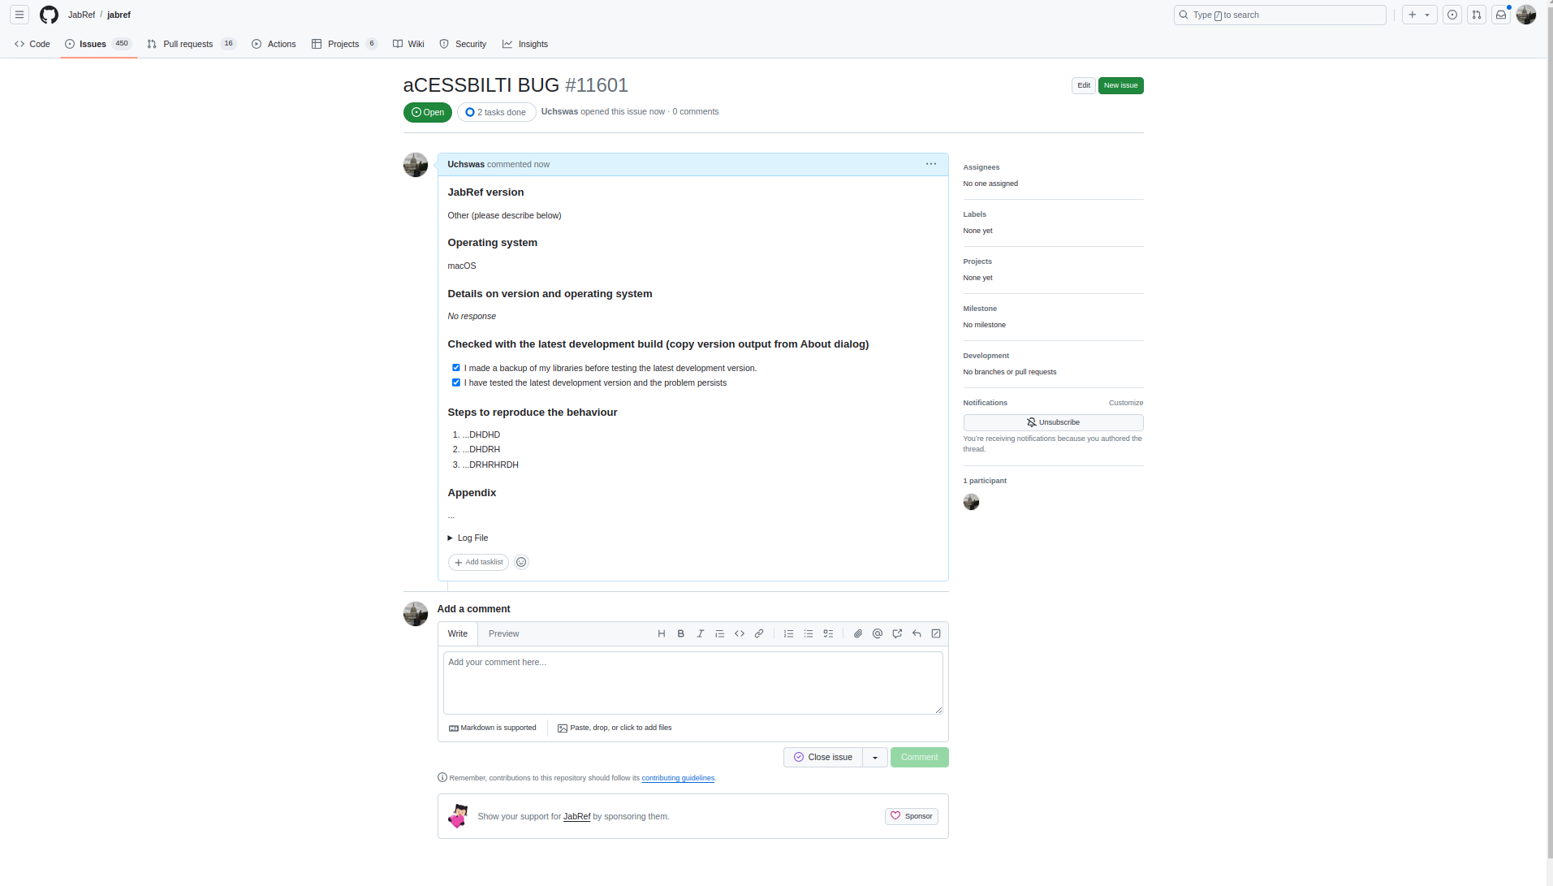
Action 5: Click the button 'Submit new issue'(After)
If Abi does the right thing, will s/he know that s/he did the right thing and is making progress toward their goal? Why?
Answer
Click here to view the full image

