Slide 1
CHENNAI
Find an issue to solve appropriate for new comer

Slide 2
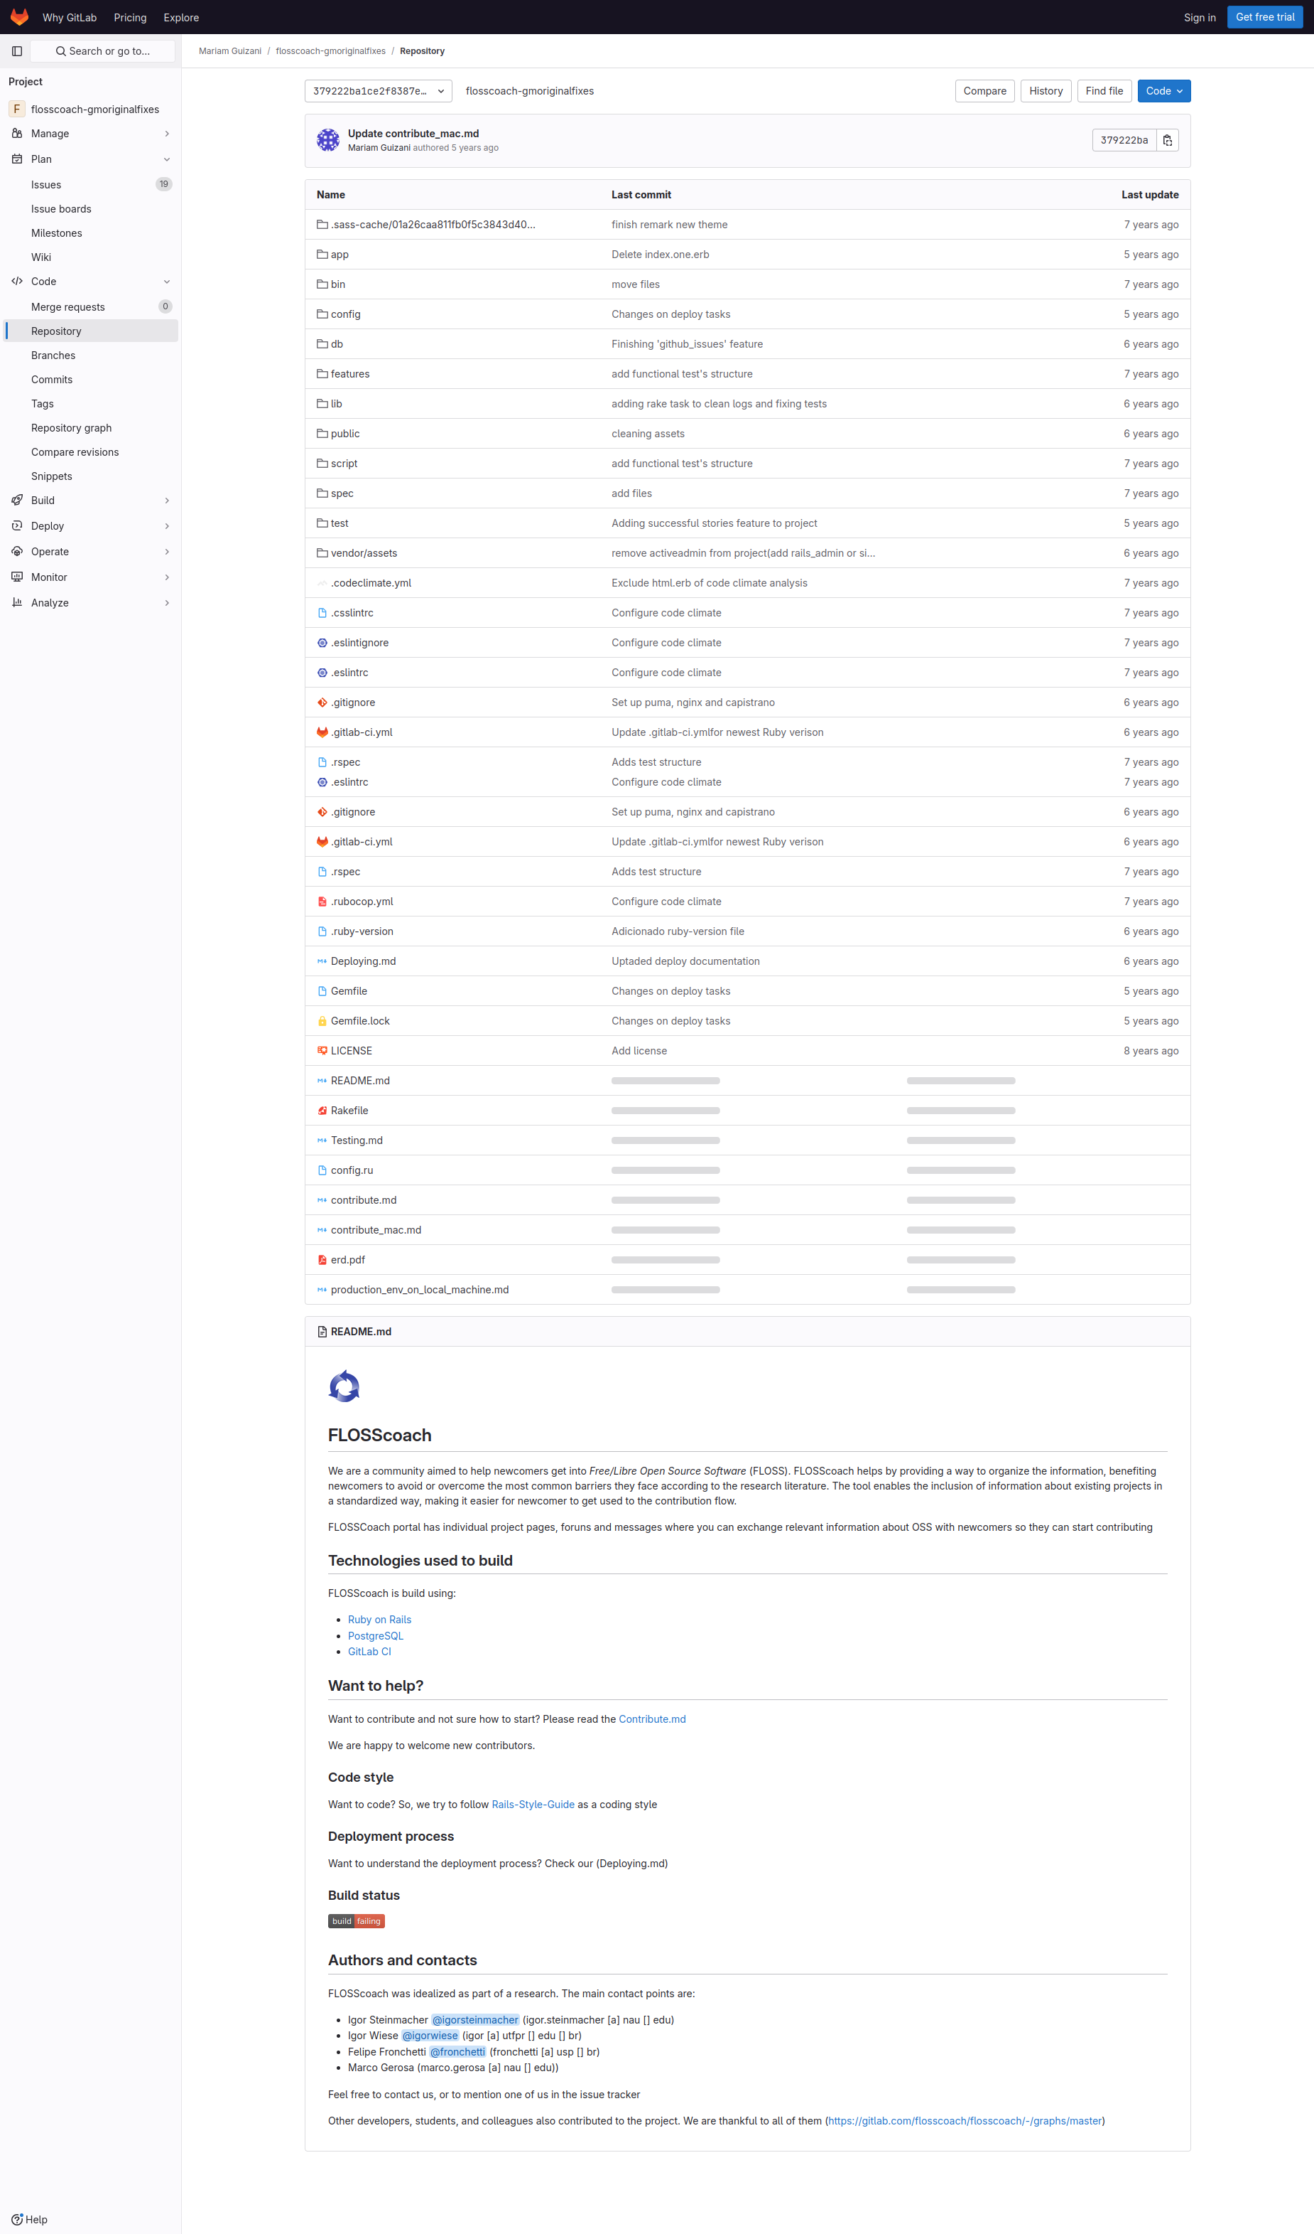
Subgoal 1: Find the list of issues
Will Abi have formed this sub-goal as a step to their overall goal?
Answer
Click here to view the full image

Slide 3
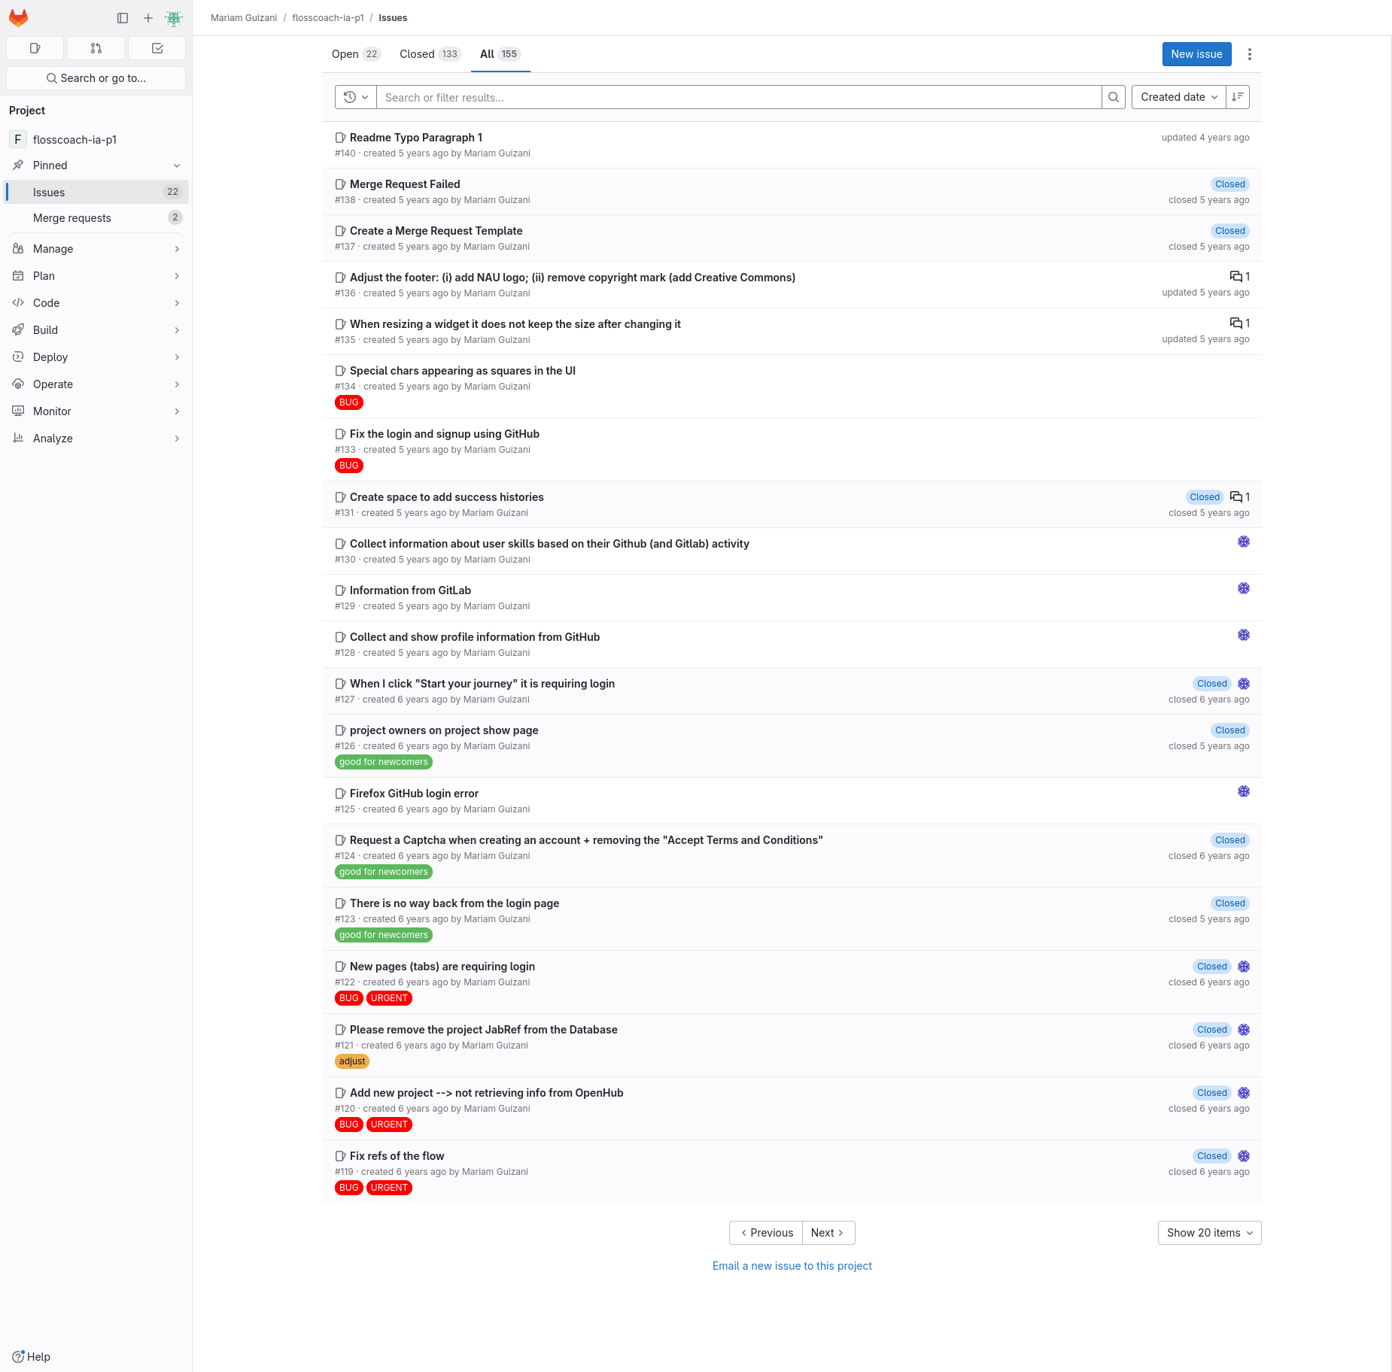
Action 1: Hover over Issues and click on List(Before)
Will ABI know what to do at this step and is the page good enough for abi to take this action? Why?
Answer
Click here to view the full image

Slide 4
Action 1: Hover over Issues and click on List(After)
If Abi does the right thing, will s/he know that s/he did the right thing and is making progress toward their goal? Why?
Answer
Click here to view the full image

Slide 5
Subgoal 2: Find the most appropriate issue to solve
Will Abi have formed this sub-goal as a step to their overall goal?
Answer
Click here to view the full image

Slide 6
Action 1: Read through issues to see if there’s an appropriate issue(Before)
Will ABI know what to do at this step and is the page good enough for abi to take this action? Why?
Answer
Click here to view the full image

Slide 7
Action 1: Read through issues to see if there’s an appropriate issue(After)
If Abi does the right thing, will s/he know that s/he did the right thing and is making progress toward their goal? Why?
Answer
Click here to view the full image

Slide 8
Action 2: Click on issue #136(Before)
Will ABI know what to do at this step and is the page good enough for abi to take this action? Why?
Answer
Click here to view the full image

Slide 9
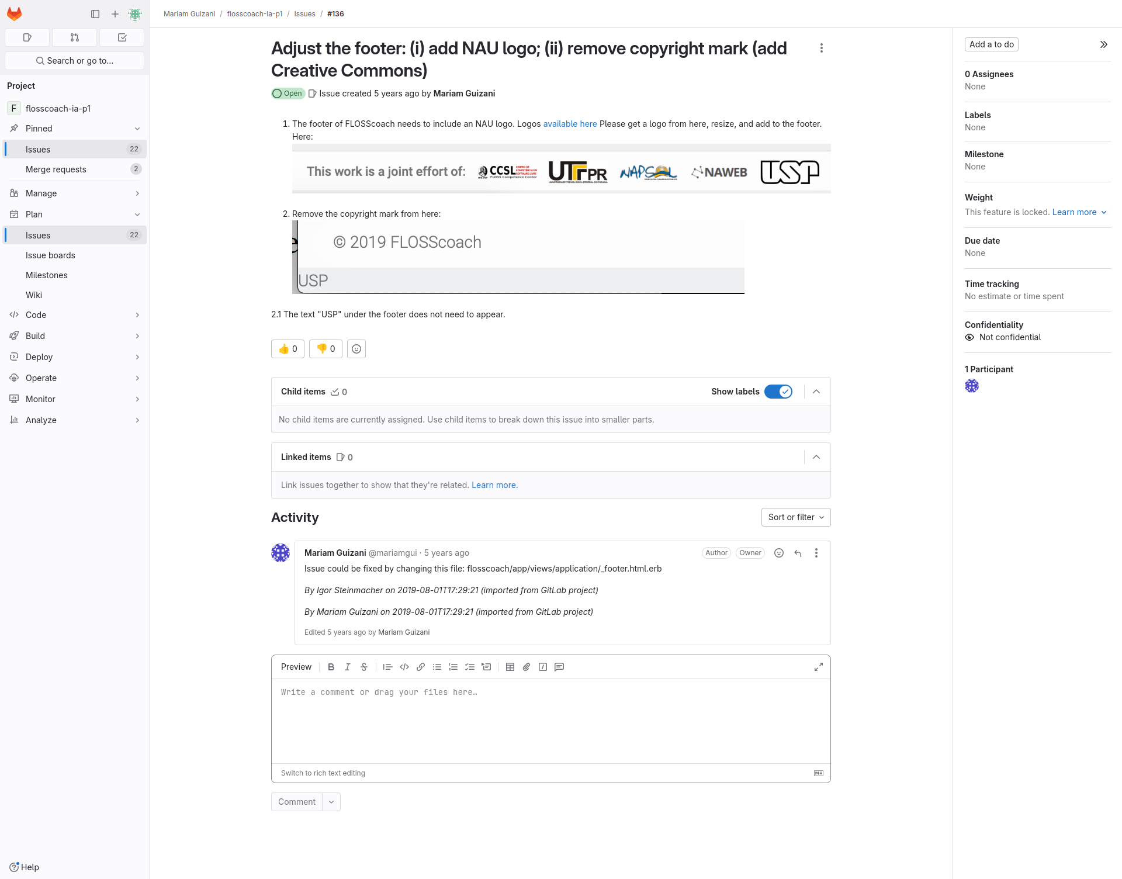
Action 2: Click on issue #136(After)
If Abi does the right thing, will s/he know that s/he did the right thing and is making progress toward their goal? Why?
Answer
Click here to view the full image

