Slide 1
FIJI
Ecampus CS162 student wants to figure out what to do to complete the course to be able to plan their term.

Slide 2
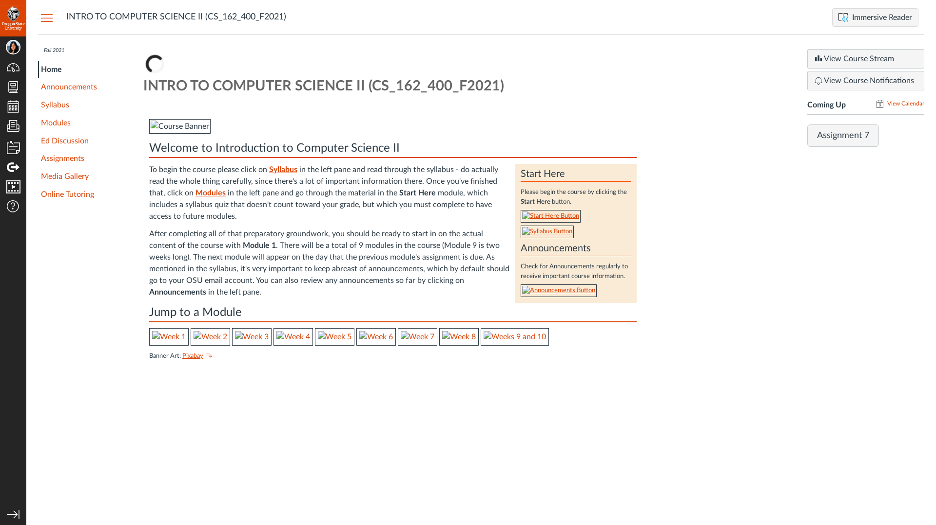
Subgoal 1: Find the Syllabus page
Will Abi have formed this sub-goal as a step to their overall goal?
Answer
Click here to view the full image

Slide 3
Action 1: Find the Syllabus page(Before)
Will ABI know what to do at this step and is the page good enough for abi to take this action? Why?
Answer
Click here to view the full image

Slide 4
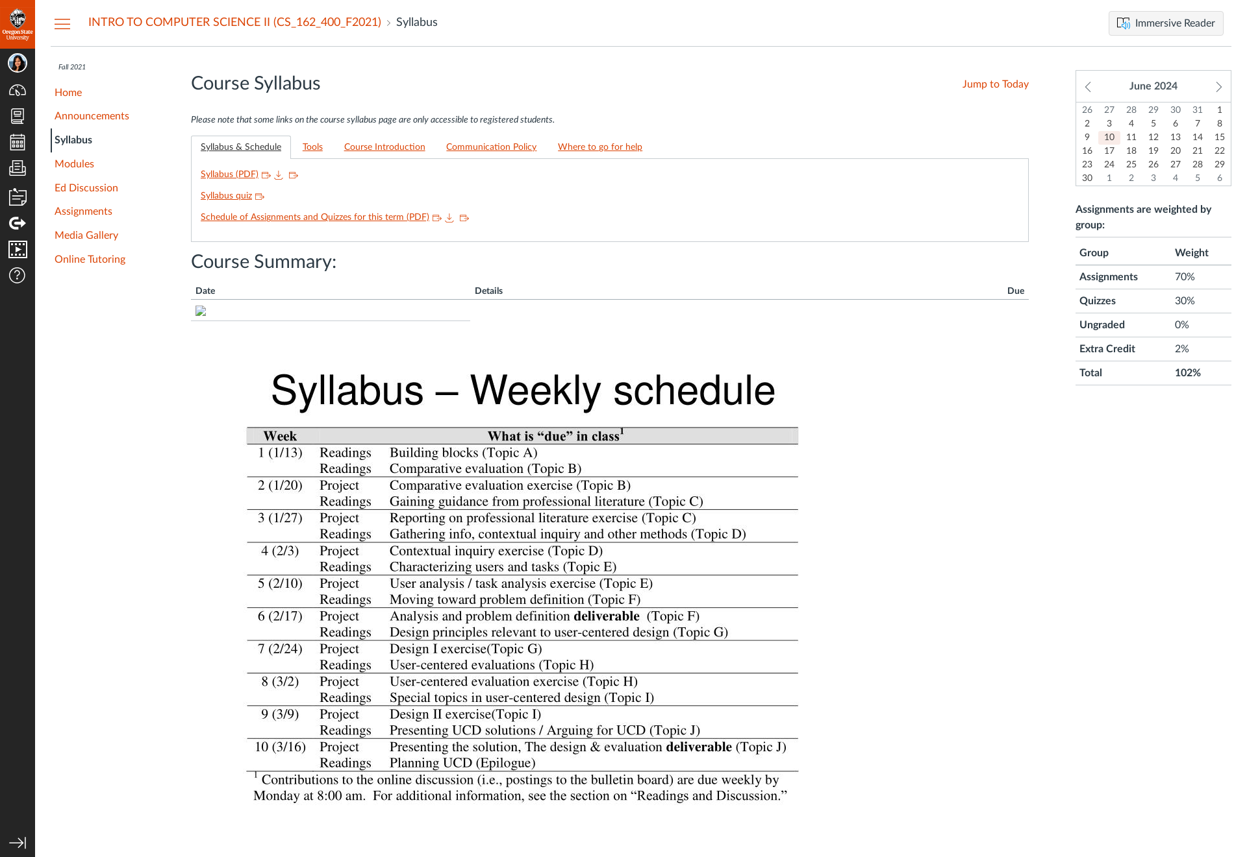
Action 1: Find the Syllabus page(After)
If Abi does the right thing, will s/he know that s/he did the right thing and is making progress toward their goal? Why?
Answer
Click here to view the full image

Slide 5
Subgoal 2: Find the summary of activities and deadlines
Will Abi have formed this sub-goal as a step to their overall goal?
Answer
Click here to view the full image

Slide 6
Action 1: Scroll down to “Course Summary” and read through it(Before)
Will ABI know what to do at this step and is the page good enough for abi to take this action? Why?
Answer
Click here to view the full image

Slide 7

Action 1: Scroll down to “Course Summary” and read through it(After)
If Abi does the right thing, will s/he know that s/he did the right thing and is making progress toward their goal? Why?
Answer
Click here to view the full image

Slide 8
Subgoal 3: Find list of tools to be installed/Setup for the course
Will Abi have formed this sub-goal as a step to their overall goal?
Answer
Click here to view the full image

Slide 9
Action 1: Click on “Tools” Tab on top(Before)
Will ABI know what to do at this step and is the page good enough for abi to take this action? Why?
Answer
Click here to view the full image

Slide 10
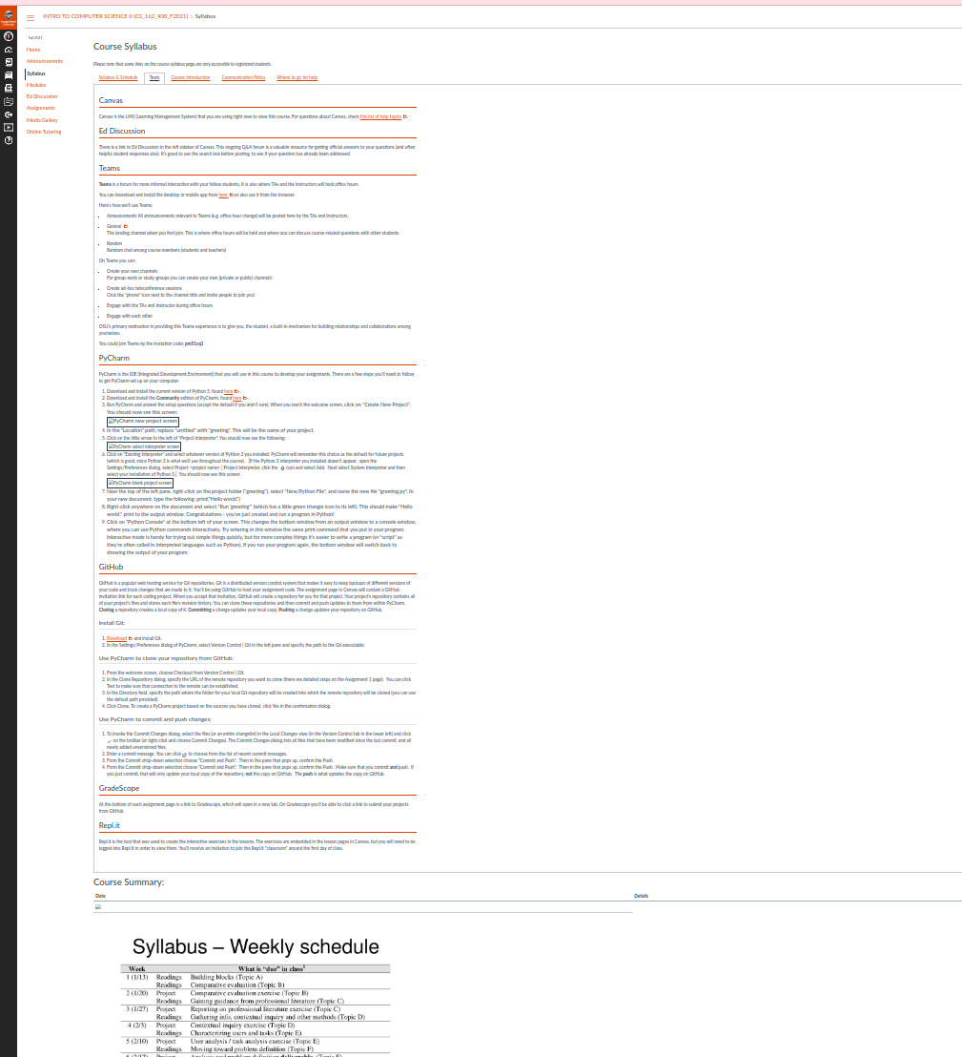
Action 1: Click on “Tools” Tab on top(After)
If Abi does the right thing, will s/he know that s/he did the right thing and is making progress toward their goal? Why?
Answer
Click here to view the full image

