Slide 1
HONULULU
Abi wants to get started with the course

Slide 2
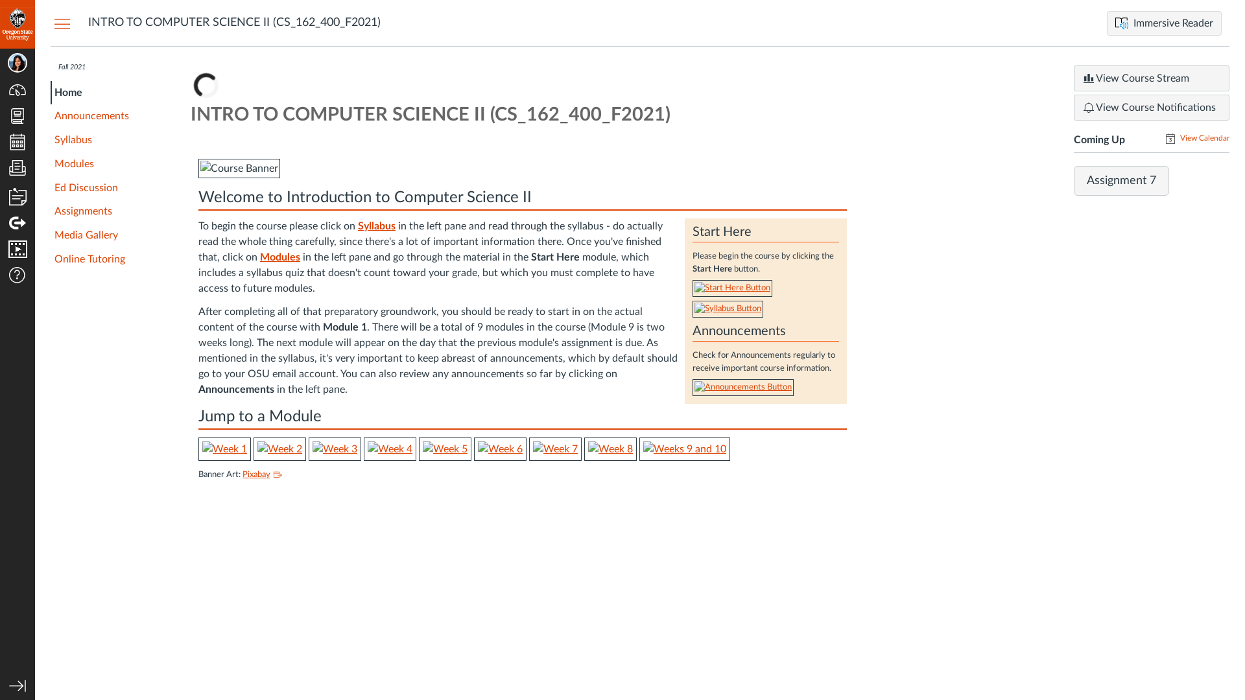
Subgoal 1: Find the Syllabus
Will ABI know what to do at this step and is the page good enough for abi to take this action? Why?
Answer
Click here to view the full image

Slide 3
Action 1: Click on Syllabus(Before)
Will ABI know what to do at this step? Why?
Answer
Click here to view the full image

Slide 4
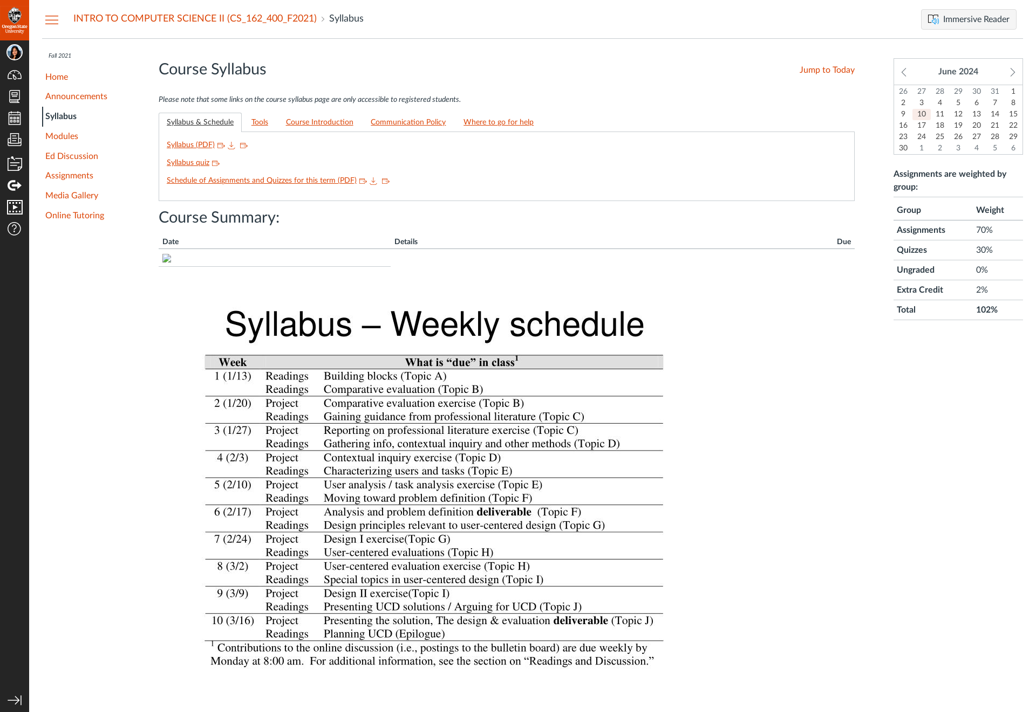
Action 1: Click on Syllabus(After)
If Abi does the right thing, will s/he know that s/he did the right thing and is making progress toward their goal? Why?
Answer
Click here to view the full image

Slide 5
Subgoal 2: Read the Syllabus
Will ABI know what to do at this step and is the page good enough for abi to take this action? Why?
Answer
Click here to view the full image

Slide 6
Action 1: Click on Syllabus(PDF)(Before)
Will ABI know what to do at this step? Why?
Answer
Click here to view the full image

Slide 7
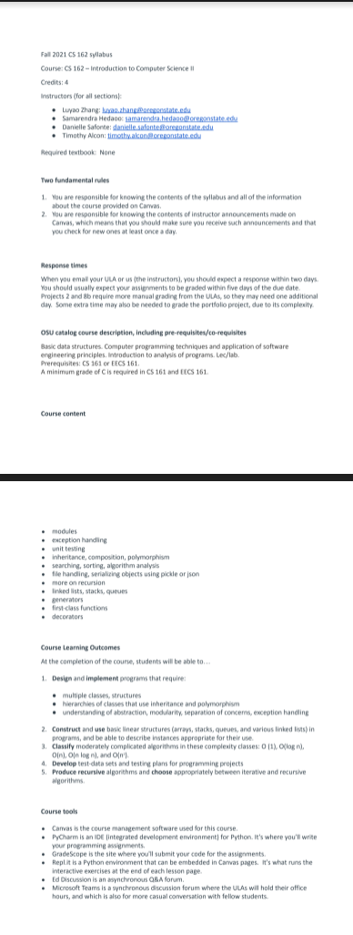
Action 1: Click on Syllabus(PDF)(After)
If Abi does the right thing, will s/he know that s/he did the right thing and is making progress toward their goal? Why?
Answer
Click here to view the full image

Slide 8
Subgoal 3: Read information under Modules
Will ABI know what to do at this step and is the page good enough for abi to take this action? Why?
Answer
Click here to view the full image

Slide 9
Action 1: Click on Modules(Before)
Will ABI know what to do at this step? Why?
Answer
Click here to view the full image

Slide 10
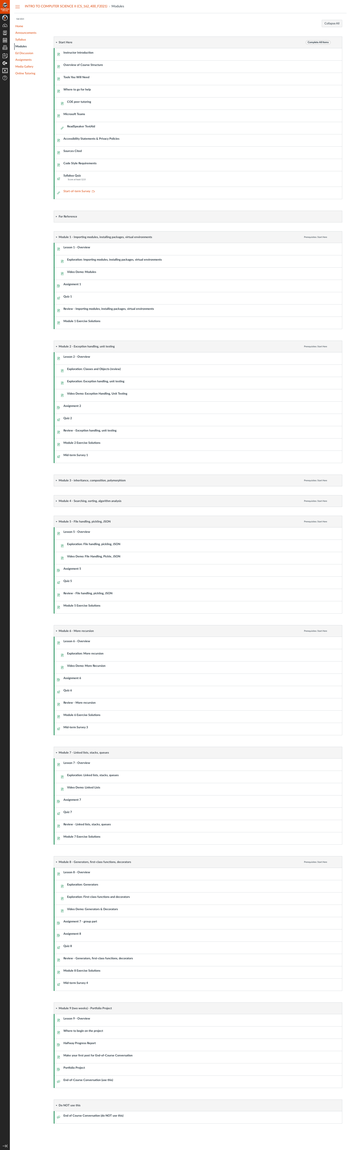
Action 1: Click on Modules(After)
If Abi does the right thing, will s/he know that s/he did the right thing and is making progress toward their goal? Why?
Answer
Click here to view the full image

