Slide 1
KEYWEST
Ecampus CS162 student wants to figure out what to do during Week 1 and what the Week 1 deadlines are

Slide 2
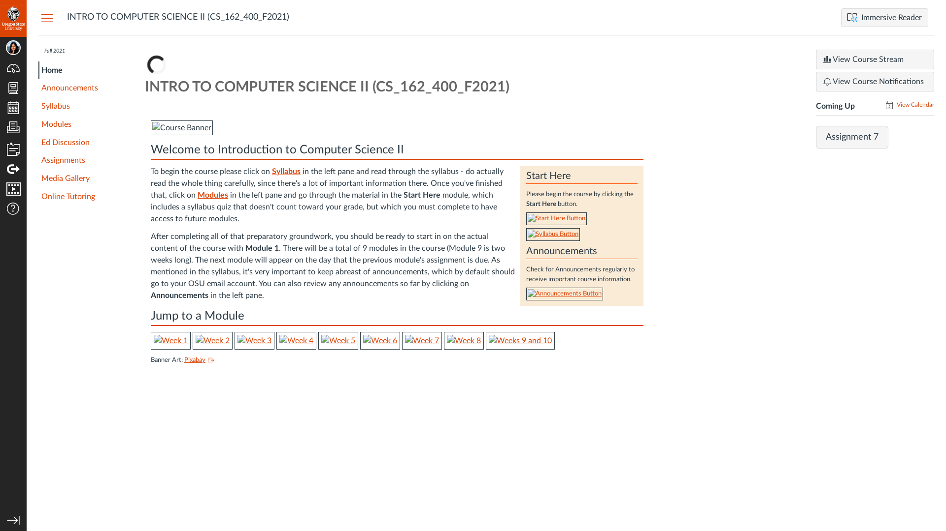
Subgoal 1: Find the Syllabus page
Will Abi have formed this sub-goal as a step to their overall goal?
Answer
Click here to view the full image

Slide 3
Action 1: Click “Syllabus” on the left pane(Before)
Will ABI know what to do at this step and is the page good enough for abi to take this action? Why?
Answer
Click here to view the full image

Slide 4
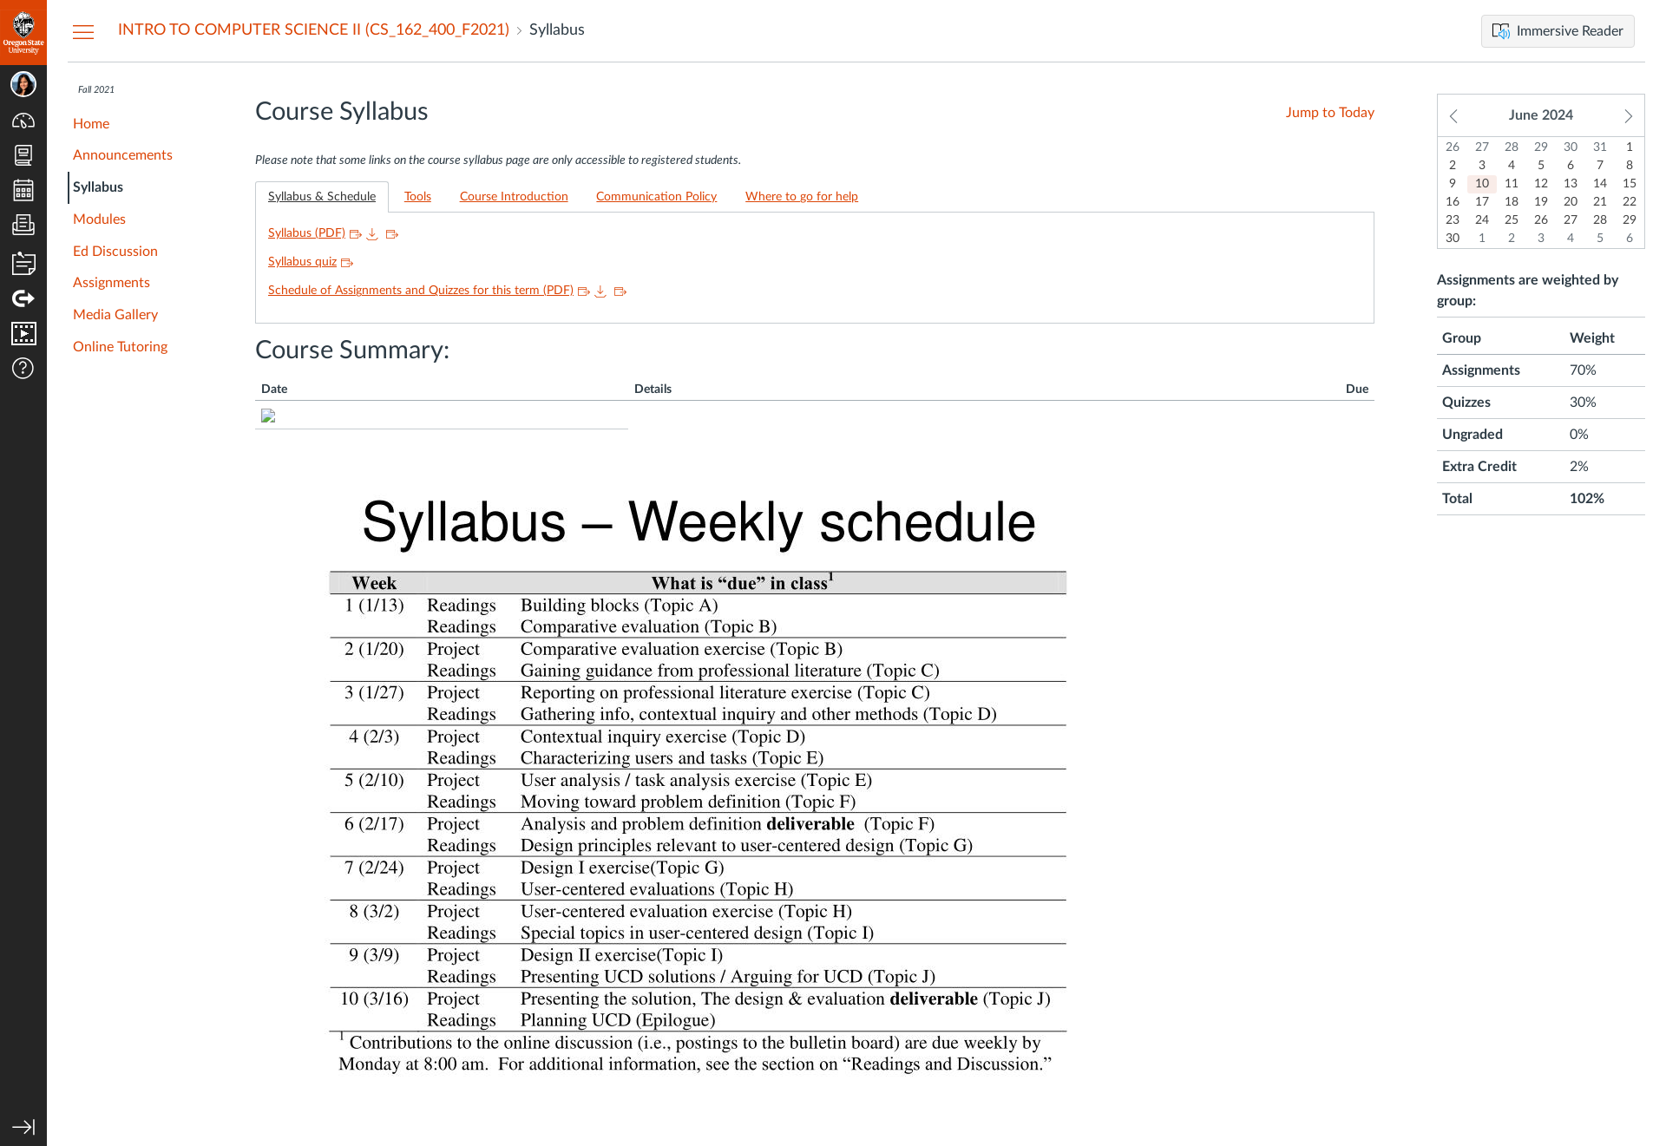
Action 1: Click “Syllabus” on the left pane(After)
If Abi does the right thing, will s/he know that s/he did the right thing and is making progress toward their goal? Why?
Answer
Click here to view the full image

Slide 5
Subgoal 2: Find the summary of activities and deadlines
Will Abi have formed this sub-goal as a step to their overall goal?
Answer
Click here to view the full image

Slide 6
Action 1: Scroll down to “Course Summary” and read through it(Before)
Will ABI know what to do at this step and is the page good enough for abi to take this action? Why?
Answer
Click here to view the full image

Slide 7

Action 1: Scroll down to “Course Summary” and read through it(After)
If Abi does the right thing, will s/he know that s/he did the right thing and is making progress toward their goal? Why?
Answer
Click here to view the full image

