Slide 1
KOLKATA
Add information to the README

Slide 2
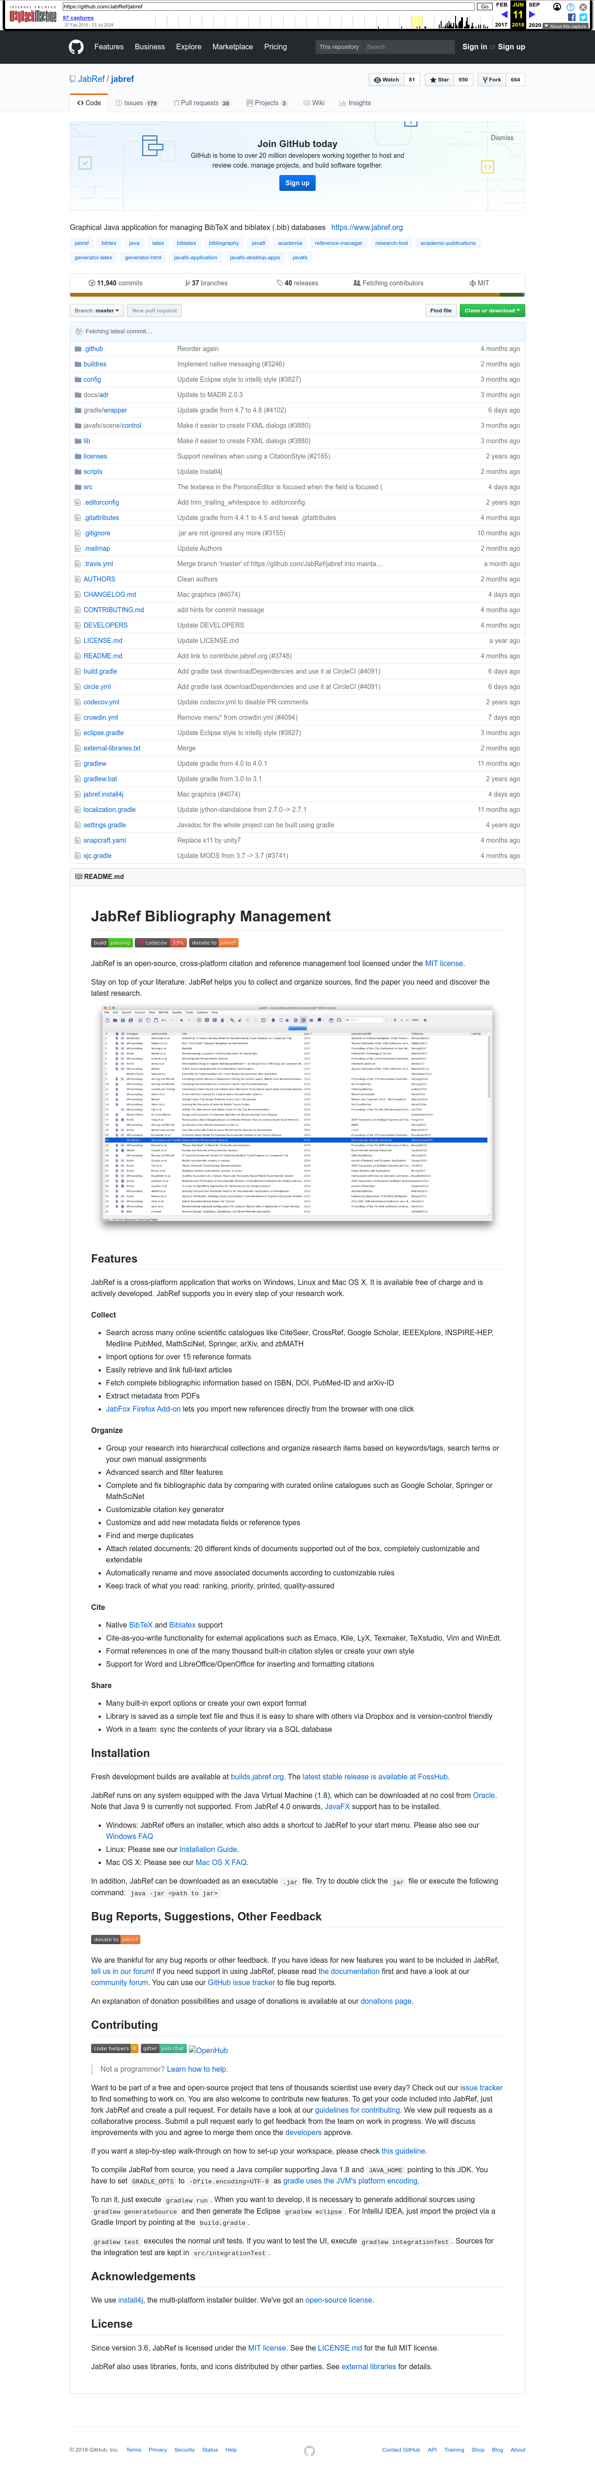
Subgoal 1: Find the README
Will Abi have formed this sub-goal as a step to their overall goal?
Answer
Click here to view the image

Slide 3
Action 1: Scroll down to read(Before)
Will ABI know what to do at this step and is the page good enough for abi to take this action? Why?
Answer
Click here to view the image

Slide 4
Action 1: Scroll down to read(After)
If Abi does the right thing, will s/he know that s/he did the right thing and is making progress toward their goal? Why?
Answer
Click here to view the image

Slide 5
Action 2: Click on README.md(Before)
Will ABI know what to do at this step and is the page good enough for abi to take this action? Why?
Answer
Click here to view the image

Slide 6
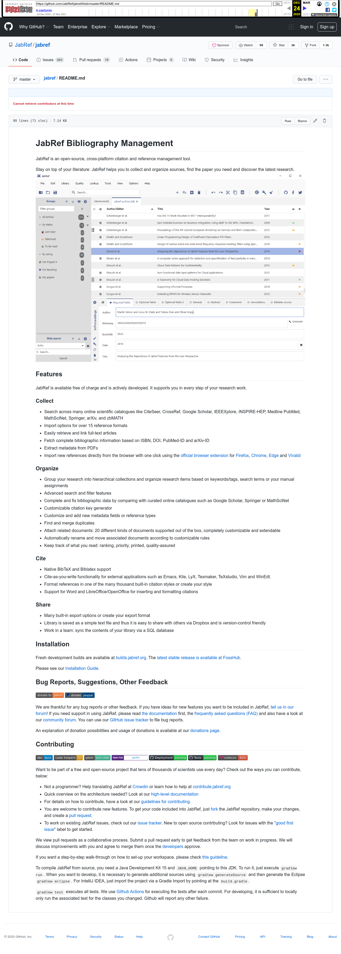
Action 2: Click on README.md(After)
If Abi does the right thing, will s/he know that s/he did the right thing and is making progress toward their goal? Why?
Answer
Click here to view the image

Slide 7
Subgoal 2: Find out how to edit it
Will Abi have formed this sub-goal as a step to their overall goal?
Answer
Click here to view the image

Slide 8
Action 1: Click the pencil button(Before)
Will ABI know what to do at this step and is the page good enough for abi to take this action? Why?
Answer
Click here to view the image

Slide 9
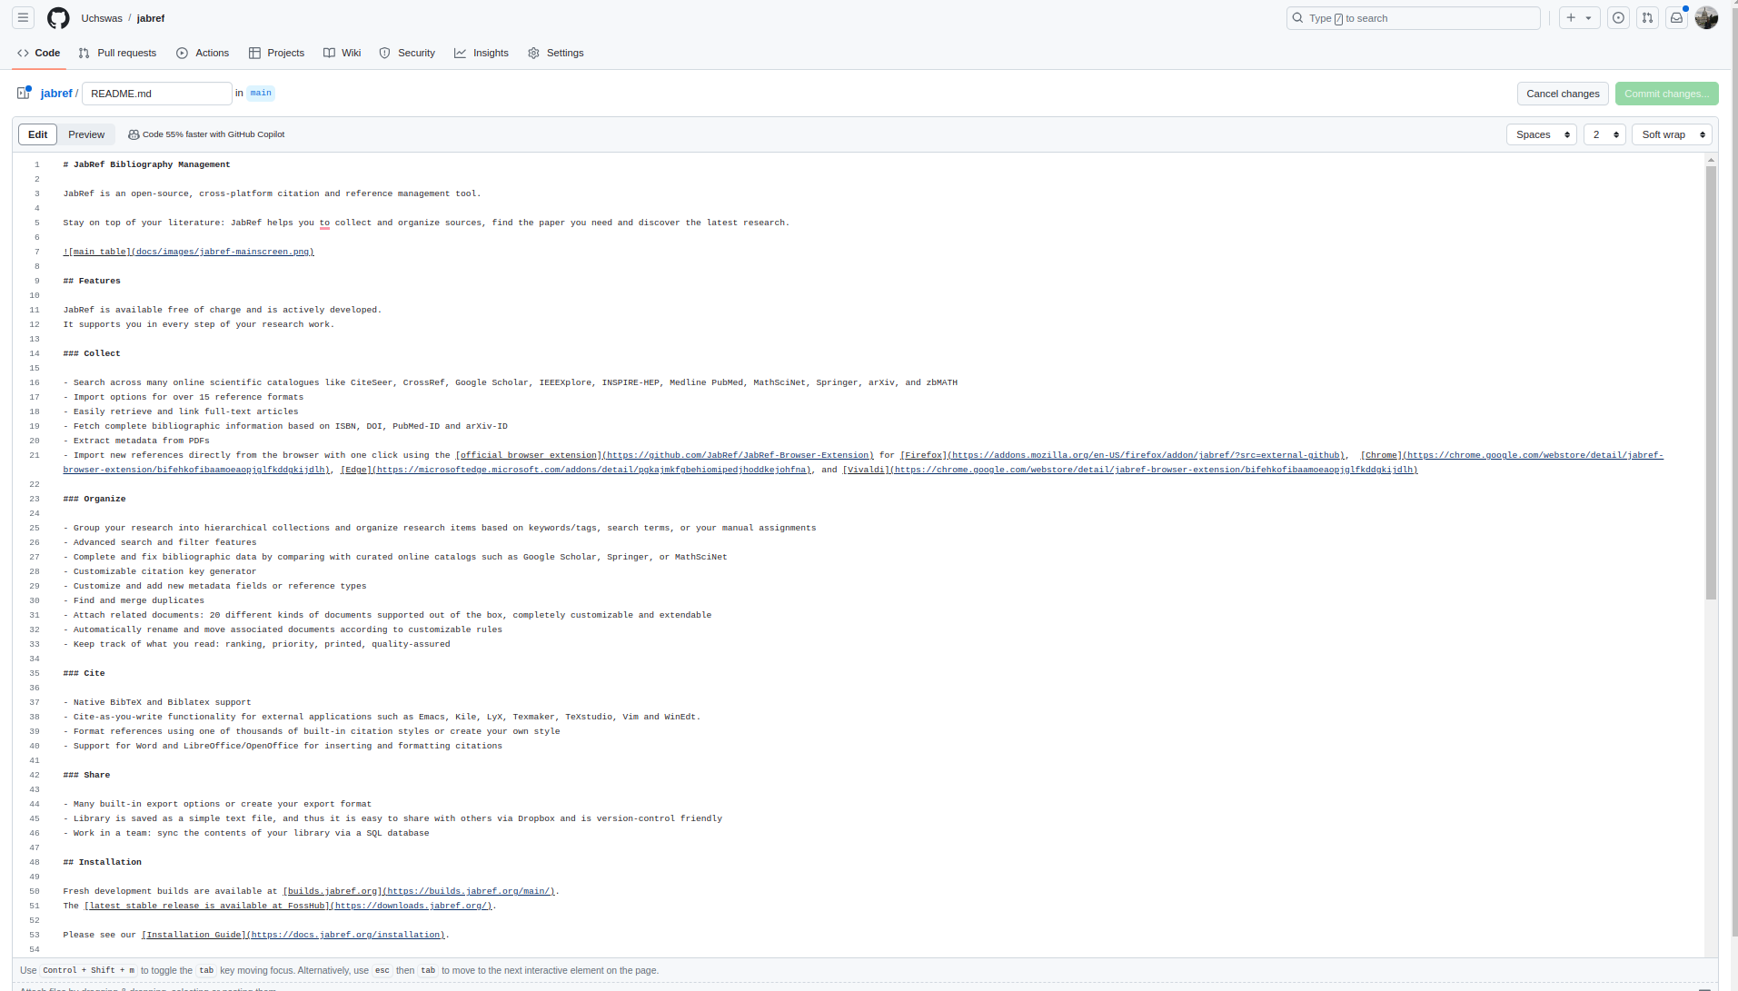
Action 1: Click the pencil button(After)
If Abi does the right thing, will s/he know that s/he did the right thing and is making progress toward their goal? Why?
Answer
Click here to view the image

Slide 10
Action 2: Edit the file(Before)
Will ABI know what to do at this step and is the page good enough for abi to take this action? Why?
Answer
Click here to view the image

Slide 11
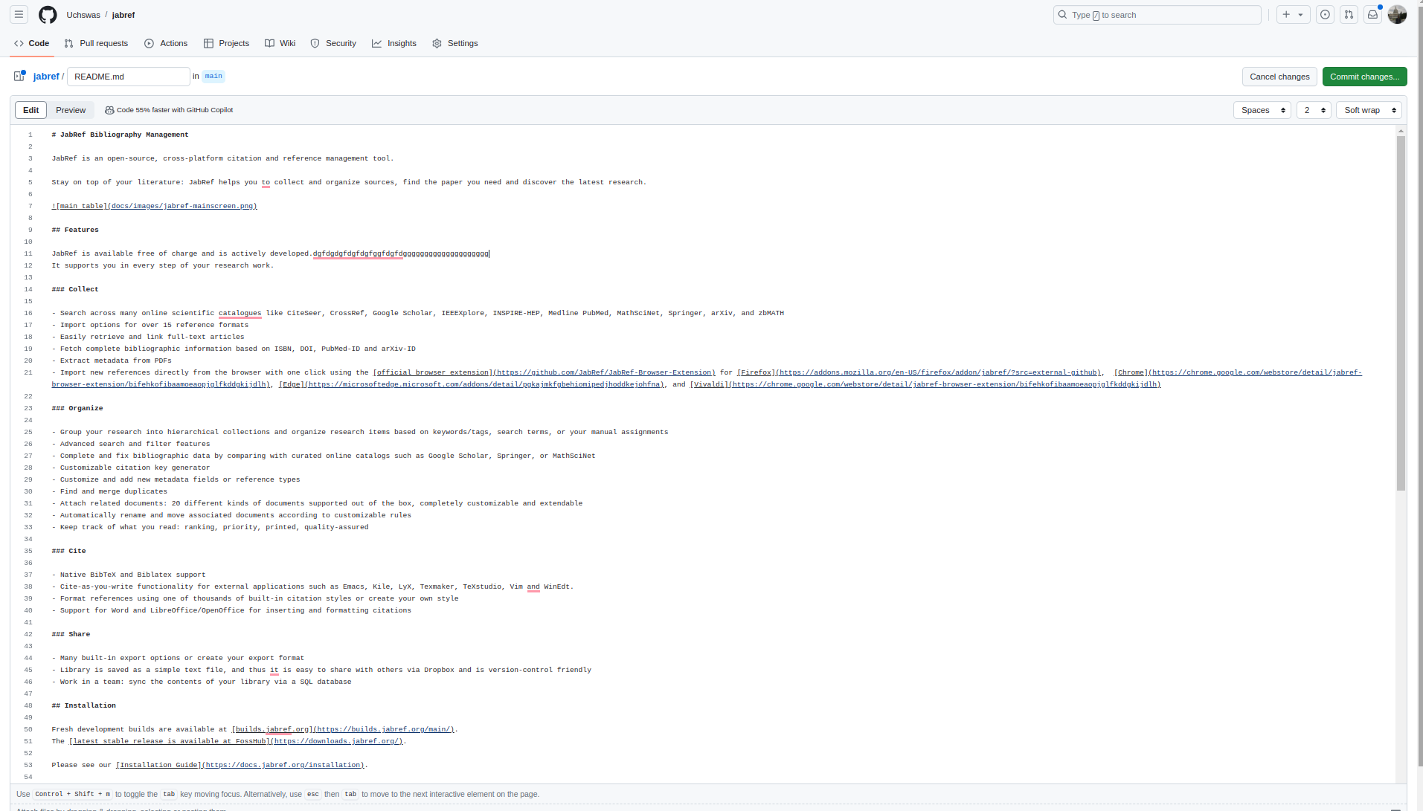
Action 2: Edit the file(After)
If Abi does the right thing, will s/he know that s/he did the right thing and is making progress toward their goal? Why?
Answer
Click here to view the image

Slide 12
Action 3: Click 'preview change'(Before)
Will ABI know what to do at this step and is the page good enough for abi to take this action? Why?
Answer
Click here to view the image

Slide 13
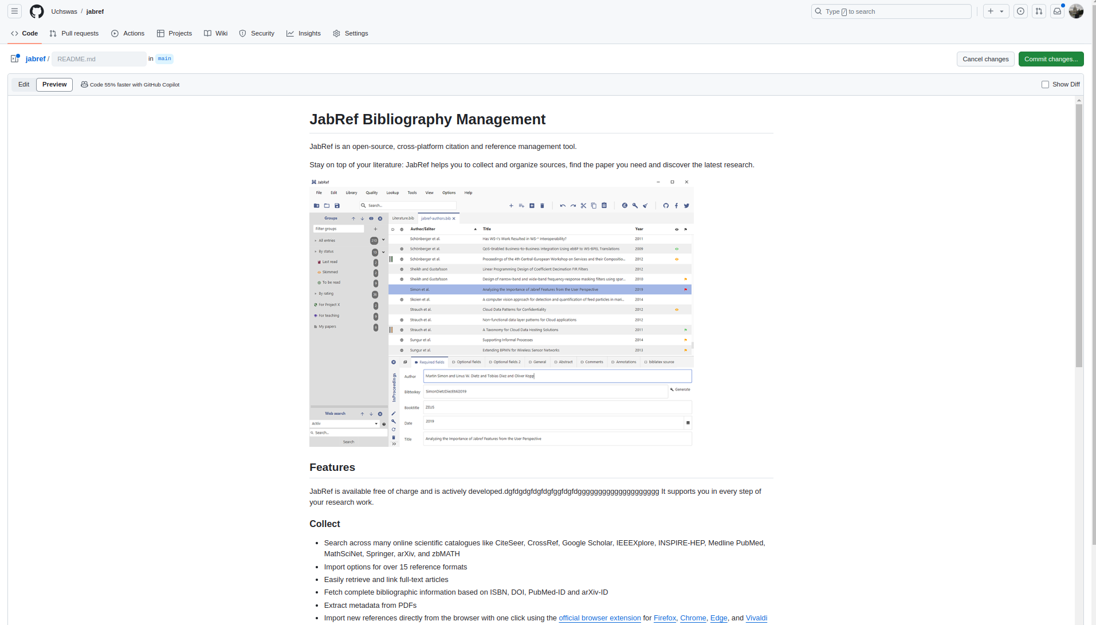
Action 3: Click 'preview change'(After)
If Abi does the right thing, will s/he know that s/he did the right thing and is making progress toward their goal? Why?
Answer
Click here to view the image

