Slide 1
Lincoln
File an issue

Slide 2
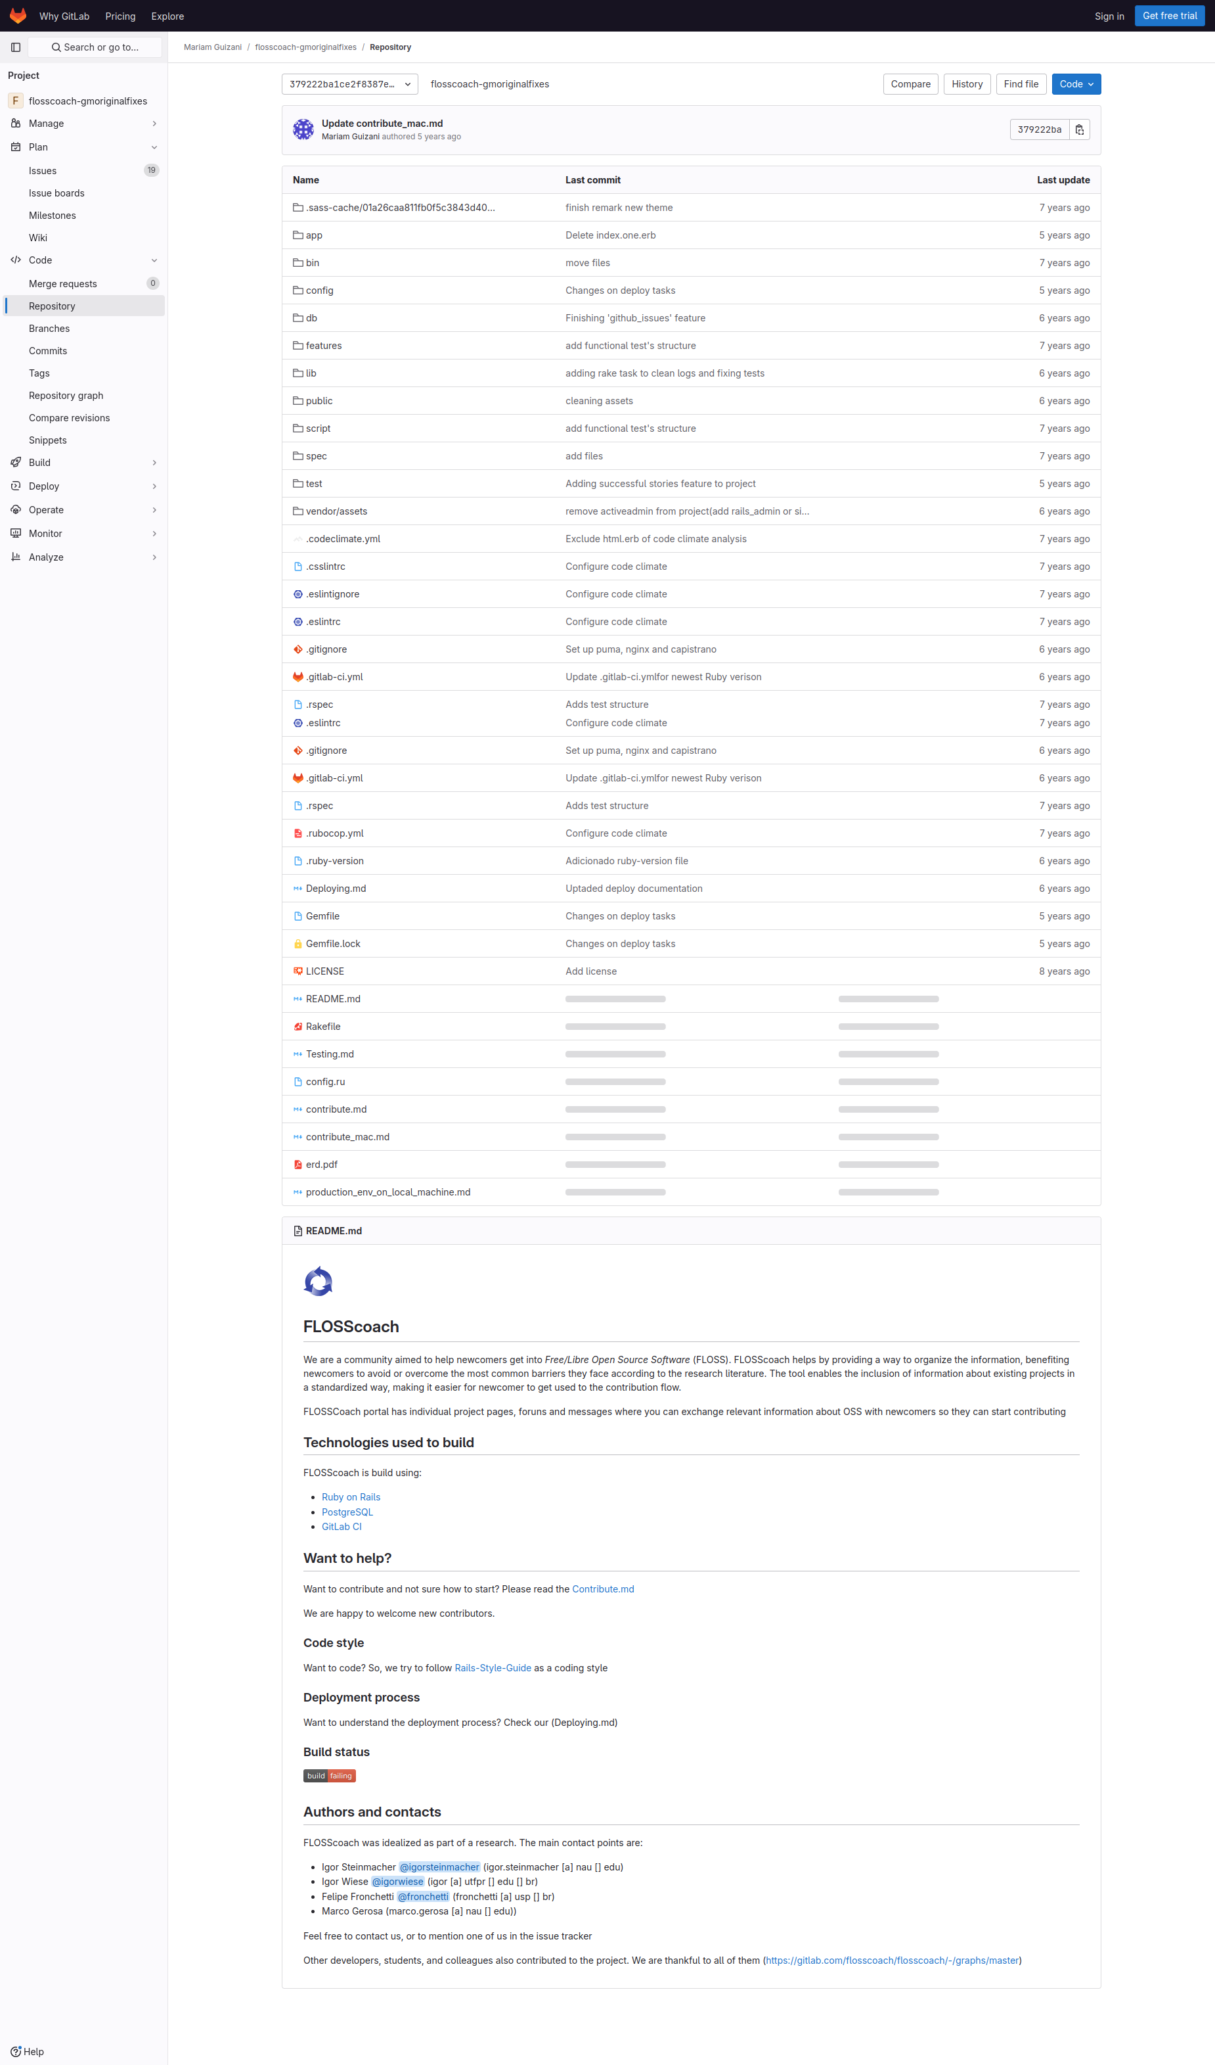
Subgoal 1: Find information about filing an issue
Will Abi have formed this sub-goal as a step to their overall goal?
Answer
Click here to view the full image

Slide 3
Action 1: Click on issue button on the side(Before)
Will ABI know what to do at this step and is the page good enough for abi to take this action? Why?
Answer
Click here to view the full image

Slide 4
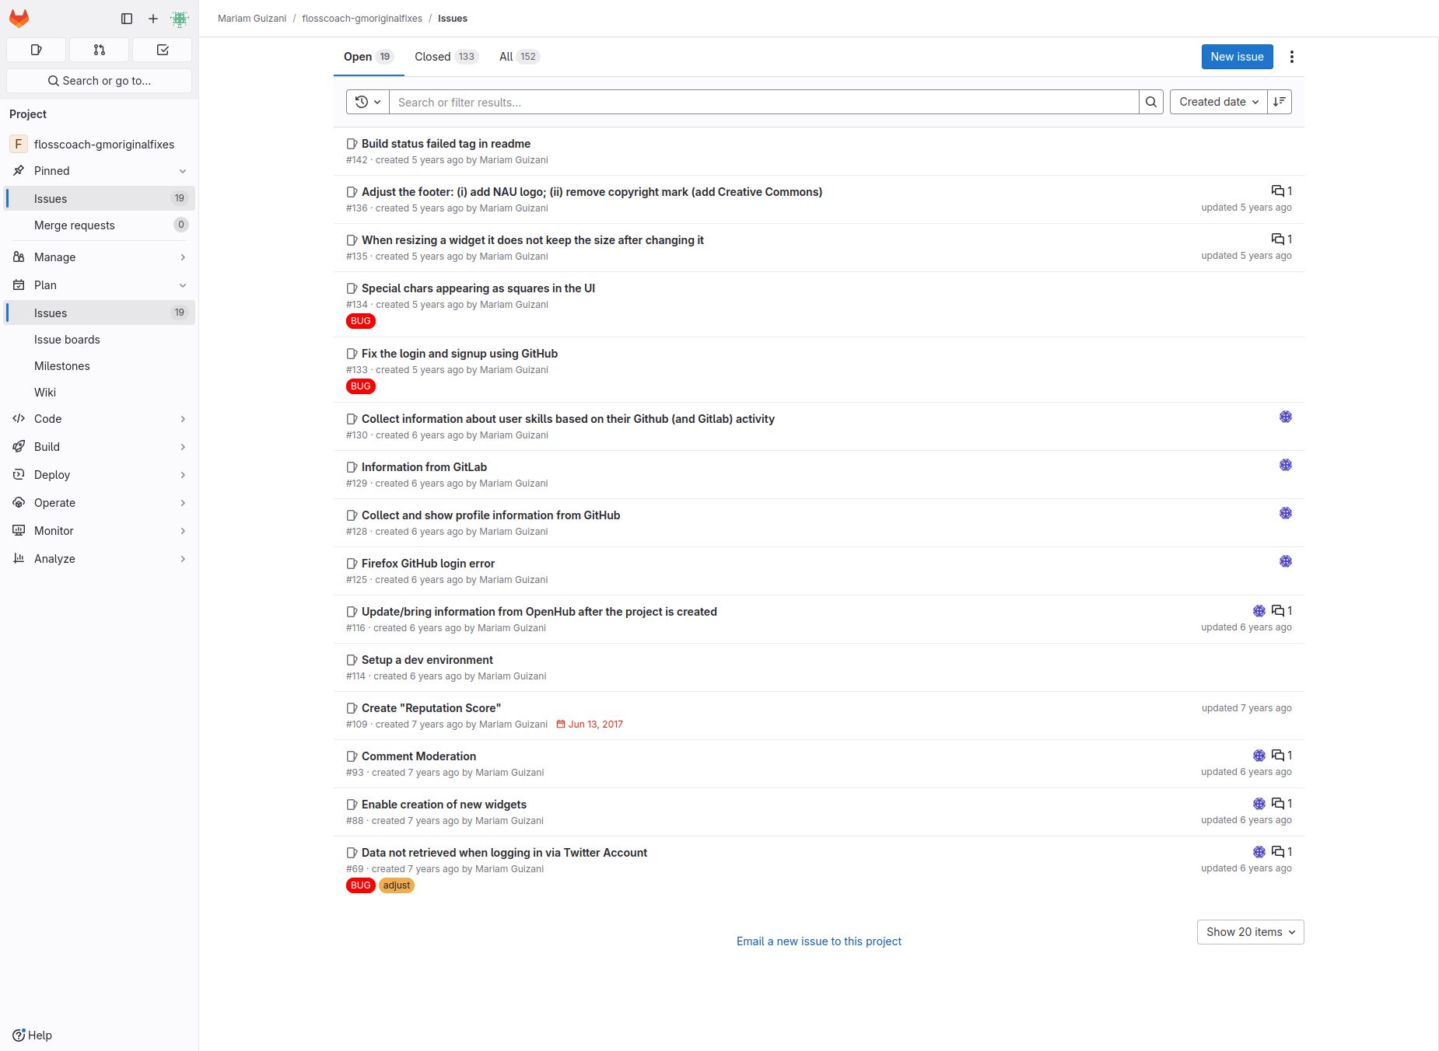
Action 1: Click on issue button on the side(After)
If Abi does the right thing, will s/he know that s/he did the right thing and is making progress toward their goal? Why?
Answer
Click here to view the full image

Slide 5
Action 2: Click on the blue new issue button(Before)
Will ABI know what to do at this step and is the page good enough for abi to take this action? Why?
Answer
Click here to view the full image

Slide 6
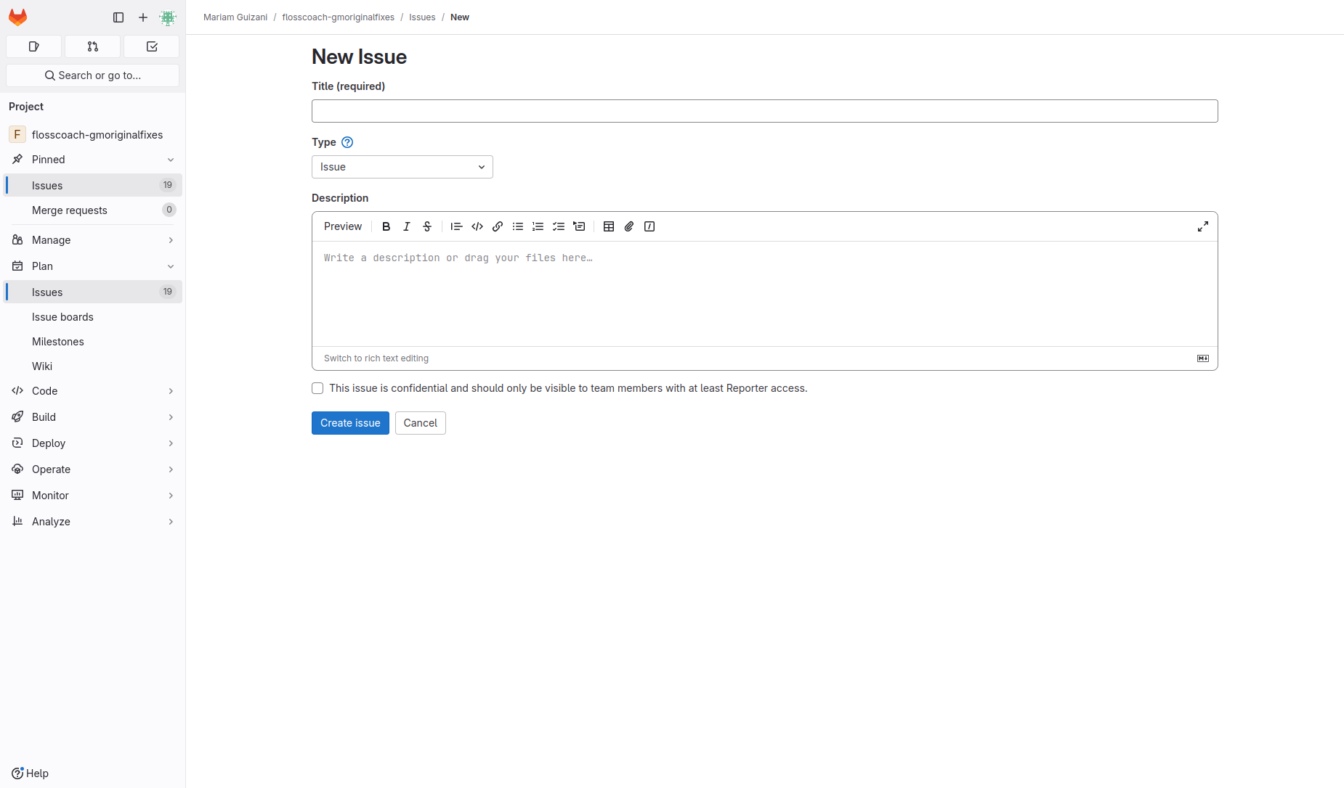
Action 2: Click on the blue new issue button(After)
If Abi does the right thing, will s/he know that s/he did the right thing and is making progress toward their goal? Why?
Answer
Click here to view the full image

