Slide 1
MIAMI
Abi wants to submit Assignment 7

Slide 2
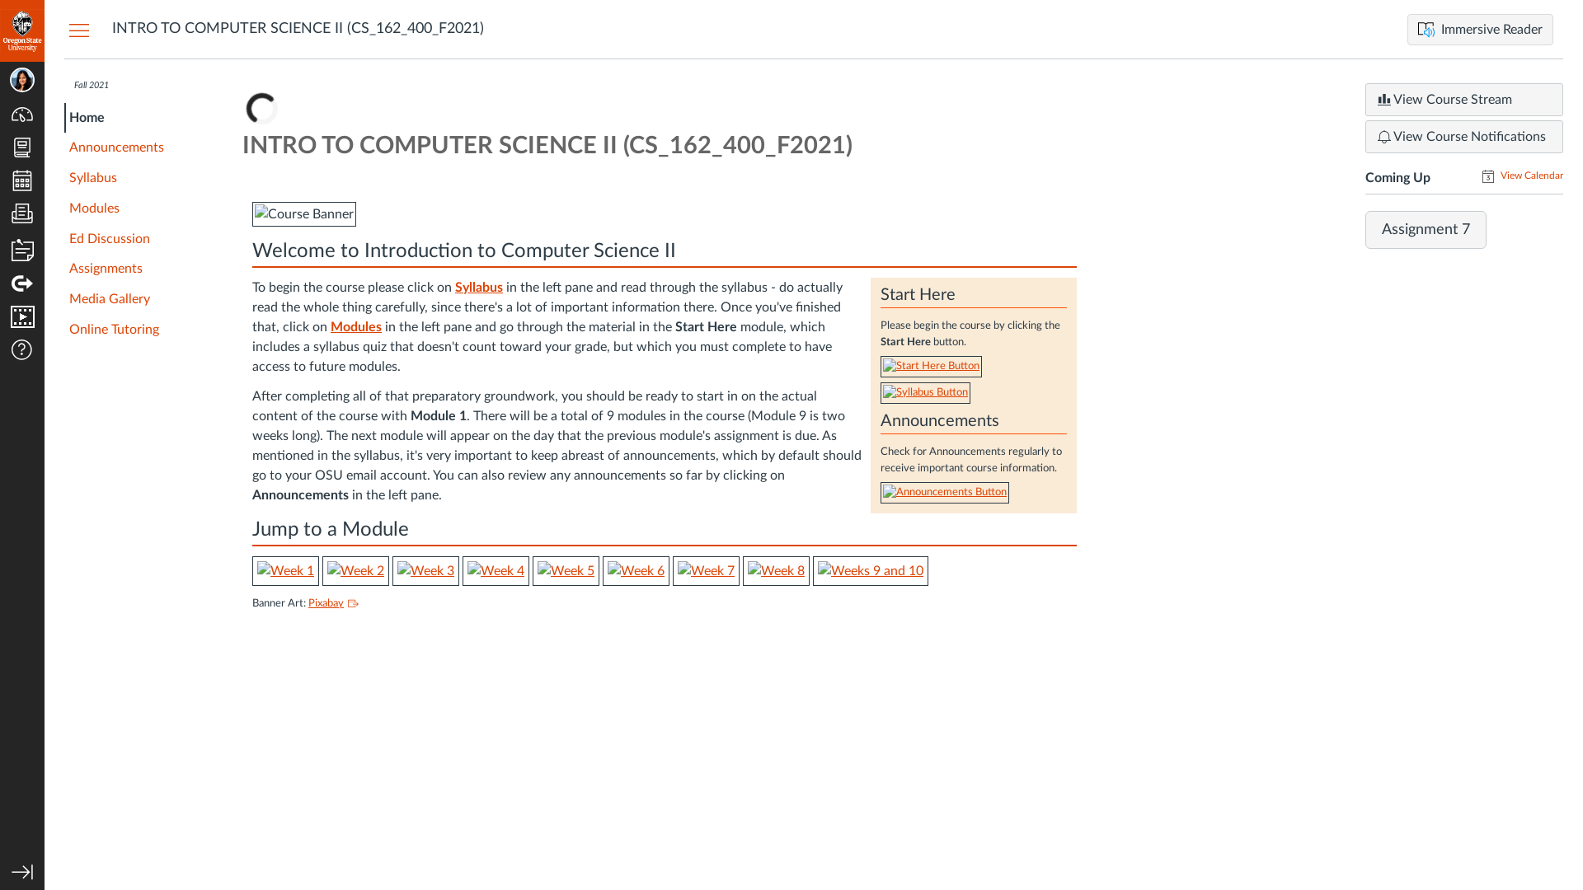
Subgoal 1: Find assignment 7
Will Abi have formed this sub-goal as a step to their overall goal?
Answer
Click here to view the full image

Slide 3
Action 1: Click on assignment 7 link under Coming up section (Before)(Before)
Will ABI know what to do at this step and is the page good enough for abi to take this action? Why?
Answer
Click here to view the full image

Slide 4
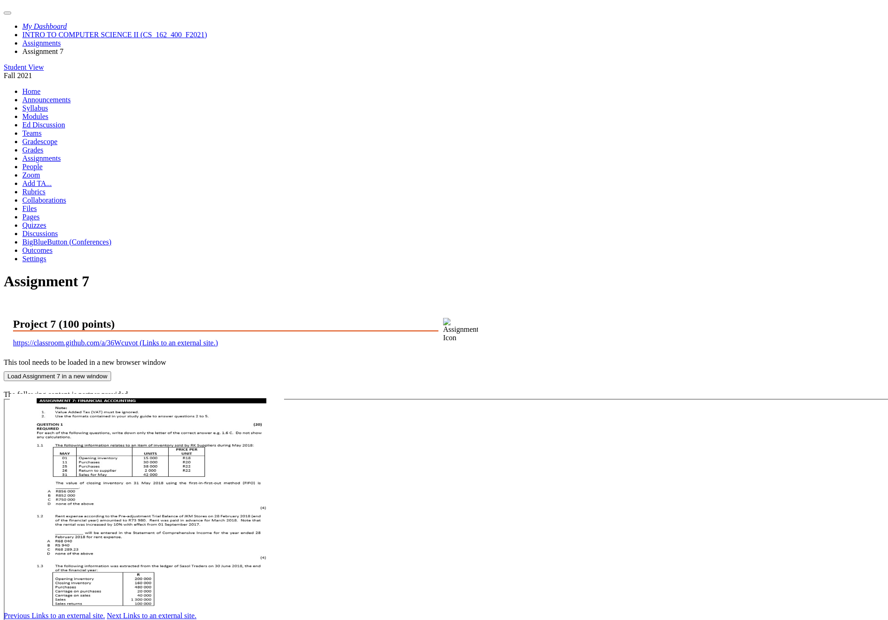
Action 1: Click on assignment 7 link under Coming up section (Before)(After)
If Abi does the right thing, will s/he know that s/he did the right thing and is making progress toward their goal? Why?
Answer
Click here to view the full image

Slide 5
Action 2: Click on Github link (Before)(Before)
Will ABI know what to do at this step and is the page good enough for abi to take this action? Why?
Answer
Click here to view the full image

Slide 6
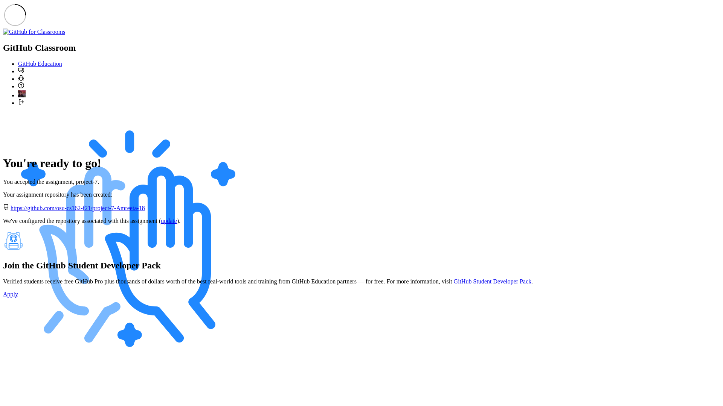
Action 2: Click on Github link (Before)(After)
If Abi does the right thing, will s/he know that s/he did the right thing and is making progress toward their goal? Why?
Answer
Click here to view the full image

Slide 7
Subgoal 2: Go to Gradescope to submit assignment
Will Abi have formed this sub-goal as a step to their overall goal?
Answer
Click here to view the full image

Slide 8
Action 1: Click on assignment 7 link under Coming up section(Before)
Will ABI know what to do at this step and is the page good enough for abi to take this action? Why?
Answer
Click here to view the full image

Slide 9
Action 1: Click on assignment 7 link under Coming up section(After)
If Abi does the right thing, will s/he know that s/he did the right thing and is making progress toward their goal? Why?
Answer
Click here to view the full image

Slide 10
Action 2: Click on load assignment 7 for submission(Before)
Will ABI know what to do at this step and is the page good enough for abi to take this action? Why?
Answer
Click here to view the full image

Slide 11
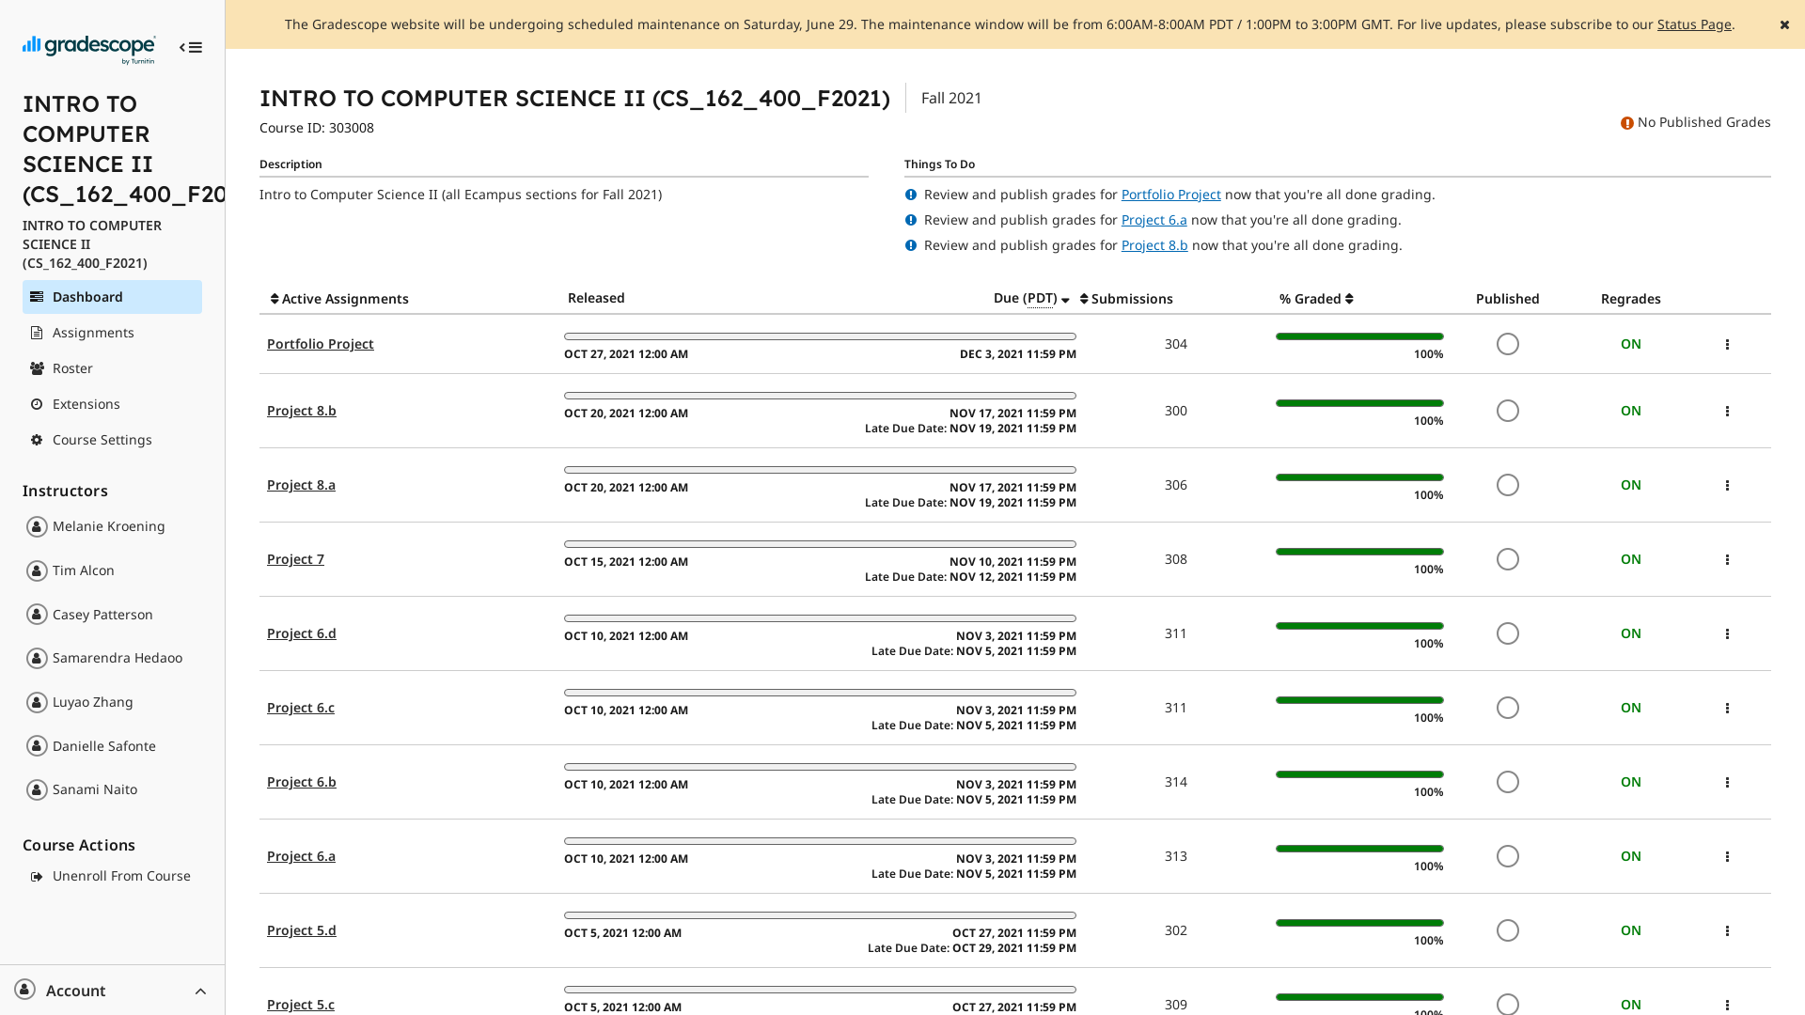
Action 2: Click on load assignment 7 for submission(After)
If Abi does the right thing, will s/he know that s/he did the right thing and is making progress toward their goal? Why?
Answer
Click here to view the full image

