Slide 1
PATTAYA
Abi decided to attend ICSE 2019 and is making travel arrangements (not doing the third-party registration sequence) - she is the second author on a paper that got accepted, so she doesn't have to go, but she has decided to go.

Slide 2
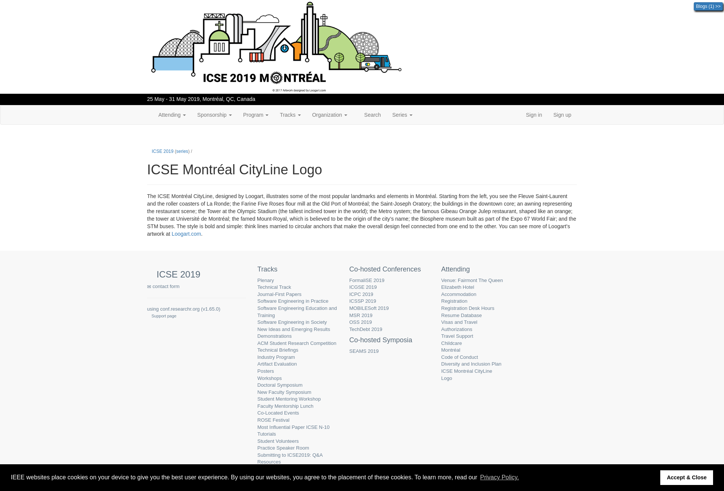
Subgoal 1: Abby wants to know where people are staying
Will Abi have formed this sub-goal as a step to their overall goal?
Answer
Click here to view the full image

Slide 3
Action 1: Click on attending(Before)
Will ABI know what to do at this step and is the page good enough for abi to take this action? Why?
Answer
Click here to view the full image

Slide 4
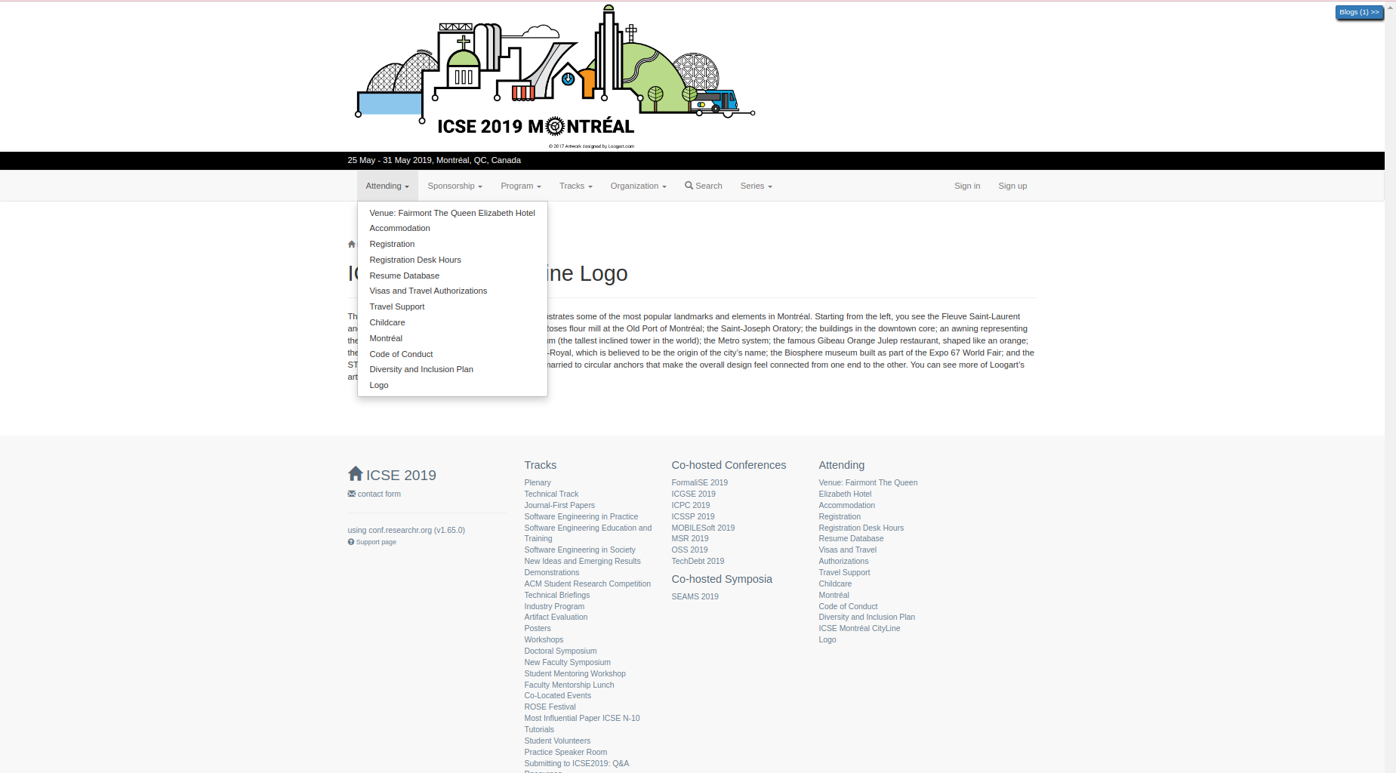
Action 1: Click on attending(After)
If Abi does the right thing, will s/he know that s/he did the right thing and is making progress toward their goal? Why?
Answer
Click here to view the full image

Slide 5
Action 2: Click on accommodation(Before)
Will ABI know what to do at this step and is the page good enough for abi to take this action? Why?
Answer
Click here to view the full image

Slide 6
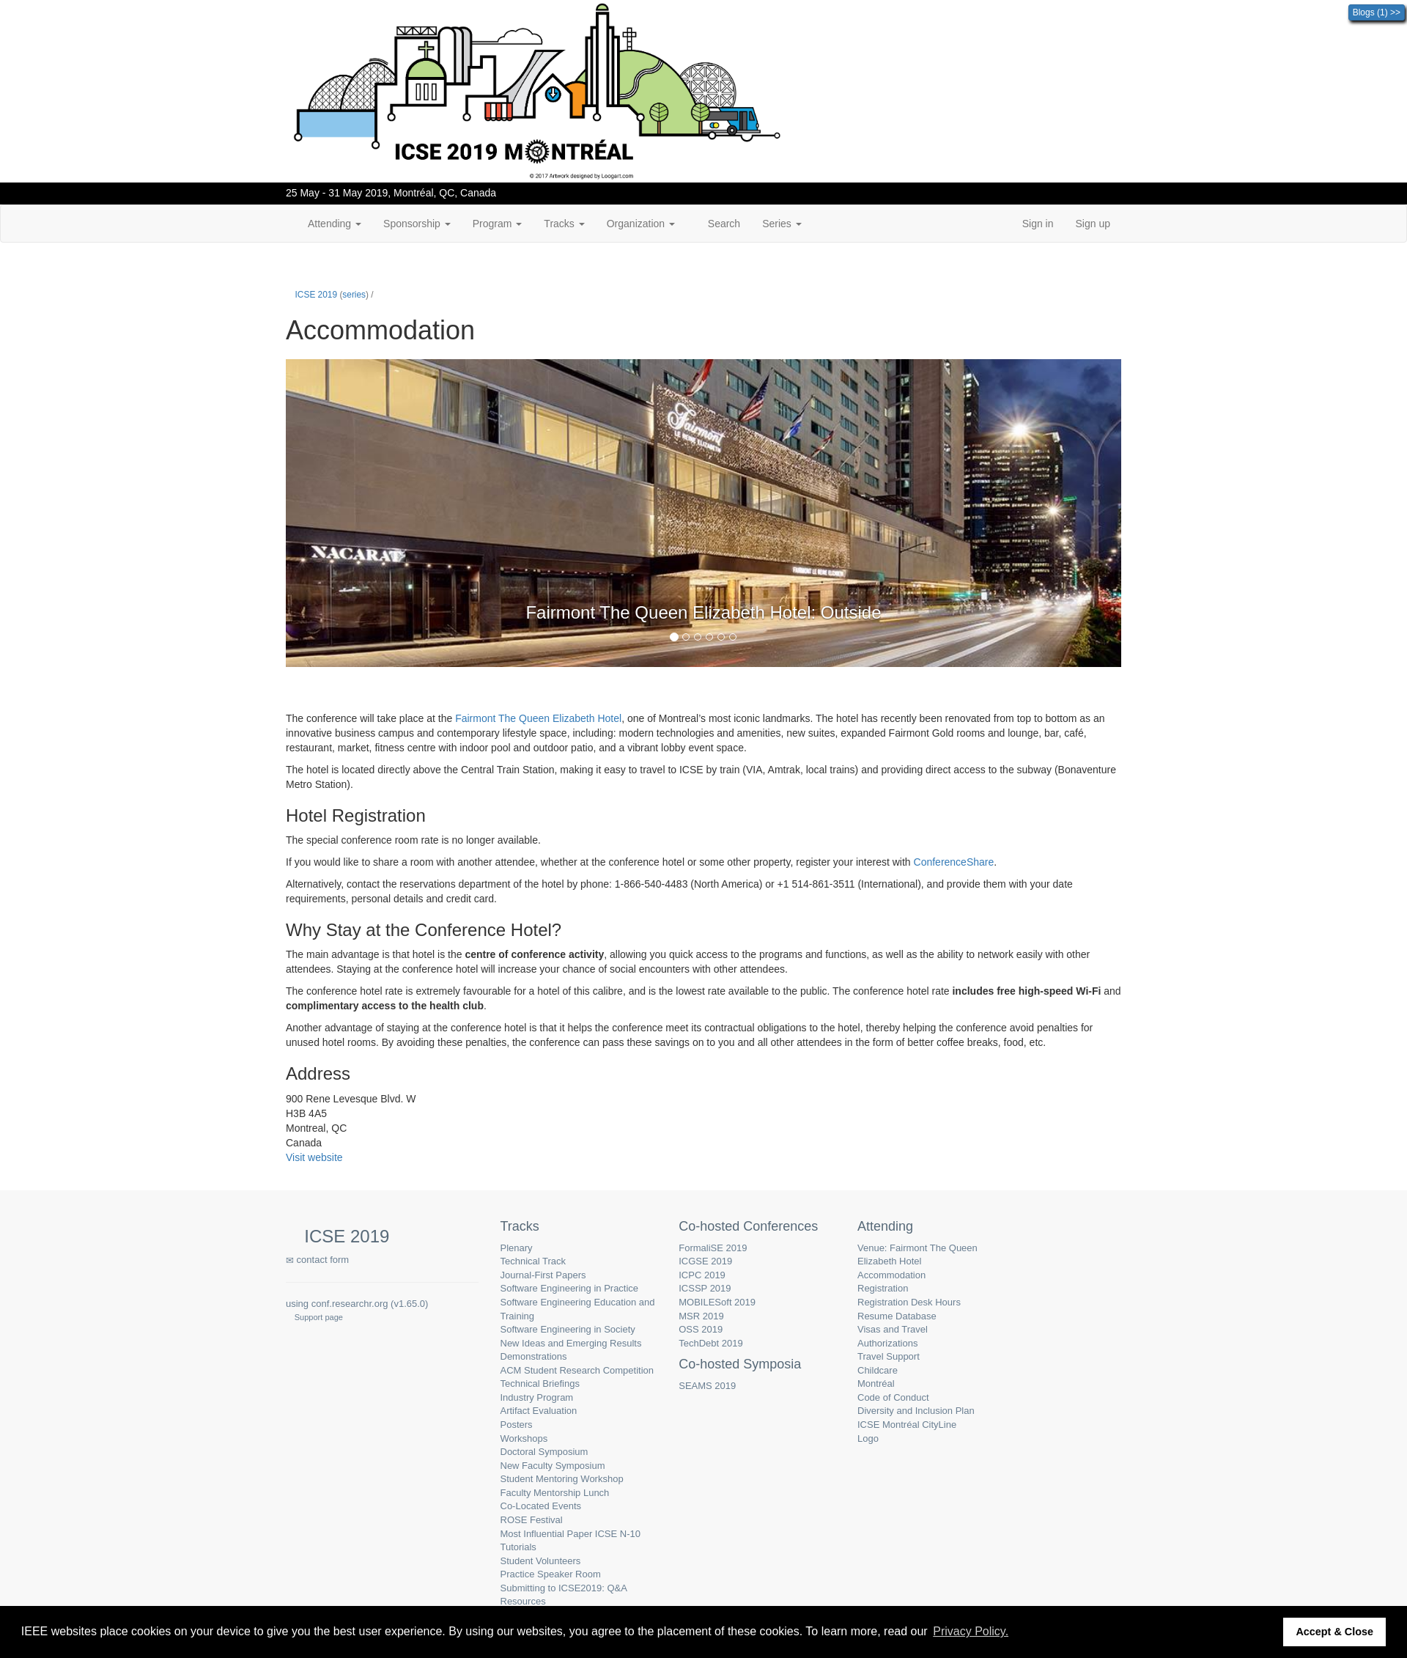
Action 2: Click on accommodation(After)
If Abi does the right thing, will s/he know that s/he did the right thing and is making progress toward their goal? Why?
Answer
Click here to view the full image

Slide 7
Action 3: Scroll(Before)
Will ABI know what to do at this step and is the page good enough for abi to take this action? Why?
Answer
Click here to view the full image

Slide 8
Action 3: Scroll(After)
If Abi does the right thing, will s/he know that s/he did the right thing and is making progress toward their goal? Why?
Answer
Click here to view the full image

Slide 9
Subgoal 2: How many days to stay at the conference
Will Abi have formed this sub-goal as a step to their overall goal?
Answer
Click here to view the full image

Slide 10
Action 1: Click on program(Before)
Will ABI know what to do at this step and is the page good enough for abi to take this action? Why?
Answer
Click here to view the full image

Slide 11
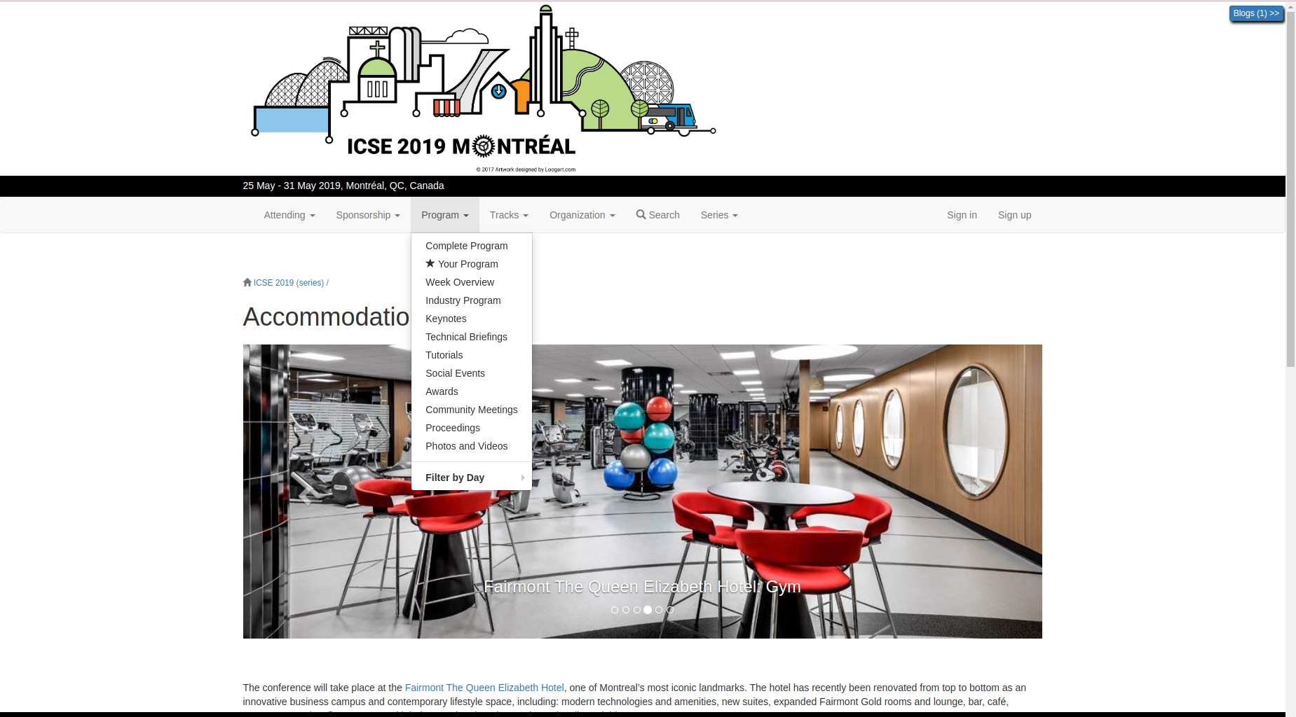
Action 1: Click on program(After)
If Abi does the right thing, will s/he know that s/he did the right thing and is making progress toward their goal? Why?
Answer
Click here to view the full image

Slide 12
Action 2: Click Week overview(Before)
Will ABI know what to do at this step and is the page good enough for abi to take this action? Why?
Answer
Click here to view the full image

Slide 13
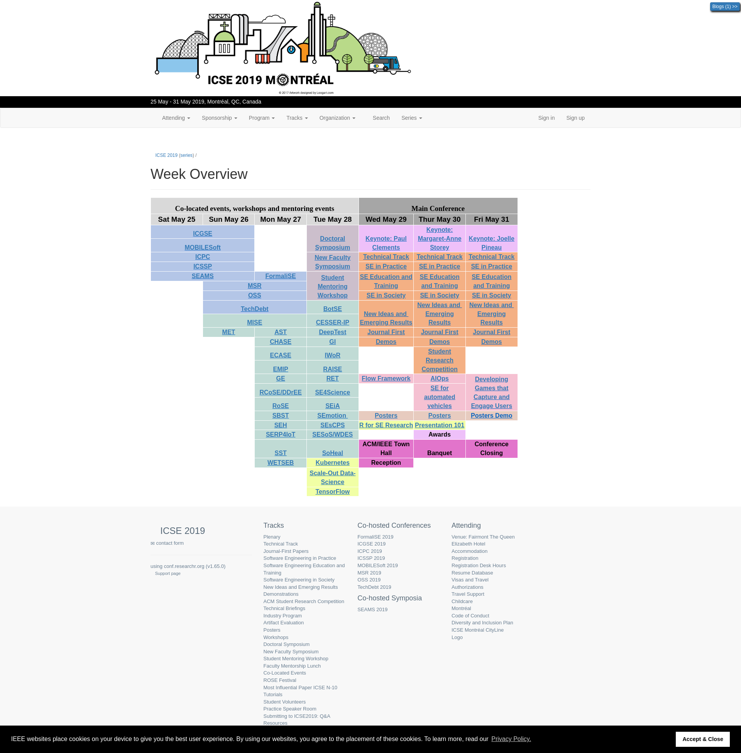
Action 2: Click Week overview(After)
If Abi does the right thing, will s/he know that s/he did the right thing and is making progress toward their goal? Why?
Answer
Click here to view the full image

Slide 14
Action 3: Go up the page and click on tracks(Before)
Will ABI know what to do at this step and is the page good enough for abi to take this action? Why?
Answer
Click here to view the full image

Slide 15
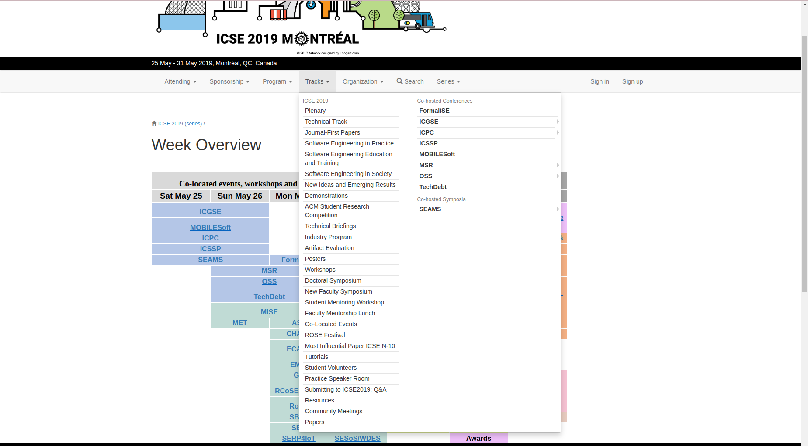
Action 3: Go up the page and click on tracks(After)
If Abi does the right thing, will s/he know that s/he did the right thing and is making progress toward their goal? Why?
Answer
Click here to view the full image

