Slide 1
PITTSBURG
Find an issue for new comer to work on

Slide 2
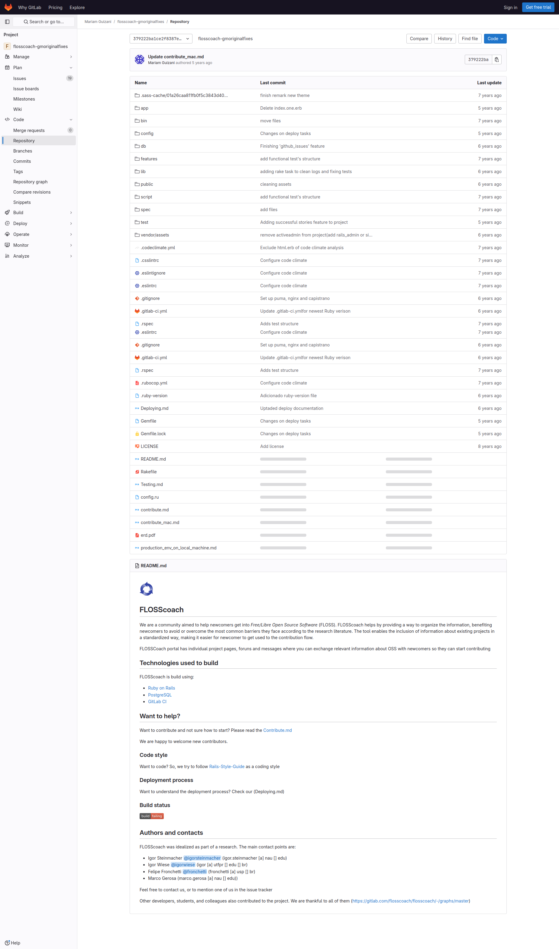
Subgoal 1: Find list of issues/where issues are
Will Abi have formed this sub-goal as a step to their overall goal?
Answer
Click here to view the full image

Slide 3
Action 1: Scroll down the webpage(Before)
Will ABI know what to do at this step and is the page good enough for abi to take this action? Why?
Answer
Click here to view the full image

Slide 4
Action 1: Scroll down the webpage(After)
If Abi does the right thing, will s/he know that s/he did the right thing and is making progress toward their goal? Why?
Answer
Click here to view the full image

Slide 5
Action 2: Click on the issue icon on the left side(Before)
Will ABI know what to do at this step and is the page good enough for abi to take this action? Why?
Answer
Click here to view the full image

Slide 6
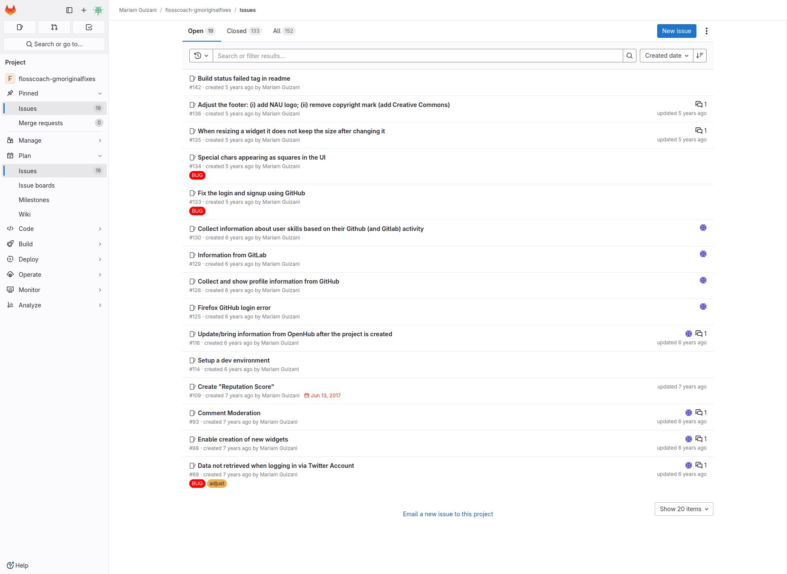
Action 2: Click on the issue icon on the left side(After)
If Abi does the right thing, will s/he know that s/he did the right thing and is making progress toward their goal? Why?
Answer
Click here to view the full image

Slide 7
Subgoal 2: Selecting an issue to work on
Will Abi have formed this sub-goal as a step to their overall goal?
Answer
Click here to view the full image

Slide 8
Action 1: Read through the list(Before)
Will ABI know what to do at this step and is the page good enough for abi to take this action? Why?
Answer
Click here to view the full image

Slide 9
Action 1: Read through the list(After)
If Abi does the right thing, will s/he know that s/he did the right thing and is making progress toward their goal? Why?
Answer
Click here to view the full image

Slide 10
Action 2: Select/click on an issue(Before)
Will ABI know what to do at this step and is the page good enough for abi to take this action? Why?
Answer
Click here to view the full image

Slide 11
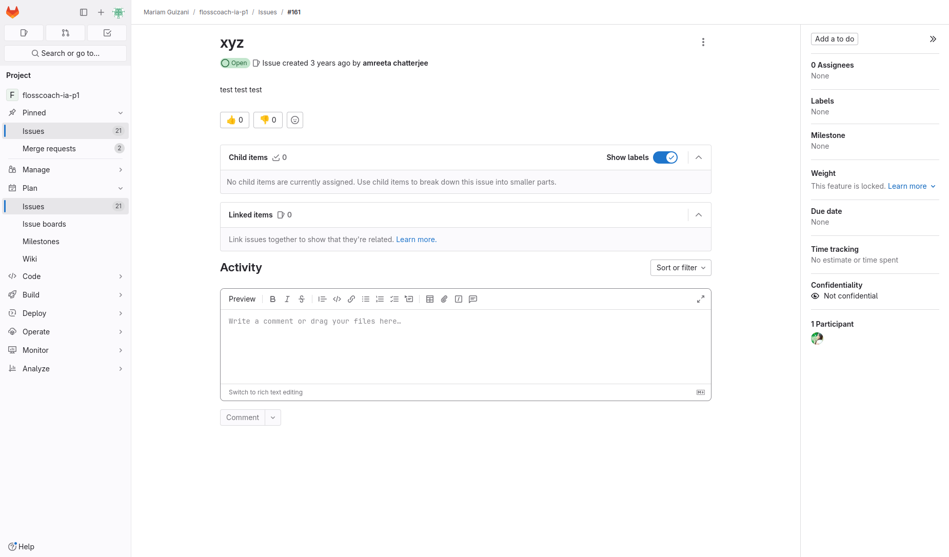
Action 2: Select/click on an issue(After)
If Abi does the right thing, will s/he know that s/he did the right thing and is making progress toward their goal? Why?
Answer
Click here to view the full image

