Slide 1
POMPANO
Abi (is Chinese citizen, lives in US (NOT a permanent resident)) has decided to go to ICSE and is looking into Travel Visa stuff now

Slide 2
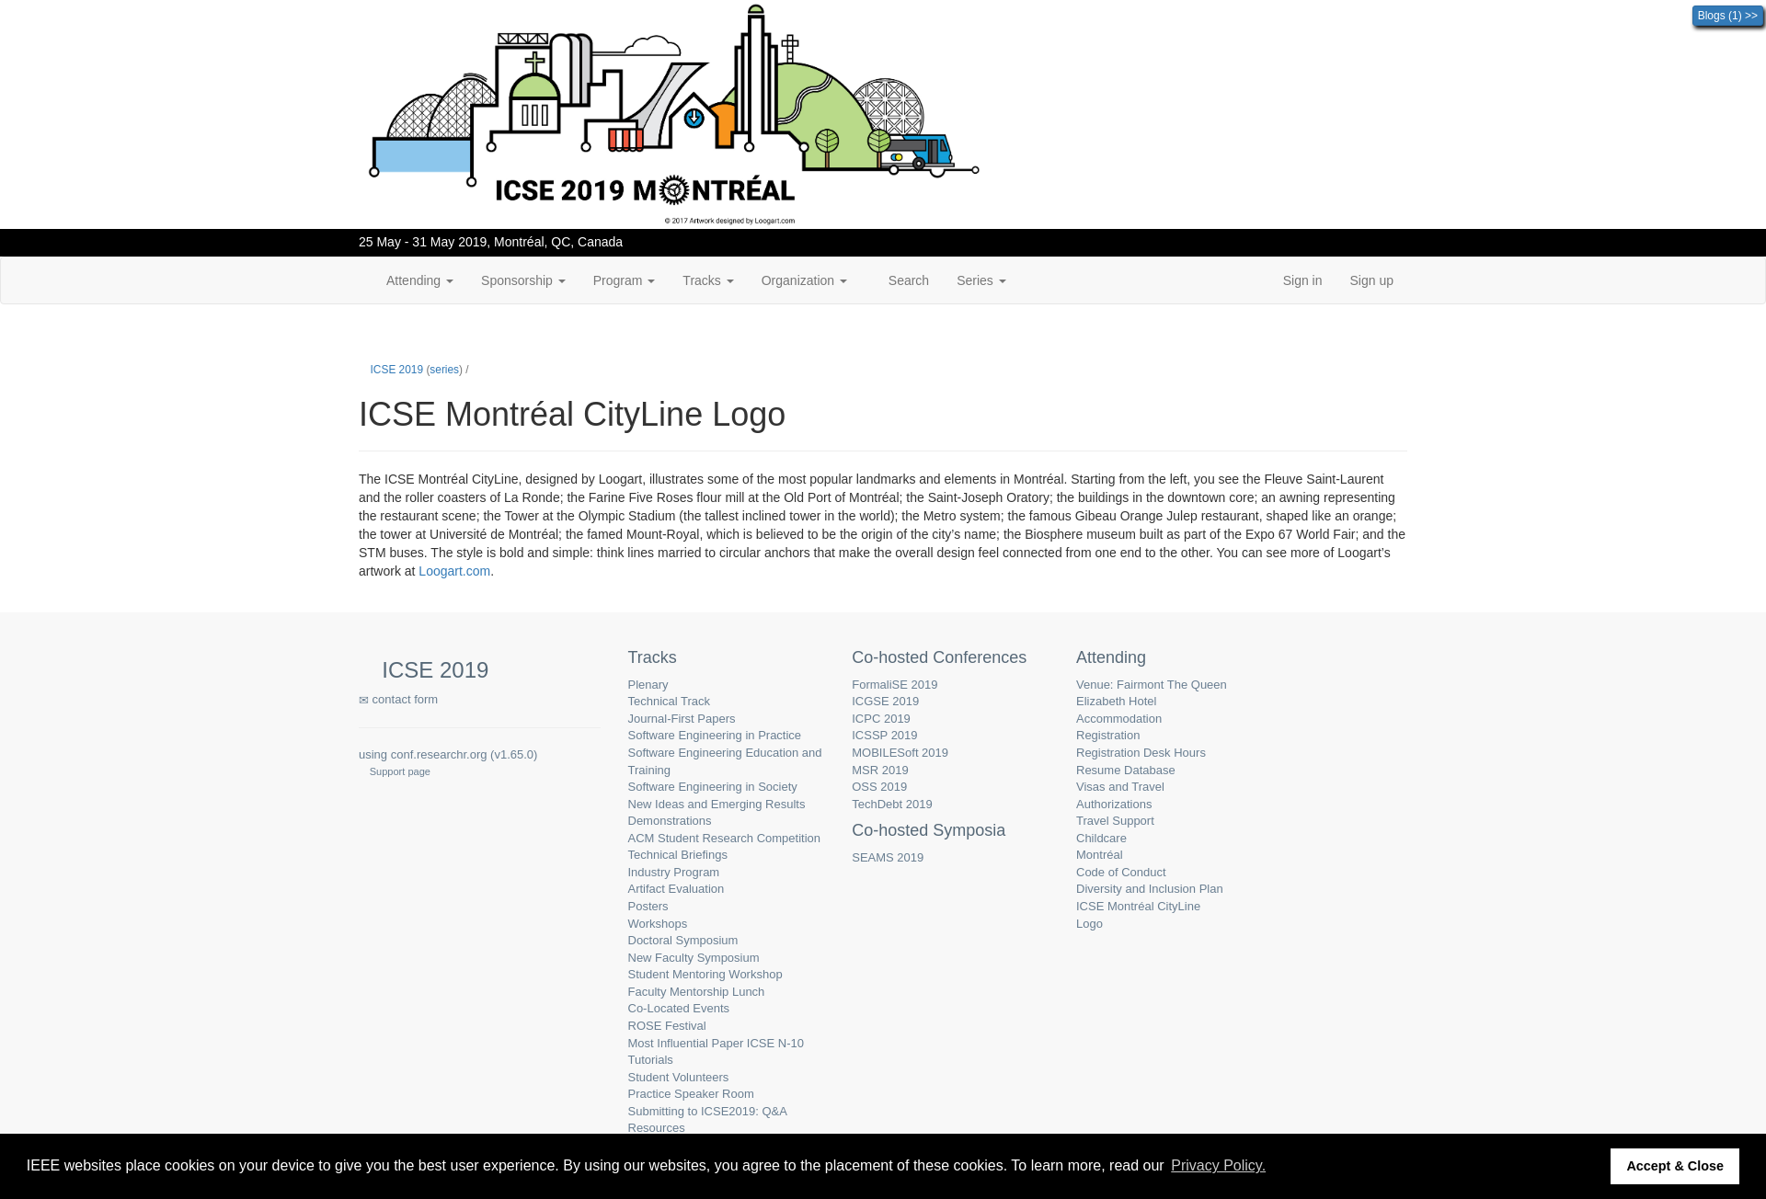
Subgoal 1: Look for visa information in the conference website
Will Abi have formed this sub-goal as a step to their overall goal?
Answer
Click here to view the full image

Slide 3
Action 1: Click attending(Before)
Will ABI know what to do at this step? Why?
Answer
Click here to view the full image

Slide 4
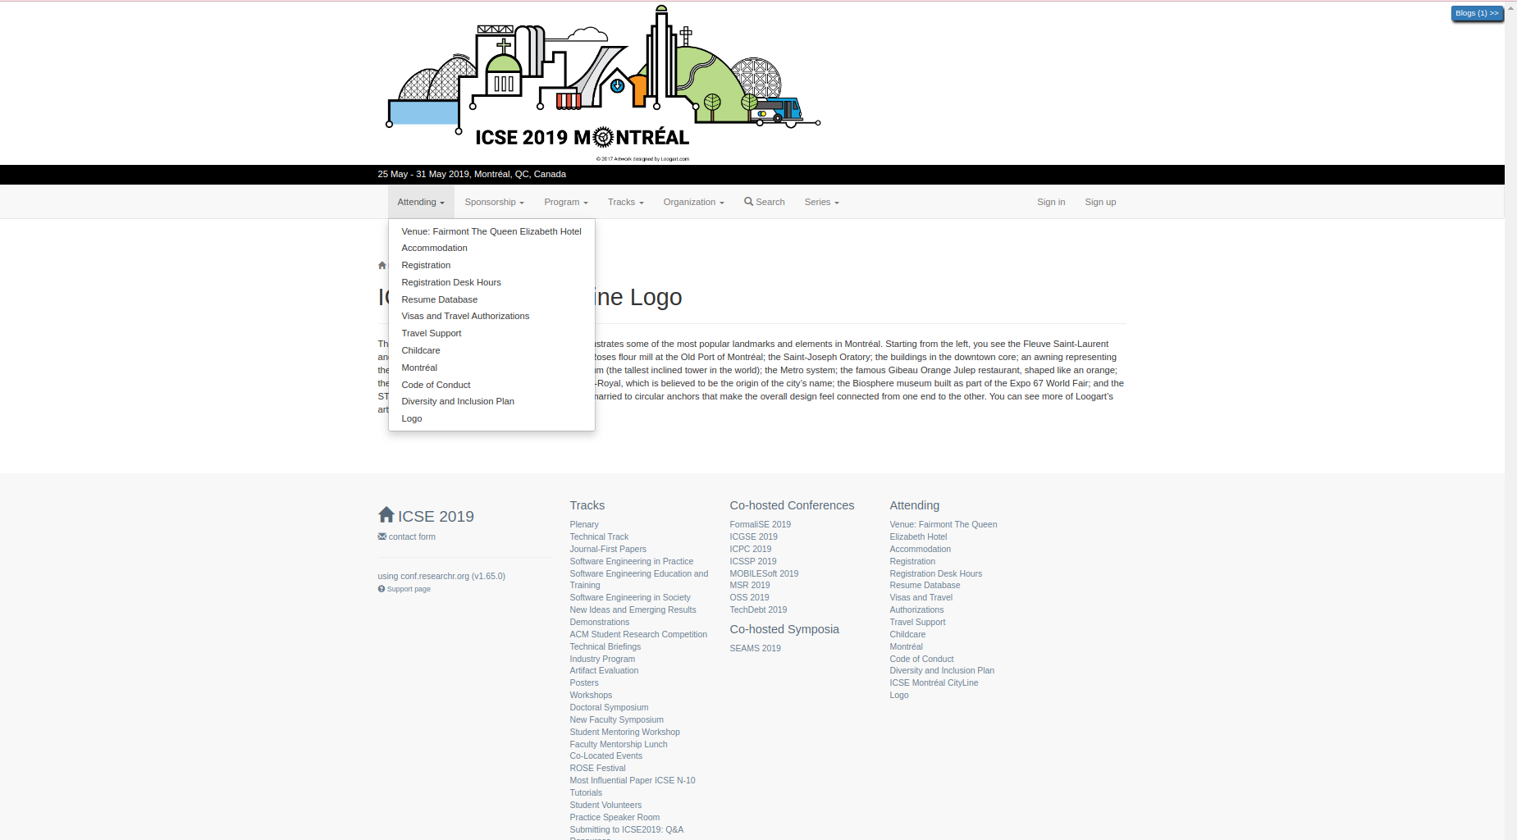
Action 1: Click attending(After)
If Abi does the right thing, will s/he know that s/he did the right thing and is making progress toward their goal? Why?
Answer
Click here to view the full image

Slide 5
Action 2: Click on Visa(Before)
Will ABI know what to do at this step? Why?
Answer
Click here to view the full image

Slide 6
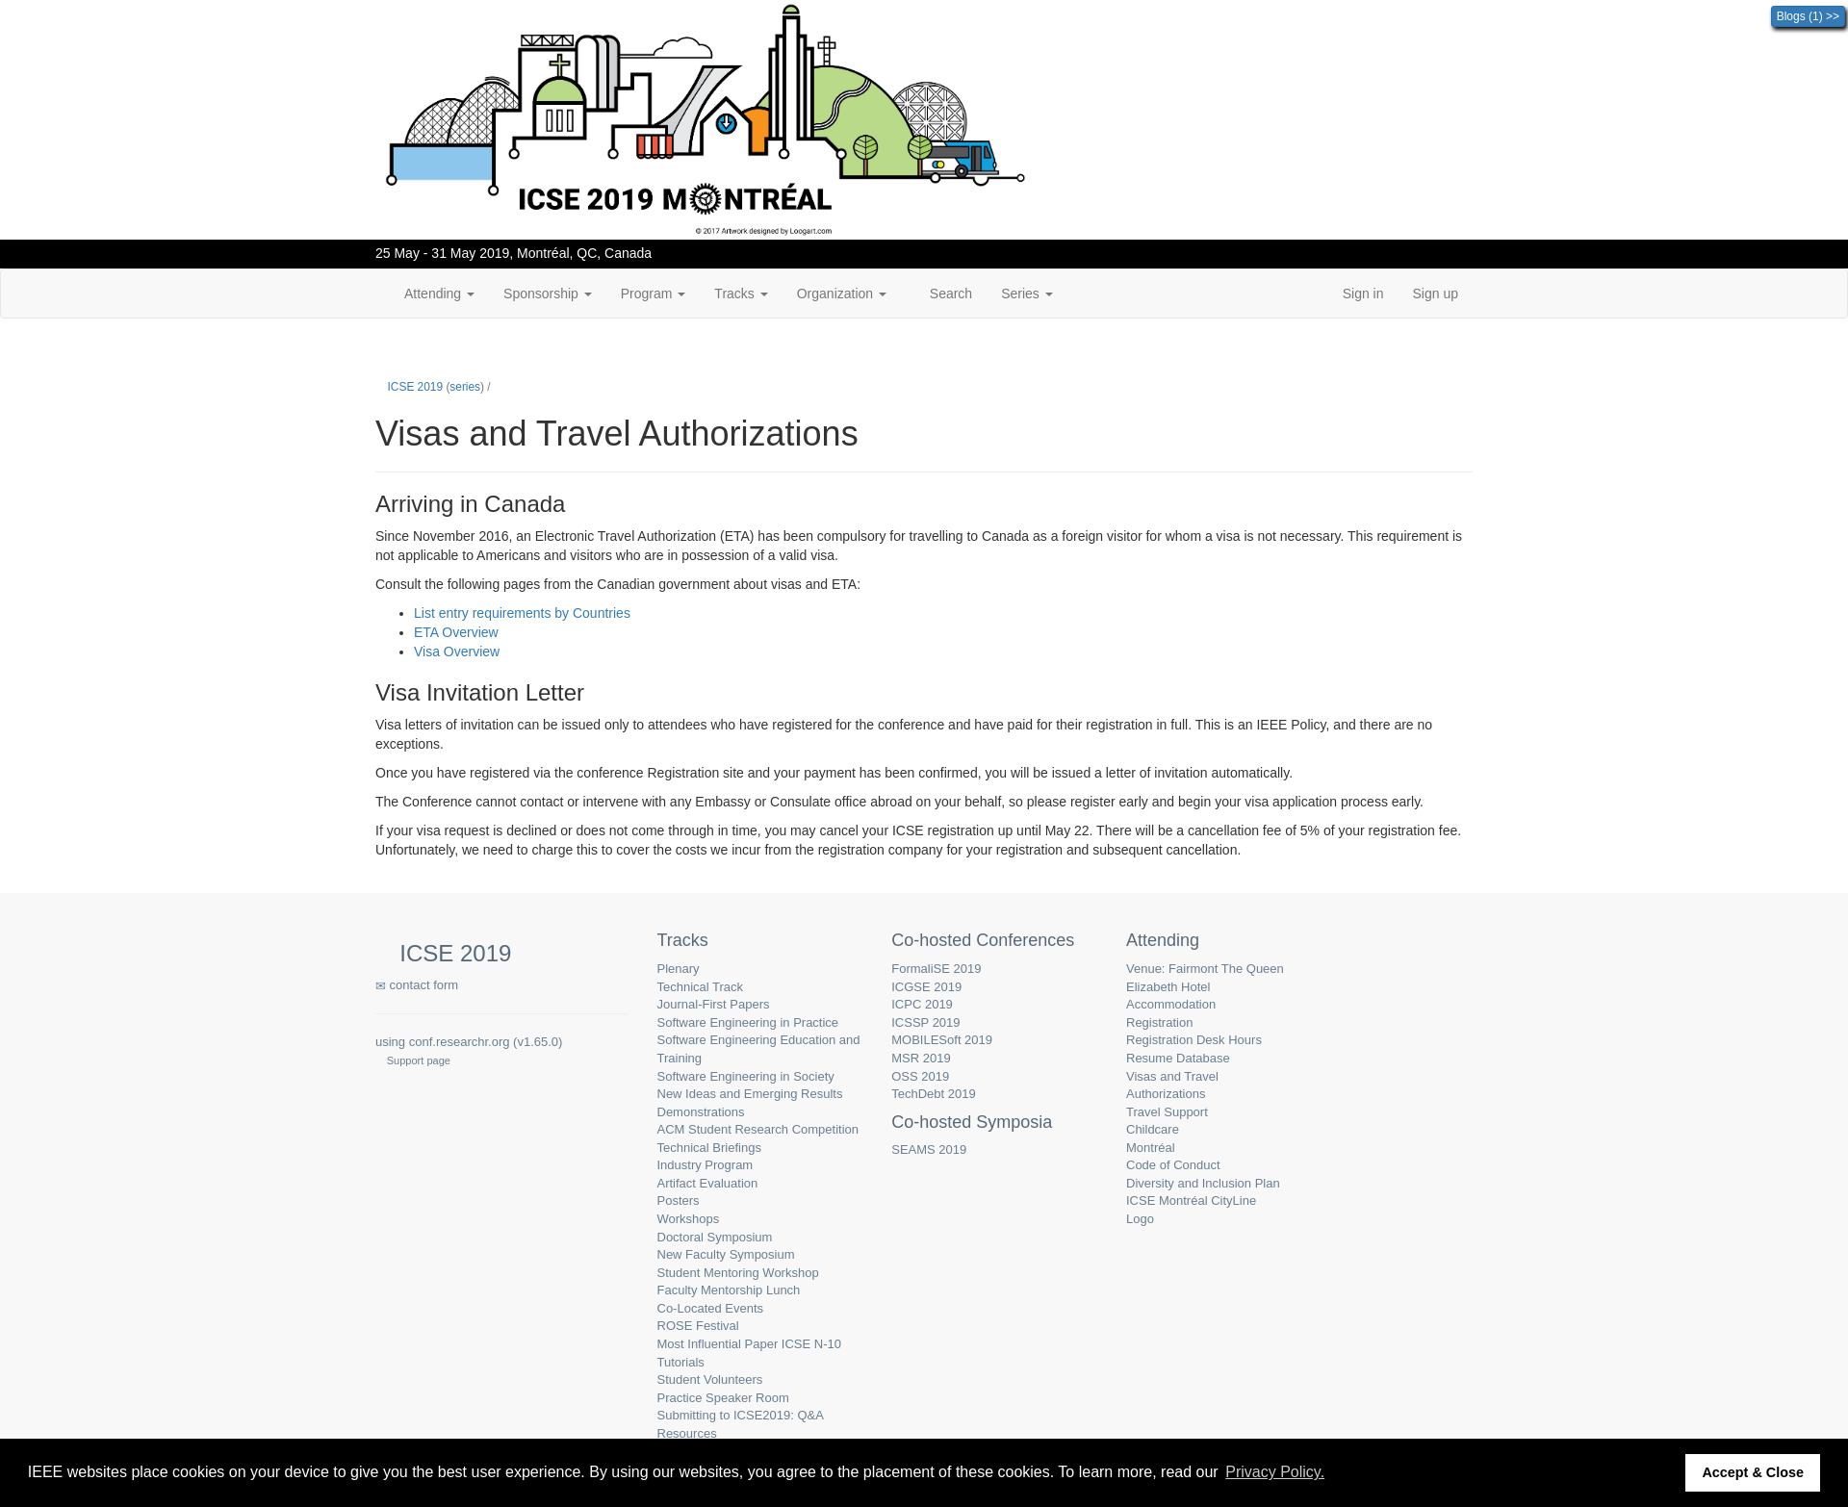
Action 2: Click on Visa(After)
If Abi does the right thing, will s/he know that s/he did the right thing and is making progress toward their goal? Why?
Answer
Click here to view the full image

Slide 7
Action 3: Click on Visa Overview(Before)
Will ABI know what to do at this step? Why?
Answer
Click here to view the full image

Slide 8
Action 3: Click on Visa Overview(After)
If Abi does the right thing, will s/he know that s/he did the right thing and is making progress toward their goal? Why?
Answer
Click here to view the full image

