Slide 1
RALEIGH
Set up the environment

Slide 2
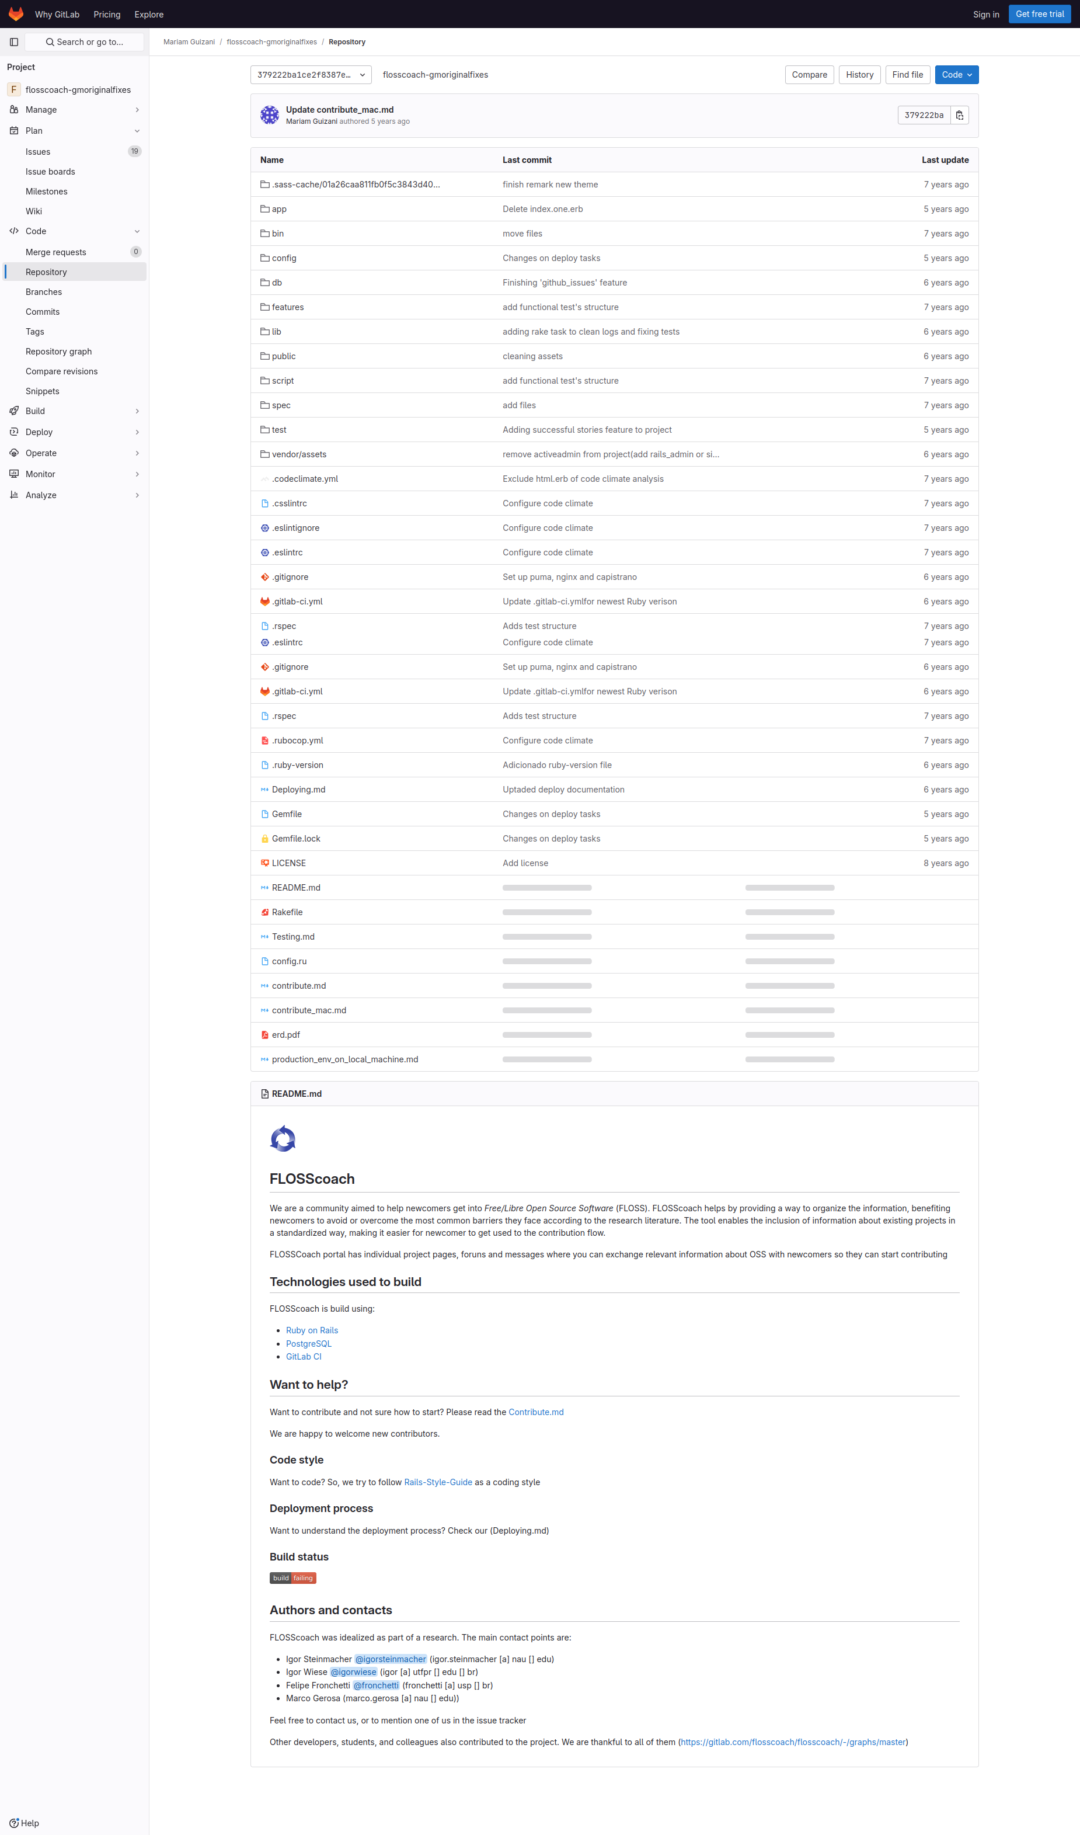
Subgoal 1: Gather more information on setting up the environment
Will Abi have formed this sub-goal as a step to their overall goal?
Answer
Click here to view the full image

Slide 3
Action 1: Scrolling to find information about this subgoal(Before)
Will ABI know what to do at this step and is the page good enough for abi to take this action? Why?
Answer
Click here to view the full image

Slide 4
Action 1: Scrolling to find information about this subgoal(After)
If Abi does the right thing, will s/he know that s/he did the right thing and is making progress toward their goal? Why?
Answer
Click here to view the full image

