Slide 1
ROME
File an issue to have a merge request template

Slide 2
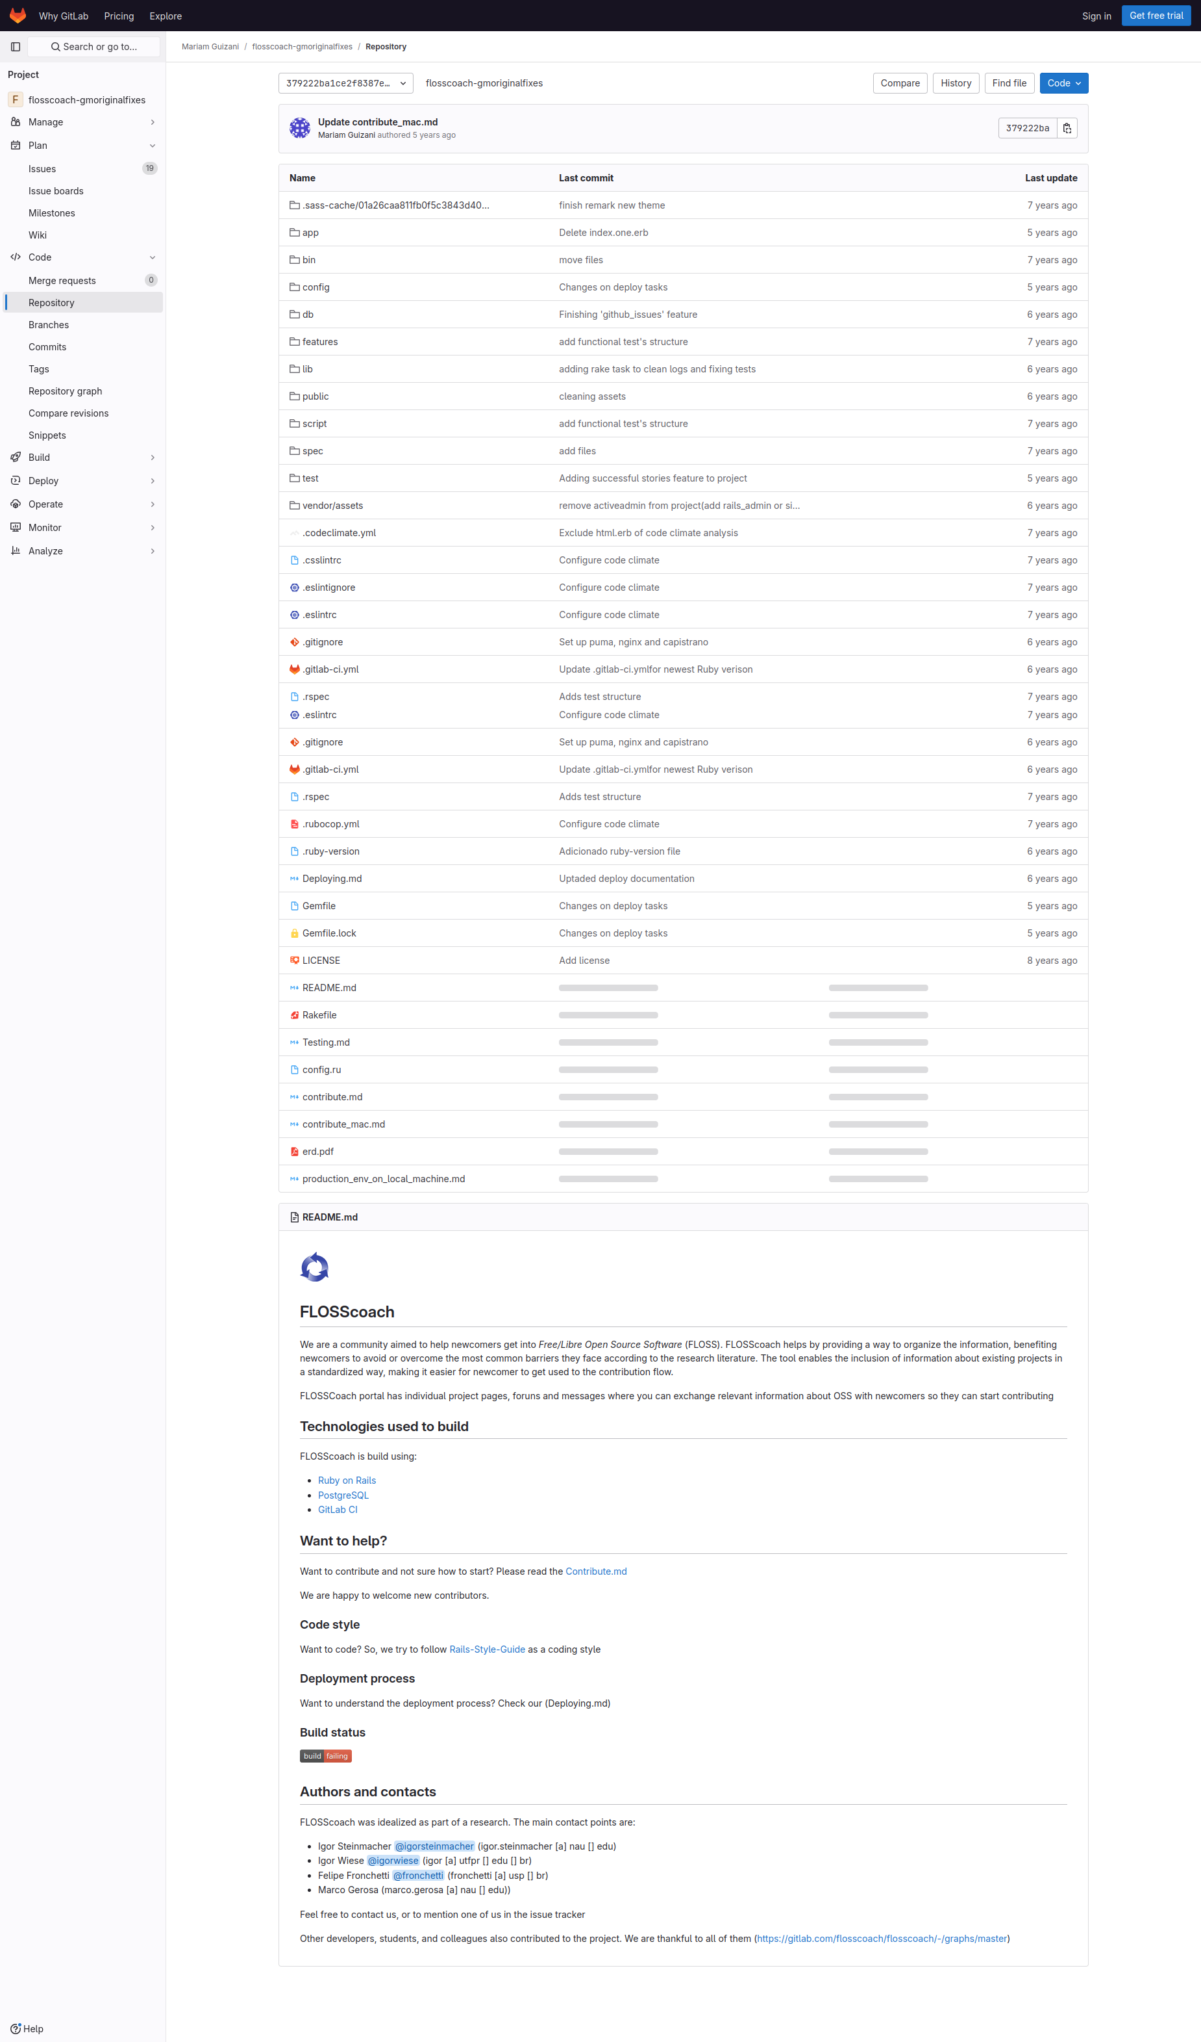
Subgoal 1: Find information about how to file an issue
Will Abi have formed this sub-goal as a step to their overall goal?
Answer
Click here to view the full image

Slide 3
Action 1: Read the readme(Before)
Will ABI know what to do at this step and is the page good enough for abi to take this action? Why?
Answer
Click here to view the full image

Slide 4
Action 1: Read the readme(After)
If Abi does the right thing, will s/he know that s/he did the right thing and is making progress toward their goal? Why?
Answer
Click here to view the full image

Slide 5
Action 2: Click on the contribute.md(Before)
Will ABI know what to do at this step and is the page good enough for abi to take this action? Why?
Answer
Click here to view the full image

Slide 6
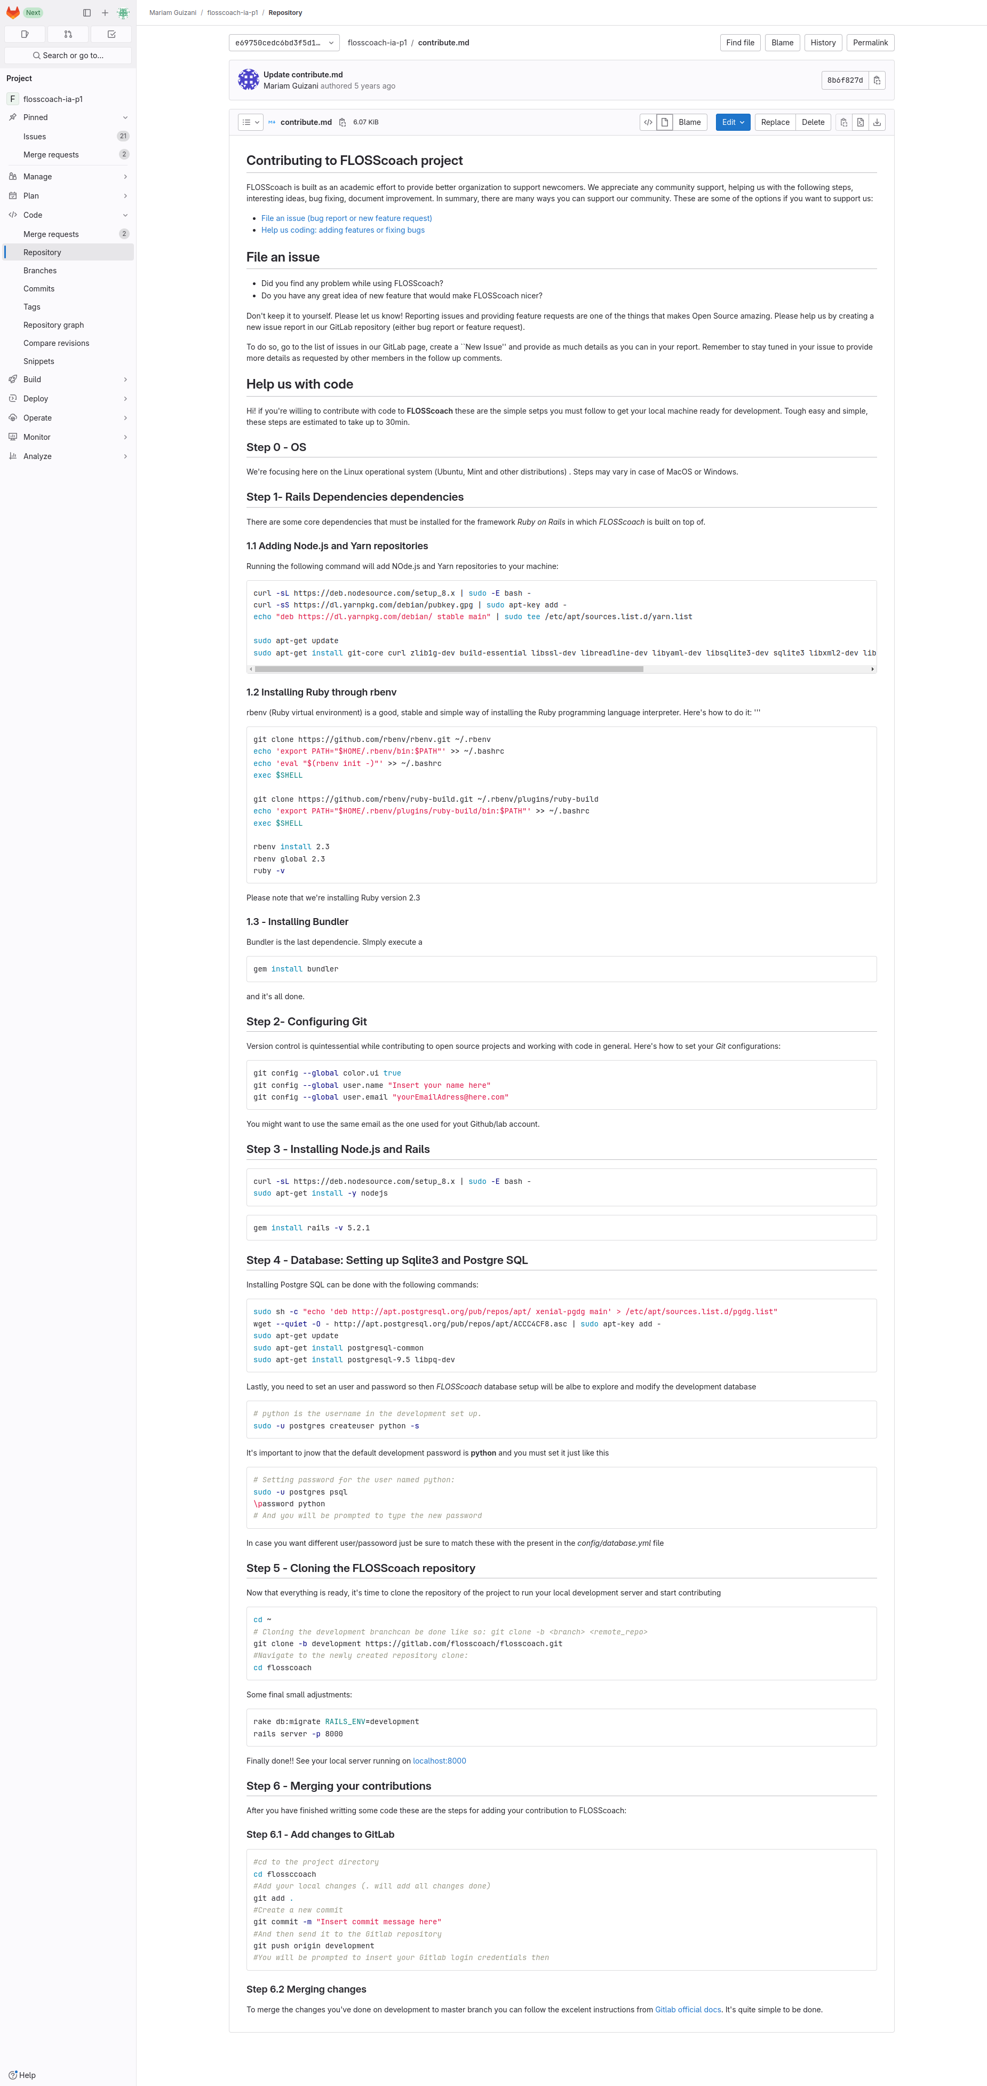
Action 2: Click on the contribute.md(After)
If Abi does the right thing, will s/he know that s/he did the right thing and is making progress toward their goal? Why?
Answer
Click here to view the full image

Slide 7
Subgoal 2: File the issue
Will Abi have formed this sub-goal as a step to their overall goal?
Answer
Click here to view the full image

Slide 8
Action 1: Go to the list of issues(Before)
Will ABI know what to do at this step and is the page good enough for abi to take this action? Why?
Answer
Click here to view the full image

Slide 9
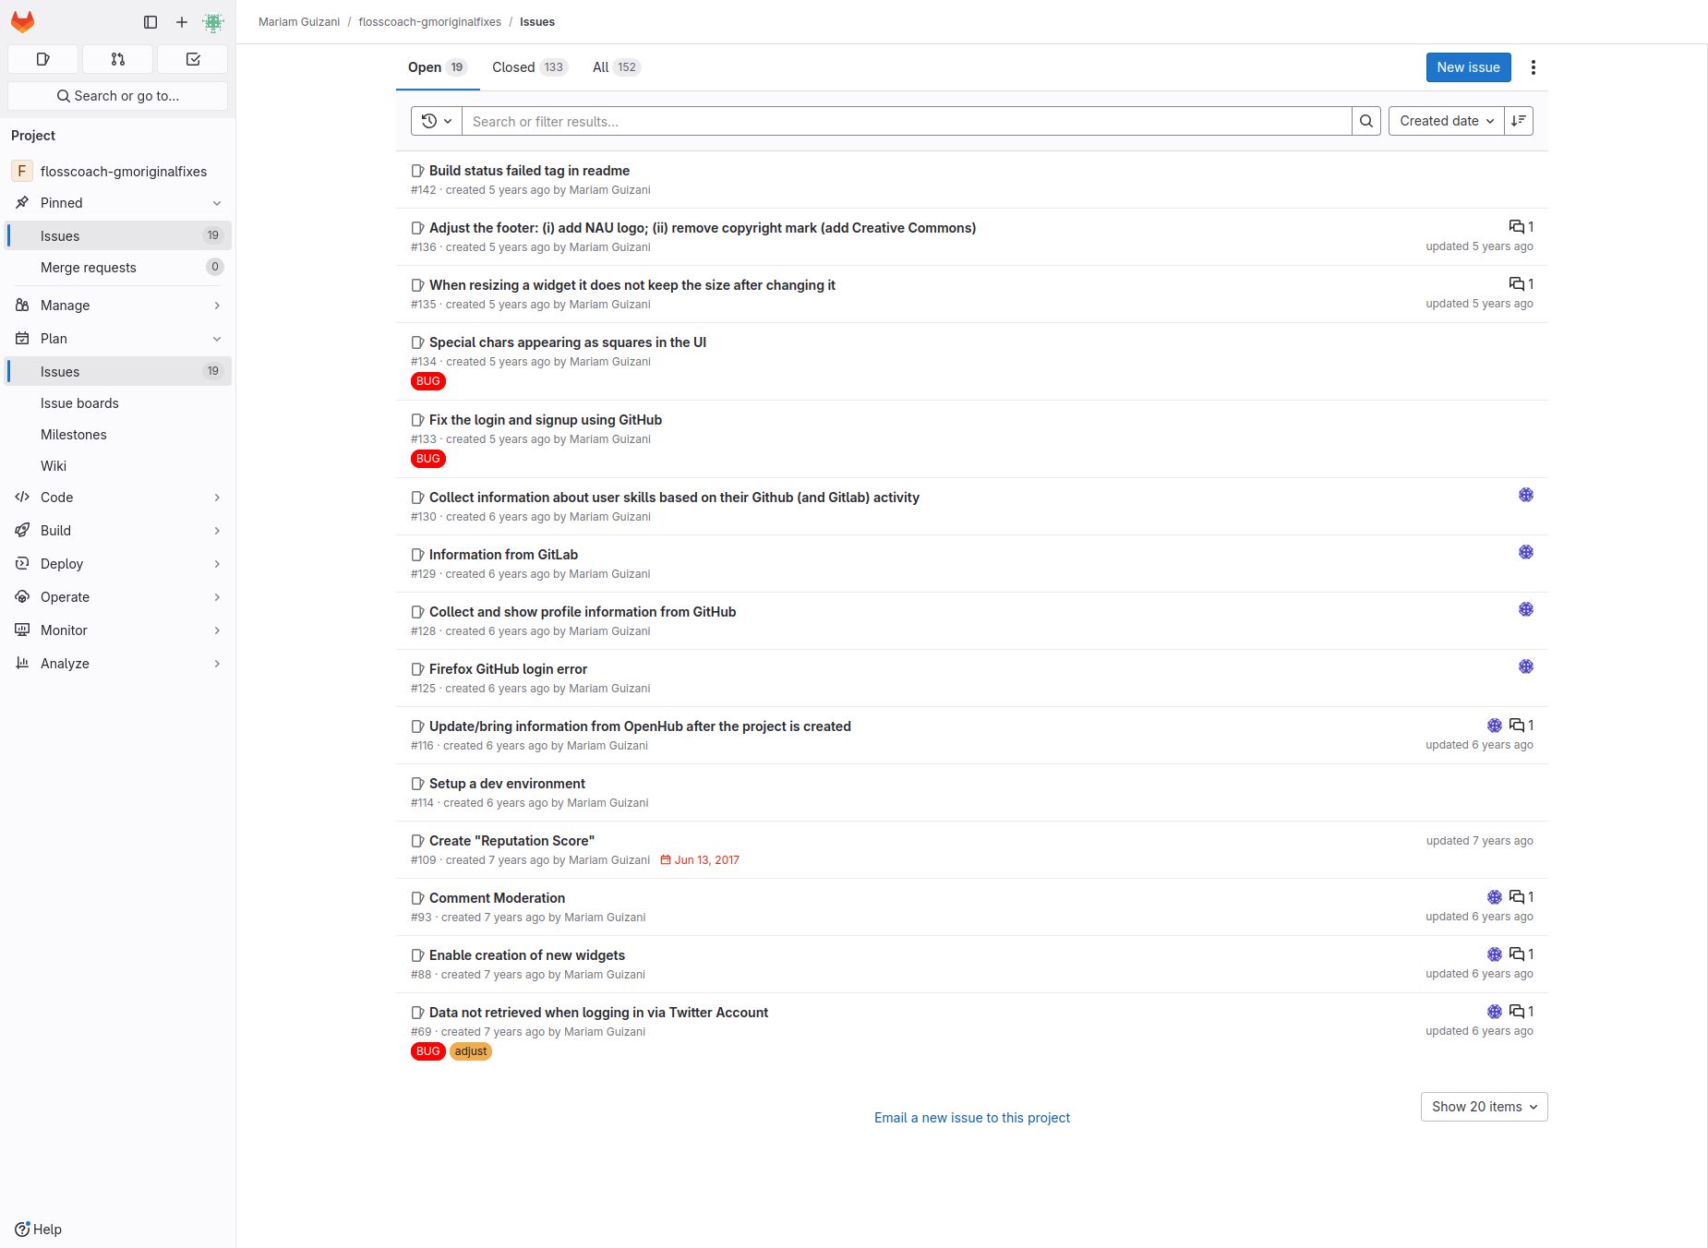
Action 1: Go to the list of issues(After)
If Abi does the right thing, will s/he know that s/he did the right thing and is making progress toward their goal? Why?
Answer
Click here to view the full image

Slide 10
Action 2: Click 'new issue'(Before)
Will ABI know what to do at this step and is the page good enough for abi to take this action? Why?
Answer
Click here to view the full image

Slide 11
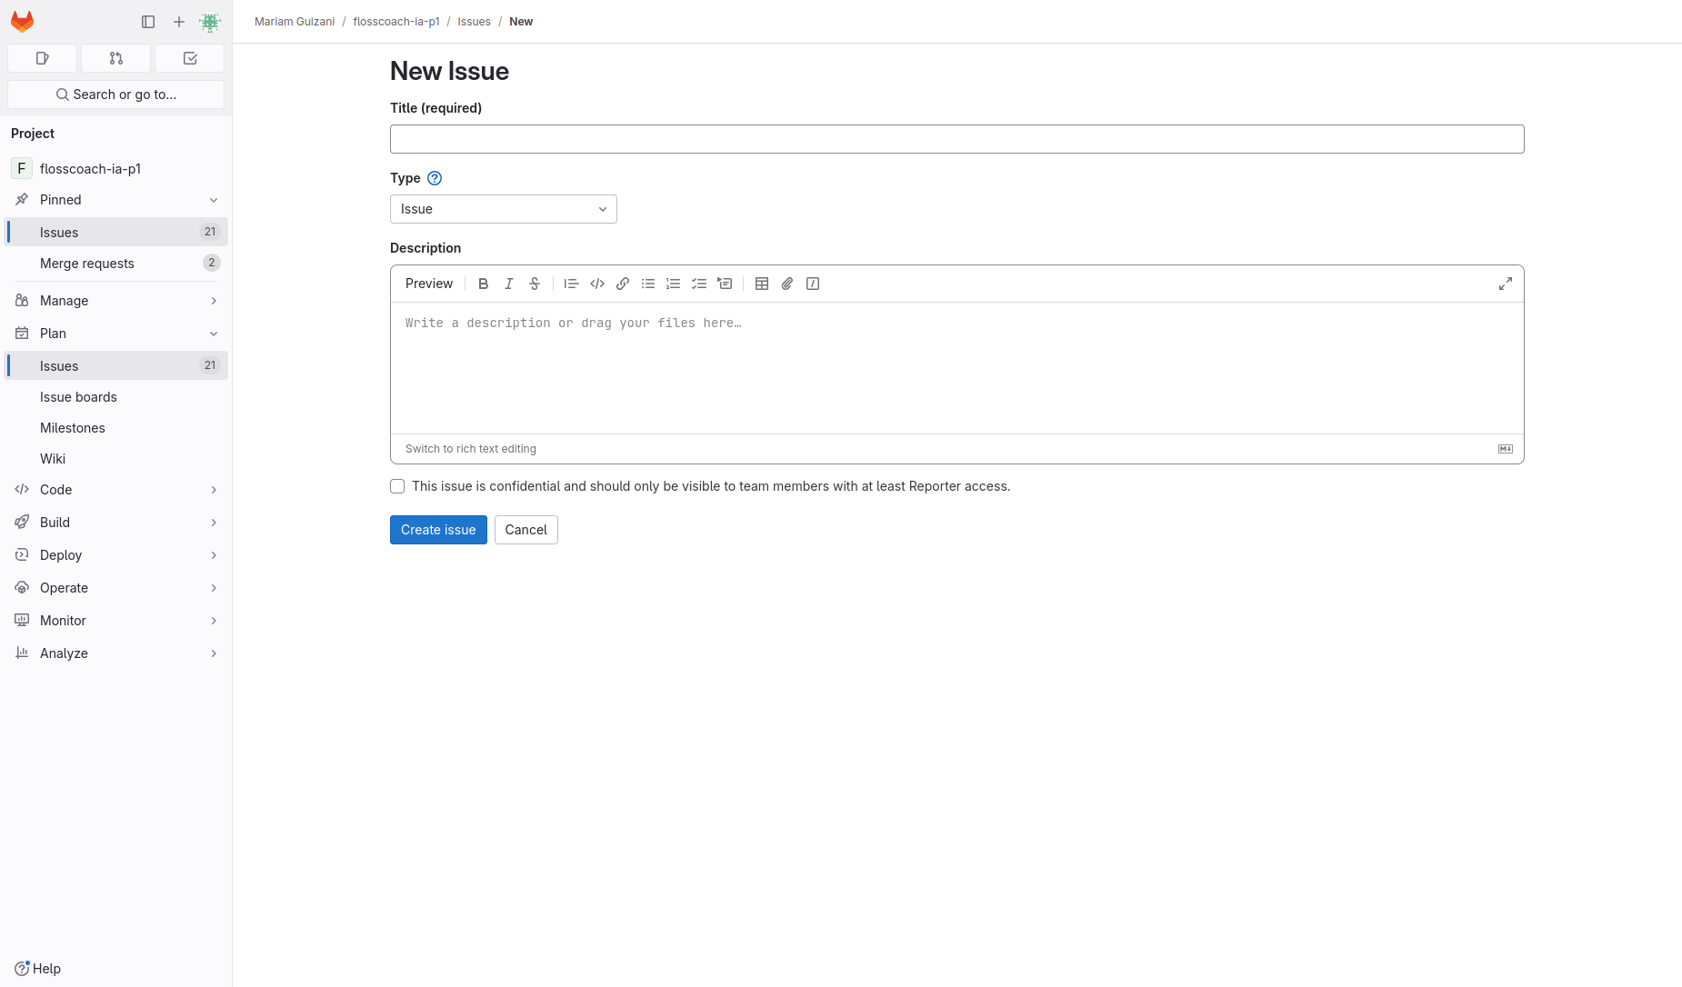
Action 2: Click 'new issue'(After)
If Abi does the right thing, will s/he know that s/he did the right thing and is making progress toward their goal? Why?
Answer
Click here to view the full image

Slide 12
Action 3: Fill out the form and submit the issue(Before)
Will ABI know what to do at this step and is the page good enough for abi to take this action? Why?
Answer
Click here to view the full image

Slide 13
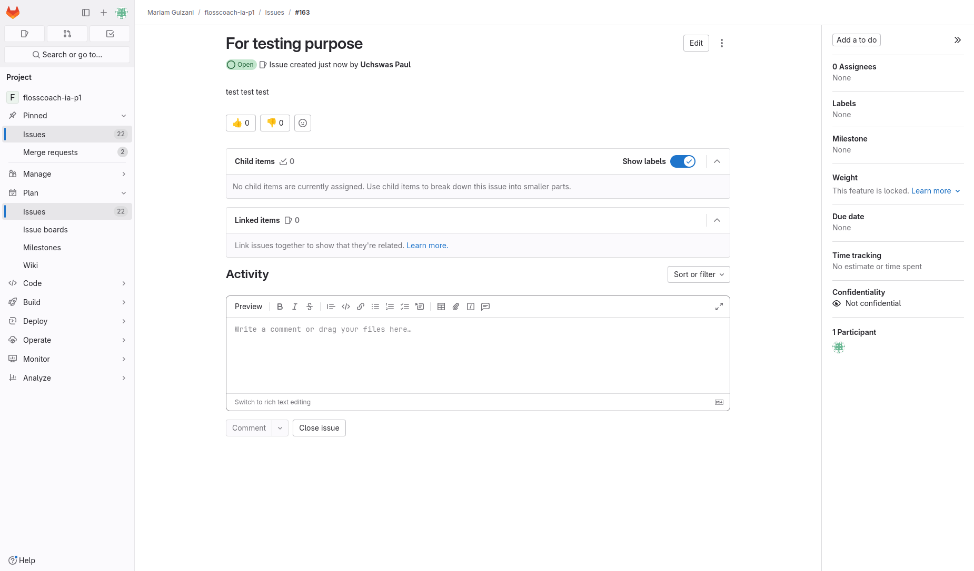
Action 3: Fill out the form and submit the issue(After)
If Abi does the right thing, will s/he know that s/he did the right thing and is making progress toward their goal? Why?
Answer
Click here to view the full image

