Slide 1
EthicAL IsSUES ABOUT Abortion
Presented by:
Odenigbo Uchechukwu Cynthia
Ogunrinde Raimot Oluwapelumi
Godswill Emmanuel Inyang
Uzoma Mmesomachukwu Nneoma

Slide 2
Introduction
It is estimated that about 56 million abortions are performed yearly worldwide making it a perennial problem among scholars especially in the field of bio-ethics. While some consider it as a grave evil to be avoided, others see it as an exercise of human right. One major point of disagreement is when human life starts. And until this controversy is addressed, the debate will be endless.
In this presentation, we shall discuss the concept of abortion and a case study on abortion.

Slide 3
Definition
The term abortion is derived from the Latin word aboriri, ‘to perish’. In simple terms, abortion refers to an induced procedure at any point during human pregnancy.
Abortion could simply be taken to be the termination of pregnancy or the expulsion of the fetus from the uterus before it is viable, that is before it can live outside the uterus, resulting in its death.

Slide 4
Hungarian Policy on Abortion
Introduced in 1992, allow the termination of a pregnancy up until the 12th week under the following circumstances:
If the woman’s health is in danger
If the pregnancy is the result of rape
If the fetus has a serious health impairment (mental or physical)
If the woman is in a ‘grave crisis situation’
The deadline can be extended until the 18th week if the woman is under guardianship or if the woman was previously not aware of her pregnancy because of a medical condition or due to an institution’s mistake. The pregnancy can be terminated at any time if it puts the woman’s life in danger or if the fetus is lethally affected.

Slide 5
Case Study
For months, doctors told eleven-year-old Vesna (as we’ll call her) and her parents that her abdominal pains were nothing but indigestion. Then after some time in July, the truth finally emerged—Vesna was twenty-seven weeks pregnant.
Vesna's family had emigrated from India to the Detroit suburb of Sterling Heights, Michigan, only the previous summer. Her parents found factory jobs and rented a two-bedroom apartment, and Vesna shared one of the rooms with Hari, her sixteen-year-old brother. Sometime during the winter after their arrival in the United States, Vesna told her parents that Hari had raped her, but this emerged only after Vesna, who had turned twelve, was found to be pregnant.
As soon as Vesna’s parents learned her condition, they made plans to take her to Kansas for an abortion. Vesna would have to have a late-term abortion, and because Michigan law bans almost all abortions after twenty-four weeks, her family would have to take her out of state. But their plans were frustrated when they were leaked to a family court judge. Charges of parental negligence were filed by prosecutors against her parents, and the court immediately removed Vesna from her family and made her a ward of the state.

Slide 6
At a court hearing, Vesna's doctor argued that if her pregnancy were allowed to continue, it could cause her both physical and psychological damage. A psychologist testified that because Vesna was a Hindu, if she were forced to have an illegitimate child, it would make her unfit for marriage by another Hindu. Her parents also expressed their worry that if Vesna had a child, the child might suffer from genetic abnormalities and might be mentally retarded, because her brother was the father.
At the end of the hearing the prosecution announced it was convinced pregnancy might endanger Vesna's life and dropped the negligence charge against her parents. Visna was reunited with her family, and her parents pursued their original plan of taking her to Kansas. In Wichita, Dr. George Tiller, who had been shot in 1993 by a pro-life activist, stopped the fetus’s heart and used drugs to induce labor, thus performing a “partial-birth” abortion.

Slide 7
Bioethical Decision Model
Review
Review the situation to determine health problems, decision needs, ethical components, and key individuals.
Gather
Gather additional information to clarify the situation
Identify
Identify the ethical issues in the situation.
Define
Define personal and professional moral positions.
Identify
Identify moral positions of key individuals involved
Identify
Identify value conflicts, if any
Determine
Determine who should make the decision
Identify
Identify range of actions with anticipated outcomes.
Decide on
Decide on a course of action and carry it out.
Evaluate / review
Evaluate / review results of decision / action

Slide 8
Conclusion
At the end, the patient’s health is the priority and according to WHO, health is a state of complete physical, mental and social well-being and not merely the absence of disease or infirmity.

Slide 9
Reference
https://pubmed.ncbi.nlm.nih.gov/7041095/
https://www.qcc.cuny.edu/socialsciences/ppecorino/medical_ethics_text/chapter_8_abortion/Decision_Scenarios.htm
Major, Brenda, et al. “Abortion and Mental Health: Evaluating the Evidence.” American Psychological Association, doi:10.1037/a0017497
https://www.who.int/data/gho/data/major-themes/health-and-well-being

Slide 10
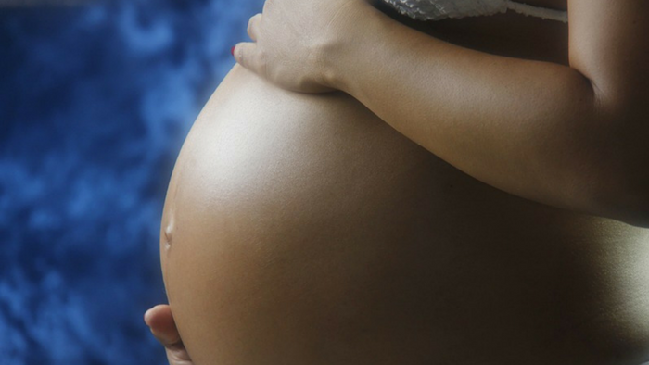
Thank you for your attention

