Slide 1


Slide 2
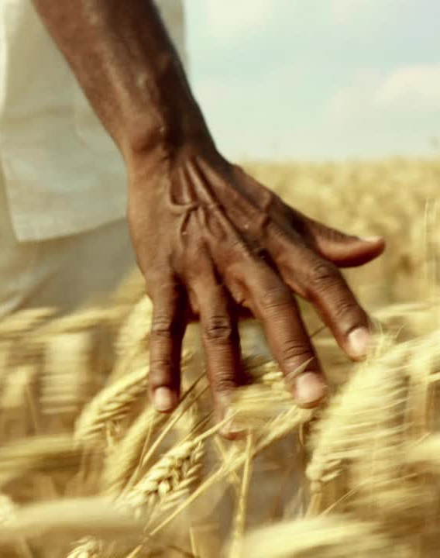
Despite being the backbone of our economy, agriculture in India and many parts of the world still faces major challenges:
🌱 Challenges Farmers Face Today
❌ No real-time insights on soil moisture, fertility, or crop health — decisions are based on guesswork.
❌ Wrong crop choices due to lack of scientific soil and weather data → market mismatch and losses.
❌ Late detection of diseases and pests, causing significant yield reduction.
❌ Lack of direct market access → farmers forced to sell through middlemen at low prices.
Impact: Farmers face unpredictable yields, higher costs, and low profits. Productivity remains far below potential despite available technology.
📉 Government & Systemic Challenges
❌ No accurate real-time data on crops, yield, or land use → poor policy decisions.
❌ Tenant farmers frequently miss out on support due to outdated records.
❌ No unified system to track crop transportation and storage, enabling hoarding and price manipulation.
🌍 Broader Impacts
🚱 Water and fertilizer overuse → environmental degradation.
🔄 No link between space data and on-ground farming decisions.

Slide 3
🎯 The Core Problem: Farmers, governments, and policymakers lack an integrated, real-time system that connects satellite observations, IoT sensor data, and AI analytics to make agriculture more efficient, sustainable, and profitable.
💡 Why NASA: NASA’s Earth observation satellites (SMAP, MODIS, Landsat, AIRS) provide powerful insights on soil moisture, weather, and vegetation — but this data is not reaching the field. Bridging this gap can transform farming.
👉 This is the challenge our project, DIFMS (Digital India Farming and Monitoring System), solves.
We created our own challenge:
“Design and implement a smart, data-driven agriculture system that integrates NASA satellite data, IoT sensors, and AI analytics to digitize farming end-to-end — from soil to sale — improving yield, water use, and policy decisions.”

Slide 4
Project Overview: Our project focuses on environmental monitoring and smart management using satellite data and IoT technology. The main goal is to collect, analyze, and visualize real-time environmental data to support better decision-making and resource management.
How It Works (Main Flow):
Sensors collect data → data sent to backend → processed and analyzed → combined with satellite data → visualized on dashboards → alerts or insights delivered to users for decision-making.
Impact: Helps in efficient environmental monitoring, early detection of issues, and better resource management with minimal manual intervention.
1.
2.

Slide 5
What We Are Doing:
Data Collection: Using IoT devices (sensors like soil moisture, temperature, humidity) connected via Arduino/ESP32 and communication modules (Wi-Fi, LoRa) to collect real-time environmental data.
Satellite Integration: Fetching and processing satellite imagery and geospatial data from NASA Earthdata API and Google Earth Engine to monitor environmental changes over large areas.
Data Processing & AI: Backend built with Python, FastAPI/Flask, and AI/ML models (TensorFlow, scikit-learn) analyzes both IoT and satellite data to identify patterns, anomalies, or predictions.
Visualization: Using frontend tools like React.js, Flutter, Leaflet.js, Plotly.js, and Mapbox to display interactive dashboards and maps for users to monitor conditions.
Deployment & Storage: Cloud hosting via AWS, Firebase, Heroku; databases like PostgreSQL/PostGIS and Firebase for storing structured, geospatial, and real-time data.

Slide 6
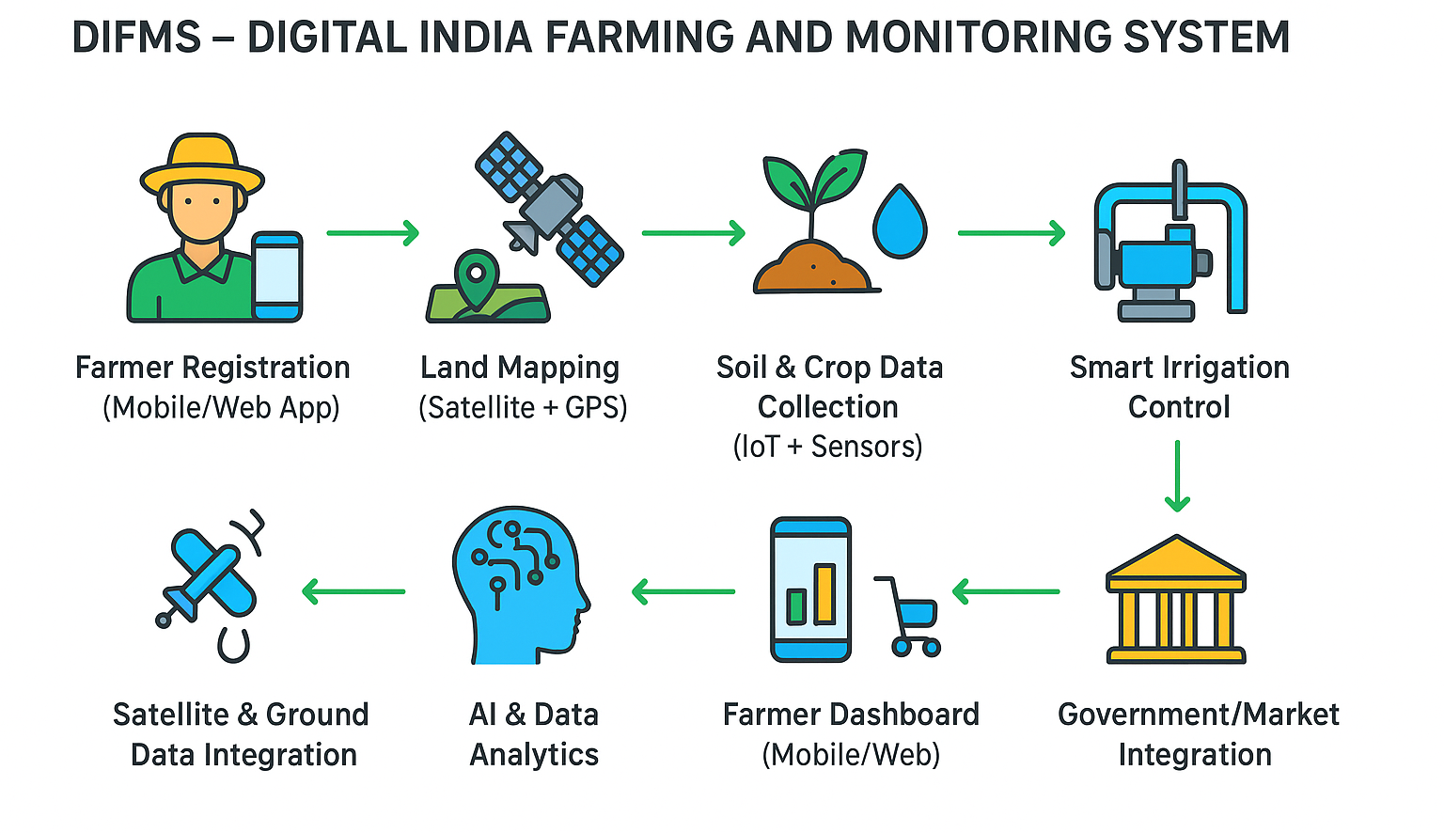

Slide 7
🌍 NASA Satellites and Their Role in DIFMS
💡 Why It Matters: By combining NASA’s trusted satellite observations with on-ground IoT data, DIFMS converts global space data into field-level intelligence for every farmer — enabling precision agriculture, efficient resource use, and sustainable food production.
🛰️ Satellite / Mission | 📊 Data Provided | 🌱 How DIFMS Uses It
SMAP – Soil Moisture Active Passive | - Global soil moisture (~0–5 cm) - Freeze/thaw state of soil | ✅ Matches with ground soil moisture sensors to optimize irrigation and detect drought stress. ✅ Helps automate motor ON/OFF decisions and water scheduling.
MODIS – Terra & Aqua | - Land Surface Temperature (LST) - Evapotranspiration (ET) - Vegetation indices (NDVI, EVI) | ✅ Detects crop water stress and heat stress zones. ✅ Identifies drought conditions and supports yield forecasting.
Landsat 8 & 9 – NASA/USGS | - High-resolution multispectral imagery - NDVI and crop health data | ✅ Monitors vegetation vigor and crop growth stage. ✅ Helps estimate yield and detect early signs of disease.
AIRS – Atmospheric Infrared Sounder (Aqua) | - Air humidity and temperature profiles | ✅ Predicts pest and disease risks based on temperature and humidity patterns. ✅ Supports irrigation planning and fertilizer timing.
NISAR – NASA-ISRO SAR Mission | - Soil moisture and land surface changes - Land deformation and subsidence | ✅ Detects changes in soil conditions due to flood/drought. ✅ Improves land mapping and boundary verification.

Slide 8
Why We Used NASA Satellite Data with IoT Sensors in DIFMS
🌍 NASA Satellite Data
Provides large-scale environmental insights including: ✅ Soil moisture and temperature ✅ Weather patterns and rainfall data ✅ Vegetation health (NDVI, chlorophyll index)
🌱 IoT Sensor Data
Collects precise, on-ground measurements such as: ✅ Soil pH, temperature, and humidity ✅ Local air temperature and CO₂ levels ✅ Real-time irrigation and fertilizer data
🔍 Comparison & Integration
Instead of simply combining the two datasets, the system compares NASA satellite data with IoT sensor data to identify: ✅ Deviations between remote-sensing estimates and real field conditions ✅ Micro-level variations missed by satellite data ✅ Accuracy improvements through cross-verification ✅ Real-time decision support for farmers based on consistent, validated data
🚀 Outcome
By comparing IoT ground truth with satellite-scale environmental data, the model enhances accuracy, detects anomalies faster, and delivers reliable, data-driven smart farming recommendations.
NASA Satellite Data 🌍 + IoT Sensor Comparison 🌱 → Highly Accurate, Real-Time Smart Farming Decisions

Slide 9
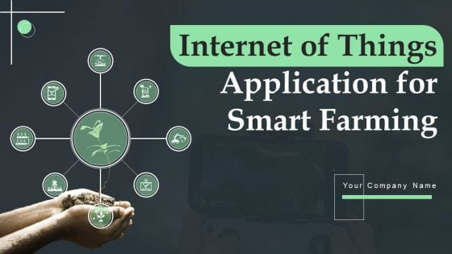
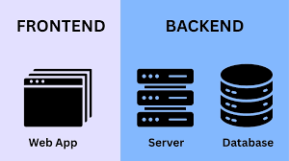
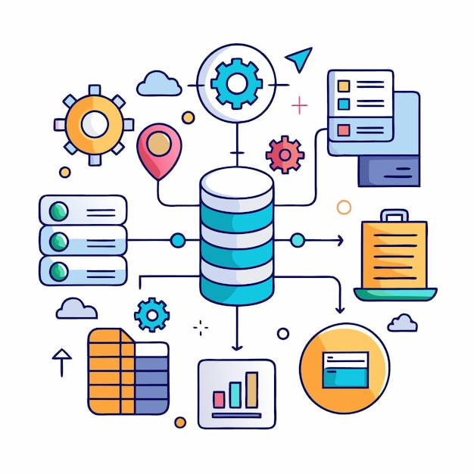
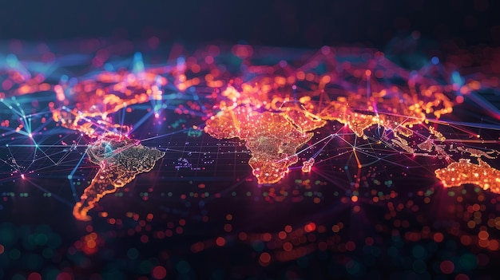
Backend / AI: Python, FastAPI / Flask, scikit-learn, TensorFlow, PyTorch, OpenCV, PostgreSQL / PostGIS, Node.js – for building APIs, running AI/ML models, image processing, and managing relational/geospatial databases.
IoT Hardware: Arduino
UNO / ESP32, ESP8266, Soil Moisture Sensor, DHT11, Relay Module, LoRa modules, Raspberry Pi, GPS modules – for environmental sensing, device control, long-range communication, and geolocation tracking.
Frontend: React.js / Flutter, Leaflet.js, Plotly.js, D3.js, React.js, Node.js – for interactive web/mobile interfaces, mapping, data visualization, and 3D visualizations.
Tech Stack
Database / Storage: PostgreSQL, Firebase, PostGIS, MongoDB, AWS S3 – for structured, geospatial, real-time, and unstructured data storage.
Visualization / Mapping: Folium, Plotly, Recharts, Mapbox, Kepler.gl, Tableau – for interactive maps, charts, dashboards, and advanced geospatial visualizations.
Data Processing / Analytics: Pandas, NumPy, Apache Spark, Airflow – for data manipulation, analytics, and orchestrating data pipelines.
Cloud Hosting / DevOps: Render, Heroku, AWS, Firebase, Docker, Kubernetes, GitHub Actions – for deployment, scaling, containerization, CI/CD, and managing backend services.

Slide 10

🎯 Objectives of DIFMS
The primary objective of DIFMS (Digital India Farming & Monitoring System) is to revolutionize agriculture by integrating NASA satellite data, IoT sensors, and AI analytics into a unified digital platform that empowers farmers and policymakers with real-time, actionable insights.
Key Objectives:
🛰️ Leverage NASA Earth Observation Data – Use SMAP, MODIS, Landsat, AIRS, and NISAR data to monitor soil moisture, crop health, weather, and environmental conditions.
📡 Enable Real-Time Farm Monitoring – Deploy IoT sensors to measure soil moisture, humidity, and temperature directly from the field.
🤖 AI-Driven Decision Support – Provide scientific recommendations for crop selection, irrigation scheduling, fertilizer use, and disease control.
💧 Optimize Water and Resource Usage – Automate irrigation systems based on real-time soil and satellite data to save water and improve yield.
📈 Improve Yield and Profitability – Reduce losses by early detection of stress, diseases, and nutrient deficiencies.
🏛️ Strengthen Policy & Subsidy Implementation – Provide accurate land usage and crop data to ensure benefits reach genuine farmers.
🌍 Promote Sustainable and Climate-Smart Agriculture – Reduce chemical misuse, conserve water, and enhance soil fertility through data-driven decisions.

Slide 11
🔧 Challenges Faced During Development
Building DIFMS was a complex project that required overcoming several technical and practical challenges.
1. 🌍 NASA Data Integration
Challenge: NASA datasets are large, complex, and not directly usable for small-scale farms.
Solution: We used Google Earth Engine, but we choose Nasa Earth Engine only and Earth data APIs to extract and process only the relevant layers (NDVI, soil moisture, LST) for specific farm coordinates.
2. 📡 Data Fusion Between Satellite and IoT Sensors
Challenge: Combining satellite data (global scale) with IoT sensor data (local scale) required calibration and synchronization.
Solution: We created a data fusion pipeline that aligns timestamps and geolocations and applies correction factors for field-level accuracy.
3. ⚙️ Hardware and Connectivity Issues
Challenge: IoT devices faced unstable internet connectivity and power fluctuations in field conditions.
Solution: We will use both Solar panels and Batteries; Morning Via Solar Panel and it will charge and night we will use that or the batteries and in Case if Fluctuations occurs, we will use BMS .
4. 🧠 AI Model Training with Limited Data
Challenge: Lack of large local datasets for crop recommendation and yield prediction.
Solution: We combined NASA open data with our collected field data and used rule-based AI models initially, which can evolve into ML models as more data is collected.
5. 🗺️ Land Identification & Mapping
Challenge: Mapping accurate field boundaries and linking them to farmer records.
Solution: We integrated GPS-based location capture and ResourceSat-2 boundary mapping to create a FLIN (Farmer & Land Identification Number) system.
6. 📊 User Interface Simplicity
Challenge: Farmers needed a simple, local-language interface despite complex backend analytics.
Solution: We built a minimal dashboard and plan to integrate voice-based assistance for ease of use.
🛠️ How We Overcame These Challenges
Used Nasa Earth Engine (NEE) to simplify and scale satellite data processing.
Implemented a data fusion algorithm to synchronize IoT and satellite data.
Built a low-cost, reliable IoT hardware setup with local caching and remote motor control.
Started with rule-based AI models and gradually improved them as field data grew.
Designed a user-friendly dashboard focusing on clarity and actionable insights.
Created a FLIN-based land identification system to solve data linkage and subsidy issues.

Slide 12
