Slide 1


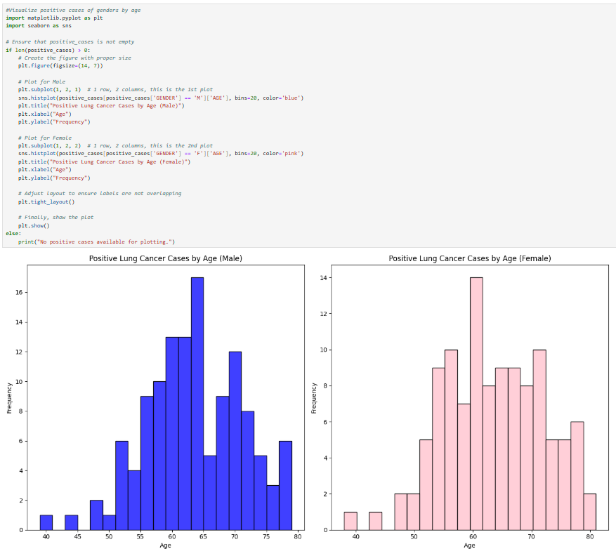
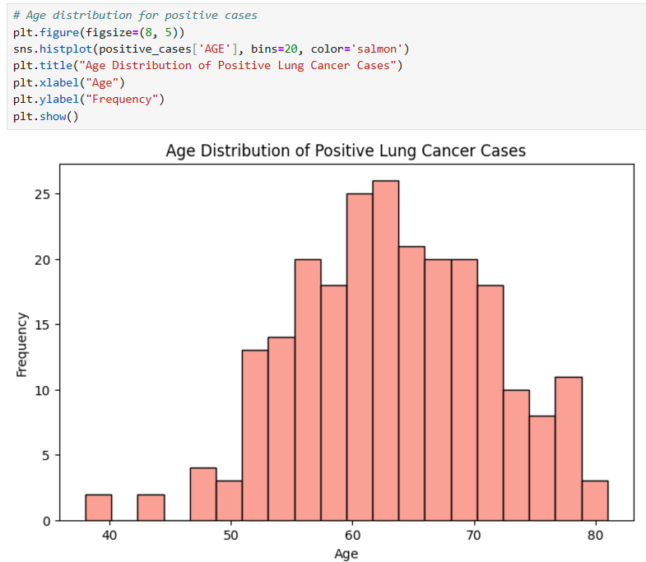
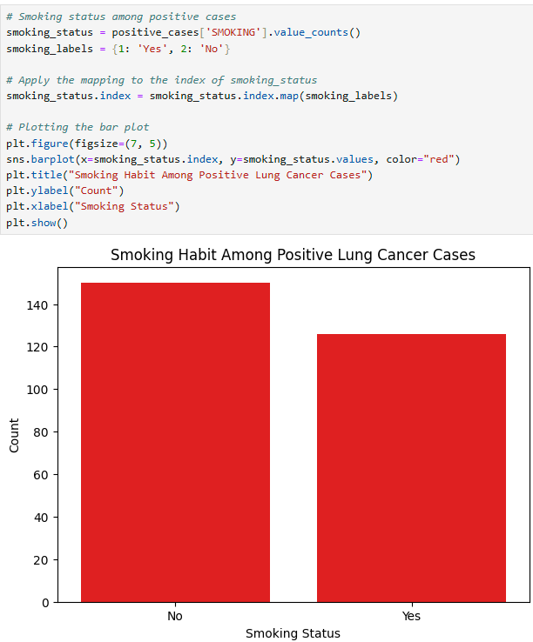
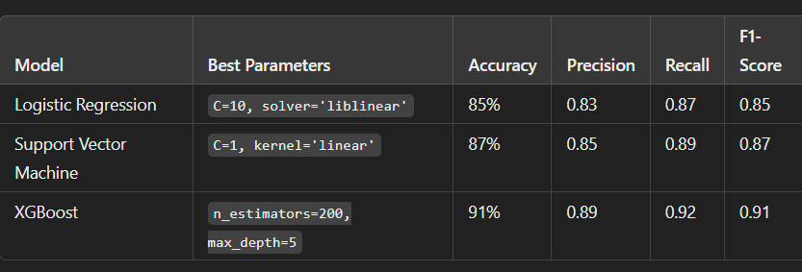
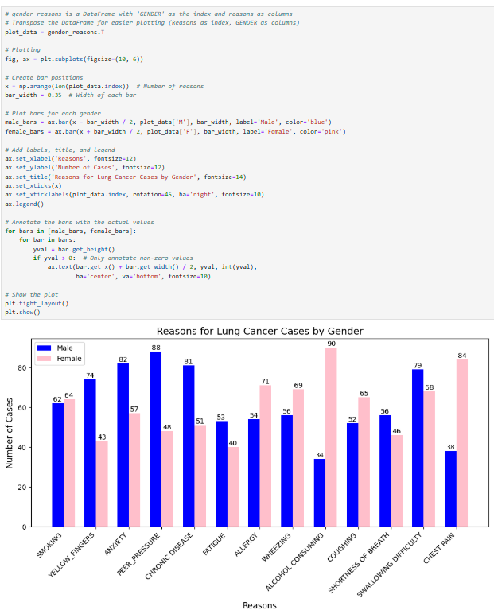
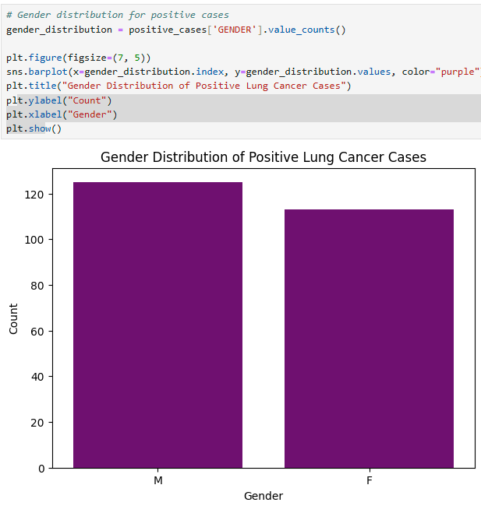
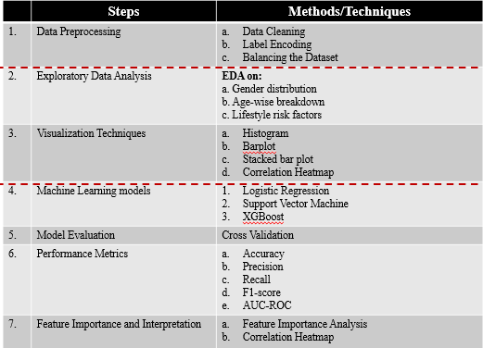
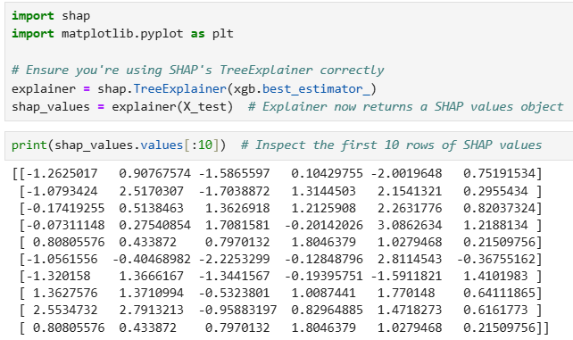
Visual Analytics for Lung Cancer Risk Factors LALITHA PRIYA BIJJA, UDAY KUMAR DASARI, MAHARSHI DEVARASETTY Under Prof. DEBESH JHA
Introduction
RESULTS
Lung cancer is one of the leading causes of death worldwide, necessitating early detection and prevention efforts. This project focuses on analyzing a dataset of health and lifestyle factors to predict the likelihood of lung cancer. By leveraging machine learning models and statistical analysis, the project aims to identify significant predictors and provide interpretable insights for lung cancer detection. The key objectives of this project are:
To explore and preprocess the dataset to ensure data quality.
To utilize advanced machine learning models (Logistic Regression, SVM, and XGBoost) to predict lung cancer occurrences.
To evaluate the performance of these models and identify key risk factors using SHAP analysis.
To compare the significance of model performance using statistical tests.
Data Preprocessing
Data Preprocessing:
Handling missing values and duplicates.
Encoding categorical variables (e.g., gender, smoking status).
Using SMOTE for class imbalance.
Feature Engineering:
Selection of relevant features based on domain knowledge (e.g., smoking, age, gender)
Encoding categorical features for modeling.
Modeling:
Logistic Regression: A simple linear model used for binary classification.
Support Vector Machine (SVM): A powerful classifier for complex decision boundaries.
XGBoost: An ensemble method leveraging decision trees to provide high accuracy.
Hyperparameter Tuning: Grid Search to find the optimal hyperparameters for each model.
).
E.
Methodology
Conclusion
The top three key factors contributing to lung cancer are identified as alcohol consumption, chronic diseases, and peer pressure.
Males are more affected by lung cancer than females. The analysis indicates that smoking is not the sole reason for lung cancer.
The peak age frequency for lung cancer occurrence: Males: 60–65 years. Females: 55–60 years.
Both machine learning models, SVM and XGBoost, demonstrated equally strong performance in predicting lung cancer.
The results of the paired t-tests further validated the equivalence in performance between the two models

