Slide 1
Smart Route Planning System
Geographical Routing & Emergency Spatial Search
Submitted By: Udayveer Singh Chaudhary (12320106) Course: B.Tech CSE Submitted To: Sachin Garg

Slide 2
1. Introduction & Objectives
• Efficient geographical routing is critical for modern logistics and emergency response.
• Problem Statement:
Commercial maps are heavy and rely on internet APIs.
Need a dynamic system that adapts to traffic and weather offline.
• Objectives:
Model geographical data (cities/highways) using Graph Theory.
Implement heuristic pathfinding algorithms from scratch.
Develop a proximity-based search engine for emergency facilities.

Slide 3
2. Technology Stack
• The system was built entirely on native, lightweight technologies:
• Programming Language:
Java (JDK 17) - Chosen for robust Object-Oriented capabilities.
• UI Framework:
Java Swing - Core foundation for the desktop interface.
FlatLaf Engine - Modern library for a sleek, high-DPI UI.
• Architecture Pattern:
MVC (Model-View-Controller) separating data logic from visual rendering.
• Deployment:
Standalone Executable Java Archive (.jar)

Slide 4
3. System Architecture (MVC)
• The project strictly follows the Model-View-Controller (MVC) design pattern:
• Model (Data & Logic):
Contains the raw entities: City, Road (Edge), and Graph.
Maintains the state of the road network and real-world geographic coordinates.
• View (User Interface):
Built entirely with Java Swing and FlatLaf.
Custom MapPanel normalizes GPS coordinates to render the 2D visual map.
• Controller (Data Processing):
Acts as the bridge between UI inputs and backend algorithms.
RoutingAlgorithms and NearbyPlacesFinder execute complex graph traversals.

Slide 5
4. File & Package Structure
• The source code is cleanly modularized into distinct Java packages:
• com.routeplanner.model:
Entity classes (City.java, Road.java, Graph.java, Place.java)
• com.routeplanner.ui:
Frontend visual components (MainFrame.java, MapPanel.java)
• com.routeplanner.dsa:
Core algorithmic engines (RoutingAlgorithms.java, NearbyPlacesFinder.java)
• com.routeplanner.manager:
Business logic and cost calculators (TollFuelCalculator.java)
• com.routeplanner.dao:
Data Access Objects for persistent storage interactions (CityDAO.java)

Slide 6
5. Core Data Structures (DSA)
• Heavily optimized data structures form the backbone of the system:
• Adjacency List (Graphs):
Stores the network of cities and roads (edges).
Ensures memory scales linearly O(V + E) rather than exponentially.
• Priority Queues (Min-Heap):
Used in Dijkstra/A* to extract the closest nodes in O(log V) time.
• Priority Queues (Max-Heap):
Maintains the K-nearest emergency facilities during spatial searches.
• HashMaps:
Caches city names to coordinate objects for instant O(1) lookups.

Slide 7
6. Core Algorithms Implemented
• Multiple algorithms were implemented and compared:
• Dijkstra's Algorithm:
Calculates the absolute shortest path across all edges.
• A* (A-Star) Search:
Utilizes the Haversine formula as a geographic heuristic to boost speed.
• Breadth-First Search (BFS):
Ignores physical distance to find routes with the fewest stops.
• Floyd-Warshall:
Dynamic programming for all-pairs shortest paths.

Slide 8
7. The Haversine Formula
• Crucial mathematical logic used to account for Earth's curvature:
• Purpose:
Calculates the 'great-circle' geographic distance between two points.
• Usage in System:
Acts as the heuristic 'h(n)' in the A* Search algorithm.
Validates whether an emergency facility is strictly within the 50km radius.
• Formula Concept:
a = sin²(Δφ/2) + cos φ1 ⋅ cos φ2 ⋅ sin²(Δλ/2)
c = 2 ⋅ atan2( √a, √(1−a) )
d = R ⋅ c (Where R = Earth Radius 6371km)

Slide 9
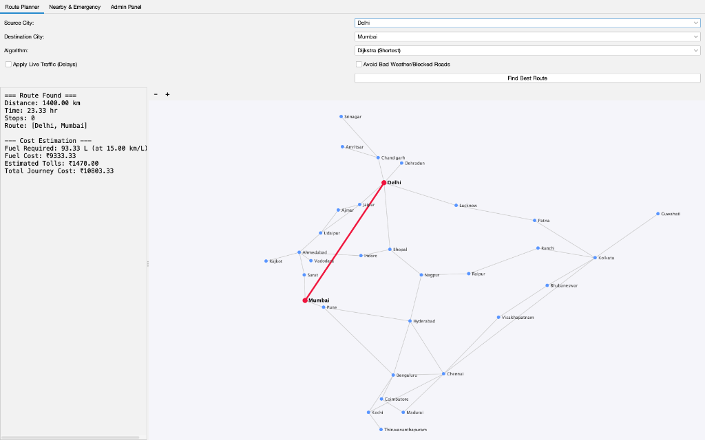
Route Planner: Shortest Path Demonstration

Slide 10
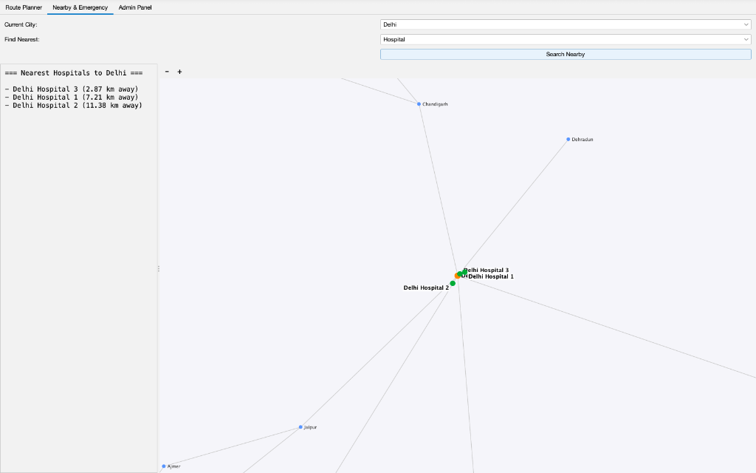
Spatial Search: Nearby Emergency Locator

Slide 11
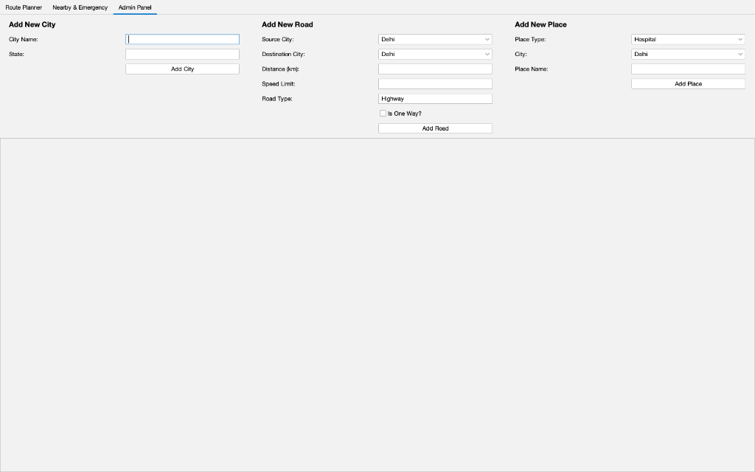
Database Management: Administrator Panel

Slide 12
8. Future Scope
• The modular architecture allows for massive future scalability:
• Live API Integration:
Fetch real-time traffic data from Google Maps API or OpenWeather API.
• Database Persistence:
Migrate in-memory HashMaps to an AWS RDS (MySQL) cloud database.
• Turn-by-Turn Telemetry:
Implement vector calculations to generate 'Turn Left / Turn Right' instructions.
• Mobile Porting:
Migrate core Java DSA logic to Kotlin for Android deployment.

Slide 13
Thank You!

