Slide 1
Digital Literacy for Everyday Life
BCPS Computer Practical 09–10
Prepared by: Udaypartap Singh | Roll No: 2610997576
BCPS • Digital Literacy 1 / 8
Notes:
Speaker notes: Explain the main idea of “Digital Literacy for Everyday Life” and give a brief everyday example. Ask learners to connect the tip to their own study or work habits.

Slide 2
What digital literacy means
Use devices and information effectively
Make informed choices online
Act safely and responsibly
BCPS • Digital Literacy 2 / 8
Notes:
Speaker notes: Explain the main idea of “What digital literacy means” and give a brief everyday example. Ask learners to connect the tip to their own study or work habits.

Slide 3
Organizing files
Choose clear, descriptive file names
Group related work in folders
Keep backups in a second location
BCPS • Digital Literacy 3 / 8
Notes:
Speaker notes: Explain the main idea of “Organizing files” and give a brief everyday example. Ask learners to connect the tip to their own study or work habits.

Slide 4
Finding reliable information
Check author and publication date
Look for evidence and cited sources
Cross-check important claims
BCPS • Digital Literacy 4 / 8
Notes:
Speaker notes: Explain the main idea of “Finding reliable information” and give a brief everyday example. Ask learners to connect the tip to their own study or work habits.

Slide 5
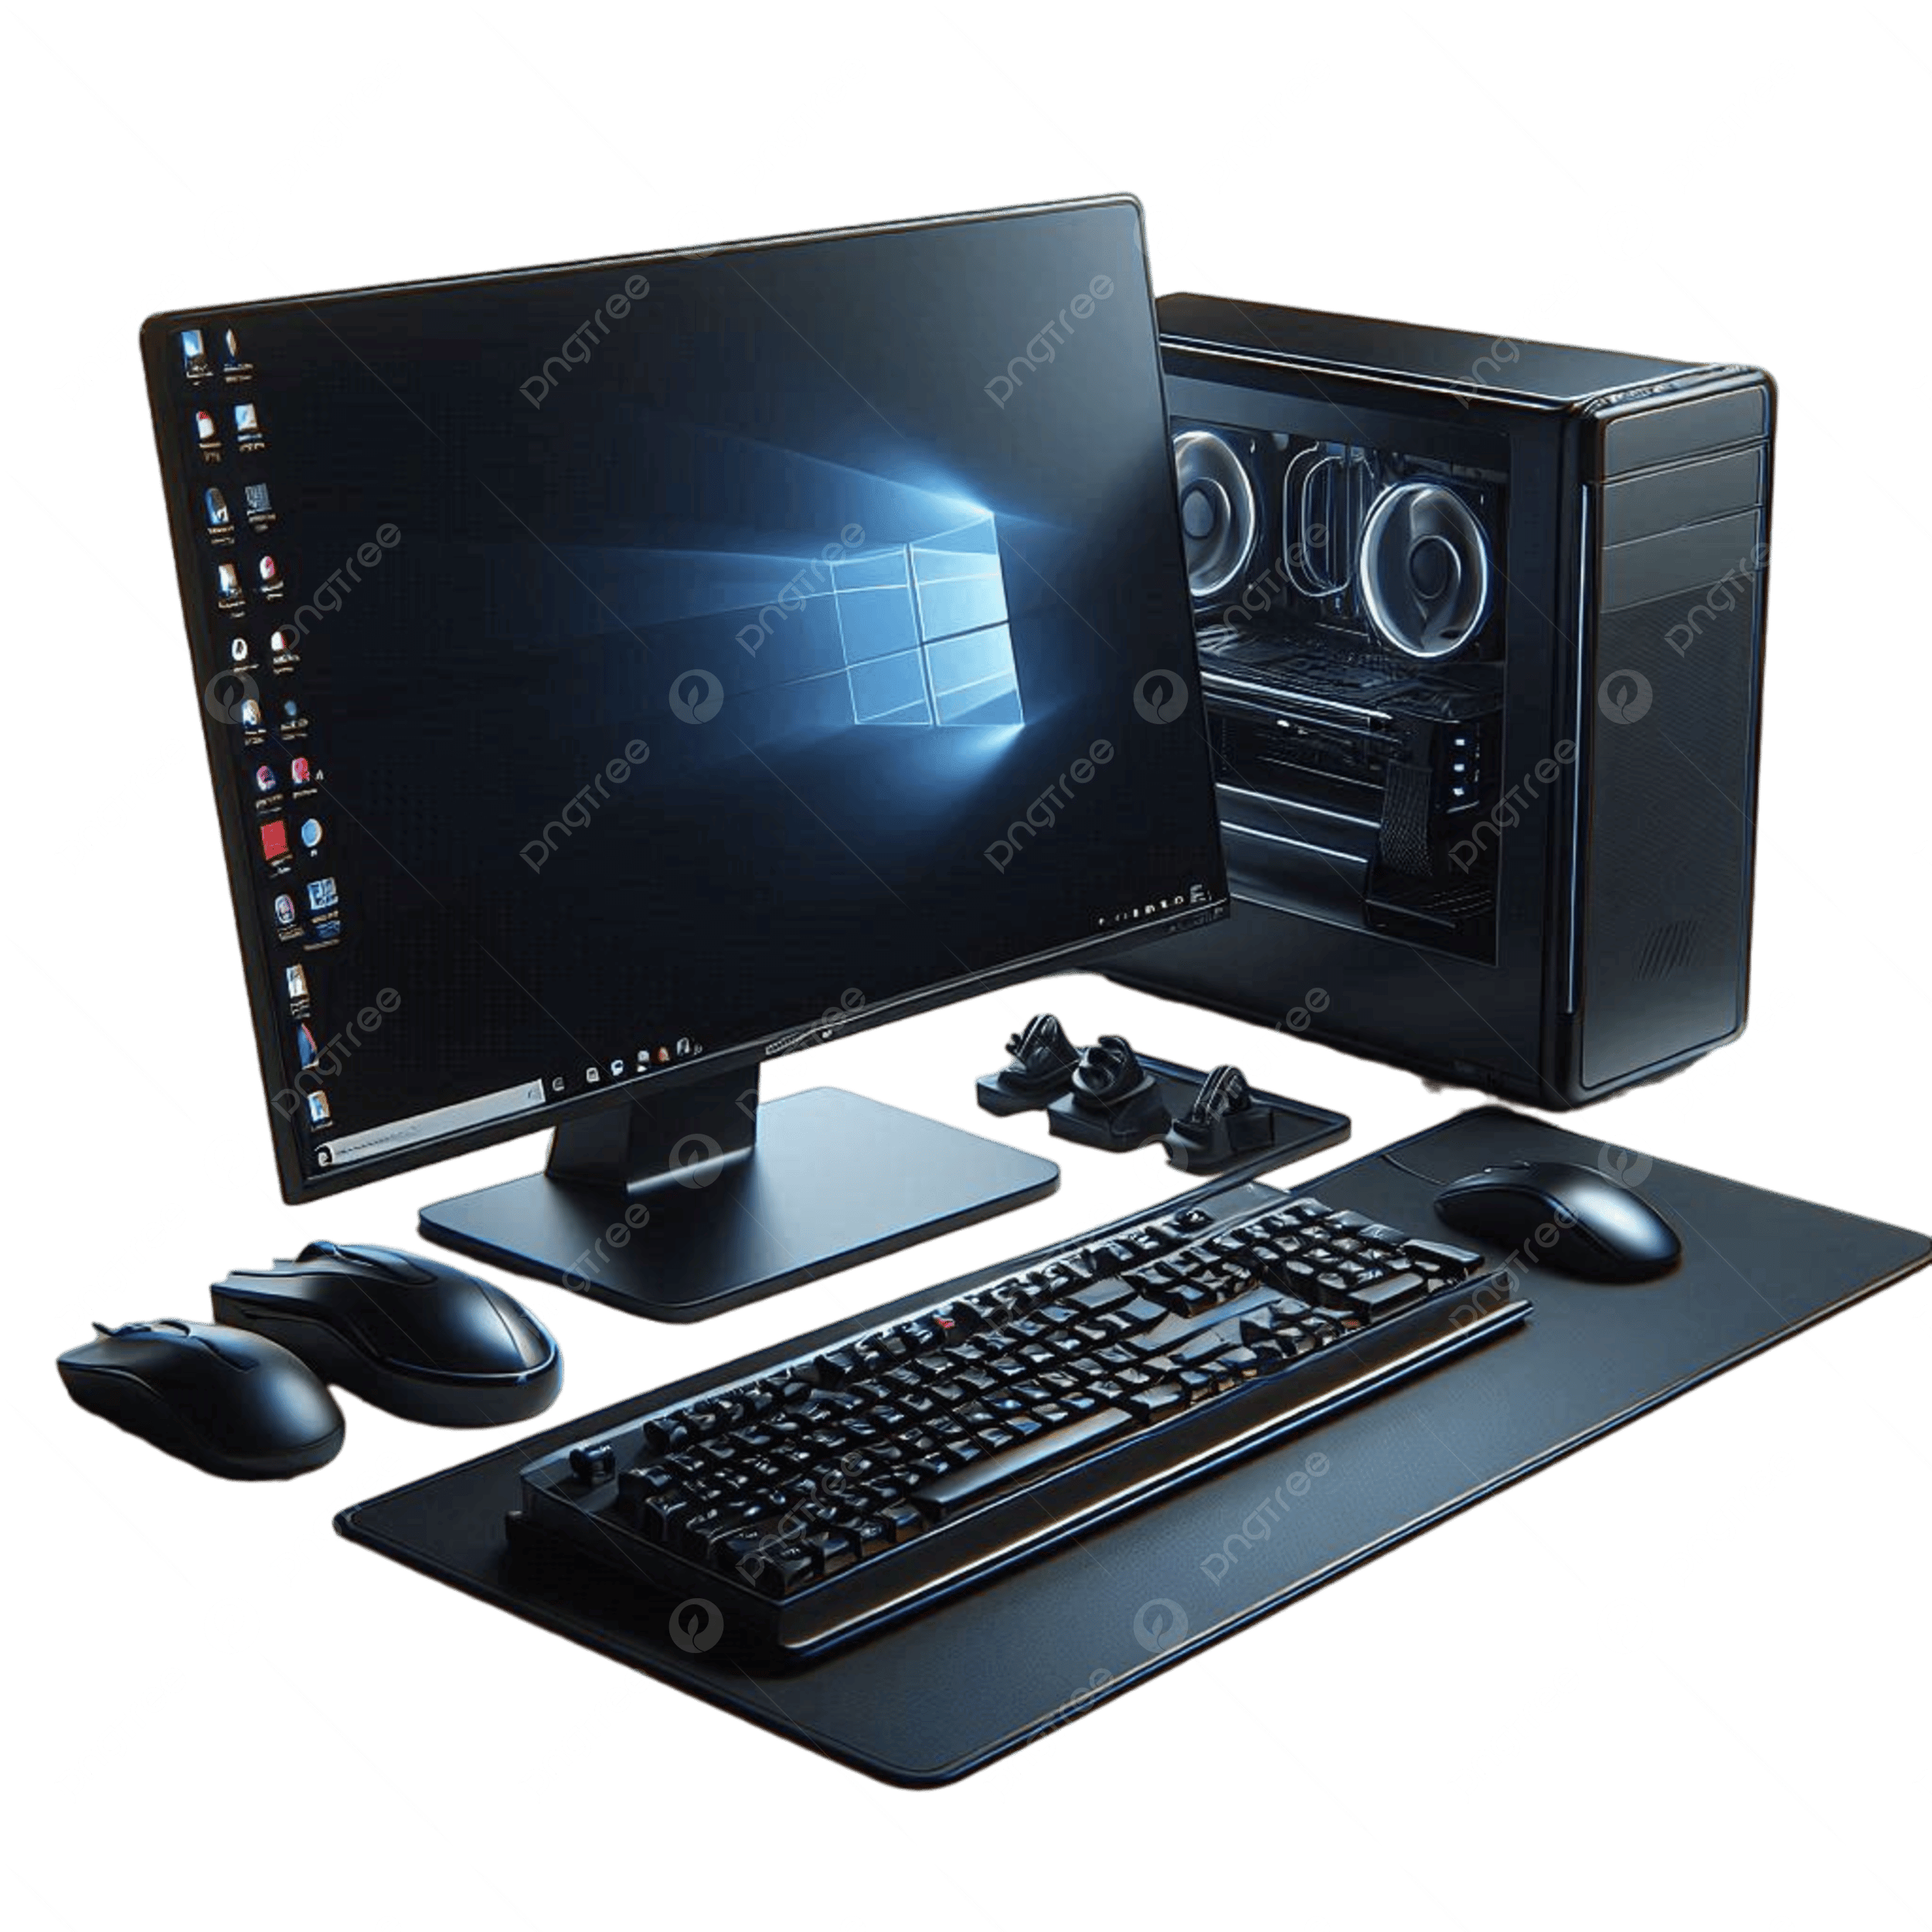
Online safety
Use unique passwords and MFA
Recognize suspicious links and messages
Update software and protect personal data
BCPS • Digital Literacy 5 / 8
Notes:
Speaker notes: Explain the main idea of “Online safety” and give a brief everyday example. Ask learners to connect the tip to their own study or work habits.

Slide 6
Online safety
Use unique passwords and MFA
Recognize suspicious links and messages
Update software and protect personal data
BCPS • Digital Literacy 5 / 8
Notes:
Speaker notes: Explain the main idea of “Online safety” and give a brief everyday example. Ask learners to connect the tip to their own study or work habits.

Slide 7
Communicating responsibly
Use a respectful tone
Protect your own and others’ privacy
Credit creators and respect copyright
BCPS • Digital Literacy 6 / 8
Notes:
Speaker notes: Explain the main idea of “Communicating responsibly” and give a brief everyday example. Ask learners to connect the tip to their own study or work habits.

Slide 8
Office tools
Writer: create structured documents
Calc: organize data and calculate
Impress: explain ideas visually
BCPS • Digital Literacy 7 / 8
Notes:
Speaker notes: Explain the main idea of “Office tools” and give a brief everyday example. Ask learners to connect the tip to their own study or work habits.

Slide 9
Summary and questions
Organize files, verify information, protect accounts
Questions?
Sources: CISA Secure Our World; UNESCO Media and Information Literacy
https://encrypted-tbn0.gstatic.com/images?q=tbn:ANd9GcQxeQDP5GmQib-P6JmqpJLeaM4kn23ZlWJJ_HZVge0nIw&s=10
BCPS • Digital Literacy 8 / 8
Notes:
Speaker notes: Explain the main idea of “Summary and questions” and give a brief everyday example. Ask learners to connect the tip to their own study or work habits.

