Slide 1
“ E-mail Slicer ”

Slide 2
Introduction:
The thing that Email Slicer is a tool that will take an email address as an input and slice operations on it to return the username and the domain of the email address.
If one needs to rapidly determine the domain name of an email address as well as sort a collection of email addresses by domain name, it is likely to be helpful.

Slide 3
Use Case of E-mail Slicer:
Particularly in industries like marketing, sales, and customer segmentation, Email Slicer is a helpful tool for data analysis.
It is a useful tool for data analysis since it can be used to classify and arrange email addresses according to the domain name, which is beneficial for customer, market, and sales segmentation.

Slide 4
A collection of email addresses for customers or clients, for instance, can be sorted by domain name using an email slicer.
Following that, one may utilize this data to modify your marketing messages so that they more effectively reach your target market.
This might give important information about the characteristics and preferences of a specific clientele or set of customers.

Slide 5
Creating E-mail Slicer Using Python:
For a single e-mail id-
Code~ | Given E-mail Id~
email = input("Enter your email address: ") username = email[:email.index("@")] domain = email[email.index("@") + 1 :] print(f"Your username is {username} and your domain is {domain}.") | uday1511@bu.edu

Slide 6
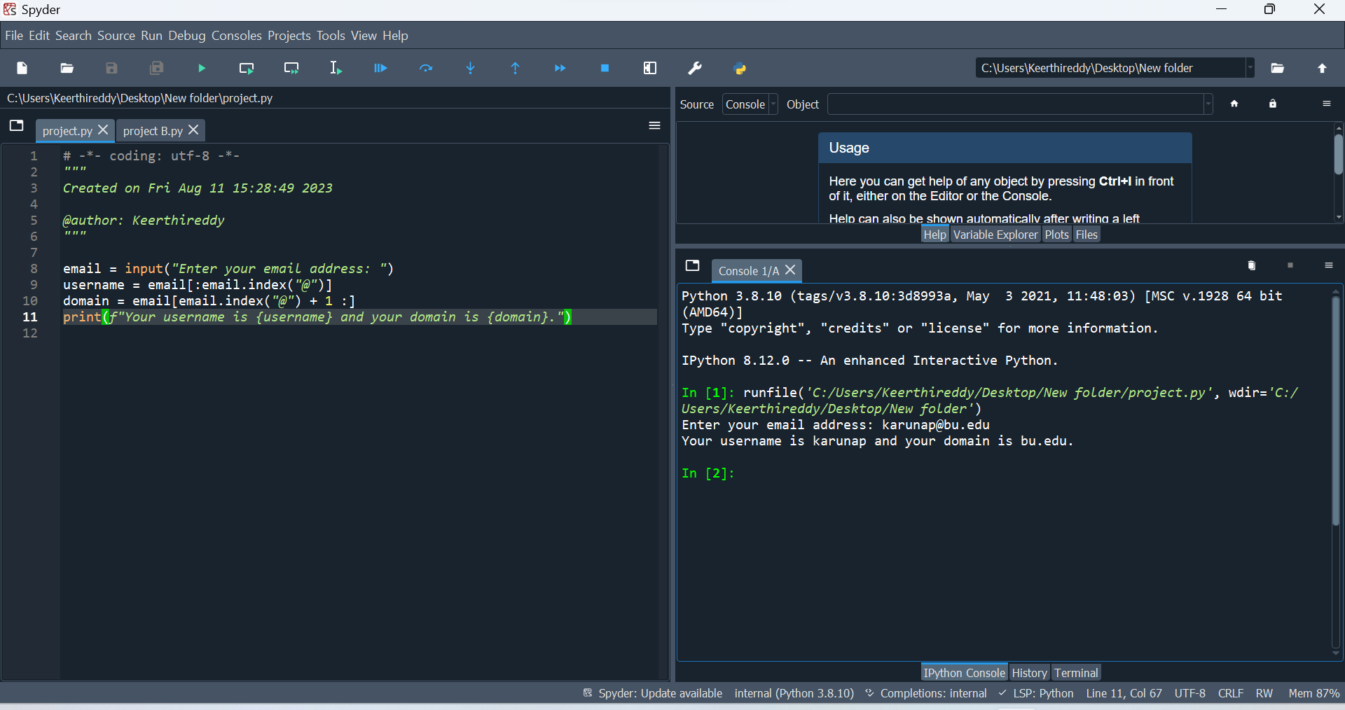
After Execution:

Slide 7
For a list of email id’s:
Code:
import csv
class EmailProcessor:
def __init__(self, input_file):
self._input_file = input_file
self.emails = [] # Public instance attribute
def _read_emails(self):
try:
with open(self._input_file, 'r') as csv_file:
reader = csv.reader(csv_file)
next(reader) # Skip the header row if present
self.emails = [row[0] for row in reader]
except FileNotFoundError:
print("Input file not found.")

Slide 8
def slice_email(self, email):
username, domain = email.split('@')
return username, domain
def process_emails(self):
sliced_emails_list = []
for email in self.emails:
username, domain = self.slice_email(email)
sliced_emails_list.append([username, domain])
return sliced_emails_list
def save_to_csv(self, data, output_file):
with open(output_file, 'w', newline='') as csv_file:
writer = csv.writer(csv_file)
writer.writerow(['Username', 'Domain'])
writer.writerows(data)

Slide 9
def process_and_save(self, output_file):
try:
self._read_emails() # Using the private method
sliced_emails_list = self.process_emails()
sorted_sliced_emails = sorted(sliced_emails_list, key=lambda x: x[1]) # Sort by domain
self.save_to_csv(sorted_sliced_emails, output_file)
except Exception as e:
print(f"An error occurred: {e}")
else:
print("Email processing and saving completed successfully.")
def __repr__(self):
return f"EmailProcessor(input_file={self._input_file})"
@classmethod
def example_class_method(cls):
print("This is an example class method.")

Slide 10
# Unit Tests
import unittest
class TestEmailProcessor(unittest.TestCase):
def test_process_and_save_with_valid_input(self):
self.create_test_input()
email_processor = EmailProcessor(self.input_file)
email_processor.process_and_save(self.output_file)
with open(self.output_file, 'r') as csv_file:
reader = csv.reader(csv_file)
header = next(reader)
self.assertEqual(header, ['Username', 'Domain'])
actual_sliced_emails = [row for row in reader]
self.assertEqual(actual_sliced_emails, self.expected_sliced_emails)
print("Test for process_and_save with valid input passed.")
def test_process_and_save_with_invalid_input(self):

Slide 11
# Create an empty input file
open(self.input_file, 'w').close()
email_processor = EmailProcessor(self.input_file)
email_processor.process_and_save(self.output_file)
with open(self.output_file, 'r') as csv_file:
reader = csv.reader(csv_file)
header = next(reader, None)
self.assertIsNone(header)
print("Test for process_and_save with invalid input passed.")
def test_slice_email(self):
email_processor = EmailProcessor(self.input_file)
for email, expected_sliced_email in zip(self.emails, self.expected_sliced_emails):
sliced_email = email_processor.slice_email(email)
self.assertEqual(sliced_email, tuple(expected_sliced_email))
print("Test for slice_email passed.")

Slide 12
def main():
input_file = 'C:\\Users\\Keerthireddy\\Desktop\\email slicer.csv' # Replace with the actual path to your CSV file
email_processor = EmailProcessor(input_file)
email_processor.process_and_save('C:\\Users\\Keerthireddy\\Desktop\\sliced_emails.csv')
print("Unique domains:")
unique_domains_set = set()
for _, domain in email_processor.process_emails():
unique_domains_set.add(domain)
# Using an if conditional to check for a specific domain
specific_domain = 'harvard.edu'
if specific_domain in unique_domains_set:
print(f"The domain {specific_domain} is present in the unique domains set.")
else:
print(f"The domain {specific_domain} is not present in the unique domains set.")
if __name__ == "__main__":
main()

Slide 13
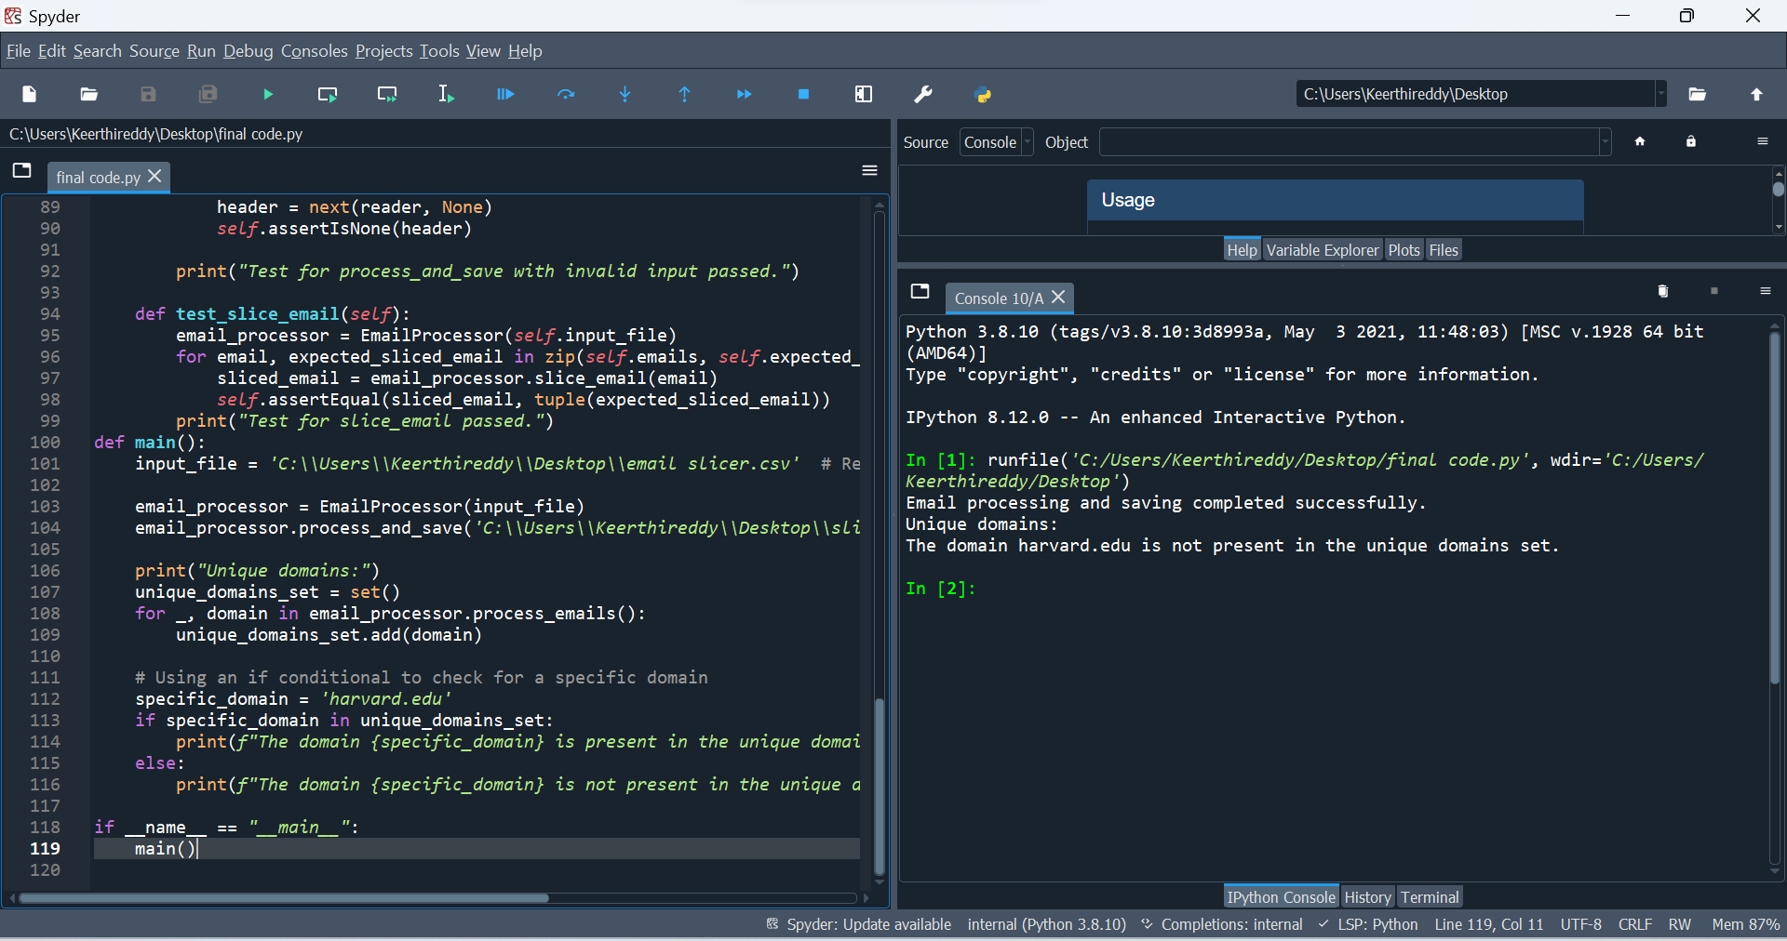
After Execution:

Slide 14
Conclusion:
The project is really quick and easy to complete and doesn't need any setup.
The application can have more features added, including a valid email address check. Regular expressions can be used to validate the email address format in order to do this.
The project can be applied to a variety of sectors or disciplines, including marketing and data research.
Various organizations can use the initiative to increase production and efficiency. It can be used, for instance, to automatically extract email addresses from huge datasets.

Slide 15
~Thank You~

