Slide 1
Normal Distribution
INTRODUCTION
NAME : AERRA UDAY
ROLL NO : 23071A6703
BRANCH : CSE(DATA SCIENCE) - A

Slide 2

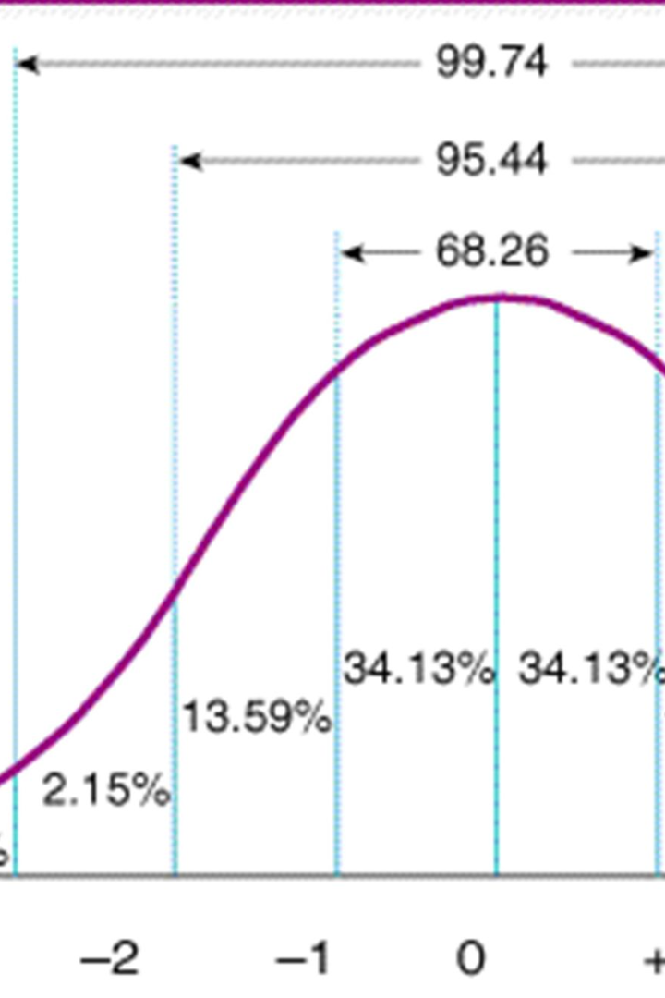

Normal Distribution
A normal distribution, also known as a bell curve, is a statistical distribution that is symmetric around the mean. It is characterized by its peak and spread.

Slide 3

Definition of Normal Distribution
The normal distribution is a probability distribution that is symmetric and bell-shaped. It is used to model various natural phenomena and is commonly used in statistics and scientific research.

Slide 4

Characteristics of a Normal Distribution
Symmetry
A normal distribution is symmetric, meaning that the left and right halves of the curve are mirror images of each other.
Bell-shaped Curve
The curve of a normal distribution resembles the shape of a bell, with a central peak and gradually tapering tails.
Mean, Median, and Mode
In a normal distribution, the mean, median, and mode are all equal and located at the center of the distribution.

Slide 5
The 68-95-99.7 Rule (emperical rule)
1
68%
2
95%
3
99.7%
About 68% of the data falls within one standard deviation of the mean in a normal distribution.
Approximately 95% of the data falls within two standard deviations of the mean in a normal distribution.
Almost all of the data, about 99.7%, falls within three standard deviations of the mean in a normal distribution.

Slide 6

Standard Deviation and the Normal Distribution
The standard deviation measures the dispersion or spread of data in a normal distribution. It quantifies the average distance between each data point and the mean.

Slide 7

Applications of the Normal Distribution
1
Quality Control
Normal distribution is used to model and analyze quality control data, ensuring products meet specified standards.
2
Stock Market Returns
Stock market returns are often assumed to follow a normal distribution, allowing for risk analysis and prediction.
3
Biological Phenomena
Many biological phenomena, such as height, weight, and IQ scores, tend to be normally distributed in the population.

Slide 8
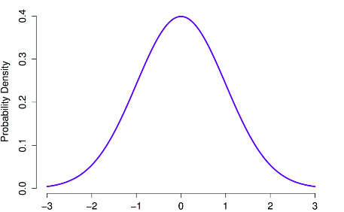
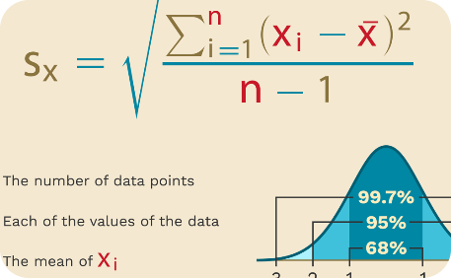
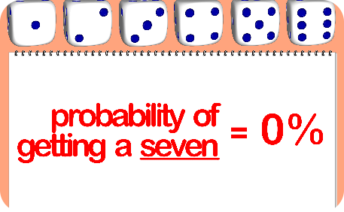
Properties of the Normal Distribution
Symmetry
Standard Deviation
Area Under the Curve
The normal distribution curve is perfectly symmetrical around the mean.
The spread of a normal distribution is determined by the standard deviation.
The area under the normal distribution curve represents the probability of certain events occurring.

Slide 9

Conclusion
The normal distribution is a fundamental concept in statistics and has wide-ranging applications in various fields. Its unique properties and predictable characteristics make it an essential tool for data analysis and decision-making.

