Slide 1
BEYOND REALITY: EXPLORING THE TRANSFORMATIVE POWER OF AR AND VR
PPT by:
A.Uday
23071A6703

Slide 2
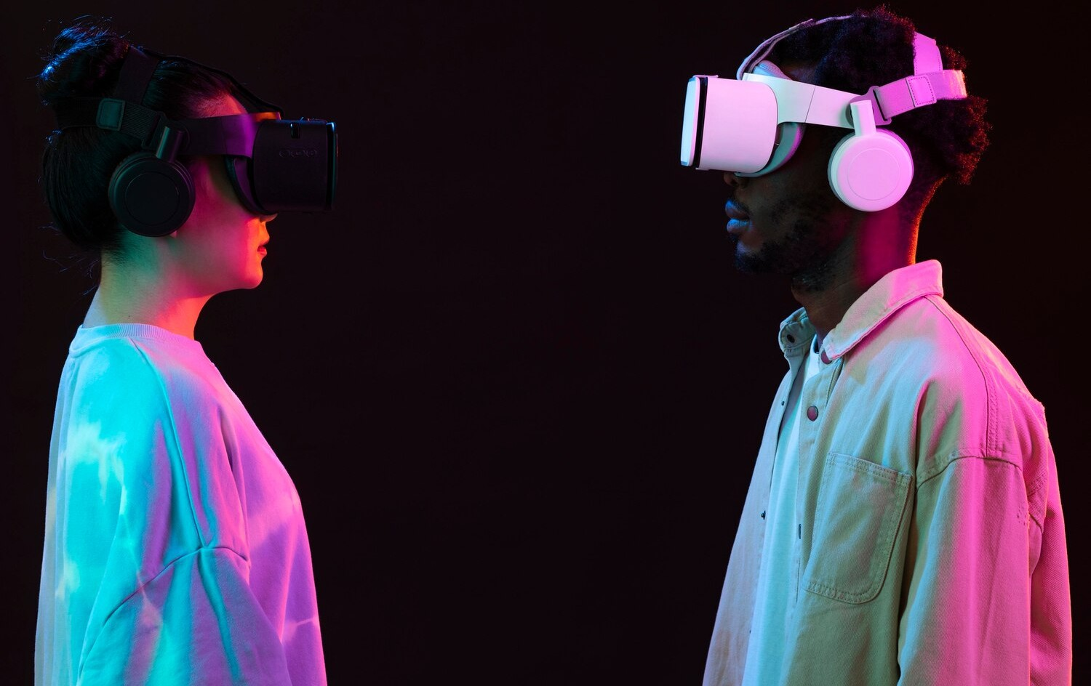



INTRODUCTION TO AR AND VR
and
are revolutionizing how we interact with the world. This presentation explores their
in various ﬁelds, including education, entertainment, and
healthcare, highlighting their potential to enhance our and
.

Slide 3





THE ESSENCE OF AR
overlays digital information onto the real world,
enriching our surroundings. By blending
with reality, AR enhances experiences in gaming, retail,
and training, making them more
and .

Slide 4





THE POWER OF VR
immerses users in a completely digital environment,
creating an experience that feels .
This technology is transforming industries like , , and
, allowing users to explore new worlds and scenarios.

Slide 5
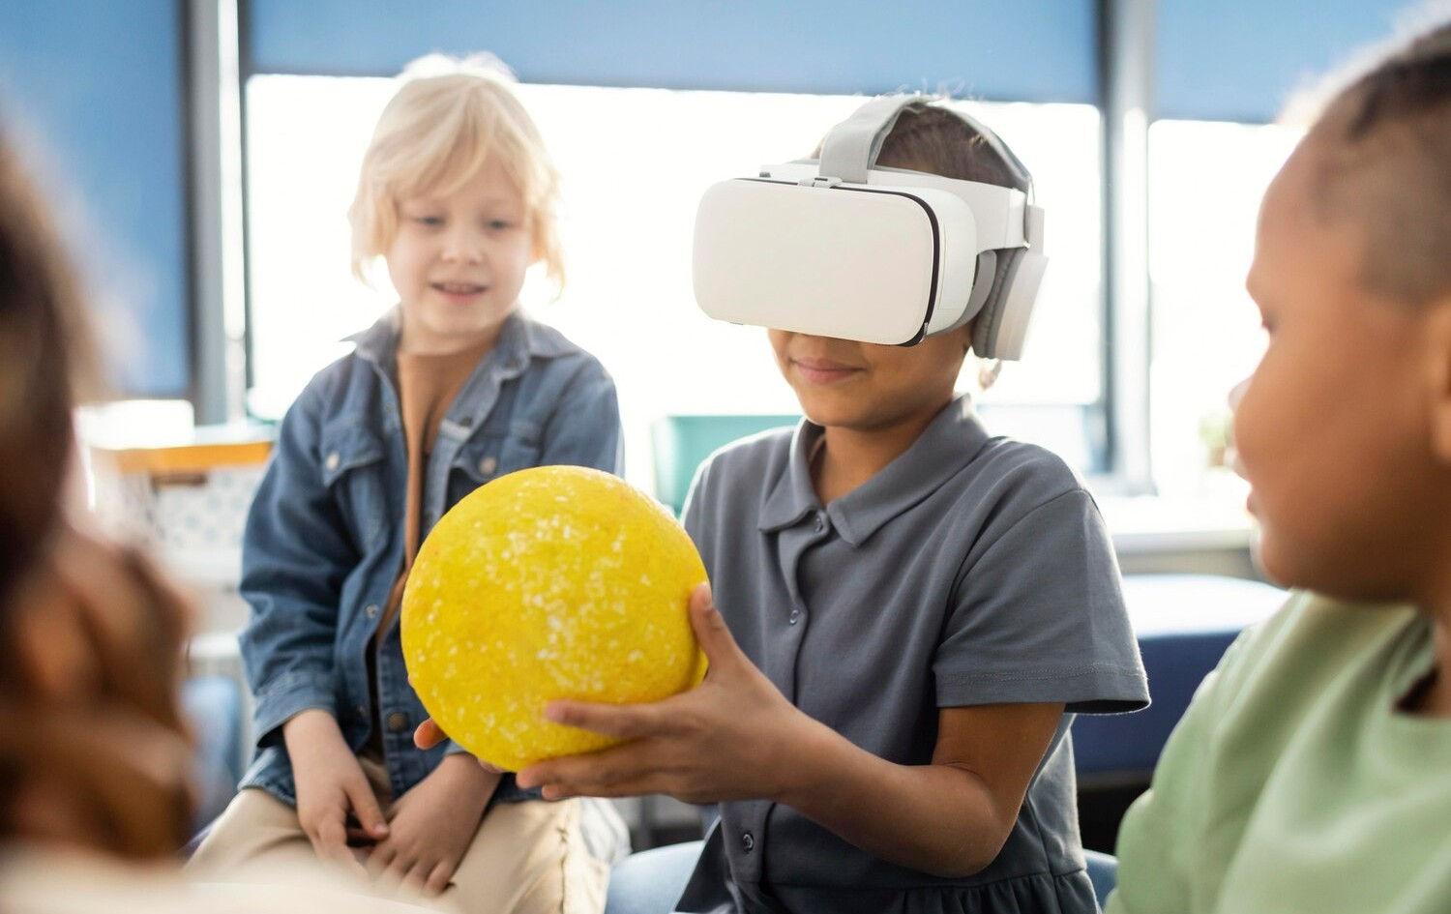





IMPACT ON EDUCATION
AR and VR are
making learning more .
by
Students can explore
or in a 3D space,
fostering deeper understanding and retention of knowledge through
.

Slide 6



TRANSFORMING HEALTHCARE
In healthcare, AR and VR are enhancing and . Surgeons can
practice procedures in a risk-free environment, while patients can experience
that alleviate
anxiety and improve recovery outcomes.

Slide 7





INNOVATIONS IN ENTERTAINMENT
The entertainment industry is experiencing a with AR and VR. From
to
, these technologies o er audiences a chance to engage with
content in ways that were previously unimaginable.

Slide 8




CHALLENGES AND CONSIDERATIONS
Despite their potential, AR and VR face challenges such as , , and
. Addressing these issues is crucial for widespread adoption and
ensuring that these technologies beneﬁt all
.

Slide 9





CONCLUSION: THE FUTURE AWAITS
As we venture , the possibilities of AR and VR are
. By fostering creativity and innovation, these technologies
promise to redeﬁne our
and
, making the world more than ever before.

