Slide 1

Smart Door Lock System with Intruder Alert
SUBMITTED BY:
REDDI UDAYA RAM

Slide 2
INTRODUCTION:
The Smart Door Lock System with Intruder Alert is an advanced security project designed to enhance access control using an LPC1768 microcontroller. This system utilizes a keypad-based password entry mechanism, an IR sensor to detect the presence of a person near the door, and a servo motor to automate the door opening and closing process. Upon detecting a person through the IR sensor, the system prompts the user to enter a 4-digit password. If the entered password is correct, the servo motor rotates to unlock and open the door, ensuring seamless and secure access. In case of incorrect password attempts, the system activates a buzzer as an intruder alert and blocks further access after multiple failed attempts. This intelligent integration of IR sensing, password protection, and automated motor control ensures both safety and convenience for modern smart home or office environments.

Slide 3
ABSTRACT:
This project is a smart password-protected door lock system based on the LPC1768 microcontroller. It uses a keypad for password entry, an LCD to display system status, a DC motor to control door locking/unlocking, and a buzzer for security alerts. The system allows three password attempts; if all are incorrect, the buzzer beeps and access is blocked. This setup ensures secure and automated access control, making it suitable for homes, laboratories, and office environments.

Slide 4
OBJECTIVES:
The objective of this project is to design and implement a smart password-protected door lock system using the LPC1768 ARM Cortex-M3 microcontroller. The system detects a person using an IR sensor, prompts for password input via a 4x4 keypad, verifies it, and upon success, opens the door using a servo motor. An LCD displays system status (like "Enter Password" or "Access Granted"), and a buzzer alerts on wrong password attempts or access denial. This enhances security, automation, and user interaction for smart access control.

Slide 5
METHODOLOGY:
Keypad Interface: A 4x4 keypad is used to enter the password.
LCD Display: Displays masked password input and system status (e.g., "Access Granted", "Access Denied").
IR Sensor: Detects the presence of a person near the door and activates the system.
Password Verification: Compares entered password with a predefined password stored in LPC1768.
Motor Control: On correct password, the motor rotates to unlock the door.
Buzzer Alert: After 3 wrong attempts, the buzzer beeps 3 times, then continuously to indicate access is blocked.
Access Blocking: The system denies access and remains locked after 3 failed attempts until reset.

Slide 6
BLOCK DIAGRAM:
Power Supply
Keypad
(4x4)
Buzzer
LPC1768
Micro Controller
Infrared Sensor
Servo Motor
LCD
(16x2 )

Slide 7
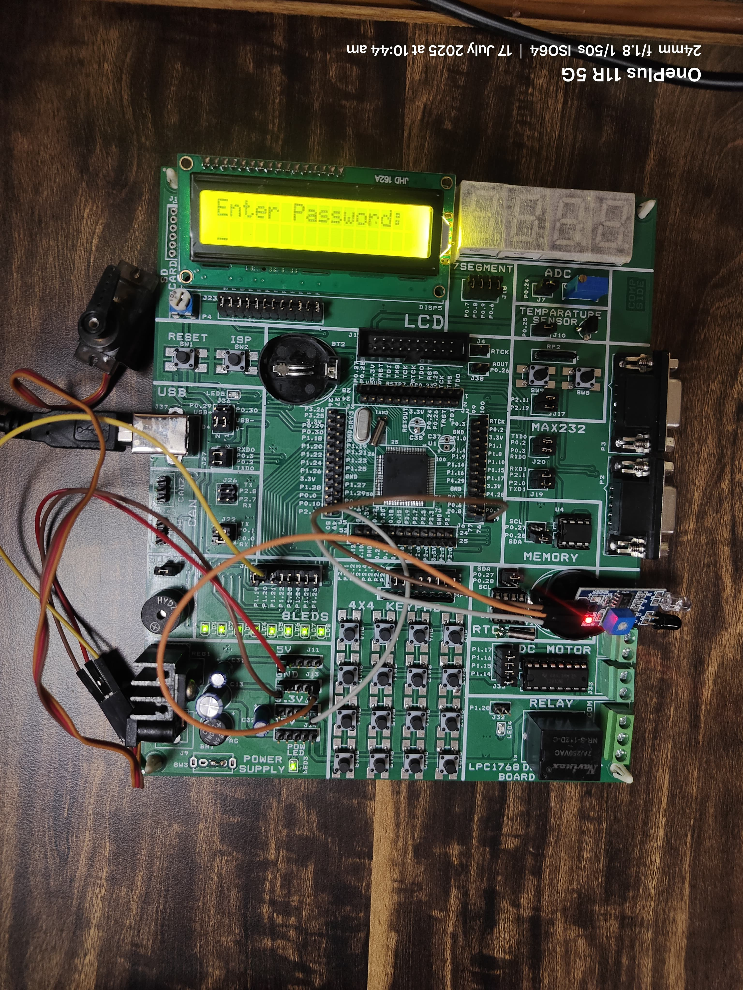
RESULT:

Slide 8
APPLICATIONS:
Home and office security systems
Lab and restricted area access control
Password-protected lockers or cabinets
Smart hostel/dorm room entry
Industrial access management
Secure smart device interfaces
Unmanned location entry control

Slide 9
CONCLUSION:
The Smart Password-Protected Door Lock System using LPC1768 provides a reliable and secure method of access control. It ensures only authorized users can unlock the door using a predefined password, and alerts with a buzzer on multiple failed attempts. By integrating a keypad, LCD, motor, and buzzer, the system effectively combines user interface, security, and automation, making it ideal for smart homes, labs, and office environments.

Slide 10
THANK YOU

