Slide 1
TEAM CHARMERS
Adepu Uday Sai
Yesu Nirmala Lekha Chittajallu
Goutham Kancherla
D. Darshana
Thriveni Ganji

Slide 2
Optical Character Recognition (OCR)

Slide 3
Problem Statement
In this fast moving world where the markets are getting larger and world is getting smaller, fast access to their information is must. To arrange or manage the hard copies of a written document has been a type of deadly so far.Furthermore to keep those at a secure place even necessitate a lot of awareness.
In these scenarios an Optical Character Recognition(OCR) is used. It’s a process that translates images of handwritten texts , pictures of characters into machine-editable text.

Slide 4
Project Design
Preprocessing dataset
Prediction from the model
Training the model
Setting the picture to certain relevance, etc
Model used is RNN.
Calculating the accuracy

Slide 5


Data Collection and Preprocessing
IAM Dataset - http://www.fki.inf.unibe.ch/databases/iam-handwriting-database
Convert the sample images into required size of (128, 32) and normalize to grayscale
Increase the data set by stretching the images randomly.

Slide 6
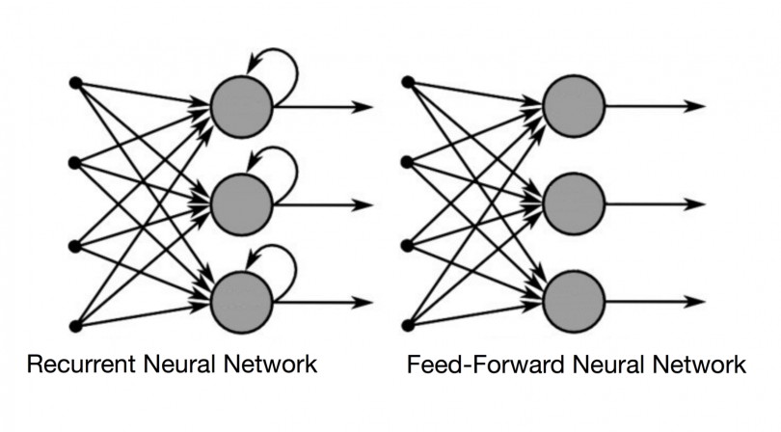
Machine Learning Model
Recurrent Neural networks

Slide 7
Future Scope
This model can recognize the characters in a single word, the next step would be to be able to digitize entire scanned documents.
Optical Character Recognition will be a great help in areas such as better Number Plate Detection in cases of Traffic Violations, make more accurate textual versions of printed documents, etc
We could also incorporate Machine Learning to intelligently predict the characters in the image or target the text one word at a time instead of one character at a time.

Slide 8
Thank you

