Slide 1
1
Machine learning
What is KNN algorithm
KNN(K -nearest Neighbor):
KNN is a non-parametric and lazy learning algorithm-Non-parametric means there is no assumption for underlying data distribution
Lazy algorithm means it does not need any training data points for model generation
It is used to solve both classification as well as regression used problem using feature similarity .
KNN does not have as training step ,all the data points will be used at the time of prediction
KNN captures the idea of similarity (Sometimes it is called distance, proximity or closeness)
KNN assumes similar things exist in close proximity (means similar thing are near to each other )

Slide 2
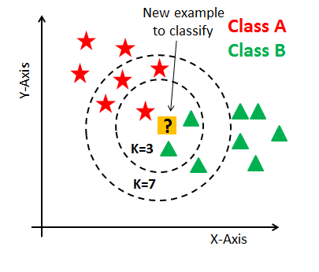
2
Machine learning
What is K in KNN
K is a number used to to identify similar neighbors for the new data point .
'k' in KNN is a parameter that refers to the number of nearest neighbors
The number of neighbors is the core deciding factor. K is generally an odd number if the number of classes is 2. When K=1, then the algorithm is known as the nearest neighbor algorithm

Slide 3
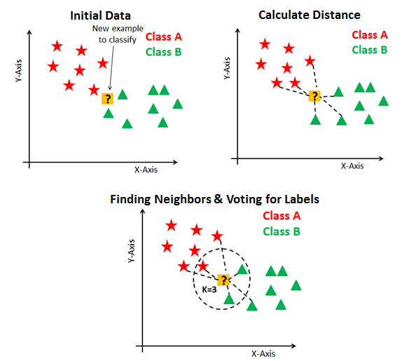
3
Machine learning
Steps in KNN
KNN has the following basic steps:
1.Choose a value of K
2.Calculate distance
3.Find closest neighbors
4.Count the number of data points in each category among the K neighbor, New data point will belong to class that has the most neighbor.

Slide 4

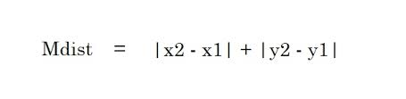
4
Machine learning
How the distance calculated in KNN
Distance can be calculated by using
1.Eucledean distance: it is the square root of the sum of squared distance between two points
2.manhattan distance :It is the sum of absolute values of the differences between to points .

