Slide 1


Marathwada Mitra mandal’s
COLLEGE OF ENGINEERING
Karvenagar, Pune
An Autonomous Institute
Presentation On Project Topic : Typing Tutor

Slide 2
Group Information
Sr.No | Prn No | Name of students
1 | B24IT1124 | UDAY KALE
2 | B24IT1133 | GANESH BIRADAR
3 | B24IT1113 | HEMANT MANE
4 | B24IT1125 | VINIT DHAKE

Slide 3
Outline:
Introduction
Research
Analysis
Ideate
Build
Test
Implement
Links
reference

Slide 4
Introduction
Purpose:
The Typing Tutor project aims to help users improve their typing speed and accuracy through an interactive platform. Its purpose is to teach touch typing, enhancing productivity and reducing typing-related fatigue.
Overview: The tool offers a variety of lessons, exercises, and games, making learning engaging and personalized. Users can track their progress, receive feedback, and enjoy gamified challenges to stay motivated
Key Themes: Key themes include user-centric design, personalized learning, progress tracking, and accessibility, ensuring a fun and effective typing experience for all skill levels.

Slide 5
Research
Objective: The purpose of the research phase was to explore existing typing tutor applications, understand user needs, and gather relevant information for developing a unique and effective typing tutor.
Market Research: We analyzed popular typing tutor applications such as “Monkey Type”. These tools help users improve typing speed and accuracy through timed tests. Common features found across these applications include typing exercises based on letter combinations, words, sentences, and progress tracking.
Target Audience: The target audience for this typing tutor is broad, ranging from beginners looking to learn typing to advanced users aiming to improve speed. The application will cater to students and casual users.
Technological Research: We also researched suitable programming languages and frameworks for building the application. We concluded that using C langauge

Slide 6
Analysis
Objective: The analysis phase aimed to define the project scope, identify user requirements, and establish the features to be implemented.
Functional Requirements:
Typing Lessons: Various levels of lessons starting from basic keys to full sentences.
Typing Speed Measurement: Real-time tracking of words per minute (WPM) and accuracy.
Error Highlighting: Real-time error feedback, highlighting incorrect keystrokes.
Customizable Settings: Users can choose difficulty levels, themes, and lesson types.
Non-Functional Requirements:
Performance: The tutor should be responsive and load lessons instantly. .
Usability: The user interface (UI) should be intuitive, easy to navigate, and accessible to users of all skill levels

Slide 7
Ideate
Objective: The ideation phase focused on brainstorming design ideas and planning the system's architecture and flow.
User Interface Design: We envisioned a clean, minimalistic interface that presents lessons in a step-by-step manner. Key components of the UI include:
Home Page: Introduction to the typing tutor, Typing Screen: Display of the lesson with a real-time feedback system, showing typing speed, accuracy, and errors.
Features to Explore:
Adaptive Difficulty: Difficulty levels that adjust based on the user's performance, providing challenges without overwhelming them.

Slide 8
Build
Objective: The building phase involved the actual development and implementation of the project, transforming the ideas into a working product.
Frontend Development:
Interactive Elements: Buttons, input fields, and real-time feedback systems were integrated into the application to ensure an engaging user experience.
Backend Development:
C language
Testing During Build: Throughout the build phase, unit testing and integration testing were conducted to ensure that each feature worked as intended

Slide 9
Test
Objective: The testing phase aimed to ensure that the application functions correctly, is bug-free, and meets the desired user experience.
Types of Testing:
UI Testing: Ensuring that all UI components are responsive and accessible. Tested on various screen sizes and platforms.
Performance Testing: Measuring the speed and responsiveness of the typing tutor, ensuring no lag or delay during typing.
Bug Fixes:
Fixed issues where the typing feedback was delayed.
Corrected minor UI alignment problems on different screen sizes.
Addressed database connection errors when storing user data.

Slide 10
Implement
Objective: The implementation phase involved deploying the application to users and ensuring it runs effectively in a production environment.
Monitoring: After the initial deployment, continuous monitoring was conducted to track any user-reported issues and ensure smooth operation.
Feedback & Iteration: Based on initial user feedback, minor changes were made to improve the app’s functionality, such as adding additional lessons and refining the error detection feature

Slide 11
#include <stdio.h>
#include <string.h>
#include <time.h>
#include <stdlib.h>
// Function to display the typing task based on the selected levelvoid display_task(int level) { if (level == 1)
{ printf("\nTask: Type the following sentence:\n"); printf("The quick brown fox jumps over the lazy dog.\n"); }
else if (level == 2) { printf("\nTask: Type the following sentence:\n"); printf("A journey of a thousand miles begins with a single step.\n"); }
else if (level == 3)
{ printf("\nTask: Type the following sentence:\n");
printf("To be or not to be, that is the question.\n"); }
else {
printf("Invalid level chosen.\n");
}
} int main() {
int level;
char task[200], input[200];
time_t start, end;
double time_taken;
CODE:

Slide 12
/ Displaying the levels
printf("Choose typing level:\n");
printf("1. Easy\n
printf("2. Medium\n"); printf("3. Hard\n printf("Enter your choice (1-3): ");
scanf("%d", &level);
getchar();
// to consume the newline character left by scanf
// Display the task based on the level display_task(level);
// Getting the task sentence if (level == 1)
{ strcpy(task, "The quick brown fox jumps over the lazy dog."); } else if (level == 2)
{ strcpy(task, "A journey of a thousand miles begins with a single step."); }
else if (level == 3)
{ strcpy(task, "To be or not to be, that is the question."); }
printf("\nStart typing the above sentence. Press ENTER to begin...\n"); getchar(); // Wait for the user to press ENTER to start typing

Slide 13
// Start the timer
start = time(NULL);
// User starts typing
printf("\nType here: ");
fgets(input, sizeof(input), stdin); // Read user input // Remove newline from input if present input[strcspn(input, "\n")] = '\0’;
// Stop the timer end = time(NULL); / Calculate the time taken to type in seconds (difference between start and end) time_taken = difftime(end, start);
// Check if the typed sentence matches the task if (strcmp(input, task) == 0) { printf("\nTask completed successfully!\n"); printf("Time taken: %.2f seconds\n", time_taken); // Display time in seconds

Slide 14
} else { printf("\nThe typed sentence doesn't match the task. Please try again.\n"); } return 0; }

Slide 15
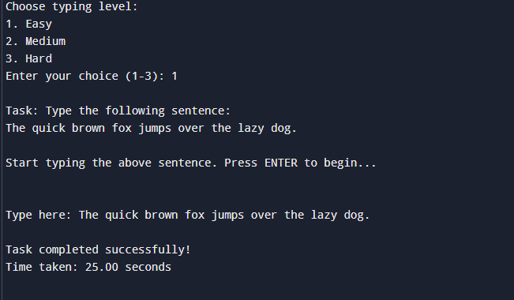

Slide 16
H. Links
Report Link: https://docs.google.com/document/d/13818XLle6bEDQHoIDxxcHVZn0nJCC2Vv/edit?usp=drive_link&ouid=113908240389611644680&rtpof=true&sd=true
Blog Link: https://docs.google.com/document/d/1aP-2lM1eRUVep5vE_JIs-RXVQdMswDqD/edit?usp=drive_link&ouid=113908240389611644680&rtpof=true&sd=true
Video Link: https://drive.google.com/file/d/1kod5q4GHEWN6Wd8ByXo5pd1G3ZereaoL/view?usp=drivesdk

