Slide 1

Pre-owned car market analysis Dashboard
Insights for Enhanced Decision-Making in the pre-owned Car Market

Slide 2
Contents
Problem Identification and Problem Statement
Problem objective and Target audience (Stakeholders)
SGQ matrix
Decisions for each Stakeholder
1.executive Overview PRE-OWNED CAR – Revenue & Market Insights
2. PRE-OWNED CARS Operational Performance Dashboard – Sales, Inventory & Trends
3. PRE-OWNED Car Market Explorer – Find the Best Deals
4. Combined Dashboard: PRE-OWNED Car Market Analysis
Key Insights & Actionable Recommendations

Slide 3
Problem Identification & Problem Statement
Problem Identification:
Complex price fluctuations in the pre-owned car market due to various factors (mileage, condition, model, location, seller type, and time of sale).
Challenges for stakeholders (dealerships, managers, and customers) in:
Evaluating a vehicle's true value.
Identifying sales trends.
Understanding customer preferences.
Problem Statement:
Analyze a pre-owned car sales dataset to uncover key trends in vehicle attributes, market conditions, and time-based factors affecting pricing and sales volume.
Develop role-based dashboards to support better decision-making across operational, strategic, and consumer-level scenarios.

Slide 4
Problem objective and Target audience (Stakeholders)
Project Objective:
Design dynamic dashboards tailored for different user levels: CEO, Manager, and Customer.
Provide actionable insights using interactive visuals.
Utilize DAX measures for advanced KPIs (e.g., depreciation, MMR comparison, and sales trends).
Empower each user role with targeted information to support their goals.
Target Audience (Stakeholders):
CEO: Strategic overview, high-level KPIs (Profit/Loss, Market Distribution).
Manager: Operational analytics, performance monitoring (Condition vs. Price, Seasonal Trends).
Customer: Value assessment, identifying best deals (Mileage effect, Color impact).

Slide 5
Gaps
SGQ Matrix
Which specific car details have the strongest influence on price variation?
How do price trends vary across different geographic markets?
Are there undervalued car models with high resale potential?
Which seller types offer the best value or pricing consistency?
Are there color or interior design features that add value disproportionately?
How does vehicle age interact with mileage in determining depreciation?
Current state
Final State
What is the average price of cars based on year, make, model, and transmission?
How do mileage and condition impact the resale value of vehicles?
What is the distribution of car prices across different U.S. states/regions?
What are the common price ranges for different seller types (e.g., dealerships vs private sellers)?
How do color and interior design preferences correlate with car prices?
Are certain brands or trims consistently priced higher than others?
Help buyers and sellers make data-driven decisions on fair car pricing.
Enable dealerships to optimize pricing strategies based on demand and car features.
Empower consumers to identify high-value cars and avoid overpriced options.
Guide used car platforms in presenting price-predictive features to increase trust.
Promote transparency in car resale markets by identifying regional pricing patterns.
Support the development of intelligent pricing tools that provide instant, fair-value estimates for both buyers and sellers, enhancing trust and efficiency in the used car market.
How do car features like year, make, model, and transmission affect price?
What is the combined impact of mileage and condition on resale value?
Do specific states or cities command higher prices for certain vehicles?
How do exterior and interior design choices influence pricing?
What is the pricing difference across dealerships, private sellers, and rentals?
How do market trends influence the valuation of aging vehicles?
Key Questions

Slide 6
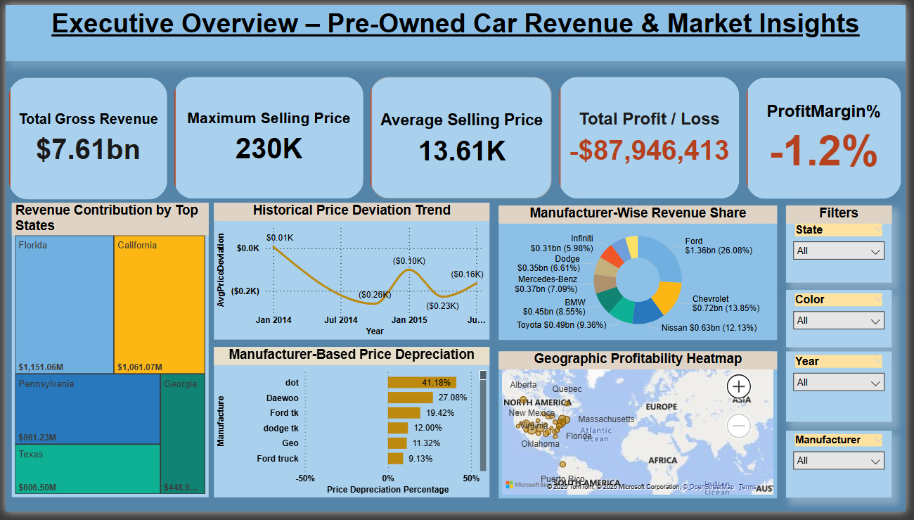
Executive Overview Pre-Owned Car – Revenue & Market Insights
Title: Executive Overview – Pre-Owned Cars Revenue & Market Insights
Key Metrics:
Total Gross Revenue: $7.61bn
Maximum Selling Price: $230K
Average Selling Price: $13.61K
Total Profit / Loss: -$87,946,413
ProfitMargin%: -1.2%
Visualizations & Insights:
Revenue Contribution by Top States: Florida, California, Pennsylvania, Texas, Georgia lead in total sales.
Historical Price Deviation Trend: Reveals price fluctuation against MMR over time, with notable deviations in Jan 2014, Jul 2014, and Jan 2015.
Manufacturer-Wise Revenue Share: Ford (26.08%), Chevrolet (13.85%), Nissan (12.13%), and Toyota (9.36%) are top contributors to revenue share.
Manufacturer-Based Price Depreciation: Highlights brands with highest depreciation (e.g., dot at 41.10%) to lowest (e.g., Ford truck at 9.13%).
Geographic Profitability Heatmap: Shows region-wise profitability using a map view, including North America, and South America.
Stakeholders: CEO, Manager

Slide 7
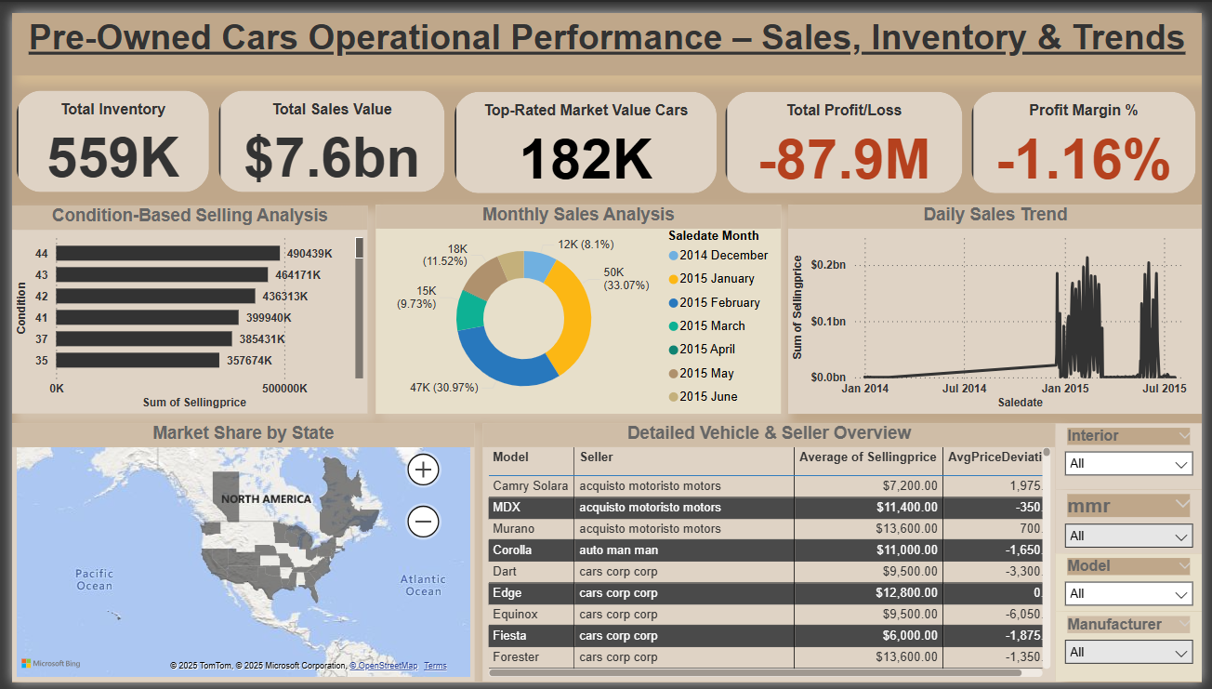
Pre-Owned Cars Operational Performance Dashboard – Sales, Inventory & Trends
Title: Pre-Owned Cars Operational Performance – Sales, Inventory & Trends
Key Metrics:
Total Inventory: 559K
Total Sales Value: $7.6bn
Top-Rated Market Value Cars: 182K
Total Profit/Loss: -$87.9M
Profit Margin %: -1.16%
Visualizations & Insights:
Condition-Based Selling Analysis: Displays selling price distribution across different car conditions (e.g., Condition 44 with 490439K units).
Monthly Sales Analysis: Shows sales distribution by month, with December leading (33.07% or 18K units) and January (18.1%) also being significant.
Daily Sales Trend: Illustrates the daily fluctuation in selling price over time, showing a gradual increase from Jan 2014 to Jul 2015.
Market Share by State: Provides a geographical breakdown of market share across North America, including specific states like Quebec, Massachusetts, and Florida.
Detailed Vehicle & Seller Overview: Presents average selling price and price deviation for various models (e.g., Camry Solara, MDX, Murano) and sellers (e.g., acquisto motoristo motors, auto man man).
Stakeholders: Manager

Slide 8
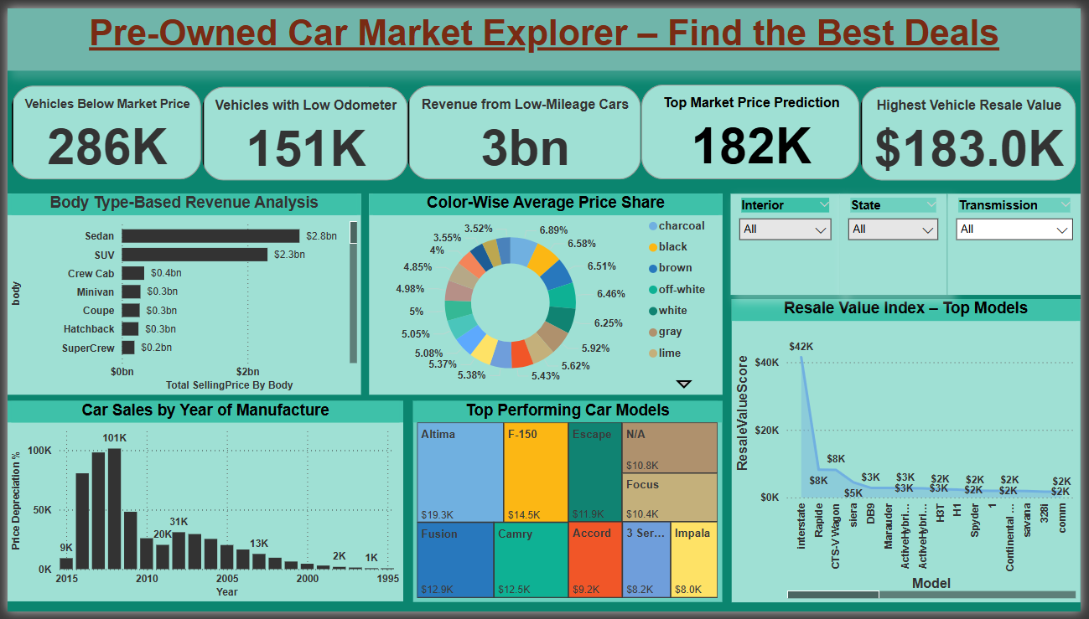
Pre-Owned Car Market Explorer – Find the Best Deals
Title: Pre-Owned Car Market Explorer – Find the Best Deals
Key Metrics:
Vehicles Below Market Price: 286K
Vehicles with Low Odometer: 151K
Revenue from Low-Mileage Cars: $3bn
Top Market Price Prediction: 182K
Highest Vehicle Resale Value: $183.0K
Visualizations & Insights:
Body Type-Based Revenue Analysis: Displays total selling price by car body type, with Sedan leading ($2.8bn), followed by SUV ($2.3bn).
Color-Wise Average Price Share: Shows the average price share across different car colors, with charcoal and black having significant shares.
Car Sales by Year of Manufacture: Illustrates the volume of car sales based on the year of manufacture, with a high volume around 2015 and then decreasing.
Top Performing Car Models: Ranks car models by total selling price, with Altima ($19.3K) and F-150 ($14.5K) leading.
Resale Value Index – Top Models: Provides a visual index of resale values for various car models, indicating models with higher resale value.
Stakeholders: Customer

Slide 9
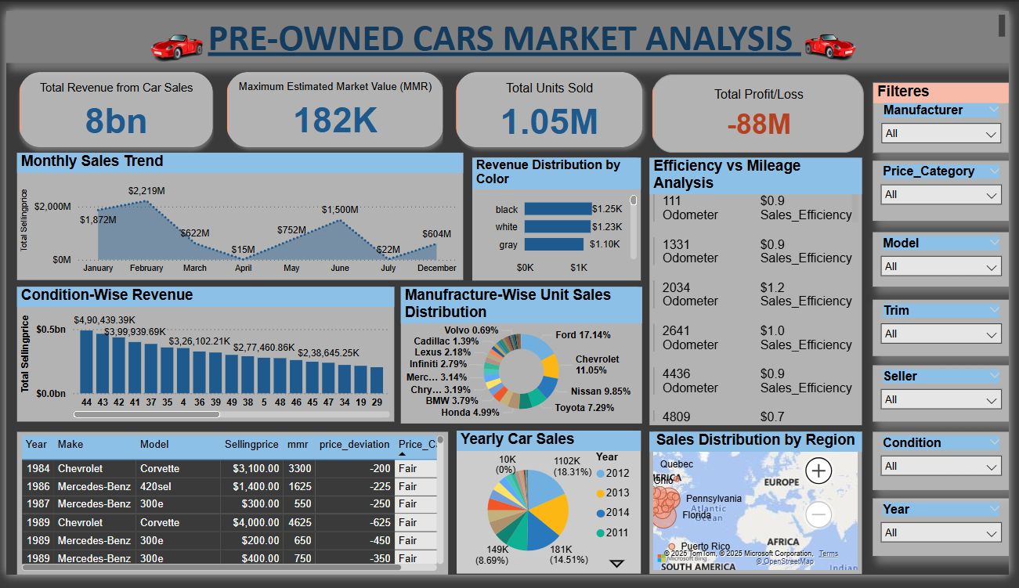
Pre-Owned Car Market Analysis
Title: Pre-Owned Car Market Analysis
Key Metrics:
Total Revenue from Car Sales: $8bn
Maximum Estimated Market Value (MMR): 182K
Total Units Sold: 1.05M
Total Profit/Loss: -$88M
Visualizations & Insights:
Monthly Sales Trend: Shows the monthly sales volume and total selling price, with a peak in January ($2.219M) and December ($694M), and a dip in May ($15M).
Revenue Distribution by Color: Illustrates revenue generated by different car colors; black ($1.25K), white ($1.23K), and gray ($1.10K) are shown.
Efficiency vs Mileage Analysis: Compares odometer readings with sales efficiency for different vehicles (e.g., 111 Odometer with $0.9 Sales Efficiency).
Manufacture-Wise Unit Sales Distribution: Displays the percentage of units sold by various manufacturers, with Ford leading (17.14%), followed by Chevrolet (11.05%) and Nissan (9.85%).
Condition-Wise Selling Price Distribution: Shows the distribution of selling prices across different car conditions, with selling prices ranging from $0.0bn to $4.90bn.Yearly Car Sales: Provides a breakdown of car sales by year, showing distributions like 18K (11.52%) for 2014 and 38K (14.51%) for 2011.Sales Distribution by Region: Geographic sales distribution across various regions including Quebec, Pennsylvania, Florida, and Puerto Rico.
Condition-Wise Price Deviation: Shows price deviation based on car condition and year of manufacture, with examples like 1984 Chevrolet Corvette with a -200 price deviation.
Stakeholders: All Levels

Slide 10
Key Insights & Actionable Recommendations
🔷 1. CEO-Level Insights & Recommendations
📌 Key Insights:
High selling prices were observed in specific states/regions, indicating geographic-based demand variation.
There is a noticeable price gap between MMR and actual selling prices, showing opportunities to optimize pricing strategy.
Dealership sellers consistently price higher than private sellers but with no consistent advantage in sales volume.
Profit margins vary significantly across locations and seller types.
✅ Recommendations:
Focus inventory acquisition and marketing efforts in high-performing regions.
Align pricing strategy closely with MMR benchmarks to stay competitive and increase conversion rates.
Encourage better-performing seller types to expand operations or adopt successful sales practices.
Implement regional profit optimization models to improve ROI.

Slide 11
Key Insights & Actionable Recommendations
🛠️ 2.Manager-Level Insights & Recommendations
📌 Key Insights:
Condition and mileage have strong impacts on vehicle price—vehicles in excellent condition sell at higher average prices.
A significant portion of inventory falls into the Medium Price Category (5K–15K).
Monthly sales trends reveal peaks and dips—seasonal patterns are present.
Odometer readings directly correlate with declining prices.
✅ Recommendations:
Rotate aging or high-odometer inventory quickly using discount strategies.
Adjust stocking levels and pricing based on seasonal trends identified in sales history.
Classify inventory more aggressively into Low/Medium/High pricing bands to improve customer targeting.
Provide sales reps with pricing guidelines based on car condition and mileage bands.

Slide 12
Key Insights & Actionable Recommendations
👥 3. Customer-Level Insights & Recommendations
📌 Key Insights:
Many vehicles are being sold below MMR, presenting opportunities for value purchases.
Depreciation rates sharply increase after a certain mileage threshold (~75,000 km).
Certain colors and body types (e.g., SUVs) consistently retain higher resale values.
Private sellers often provide better deals than dealerships but may lack warranties or post-sale service.
✅ Recommendations:
Guide buyers toward low-mileage cars with minimal price drop (high resale score).
Recommend ideal months for buying cars, based on lower price trends.
Educate customers on best color and body type combinations for value retention.
Provide a dealer vs private seller comparison tool to help make smarter decisions.

Slide 13



