Slide 1

BLOOD BANK

Slide 2
INTRODUCTION
Online Blood Bank is aims serving for human welfare. We have all the information; you will ever need. Many people are here for you, to help you, willing to donate blood for you anytime. We have done all the job, rest is yours. search the blood group you need.
You can help us by registering on Online Blood Bank if you are willing to donate your blood when needed. As a proud member of Online Blood Bank and a responsible human being, you can help someone in need. So, donate blood in online.
The number of persons who need blood are increasing in large number day by day. In order to help people who, need blood, my Online Blood Bank can be used effectively for getting the details of blood donors having the same blood group and within the same city. With the help of my Online Blood Bank people who are having the thought of donating blood gets registered in my Online Blood Bank giving his total details.
My Online Blood Bank site is available to everyone easily. A person who likes to donate blood gives his entire details i.e., fill in the registration form and can create a username with a password by which he can modify his details if at all there are any changes in his information given before.

Slide 3
Modules:
Login
Registration
Admin
Donor or User
Make a Blood Request from Admin
About Blood Bank
Feedback

Slide 4
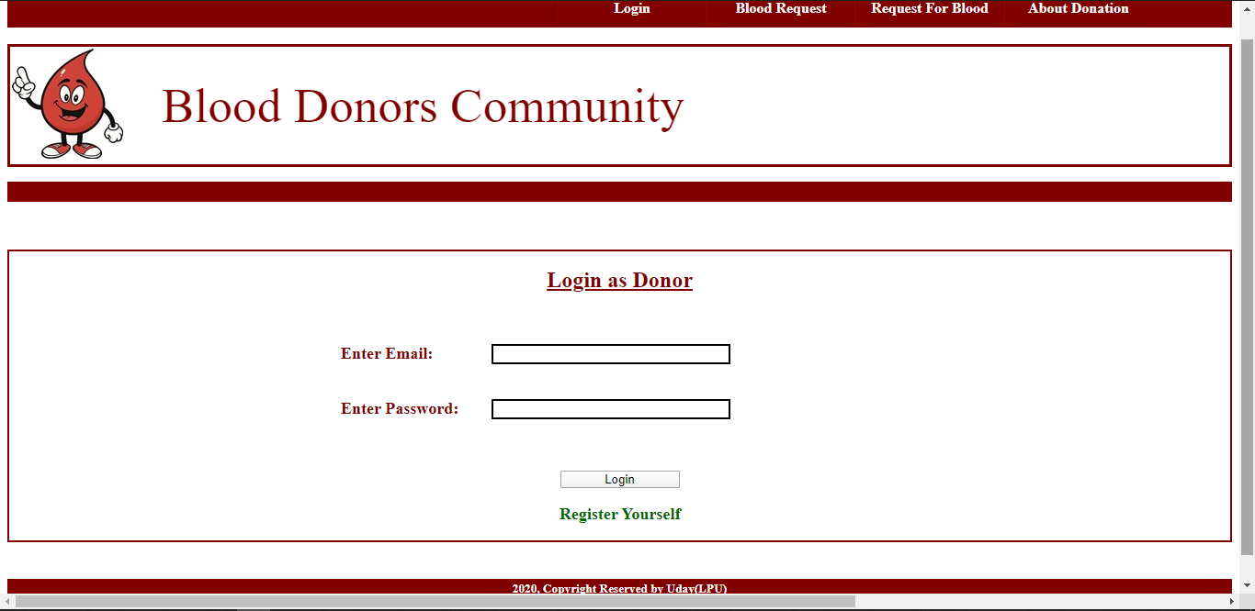

Slide 5
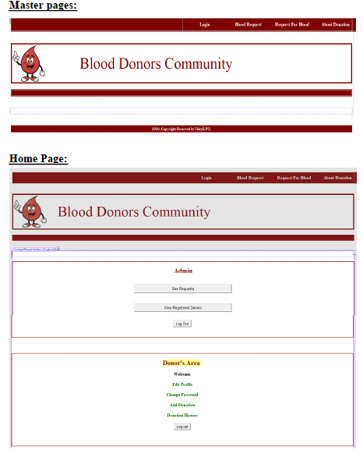
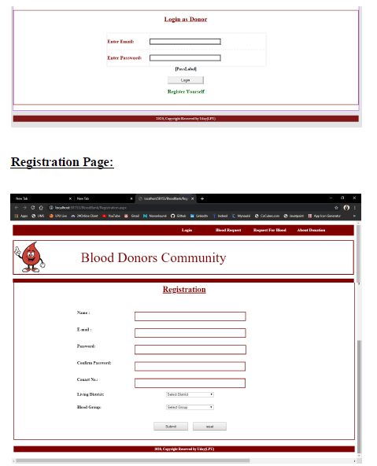

Slide 6
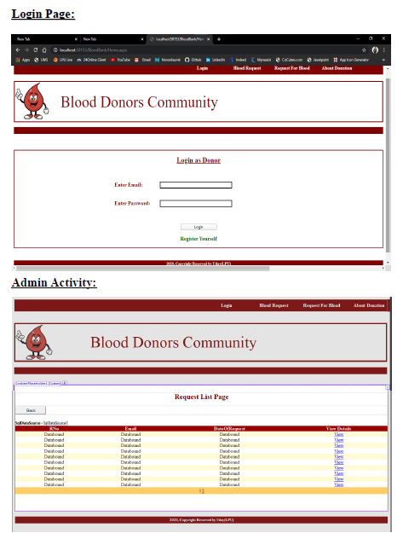
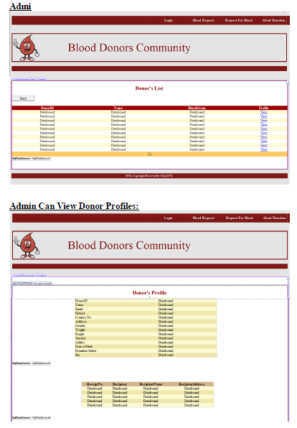

Slide 7
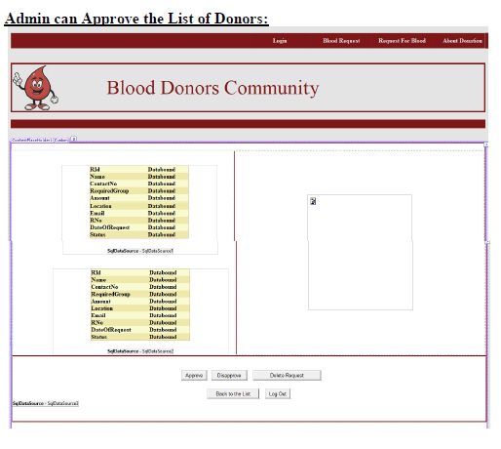

Slide 8
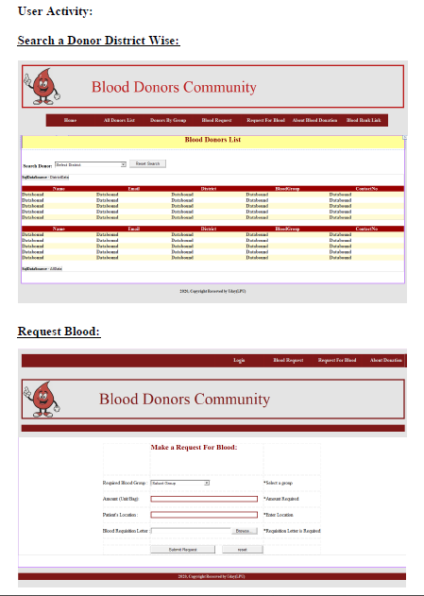
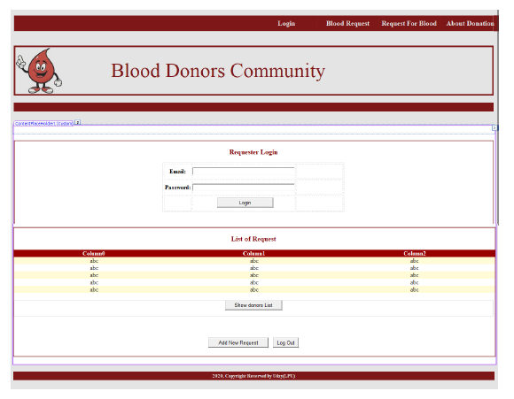

Slide 9
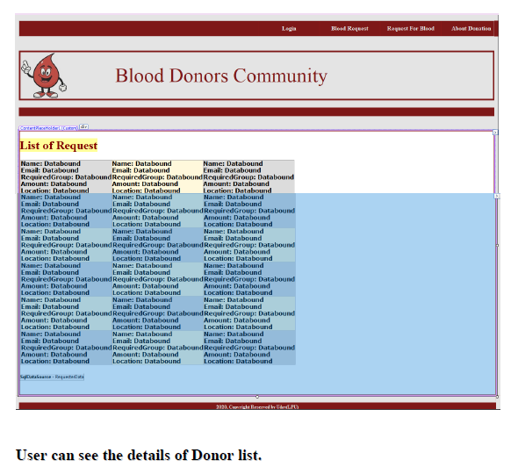
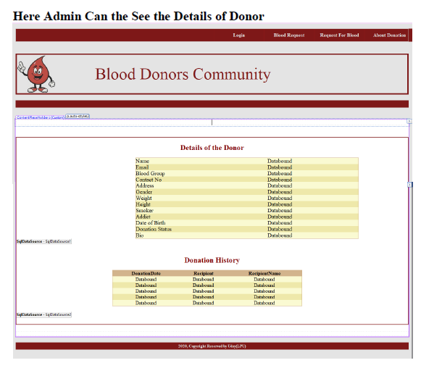

Slide 10
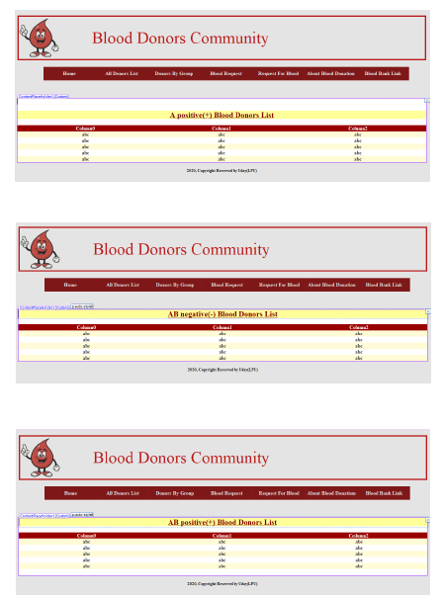
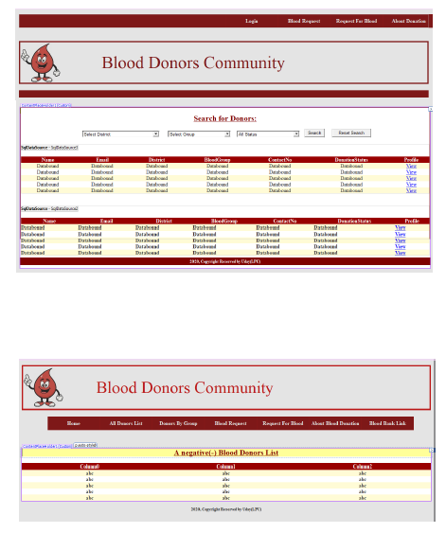

Slide 11
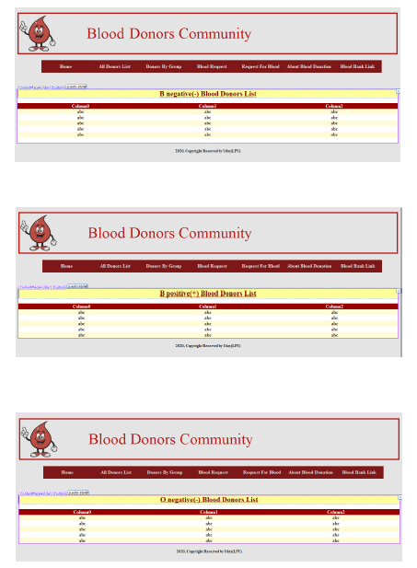
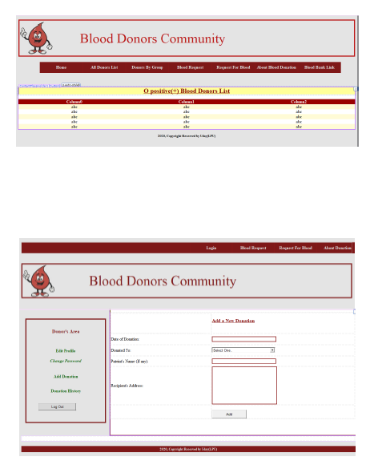

Slide 12
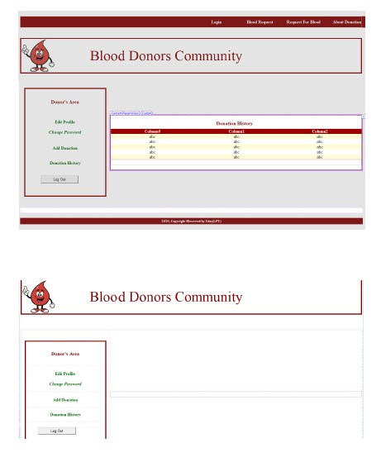
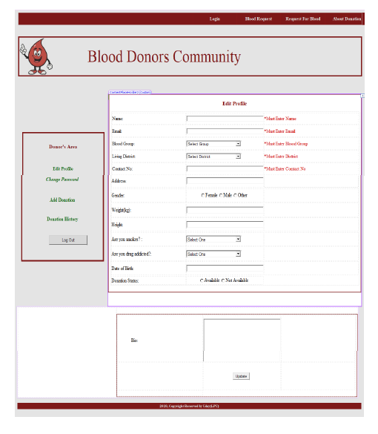

Slide 13
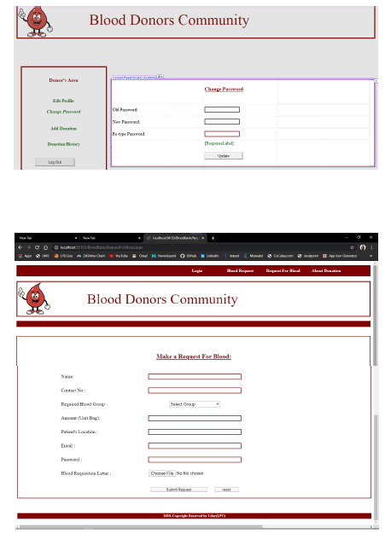
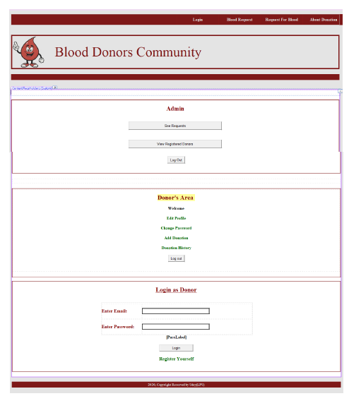

Slide 14
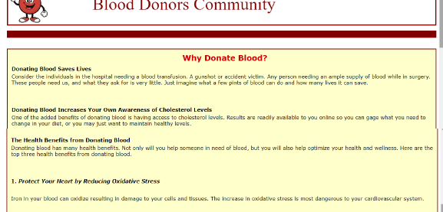

Slide 15
THANK YOU

