Slide 1
UNIT-4
BRIDGES

Slide 2
Types of Bridges:-
If the electrical components are arranged in the form a bridge or ring structure, then that electrical circuit is called a bridge. In general, bridge forms a loop with a set of four arms or branches. Each branch may contain one or two electrical components.
We can classify the bridge circuits or bridges into the following two categories based on the voltage signal with which those can be operated.
(I) DC Bridges
(II) AC Bridges
DC Bridges:-
If the bridge circuit can be operated with only DC voltage signal, then it is a DC bridge circuit or simply DC bridge. DC bridges are used to measure the value of unknown resistance. The circuit diagram of DC bridge looks like as shown in below figure.

Slide 3
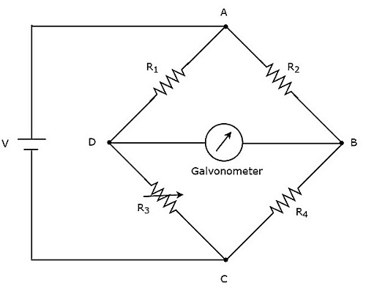
The above DC bridge has four arms and each arm consists of a resistor. Among which, two resistors have fixed resistance values, one resistor is a variable resistor and the other one has an unknown resistance value.
The above DC bridge circuit can be excited with a DC voltage source by placing it in one diagonal. The galvanometer is placed in other diagonal of DC bridge. It shows some deflection as long as the bridge is unbalanced.
Vary the resistance value of variable resistor until the galvanometer shows null (zero) deflection. Now, the above DC bridge is said to be a balanced one. So, we can find the value of unknown resistance by using nodal equations.

Slide 4
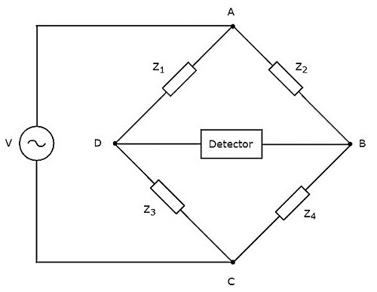
AC Bridges:-
If the bridge circuit can be operated with only AC voltage signal, then it is said to be AC bridge circuit or simply AC bridge.
AC bridges are used to measure the value of unknown inductance, capacitance and frequency.
The circuit diagram of AC bridge looks like as shown in below figure.
The circuit diagram of AC bridge is similar to that of DC bridge. The above AC bridge has four arms and each arm consists of some impedance. That means, each arm will be having either single or combination of passive elements such as resistor, inductor and capacitor.

Slide 5
Among the four impedances, two impedances have fixed values, one impedance is variable and the other one is an unknown impedance.
The above AC bridge circuit can be excited with an AC voltage source by placing it in one diagonal. A detector is placed in other diagonal of AC bridge. It shows some deflection as long as the bridge is unbalanced.
The above AC bridge circuit can be excited with an AC voltage source by placing it in one diagonal. A detector is placed in other diagonal of AC bridge. It shows some deflection as long as the bridge is unbalanced.
Vary the impedance value of variable impedance until the detector shows null (zero) deflection. Now, the above AC bridge is said to be a balanced one. So, we can find the value of unknown impedance by using balanced condition.
DC bridges can be operated with only DC voltage signal. DC bridges are useful for measuring the value of unknown resistance, which is present in the bridge. Wheatstone’s Bridge is an example of DC bridge.

Slide 6
Maxwells Bridge Definition:-
Maxwell’s bridge is also known as Maxwell’s Wein bridge or modified form of Wheatstone bridge or Maxwell’s inductance capacitance bridge, consists of four arms used to measure unknown inductances in terms of calibrated capacitances and resistances.
It can be used to measure unknown inductance value and compares it with the standard value. It works on the principle of comparison of known and unknown inductance values.
It uses the null deflection method to calculate inductance with a parallel calibrated resistor and capacitor. The Maxwell’s bridge circuit is said to be in resonance if the positive phase angle of an inductive impedance is compensated with the negative phase angle of the capacitive impedance (connected in the opposite arm). Hence there will be no current flowing through the circuit and no potential across the null detector.
Maxwells Bridge Formula
If the maxwell’s bridge is in balance condition, the unknown inductance can be measured by using a variable standard capacitor. The maxwell’s bridge formula is given as (in terms of inductance, resistance, and capacitance)
R1 = R2r3/R4
L1= R2R3C4
The quality factor of Maxwell’s bridge circuit is given as,
Q = ωL1/R1 = ωC4R4

Slide 7
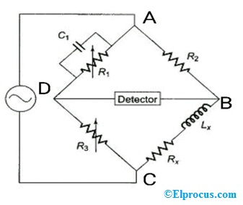
Maxwells Bridge Circuit
Maxwell’s bridge circuit consists of 4 arms connected in square or rhombus shape. In this circuit, two arms contain a single resistor, another one arm contains a resistor and inductor in series combination, and the last arm contains a resistor and capacitor in parallel combination. The basic Maxwell’s bridge circuit is shown below.

Slide 8
An AC voltage source and a null detector are connected in diagonal to the bridge circuit to measure the unknown inductance value and compared with the known values.
Maxwells Bridge Equation
From the circuit, AB, BC, CD, and DA are the 4 arms connected in rhombus shape.
AB and CD are the resistors R2 and R3,
BC is a series combination of resistor and inductor given as Rx and Lx.
DA is a parallel combination of resistor and capacitor given as R1 and C1
Consider Z1, Z2, Z3, and ZX are the impedances of the 4 arms of the bridge circuit. The values for these impedances are given as,
Z1 = (R1+jwL1) [ since Z1=R1+1/jwC1 ]
Z2 = R2
Z3=R3
ZX= (R4+jwLX)
Or

Slide 9
Z1= R1 in parallel with C1 that is, Y1=1/Z1
Y1 = 1/R1 + j ωC1
Z2=R2
Z3=R3
Zx=Rx in series with Lx =Rx+jωLx
Take the balance equation of a basic AC bridge circuit as follows,
Z1Zx=Z2Z3
Zx=Z2Z3/Z1……………………………………….(1)
Substitute the values of impedances of Maxwell’s bridge circuit in the above balance equation. Then,
Rx+jωLx = R2R3 ((1/R1)+jωC1)
Rx+jωLx = R2R3/R1+ jωC1R2R3

Slide 10
Now equate the real and imaginary terms from the above two equations,
Rx = R2R3/R1 and jωLx = jωC1R2R3
Rx = R2R3/R1 and Lx =C1R2R3
Q = ωLx/Rx = ωC1R2R3x R1/R2R3 = ωC1R1
Where Q = quality factor of the bridge circuit
Rx= unknown resistance
Lx= unknown inductance
R2 and R3 = known non-inductive resistances
C1 = capacitor connected in parallel to the variable resistor R1
Advantages of Maxwells Bridges:-
At the balance condition, the bridge circuit is independent of frequency
It helps to measure a wide range of inductance values at audio and power frequency
To measure the inductance value directly, the scale of calibrated resistance is used.
It is used to measure the high range of inductances and compared with a standard value.

Slide 11
Disadvantages of Maxwells Bridge:-
The fixed capacitor in Maxwell’s bridge circuit may create interaction between resistance and reactance balance.
It is not suitable to measure a high range of quality factor ( Q values >=10)
The variable standard capacitor used in the circuit is very costly.
It is not used to measure the low-quality factor ( Q value) due to the circuit balance condition. Hence it is used for medium quality coils.
Applications of Maxwells Bridge:-
Used in communication systems
Used in electronic circuits
Used in power and audio frequency circuits
Used to measure unknown inductance values of the circuit and compared with a standard value.
Used to measure medium quality coils.
Used in filter circuits, instrumentation, linear and non-linear circuits
Used in power conversion circuits.

Slide 12
two AC bridges.
Schering Bridge
Wien’s Bridge
These two bridges can be used to measure capacitance and frequency respectively.
Schering Bridge:-
Schering bridge is an AC bridge having four arms, which are connected in the form of a rhombus or square shape, whose one arm consists of a single resistor, one arm consists of a series combination of resistor and capacitor, one arm consists of a single capacitor & the other arm consists of a parallel combination of resistor and capacitor.
The AC detector and AC voltage source are also used to find the value of unknown impedance, hence one of them is placed in one diagonal of Schering bridge and the other one is placed in other diagonal of Schering bridge.
Schering bridge is used to measure the value of capacitance. The circuit diagram of Schering bridge is shown in the below figure.

Slide 13
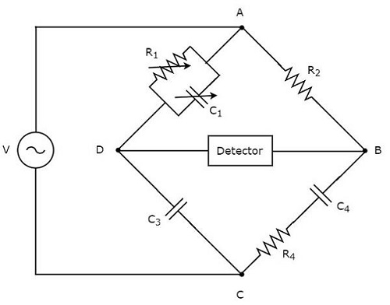
the arms AB, BC, CD and DA together form a rhombus or square shape.
The arm AB consists of a resistor, R2. The arm BC consists of a series combination of resistor, R4 and capacitor, C4.
The arm CD consists of a capacitor, C3.
The arm DA consists of a parallel combination of resistor, R1 and capacitor, C1.

Slide 14
Let, Z1, Z2,Z3 and Z4 are the impedances of arms DA, AB, CD and BC respectively. The values of these impedances will be
Z1Zx= Z2Z3
Zx= Z2Z3/ Z1, Zx= Z2Z3Y1
Zx= Rx+1/jωCx
Zx= Rx-j/ωCx
Z2 = R2
Z3= 1/jωC3= -j/ωc3
Y1 = 1/R1 + j ωC1
(Rx-j/ωCx)= R2(-j/ωC3)(1/R1 + j ωC1)
= -R2j/ωC3 R1+ R2 ωC1/ ωC3
Rx-j/ωCx =R2(-j)/R1 ωC3 + R2C1/C3
(OR)
R2C1/C3-jR2/ ωC3 R1
Now equate the real and imaginary terms
Rx = R2C1/C3 and Cx =R1/R2*C3

Slide 15
By comparing the respective real and imaginary terms of above equation, we will get
C4=R1C3/R2 Equation 1
R4=C1R2/C3 Equation 2
By substituting the values of R1,R2 and C3 in Equation 1, we will get the value of capacitor, C4. Similarly, by substituting the values of R2,C1 and C3 in Equation 2, we will get the value of resistor, R4.
The advantage of Schering bridge is that both the values of resistor, R4 and capacitor, C4 are independent of the value of frequency.
The dial of capacitor C1 can be calibrated directly to give the dissipation factor at a particular frequency.
The dissipation factor ‘D’ of a series RC ckt is defined as the cotangent of phase angle
D=Rx/Xx= ωCxRx
Also, D is the reciprocal of the quality factor Q, i.e., D=1/Q. D indicates the quality of the capacitor.
This bridge is widely used for testing small capacitors at low voltages with very high precision.

Slide 16
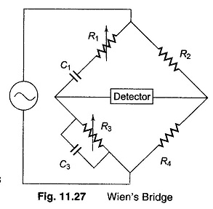
WIEN’S BRIDGE:-

Slide 17
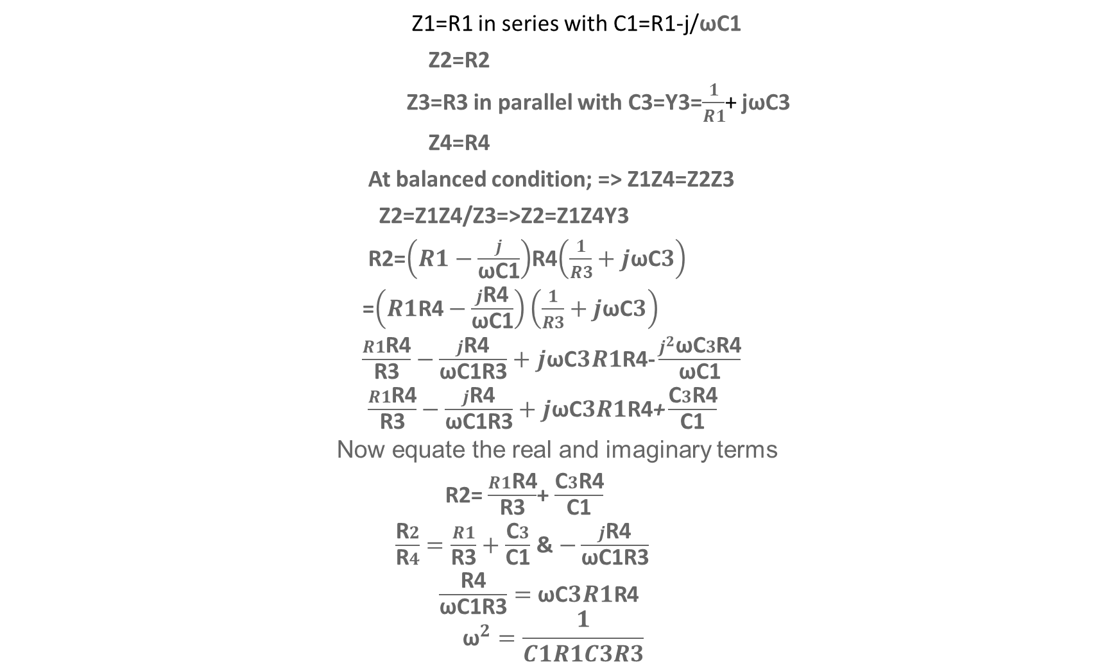
Z1=R1 in series with C1=R1-j/ωC1
Z2=R2
Z3=R3 in parallel with C3=Y3=$\frac{1}{R1}$+ jωC3
Z4=R4
At balanced condition; => Z1Z4=Z2Z3
Z2=Z1Z4/Z3=>Z2=Z1Z4Y3
R2=$\left(R1−\frac{j}{\text{ω}\text{C}\text{1}}\right)$R4$\left(\frac{1}{R3}+j\text{ω}\text{C}3\right)$
=$\left(R1\text{R}\text{4}−\frac{j\text{R}\text{4}}{\text{ω}\text{C}\text{1}}\right)\left(\frac{1}{R3}+j\text{ω}\text{C}3\right)$
$\frac{R1\text{R}\text{4}}{\text{R}\text{3}}−\frac{j\text{R}\text{4}}{\text{ω}\text{C}\text{1}\text{R}\text{3}}+$ $j\text{ω}\text{C}3R1\text{R}\text{4}\text{−}\frac{j^{2}\text{ω}\text{C}3\text{R}\text{4}}{\text{ω}\text{C}\text{1}}$
$\frac{R1\text{R}\text{4}}{\text{R}\text{3}}−\frac{j\text{R}\text{4}}{\text{ω}\text{C}\text{1}\text{R}\text{3}}+$ $j\text{ω}\text{C}3R1\text{R}\text{4}\text{+}\frac{\text{C}3\text{R}\text{4}}{\text{C}\text{1}}$
Now equate the real and imaginary terms
R2= $\frac{R1\text{R}\text{4}}{\text{R}\text{3}}$+ $\frac{\text{C}3\text{R}\text{4}}{\text{C}\text{1}}$
$\frac{\text{R}2}{\text{R}4}=\frac{R1}{\text{R}\text{3}}+$ $\frac{\text{C}3}{\text{C}\text{1}}$ & $−\frac{j\text{R}\text{4}}{\text{ω}\text{C}\text{1}\text{R}\text{3}}$
$\frac{\text{R}\text{4}}{\text{ω}\text{C}\text{1}\text{R}\text{3}}=$ $\text{ω}\text{C}3R1\text{R}$4
$${\text{ω}}^{2}=\frac{1}{C1R1C3R3}$$

Slide 18

f=$\frac{1}{2π\sqrt{R1C1R3C3}}$
If we assume C1=C3=C; R1=R3=R
f= $\frac{1}{2π\sqrt{R^{2}C^{2}}}$
f=$\frac{1}{2πRC}$

Slide 19
Applications of Wien Bridge Oscillators
It is used to measure the audio frequency.
Wien bridge oscillator designs the long range of frequencies
It produces sine wave.
Advantages
Distortion testing of power amplifier.
It supplies the signals for testing filters.
Excitation for AC Bridge.
To fabricate pure tune.
Long distance can be spanned by the resting beams.
Disadvantages
The Wheatstone bridge is not used for the high resistance.
The circuit needs the high no. of other components.
The limited output frequency is obtained because the amplitude and the phase shift characters of the amplifier.

Slide 20
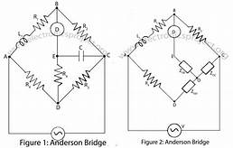
ANDERSON BRIDGE:-

Slide 21
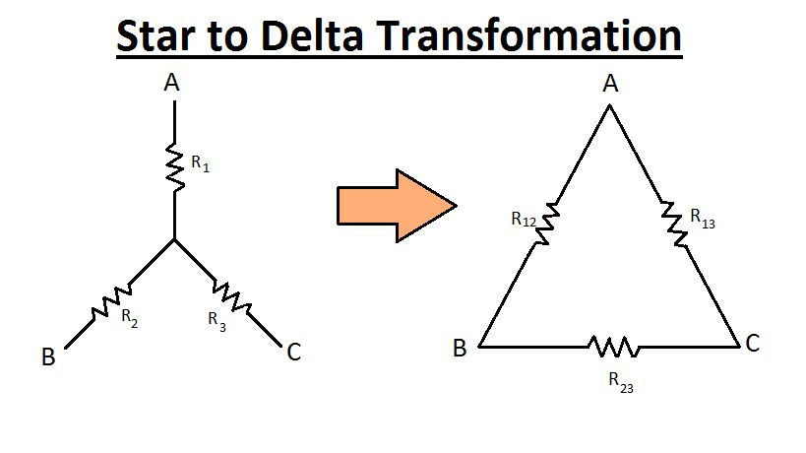
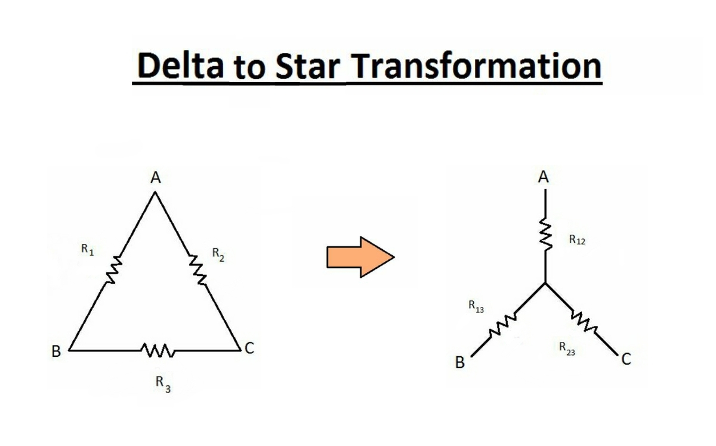
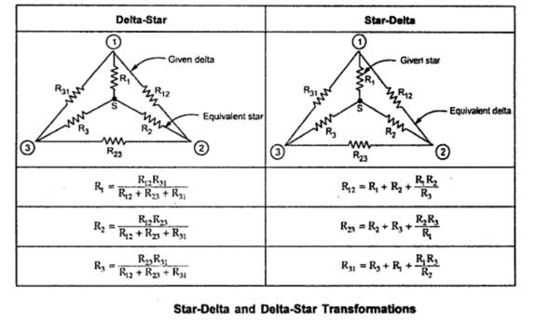

Slide 22
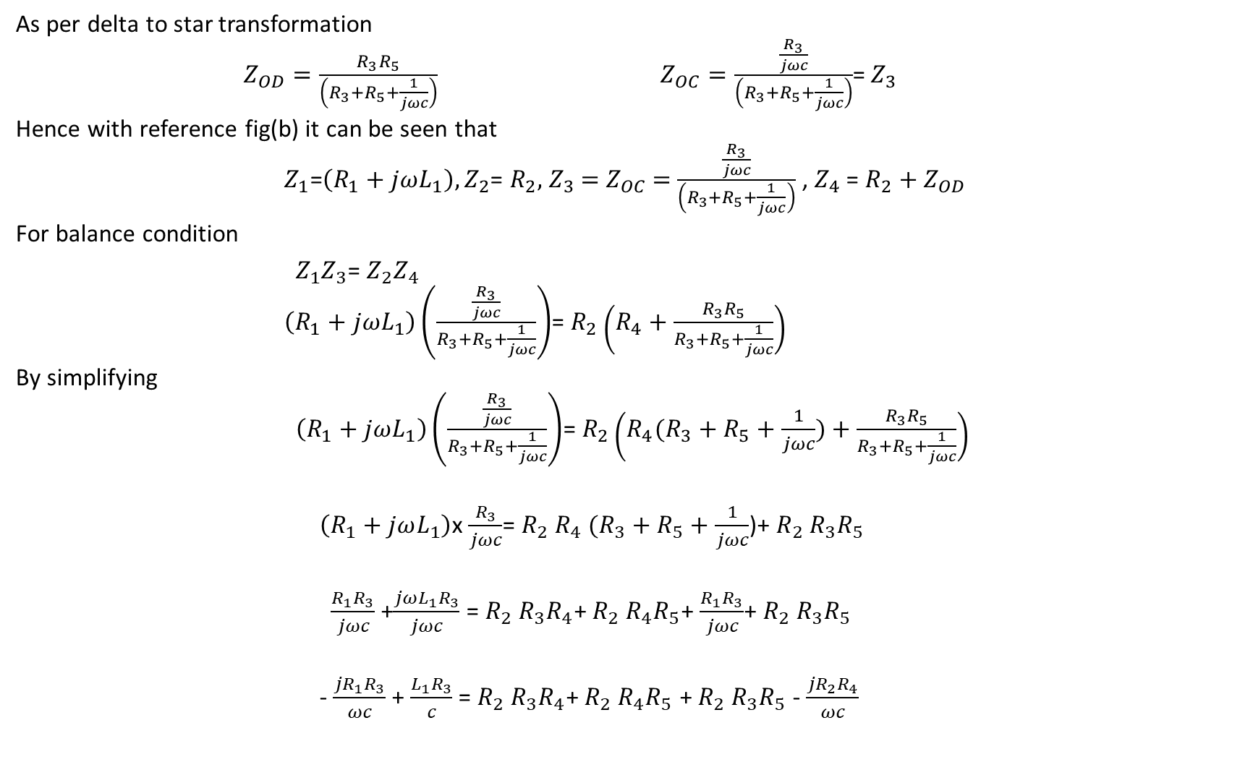
As per delta to star transformation
$Z_{OD}=\frac{R_{3}R_{5}}{\left(R_{3}+R_{5}+\frac{1}{jωc}\right)}$ $Z_{OC}=\frac{\frac{R_{3}}{jωc}}{\left(R_{3}+R_{5}+\frac{1}{jωc}\right)}$= $Z_{3}$
Hence with reference fig(b) it can be seen that
$Z_{1}$=$\left(R_{1}+jωL_{1}\right), Z_{2}$= $R_{2},$ $Z_{3}$ $=$ $Z_{OC}$ $=$ $\frac{\frac{R_{3}}{jωc}}{\left(R_{3}+R_{5}+\frac{1}{jωc}\right)}$ , $Z_{4}$ = $R_{2}+Z_{OD}$
For balance condition
$Z_{1}Z_{3}$= $Z_{2}Z_{4}$
$\left(R_{1}+jωL_{1}\right)\left(\frac{\frac{R_{3}}{jωc}}{R_{3}+R_{5}+\frac{1}{jωc}}\right)$= $R_{2}\left(R_{4}+\frac{R_{3}R_{5}}{R_{3}+R_{5}+\frac{1}{jωc}}\right)$
By simplifying
$\left(R_{1}+jωL_{1}\right)\left(\frac{\frac{R_{3}}{jωc}}{R_{3}+R_{5}+\frac{1}{jωc}}\right)$= $R_{2}\left(R_{4}(R_{3}+R_{5}+\frac{1}{jωc})+\frac{R_{3}R_{5}}{R_{3}+R_{5}+\frac{1}{jωc}}\right)$
$\left(R_{1}+jωL_{1}\right)$x $\frac{R_{3}}{jωc}$= $R_{2}$ $R_{4}$ $(R_{3}+R_{5}+\frac{1}{jωc}$)+ $R_{2}$ $R_{3}R_{5}$
$\frac{R_{1}R_{3}}{jωc}$ +$\frac{jωL_{1}R_{3}}{jωc}$ = $R_{2}$ $R_{3}R_{4}$+ $R_{2}$ $R_{4}R_{5}$+ $\frac{R_{1}R_{3}}{jωc}$+ $R_{2}$ $R_{3}R_{5}$
- $\frac{{jR}_{1}R_{3}}{ωc}$ + $\frac{L_{1}R_{3}}{c}$ = $R_{2}$ $R_{3}R_{4}$+ $R_{2}$ $R_{4}R_{5}$ + $R_{2}$ $R_{3}R_{5}$ - $\frac{{jR}_{2}R_{4}}{ωc}$

Slide 23

Now equate the real and imaginary terms
$\frac{L_{1}R_{3}}{c}$ = $R_{2}$ $R_{3}R_{4}$+ $R_{2}$ $R_{4}R_{5}$ + $R_{2}$ $R_{3}R_{5}$
$L_{1}$= $\frac{C}{R_{3}}$($R_{2}$ $R_{3}R_{4}$+ $R_{2}$ $R_{4}R_{5}$ + $R_{2}$ $R_{3}R_{5}$)
$L_{1}$=c($R_{2}$ $R_{3}R_{4}$/ $R_{3}$ + $R_{2}$ $R_{4}R_{5}$/ $R_{3}$ + $R_{2}$ $R_{3}R_{5}$/ $R_{3}$)
=> $L_{1}$=c $R_{2}$($R_{4}$ + $R_{4}R_{5}$/ $R_{3}$ + $R_{5}$)
$L_{1}$=c $R_{2}$($R_{4}$ + $R_{5} {+R}_{4}R_{5}$/ $R_{3}$)
- $\frac{{jR}_{1}R_{3}}{ωc}$ = - $\frac{{jR}_{2}R_{4}}{ωc}$ ; $R_{1}R_{3}$= $R_{2}R_{4}$
$R_{1}$= $R_{2}R_{4}$/ $R_{3}$
This method is capable of precise measurement of inductances a wide range of values from a few $μH$to several Henries.

Slide 24
Advantages of Anderson Bridge:-
The following are the advantages of the Anderson’s Bridge.
The balance point is easily obtained on the Anderson bridge as compared to Maxwell’s inductance capacitance bridge.
The bridge uses fixed capacitor because of which accurate reading is obtained.
The bridge measures the accurate capacitances in terms of inductances.
Disadvantages of Anderson Bridge:-
The main disadvantages of Anderson’s bridge are as follow.
The circuit has more arms which make it more complex as compared to Maxwell’s bridge. The equation of the bridge is also more complex.
The bridge has an additional junction which arises the difficulty in shielding the bridge.
Because of the above-mentioned disadvantages, Maxwell’s inductance capacitance bridge is used in the circuit.

