Slide 1
Section 4
LLM Engineering & AI Integration
7 days · ~1 hour each · non-technical friendly

Slide 2
7-Day Roadmap
From 'what is AI' to shipping a small multi-model assistant
• Day 1 — What is an LLM? Tokens, temperature, hallucinations
• Day 2 — Talking to OpenAI & Claude
• Day 3 — Hugging Face hands-on + Together AI
• Day 4 — Prompt engineering: role, few-shot, CoT, ReAct
• Day 5 — Structured outputs & tool calling
• Day 6 — Cost control, streaming & async
• Day 7 — Capstone: your own multi-model AI Assistant

Slide 3
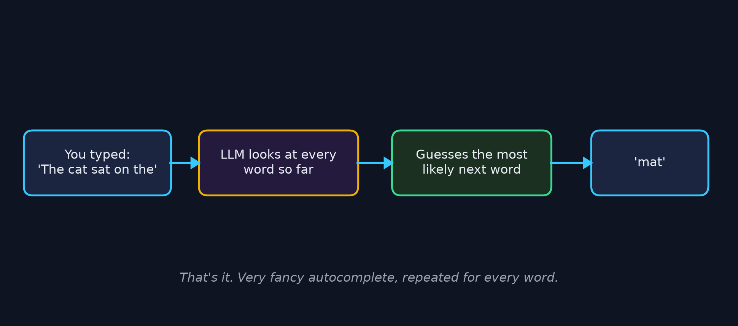
Day 1 — What is an LLM?
Answer: it's very fancy autocomplete.

Slide 4
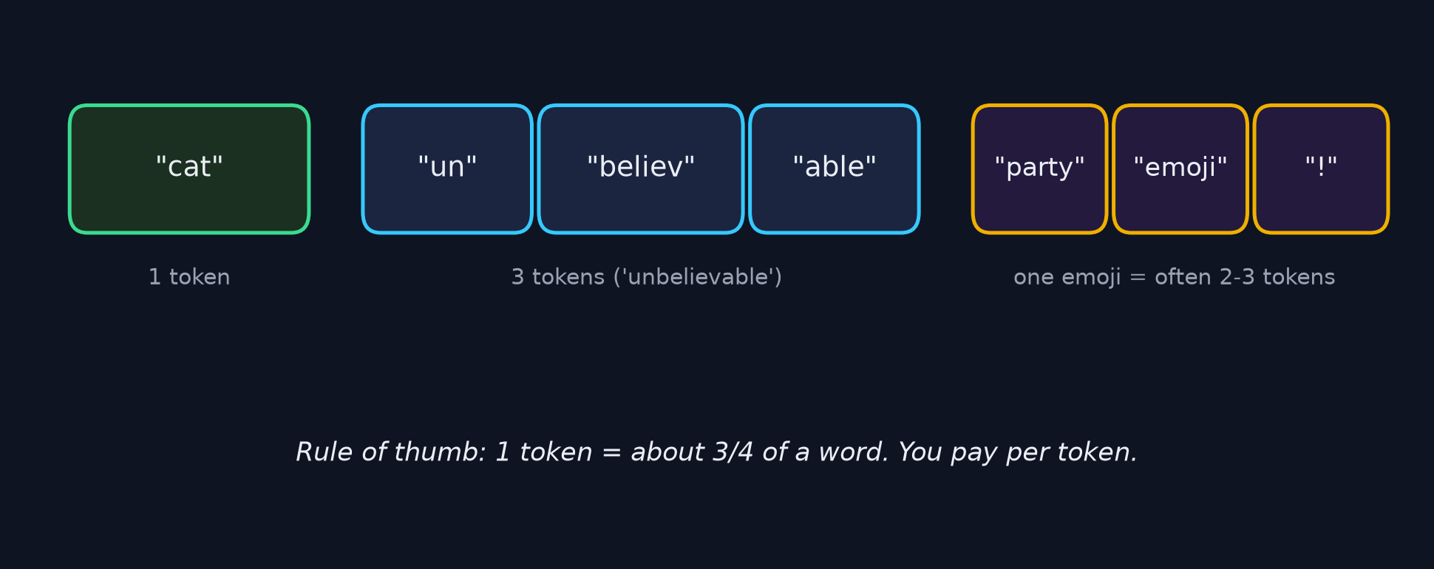
Day 1 — Tokens: how AI chops up text
You are billed per token by every AI provider. More tokens = more money.

Slide 5
Day 1 — Other key ideas
• Attention — the AI 'looks at' every earlier word to guess the next one
• Temperature — a dial from 'boring & factual' (0) to 'creative' (1.5)
• Hallucinations — LLMs invent plausible-sounding but false answers
• Real-world: ChatGPT, Claude, Copilot, Cursor all use these same ideas

Slide 6
Day 2 — Using AI APIs
OpenAI, Claude, and what Hugging Face is
• Store keys safely in a .env file — never commit them
• OpenAI: client.chat.completions.create(model, messages)
• Claude: same idea, system prompt is a separate parameter
• Multi-turn: send the whole history each time (LLMs are stateless)
• Hugging Face = 'GitHub for AI models'—Day 3 gets hands-on

Slide 7
Day 2 — Real-world examples
• ChatGPT — the app, uses GPT-4o under the hood
• GitHub Copilot — OpenAI models fine-tuned on code
• Notion AI — runs on Claude 3.5 Sonnet
• Cursor (AI code editor) — routes coding to Claude, chit-chat to a cheaper model
• You'll build a mini Cursor-style router on Day 7

Slide 8
Day 3 — Hugging Face hands-on
One line of code, thousands of open-source models
• pipeline('sentiment-analysis')(text) — real AI on your CPU
• pipeline('summarization') — turn a page into a paragraph
• SentenceTransformer(...) — turn text into vectors (preview of Section 5)
• Small models (<1 GB) run great on laptops. Big models (8-70B) don't.
• For big open-source models: Together AI (next slide)

Slide 9
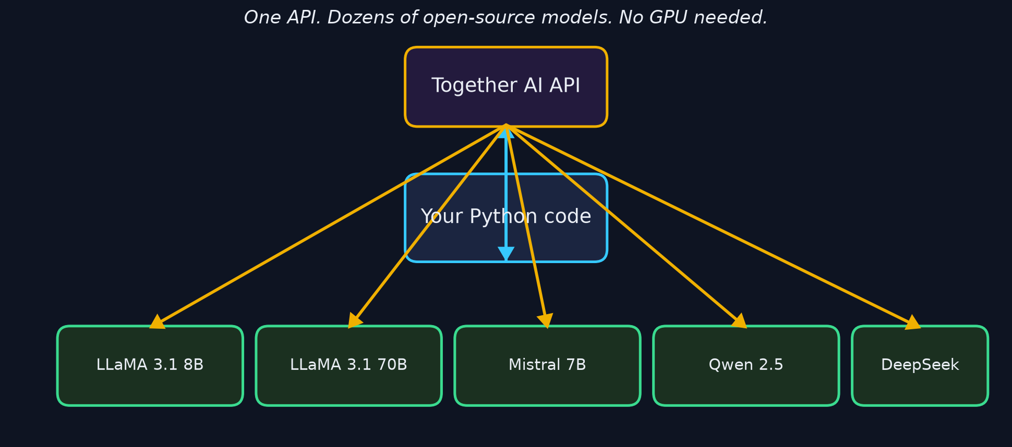
Day 3 — Together AI
Open-source LLMs via one API. No GPU needed.

Slide 10
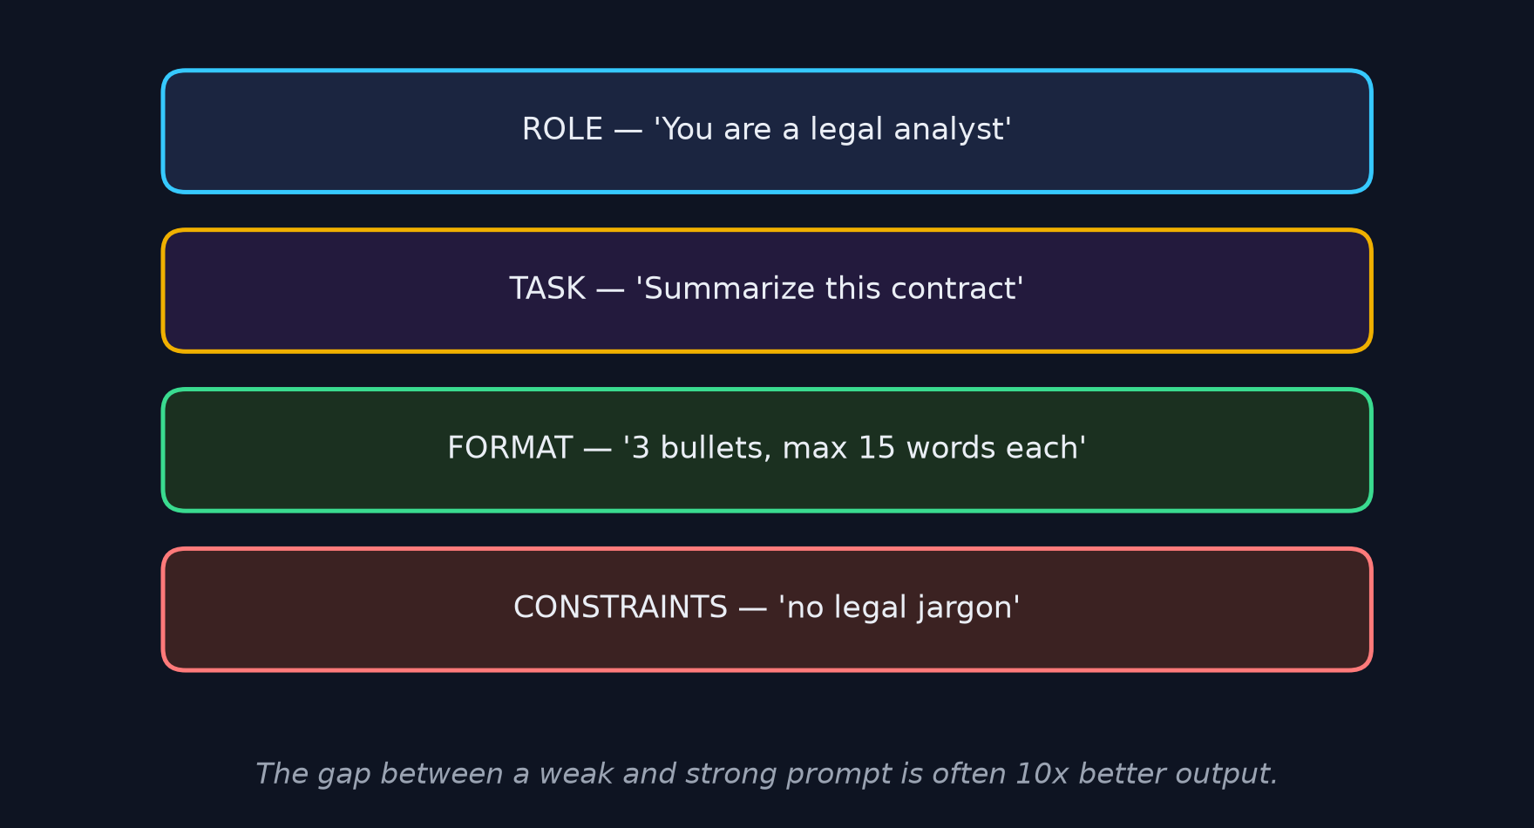
Day 4 — Prompt Engineering
Same model, better prompt = dramatically better answers

Slide 11
Day 4 — Two tricks that always help
• Few-shot: show 2-3 examples of the format you want
• Chain of Thought: add the phrase 'Let's think step by step'
• Wei et al. (2022) — CoT lifted math accuracy from 18% -> 57%
• Real-world: Cursor uses CoT before it edits your code

Slide 12
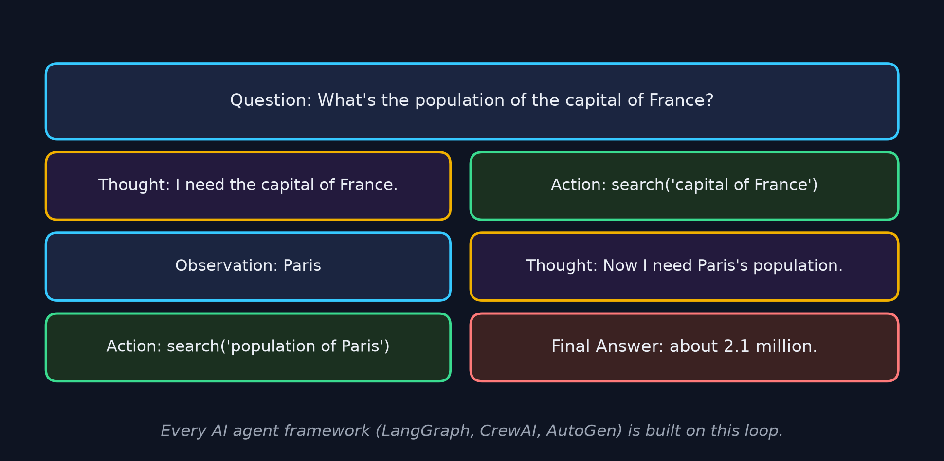
Day 4 — ReAct: the shape of an AI agent
Thought -> Action -> Observation -> ... -> Final Answer

Slide 13
Day 5 — Structured outputs
Turn AI text into typed JSON your code can use
• Ask for JSON in the prompt — works about 90% of the time
• response_format={'type':'json_object'} — guarantees valid JSON
• Then json.loads() safely — no crashes, no regex
• Real-world: Ramp auto-extracts expense data from receipts this way

Slide 14
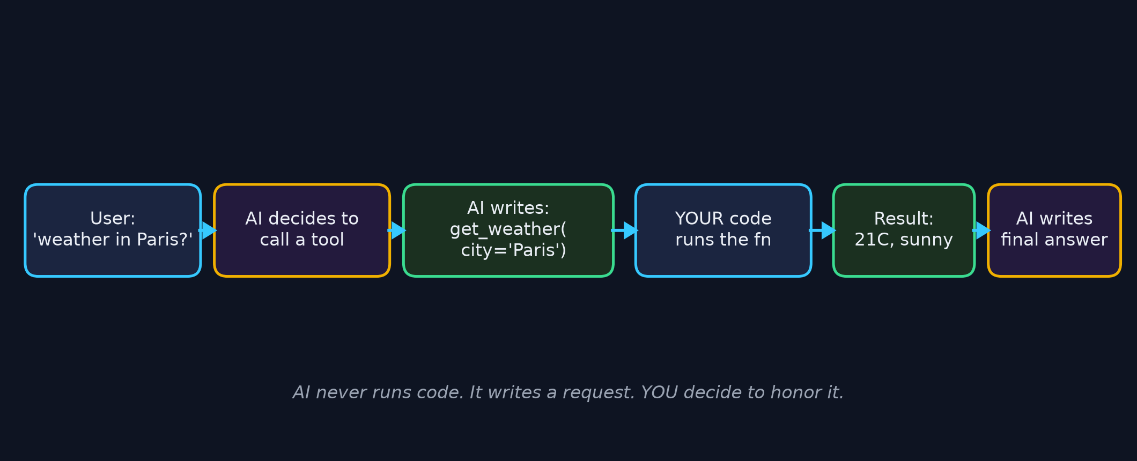
Day 5 — Tool calling
How AI apps take real actions in the world
Zapier, Notion AI, Copilot's file edits — all built on this exact pattern.

Slide 15
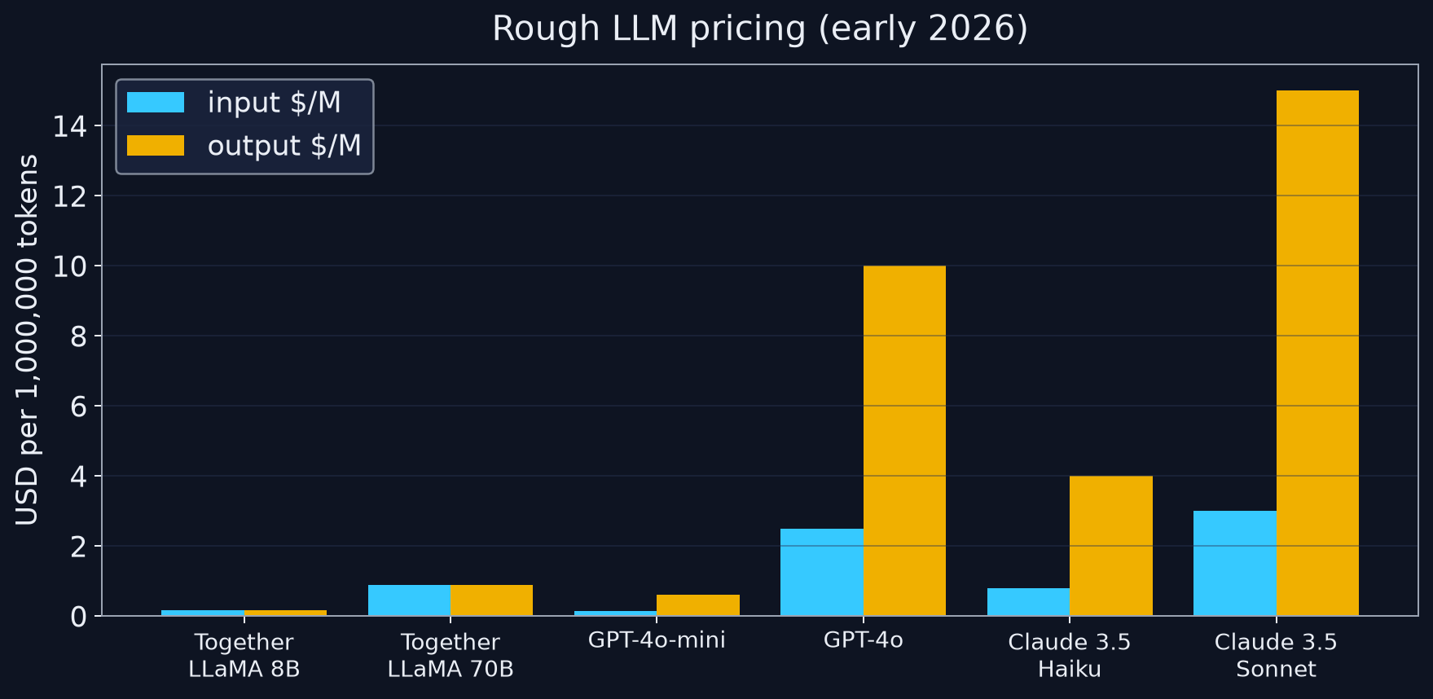
Day 6 — Cost control
Rule of thumb: output tokens cost 3-5x more than input tokens.

Slide 16
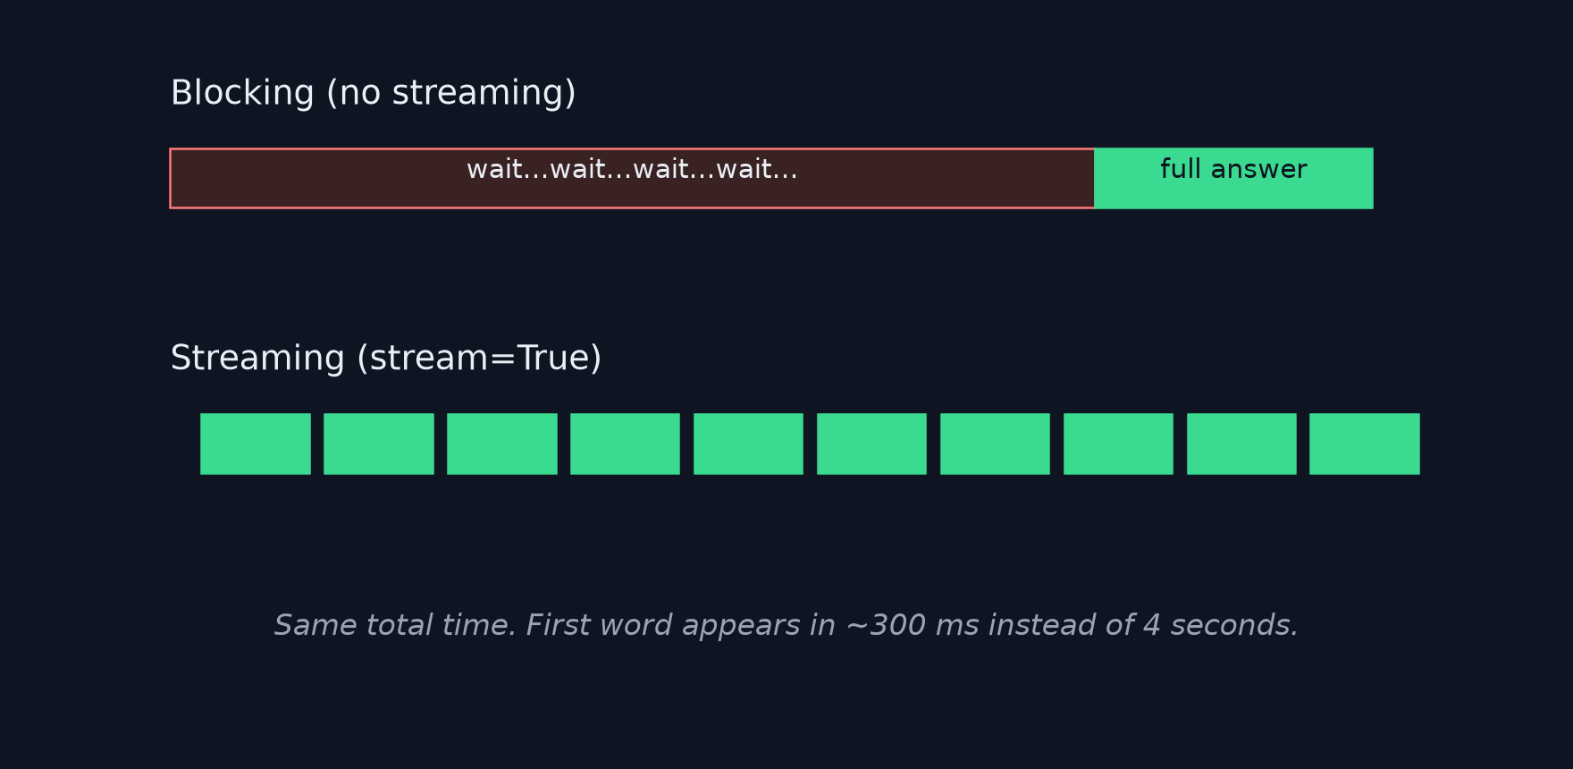
Day 6 — Streaming makes it feel instant
Same total time — first word appears in 300 ms instead of 4 s.

Slide 17
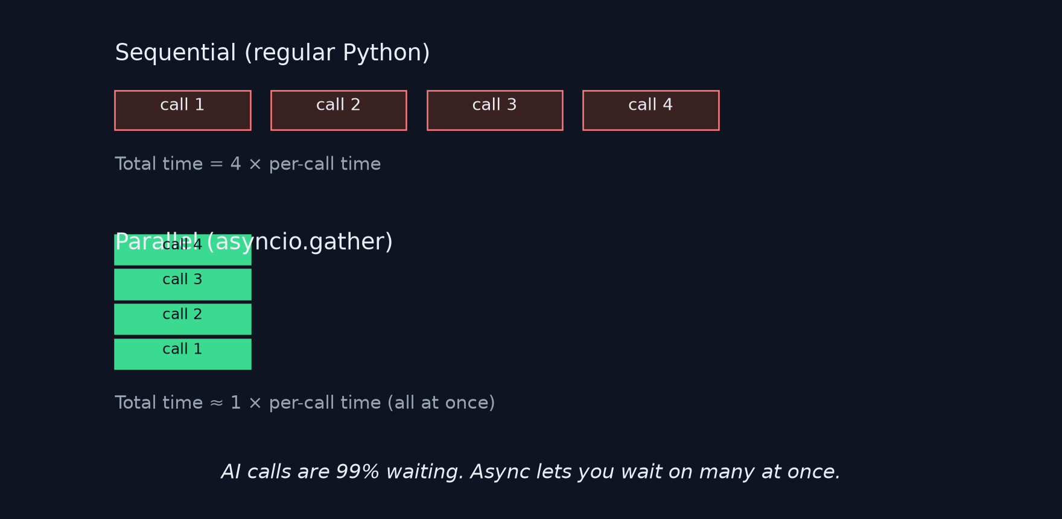
Day 6 — Async: many calls at once
AI calls are 99% waiting. asyncio.gather lets you wait on them together.

Slide 18
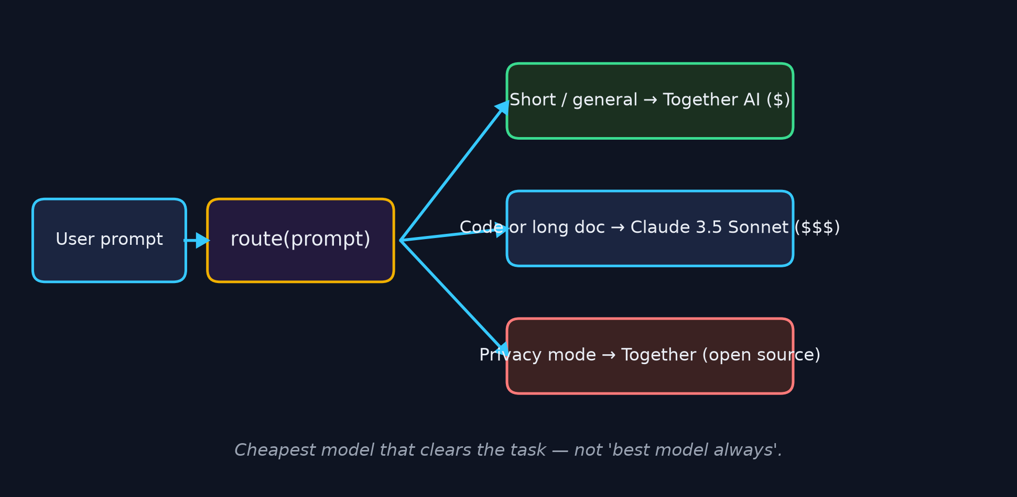
Day 7 — Multi-model routing
One assistant, three providers, right model per request

Slide 19
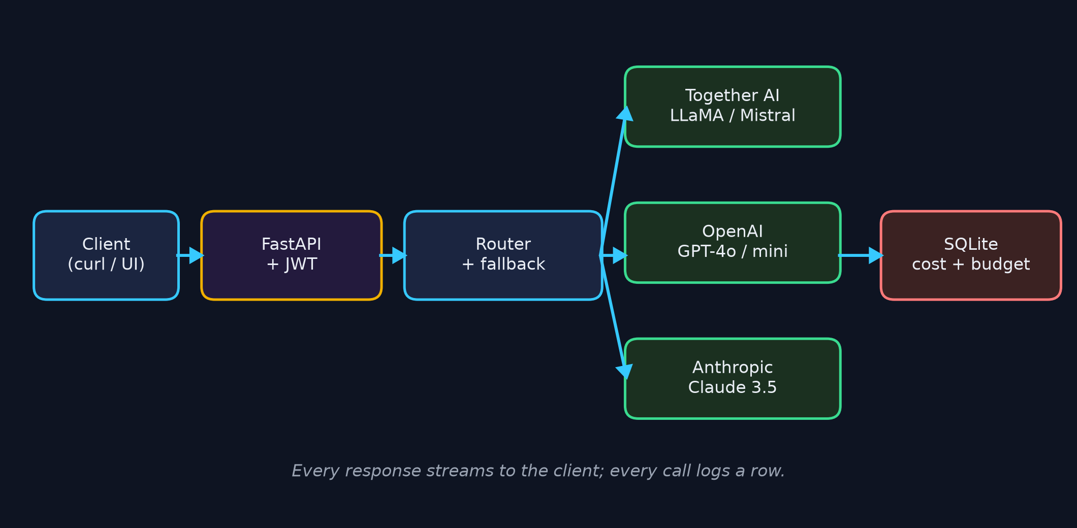
Day 7 — Capstone architecture

Slide 20
What you can build after Section 4
• AI chatbots with per-user budgets and provider fallback
• Structured extraction from receipts, resumes, medical notes
• AI agents that call your APIs via tool calling
• Private assistants that stay on open-source models for sensitive data
• Anything that needs to be fast, cheap AND smart

Slide 21
Section 4 complete.
Next — Section 5: Embeddings, Vector Search & Semantic Systems

