Slide 1
Polymorphism (Part 2) & Other Topics
by
RAGE Uday Kiran

Slide 2
Outline
Inheritance vs. Polymorphism
Mechanics of Polymorphism
abstract classes and methods
private and static methods
Other Topics
Regular expressions
Lambda functions
Calculating the memory consumption
Runtime measurement

Slide 3
Outline
Inheritance vs. Polymorphism
Mechanics of Polymorphism
abstract classes and methods
private and static methods
Other Topics
Regular expressions
Lambda functions
Calculating the memory consumption
Runtime measurement

Slide 4


What is Inheritance?
inherit
Public and no-modifier
variables & methods
Super class
Sub class

Slide 5

Importance of Inheritance?
Empowering
sub class with code reusability
inherit
Public and no-modifier
variables & methods
Super class
Sub class

Slide 6
What is Polymorphism?
inherit
Public and no-modifier
variables & methods
Super class
Sub class

Slide 7

What is Polymorphism?
=
assign
create an object
super class mimics the functionality of sub class
Super class
Sub class

Slide 8
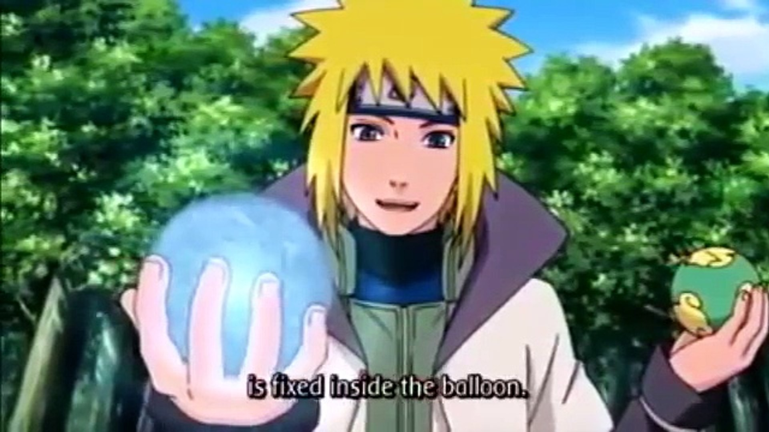

Example of Polymorphism
class Minato {
String hairColor = “Yellow”;
String wife = “Kushina”;
public String ability()
return “Rasengan”;
}
class Naruto extends Minato {
String wife = “Hinata”;
public String ability()
return “Big Ball Rasengan”;
}

Slide 9
Example of Polymorphism
class Minato {
String hairColor = “Yellow”;
String wife = “Kushina”;
public String ability()
return “Rasengan”;
}
class Demo {
public static void main(String[] args){
Minato obj = new Naruto():
}
}
class Naruto extends Minato {
String wife = “Hinata”;
public String ability()
return “Big Ball Rasengan”;
}
cast the child class
create an object

Slide 10

Example of Polymorphism
class Minato {
String hairColor = “Yellow”;
String wife = “Kushina”;
public String ability()
return “Rasengan”;
}
class Demo {
public static void main(String[] args){
Minato obj = new Naruto():
S.O.P(obj.ability())
}
}
class Naruto extends Minato {
String wife = “Hinata”;
public String ability()
return “Big Ball Rasengan”;
}
Output:
Big Ball Rasengan

Slide 11

Importance of Polymorphism?
Empowering
super class with flexibility.
(Perform a single action in many different ways)
Super class
Sub class

Slide 12

Inheritance vs. Polymorphism
Polymorphism:
Empowering
super class with flexibility.
(Perform a single action in many different ways)
Inheritance:
Empowering
sub class with code reusability
Super class
Sub class

Slide 13

A Good Programmer
Effectively uses both inheritance and polymorphism in their project

Slide 14
Outline
Inheritance vs. Polymorphism
Mechanics of Polymorphism
abstract classes and methods
private and static methods
Other Topics
Regular expressions
Lambda functions
Calculating the memory consumption
Runtime measurement

Slide 15
Mechanics of Polymorphism: Abstract classes
Rules
Classes must contain the keyword “abstract”
Methods can be abstract or non-abstract
abstract methods must not contain code.
normal methods can contain code.
If a class contains abstract method, then that class must be made abstract.
A (non-abstract) subclass must implement all abstract methods of super class.
raises error
public abstract class Minato{
}
abstract String getAbility();
abstract int getAge();
public String getLocation()
return latLong;
public class Naruto extends Minato{
public String getAbility()
return “Big Ball Rasengan”;
public int getAge()
return (int) currentTime-DoB;
}

Slide 16
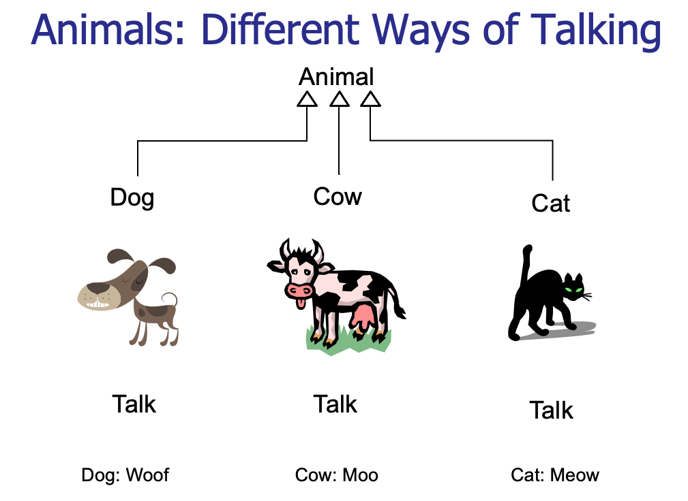
Example:1
abstract class Animal {
private String name;
public Animal(String name)
this.name=name;
public String getName()
return name;
public abstract void talk();
}
class Dog extends Animal {
public Dog(String name)
super(name);
public void talk()
System.out.println(getName()+" Woof");
}
Name
Name
Name
class Cow extends Animal {
public Cow(String name) { super(name); }
public void talk()
System.out.println(getName()+" Moo");
}
class Cat extends Animal {
public Cat(String name) { super(name); }
public void talk(){
System.out.println(getName()+" Meow");
}

Slide 17
Example:1
abstract class Animal {
private String name;
public Animal(String name)
this.name=name;
public String getName()
return name;
public abstract void talk();
}
public class AnimalReference {
public static void main(String[] args){
Animal ref = new Cow("Edna");
Dog aDog = new Dog("Humi");
ref.talk();
ref = aDog;
ref.talk();
ref = new Cat("Aya");
ref.talk();
}
}
class Dog extends Animal {
public Dog(String name)
super(name);
public void talk()
System.out.println(getName()+" Woof");
}
Output:
Edna Moo
Humi Woof
Aya Meow
class Cow extends Animal {
public Cow(String name) { super(name); }
public void talk()
System.out.println(getName()+" Moo");
}
class Cat extends Animal {
public Cat(String name) { super(name); }
public void talk(){
System.out.println(getName()+" Meow");
}

Slide 18
Example:2
public class AnimalArray {
public static void main(String[] args) {
// assign space for an array
Animal[] ref = new Animal[3];
Random rand = new Random();
// create specific objects and put them in array
ref[0] = new Cow("Edna");
ref[1] = new Dog("Humi");
ref[2] = new Cat("Aya");
ref[rand.nextInt(3)] = new Cat("Kitty");
// Compiler does not know where Kitty is
for (int i=0;i<3;++i)
ref[i].talk();
}
}

Slide 19
Behavior of the Encapsulation
Class types
Encapsulation
private variables & methods cannot be accessed by a sub-class.
no-modifier variables and methods can be:
accessed by sub-class of same package
cannot be accessed by sub-class of another package
private methods are final by default
Base Class
Private
Package
No-modifier
Visibility
Sub class
Protected
Any class
Public

Slide 20
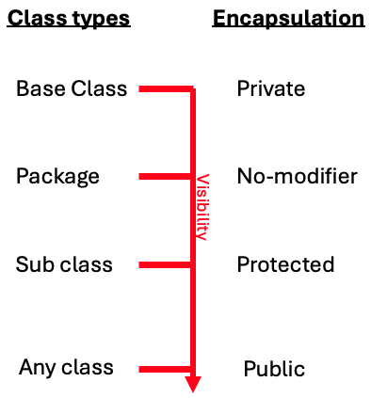
Example 3: Private Method
public class PrivateOverride {
private void f() {
System.out.println("private f()");
}
public static void main(String[] args) {
PrivateOverride po = new Derived();
po.f();
}
}
class Derived extends PrivateOverride {
public void f() {
System.out.println("public f()");
}
}
this method is final and
cannot be overloaded by Derived class
Output :
private f()

Slide 21
Note: Static Methods
class Mother {
public static String staticGet()
{ return "Mother staticGet()"; }
public String dynamicGet()
{ return "Mother dynamicGet()"; }
}
class Child extends Mother {
public static String staticGet()
{ return "Child staticGet()"; }
public String dynamicGet()
{ return "Child dynamicGet()"; }
}
public class StaticPolymorphism {
public static void main(String[] args) {
Mother child = new Child();
System.out.println(child.staticGet());
System.out.println(child.dynamicGet());
}
}
Output:
Mother staticGet()
Child dynamicGet()
If a method is static, it does not behave polymorphically.
Static methods are associated with the class and not the individual objects.

Slide 22
Order of Constructor Calls
public class Sandwich extends
PortableLunch {
private Bread b = new Bread();
private Cheese c = new Cheese();
private Lettuce l = new Lettuce();
public Sandwich() {
System.out.println("Sandwich()");
}
public static void main(String[] args) {
new Sandwich();
}
}
Print the Output?
class Meal {
Meal() { System.out.println("Meal()"); }
}
class Bread {
Bread() { System.out.println("Bread()"); }
}
class Cheese {
Cheese() { System.out.println("Cheese()"); }
}
class Lettuce {
Lettuce() { System.out.println("Lettuce()"); }
}
class Lunch extends Meal {
Lunch() { System.out.println("Lunch()"); }
}
class PortableLunch extends Lunch {
PortableLunch() {
System.out.println("PortableLunch()");}
}

Slide 23
Order of Constructor Calls
public class Sandwich extends
PortableLunch {
private Bread b = new Bread();
private Cheese c = new Cheese();
private Lettuce l = new Lettuce();
public Sandwich() {
System.out.println("Sandwich()");
}
public static void main(String[] args) {
new Sandwich();
}
}
Output:
Meal()
Lunch()
PortableLunch()
Bread()
Cheese()
Lettuce()
Sandwich()
class Meal {
Meal() { System.out.println("Meal()"); }
}
class Bread {
Bread() { System.out.println("Bread()"); }
}
class Cheese {
Cheese() { System.out.println("Cheese()"); }
}
class Lettuce {
Lettuce() { System.out.println("Lettuce()"); }
}
class Lunch extends Meal {
Lunch() { System.out.println("Lunch()"); }
}
class PortableLunch extends Lunch {
PortableLunch() {
System.out.println("PortableLunch()");}
}

Slide 24

Philosophical question
Which is first?
Designing Classes: HAS-A vs. IS-A
HAS-A
IS-A
No correct answer.
Reality is complex
Use ur knowledge

Slide 25
Outline
Inheritance vs. Polymorphism
Mechanics of Polymorphism
abstract classes and methods
private and static methods
Other Topics
Regular expressions
Lambda functions
Calculating the memory consumption
Runtime measurement

Slide 26
Regular Expressions
A regular expression is a sequence of characters that forms a search pattern.
A regular expression can be a single character, or a more complicated pattern.
Regular expressions can be used to perform all types of text search and text replace operations.
https://www.javatpoint.com/java-regex

Slide 27
Class Types of Regular Expressions
Java does not have a built-in Regular Expression class
However, we can import the java.util.regex package to work with regular expressions.
Types of classes
Pattern Class - Defines a pattern (to be used in a search)
Matcher Class - Used to search for the pattern
PatternSyntaxException Class - Indicates syntax error in a regular expression pattern

Slide 28
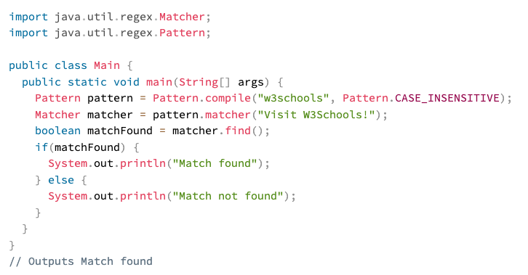
Example
define the search method
Flags

Slide 29
Flags
Flags in the compile() method change how the search is performed. Here are a few of them:
Pattern.CASE_INSENSITIVE - The case of letters will be ignored when performing a search.
Pattern.LITERAL - Special characters in the pattern will not have any special meaning and will be treated as ordinary characters when performing a search.
Pattern.UNICODE_CASE - Use it together with the CASE_INSENSITIVE flag to also ignore the case of letters outside of the English alphabet

Slide 30
Brackets in Patterns
Expression | Description
[abc] | Find one character from the options between the brackets
[^abc] | Find one character NOT between the brackets
[0-9] | Find one character from the range 0 to 9

Slide 31
Metacharacters in a Pattern
Metacharacters are characters with a special meaning:
Metacharacter | Description
| | Find a match for any one of the patterns separated by | as in: cat|dog|fish
. | Find just one instance of any character
^ | Finds a match as the beginning of a string as in: ^Hello
$ | Finds a match at the end of the string as in: World$
\d | Find a digit
\s | Find a whitespace character
\b | Find a match at the beginning of a word like this: \bWORD, or at the end of a word like this: WORD\b
\uxxxx | Find the Unicode character specified by the hexadecimal number xxxx

Slide 32
Quantifiers
Quantifiers define quantities:
Quantifier | Description
n+ | Matches any string that contains at least one n
n* | Matches any string that contains zero or more occurrences of n
n? | Matches any string that contains zero or one occurrences of n
n{x} | Matches any string that contains a sequence of X n's
n{x,y} | Matches any string that contains a sequence of X to Y n's
n{x,} | Matches any string that contains a sequence of at least X n's

Slide 33
Lambda Expressions
A lambda expression is a short block of code which takes in parameters and returns a value.
Lambda expressions are similar to methods, but they do not need a name and they can be implemented right in the body of a method.

Slide 34
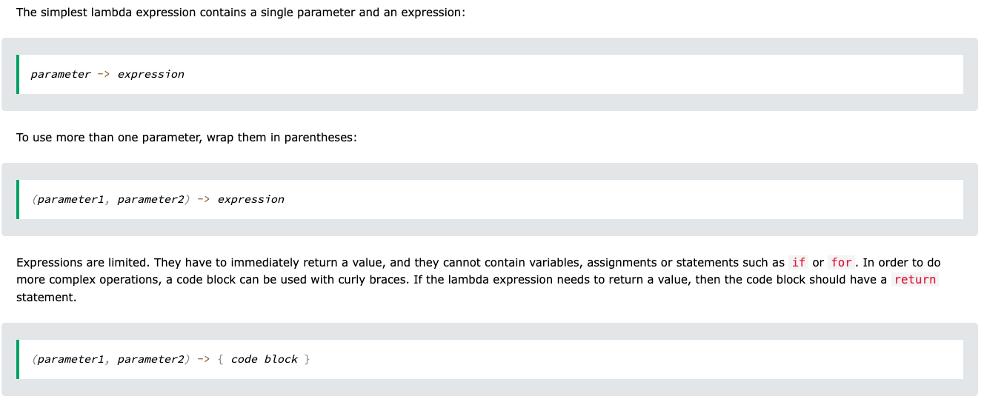
Syntax

Slide 35
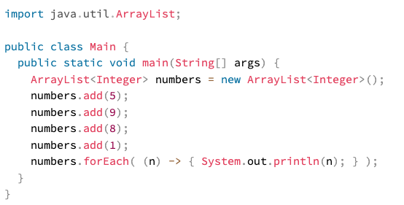
Example 1

Slide 36
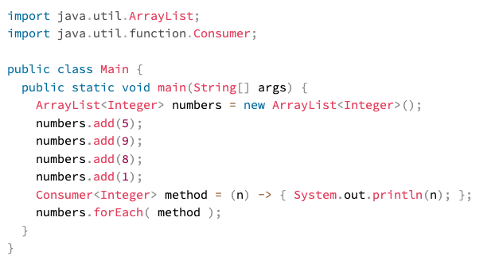
Example 2
Lambda example can be stored in a variable and be used

Slide 37
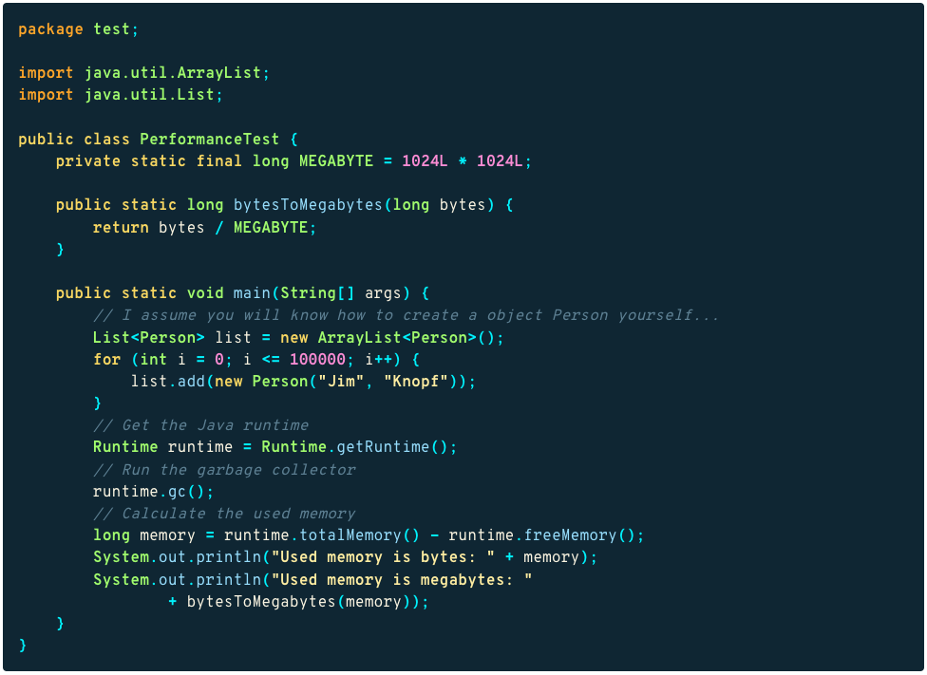
Memory Consumption

Slide 38
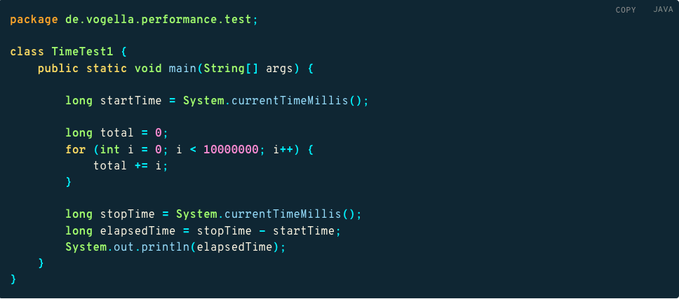
Runtime measurement

Slide 39
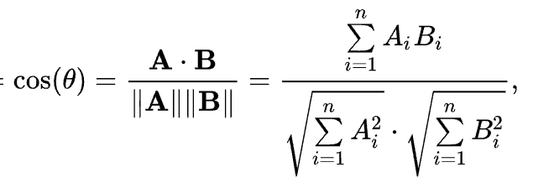
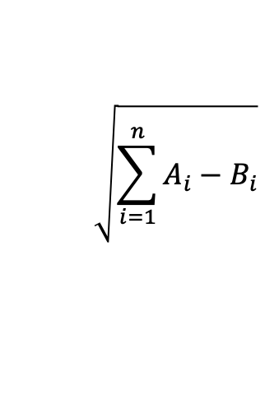
Class Work - 1
Cosine similarity
$$\sqrt{\sum_{i=1}^{n}{A_{i}−B_{i}}}$$
Task:
1) Write two different class files for each measure using similarity class
2) Try to write the code as optimally as possible.
3) Calculate the memory consumed for each class
4) Development time: 10 minutes
Euclidean distance = ED =
abstract class similarity{
abstract double getSimilarity();
}

Slide 40
Class Work - 1
public class cosine extend similarity{
double[] A, B;
cosine(double[] x, double[] y){
A = x;
B = y;
}
public double getSimilarity(){
int num = 0;
int den1 = 1;
int den2 = 1;
for(int i = 0; i<=A.length;++i){
num+=(A[i]*B[i]);
den1 *= (A[i]*A[i]);
den2 *=(B[i] * B[i]);
}
return (double) num/(Math.sqrt(den1)*Math.sqrt(den2)
}
}
Cosine similarity
$$\sqrt{\sum_{i=1}^{n}{A_{i}−B_{i}}}$$
Euclidean distance = ED =
abstract class similarity{
abstract double getSimilarity();
}

