Slide 1
Files and File Storage
by
RAGE Uday Kiran

Slide 2
Is it good to storage data in the RAM/Memory for few days, say for 10 days?
Yes/No
Storing in the memory. is called ………………. in-memory storage

Slide 3


Slide 4


Slide 5
Outline
Storage devices
Accessing data efficiently using storage devices
Types of files
Storing data in files

Slide 6
Data Storage Hierarchy
Primary storage: Media that can be directly accessed by CPUs
Example: RAM
Secondary storage: The primary choice of storage medium for permanent data
Example: SDDs and HDDs
Tertiary storage: Removable media used in today’s systems as offline storage for archiving databases and hence come under the category called tertiary storage
Example: Optical disks (CD-ROMs, DVDs, and other similar storage media) and tapes

Slide 7
Storage Organization of Databases
Transient data: Data that persists only for a limited amount of time
Persistant data: Data that persists for longer periods of time
Data in databases always represent persistant data
Data in databases is often too large to fit in main memory.
Thus, databases primarily use secondary storage for storing data.

Slide 8
Secondary storage devices: HDDs

Slide 9
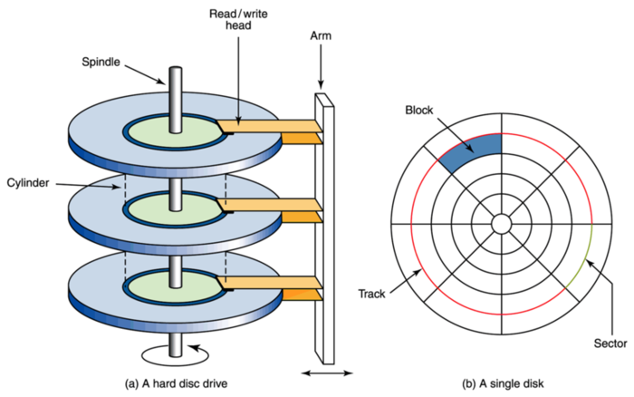
http://faculty.salina.k-state.edu/tim/ossg/File_sys/abstractions.html

Slide 10
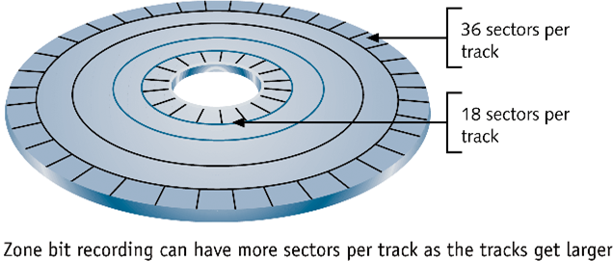

A file is an ordered collection of disk block

Slide 11
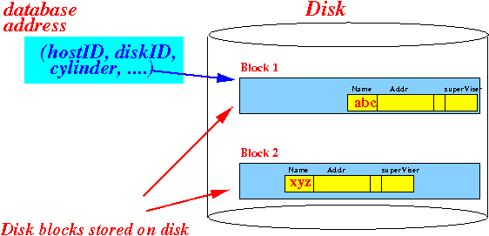

Slide 12
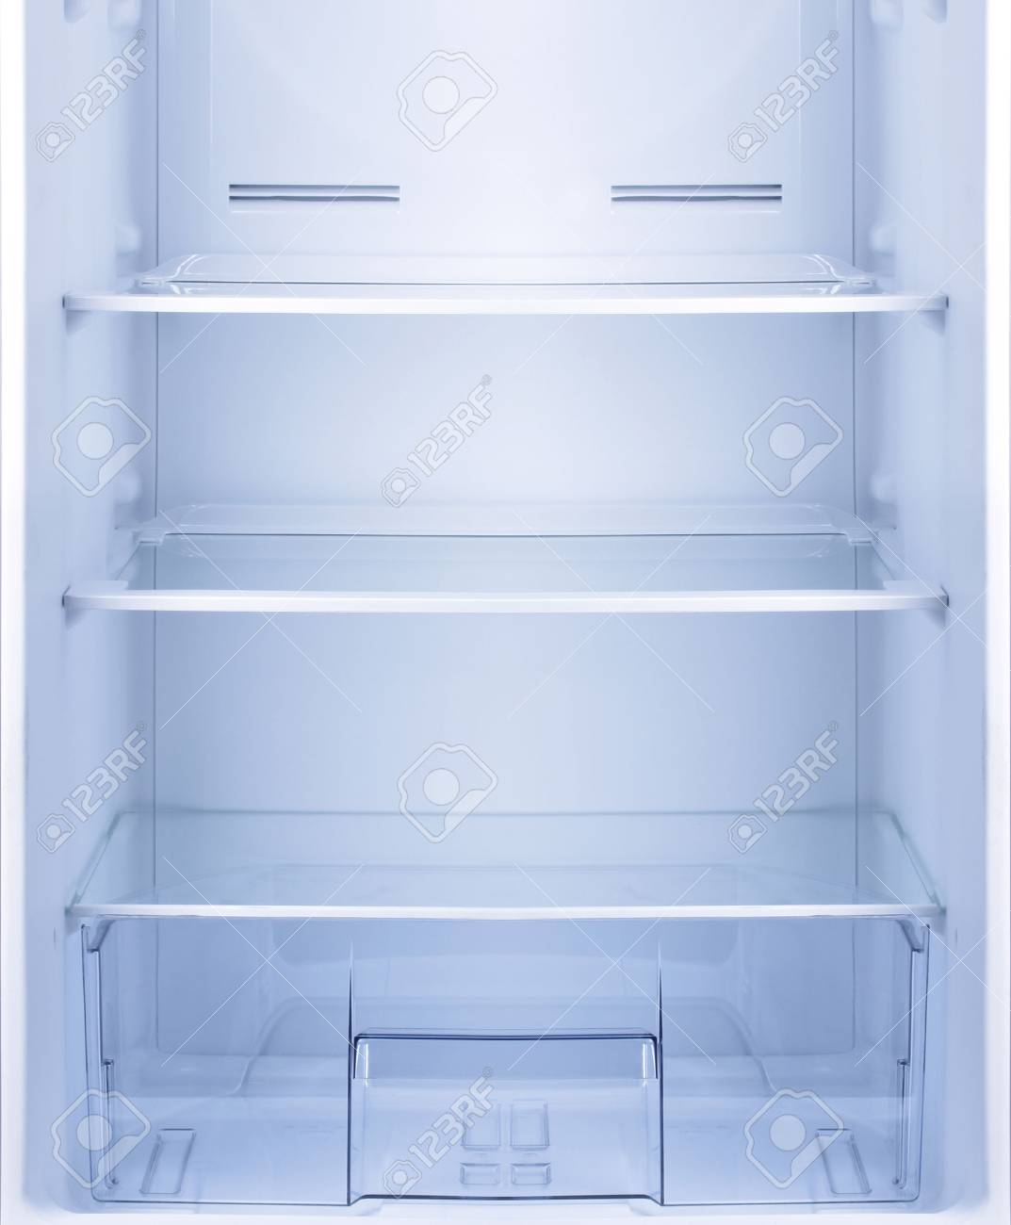
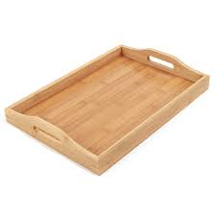
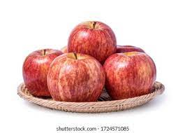
Analyzing search
If a refrigerator can store 20 trays and each tray can store 6 apples, then
How many apples you can store in a refrigerator?
stores
contains
Refrigerator
tray
apples
(Disk)
(Block)
(Record/transaction/row)

Slide 13
avg file size/per = 1000 MB
block size = 1 GB
Refrigerator = 1 TB
After 10 days, how GB h portion of refrigerator gets fulled?
how many days are needed to fill up the disk
1000 MB = 1 GB
1 GB * 10 days = 10 GB
So I need 10 Blocks
10 GB/ 1000 GB. =

Slide 14

Blocking factor (bfr) – no. of lines in a block
…
r=30000 apples
number of apples
How many apples can we put in a tray?
bfr = ?
Number of trays needs to store all applies?
b = ?
R=9 cm
B=50 cm
each apple is of 9 cm diameter
Length of a tray is 50 cm
Notes:
bfr = floor(B/R)
b= ceil(r/bfr)

Slide 15
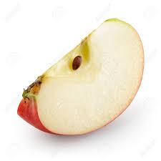
1 mm
1 cm
7500 trays
.
.
.

Slide 17
100 bytes
tweet
How many tweets can be stored in a block?
Math.floor(4096/100)
Math.floor(40.96)
40
4096 bytes
Block

Slide 18
r=300,000 tweets
How many blocks are needed to store 300,000 tweets
40 tweets
Math.ceil(300000/40)

