Slide 1
Regular Expressions and Lambda
by
RAGE Uday Kiran
Referred from W3schools

Slide 2
Introduction
A regular expression is a sequence of characters that forms a search pattern.
A regular expression can be a single character, or a more complicated pattern.
Regular expressions can be used to perform all types of text search and text replace operations.

Slide 3
Class Types of Regular Expressions
Java does not have a built-in Regular Expression class
However, we can import the java.util.regex package to work with regular expressions.
Types of classes
Pattern Class - Defines a pattern (to be used in a search)
Matcher Class - Used to search for the pattern
PatternSyntaxException Class - Indicates syntax error in a regular expression pattern

Slide 4
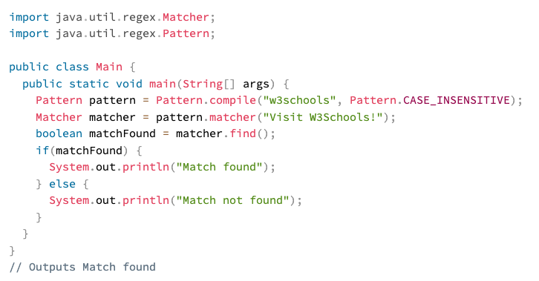
Example
define the search method
Flags

Slide 5
Flags
Flags in the compile() method change how the search is performed. Here are a few of them:
Pattern.CASE_INSENSITIVE - The case of letters will be ignored when performing a search.
Pattern.LITERAL - Special characters in the pattern will not have any special meaning and will be treated as ordinary characters when performing a search.
Pattern.UNICODE_CASE - Use it together with the CASE_INSENSITIVE flag to also ignore the case of letters outside of the English alphabet

Slide 6
Brackets in Patterns
Expression | Description
[abc] | Find one character from the options between the brackets
[^abc] | Find one character NOT between the brackets
[0-9] | Find one character from the range 0 to 9

Slide 7
Metacharacters in a Pattern
Metacharacters are characters with a special meaning:
Metacharacter | Description
| | Find a match for any one of the patterns separated by | as in: cat|dog|fish
. | Find just one instance of any character
^ | Finds a match as the beginning of a string as in: ^Hello
$ | Finds a match at the end of the string as in: World$
\d | Find a digit
\s | Find a whitespace character
\b | Find a match at the beginning of a word like this: \bWORD, or at the end of a word like this: WORD\b
\uxxxx | Find the Unicode character specified by the hexadecimal number xxxx

Slide 8
Quantifiers
Quantifiers define quantities:
Quantifier | Description
n+ | Matches any string that contains at least one n
n* | Matches any string that contains zero or more occurrences of n
n? | Matches any string that contains zero or one occurrences of n
n{x} | Matches any string that contains a sequence of X n's
n{x,y} | Matches any string that contains a sequence of X to Y n's
n{x,} | Matches any string that contains a sequence of at least X n's

Slide 9
Lambda Expressions
A lambda expression is a short block of code which takes in parameters and returns a value.
Lambda expressions are similar to methods, but they do not need a name and they can be implemented right in the body of a method.

Slide 10
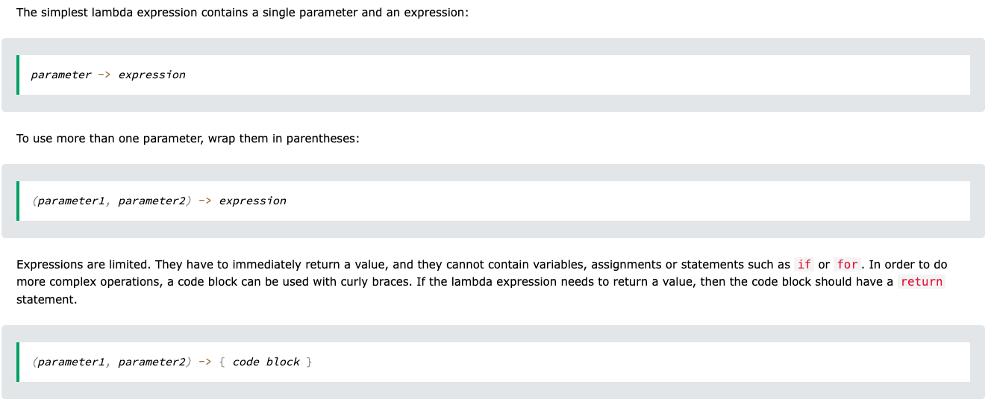
Syntax

Slide 11
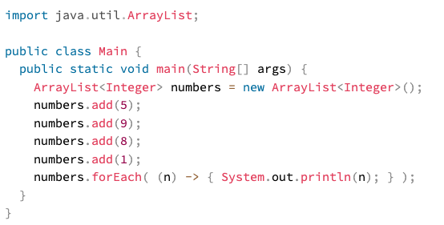
Example 1

Slide 12
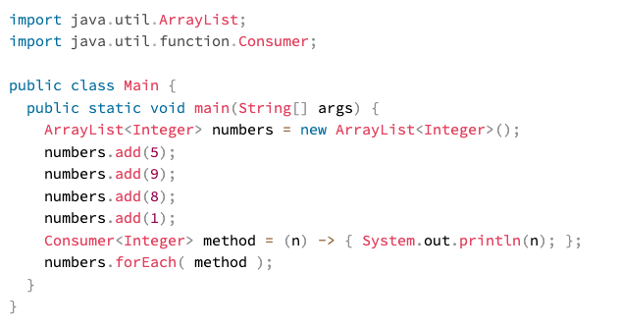
Example 2
Lambda example can be stored in a variable and be used

Slide 13
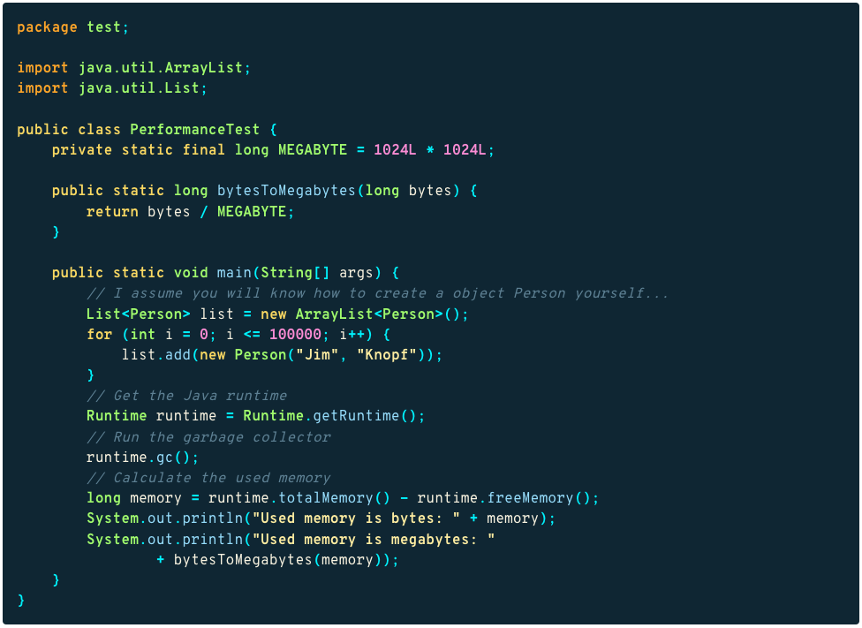
Memory Consumption

Slide 14
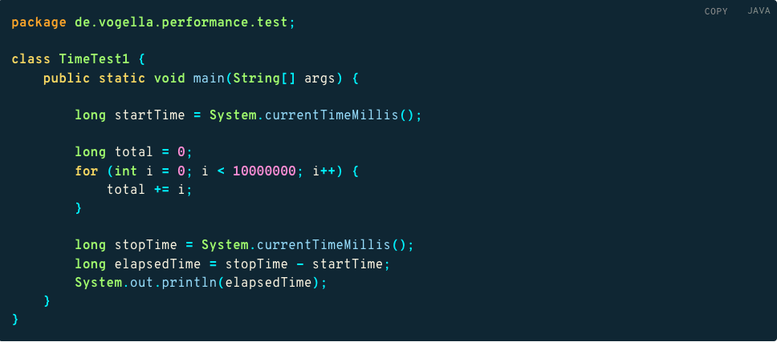
Runtime measurement

