Slide 1
Java Programming I
CHAPTER 9
Exceptions

Slide 2
Contents
Traditional Error Handling
Exceptions Vs. Traditional
What is an Exception?
Kinds of Exceptions
Exception Handling Keywords
Catching and Handling Exceptions
Keyword: finally

Slide 3
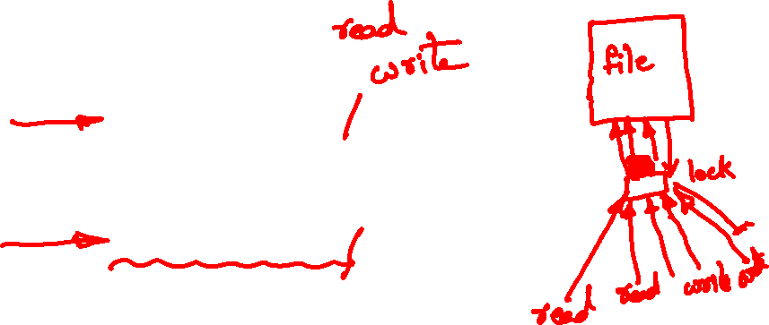
Traditional Error Handling
Consider the following pseudo code for reading a file into memory:
A file is a collection of data (information) stored together on an external media such as hard disk, USB flash memory, SD card, etc. under a particular name.
readFile {
open the file;
determine its size;
allocate that much memory;
read the file into memory;
close the file;
}

Slide 4
Problems with readFile
What happens if the file can't be opened?
What happens if the length of the file can't be determined?
What happens if enough memory can't be allocated?
What happens if the read fails?
What happens if the file can't be closed?

Slide 5
Error Handling with Traditional Programming
errorCodeType readFile {
initialize errorCode = 0;
open the file;
if (theFileIsOpen) {
determine the length of the file;
if (gotTheFileLength) {
allocate that much memory;
if (gotEnoughMemory) {
read the file into memory;
if (readFailed) {
errorCode = -1;
}
} else {
errorCode = -2;
}
} else {
errorCode = -3;
}
close the file;
if (theFileDidntClose && errorCode == 0) {
errorCode = -4;
} else {
errorCode = errorCode and -4;
}
} else {
errorCode = -5;
}
return errorCode;
}
Here text in red is regular code
Text in black is exception handling code

Slide 6
Error Handling in Java
readFile {
try {
open the file;
determine its size;
allocate that much memory;
read the file into memory;
close the file;
} catch (fileOpenFailed) {
doSomething;
} catch (sizeDeterminationFailed) {
doSomething;
} catch (memoryAllocationFailed) {
doSomething;
} catch (readFailed) {
doSomething;
} catch (fileCloseFailed) {
doSomething;
}
}
Here text in red is regular code
Text in black is exception handling code
Note that the error handling code and ``regular'' code are separate!

Slide 7
Traditional Error Handling
It is difficult to separate error-handling code from regular code!
How can we provide some systematic way for the error handling in Java? → By using Exceptions

Slide 8
Exceptions Vs. Traditional
Q: What are the
advantages/disadvantages of
Exception handling?

Slide 9
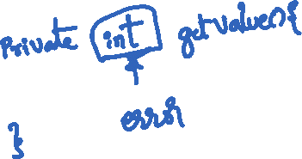
Exceptions Vs. Traditional
Drawbacks of traditional error handling:
Most of the code deals with error handling.
It is hard to see the normal flow of the program.
The return value is “occupied” for error-handling.
Exception Handling
The “normal flow” of the program and error handling code are separated.

Slide 10
What Is an Exception?
An exception (“exceptional event”) is an event, which occurs during the execution of a program that disrupts the normal flow of the program’s instructions.
When an error occurs within a method, the method creates an object and hands it off to the runtime system. The object (“exception object”) contains information about the error.
Creating an exception object and handing it to the runtime system is called “throwing an exception”

Slide 11
What Is an Exception?
Method where error occurred
Method Call
Method without an exception handler
Method Call
Method with an exception handler
Method Call
main
The Call Stack

Slide 12
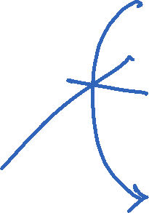
What Is an Exception?
Method where error occurred
Throws exception
Looking for appropriate handler
Method without an exception handler
Forwards exception
Looking for appropriate handler
Method with an exception handler
Catches some other exception
main
Searching the call stack for the exception handler

Slide 13
The Catch and Specify Requirement
Catch
A method can catch an exception by providing an exception handler
A try statement that catches the exception The try must provide the handler for the exception
Specify
If a method chooses not to catch, then it specifies which exceptions are thrown.
Exceptions are part of a method’s public interface.
A method specifies that it can throw the exception. The method must provide a throws clause that lists the exception.

Slide 14
Kinds of Exceptions
Three Kinds of Exceptions
Checked exception: can anticipate and recover the exception. Checked exceptions are subject to the Catch or Specify Requirement (CSR). All exceptions are checked exceptions, except for Error, RuntimeException, and their subclasses.
Error (unchecked exception): cannot anticipate and recover, not subject to CSR, ex) system malfunction
Runtime exception (unchecked exception): cannot anticipate and recover, not subject to CSR, ex) logic error or improper use of an API

Slide 15
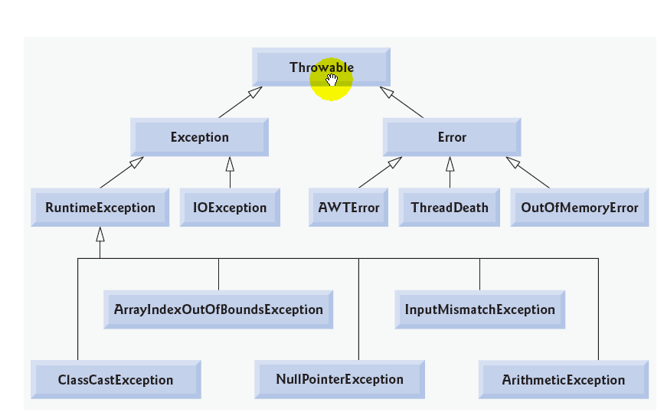
Kinds of Exceptions
Unchecked
Unchecked
Checked

Slide 16
Exception Handling Keywords
try – Entering a clause where exceptions are expected.
catch – Caught an exception.
throw – Found a problem, throwing exception.
throws – List of exceptions that the method might throw.
finally – Do always.

Slide 17
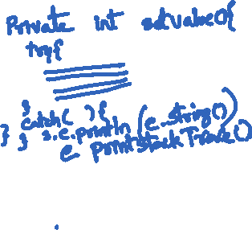
Catching and Handling Exceptions
The try, catch, and finally block
try {
// try block
}
catch (ExceptionType1 param1) {
// Exception Block
}
catch (ExceptionType2 param2) {
// Exception Block
}
……
catch (ExceptionTypeN paramN) {
// Exception Block
}
finally {
// finally Block
}
Statements that have some possibilities to generate exception(s).
Execute statements here when the corresponding exception occurred.
Do always
If a finally clause is present with a try, its code is execu- ted after all other processing in the try is complete. It allows the programmer to avoid having cleanup code accidentally bypassed by a return, continue, or break.

Slide 18
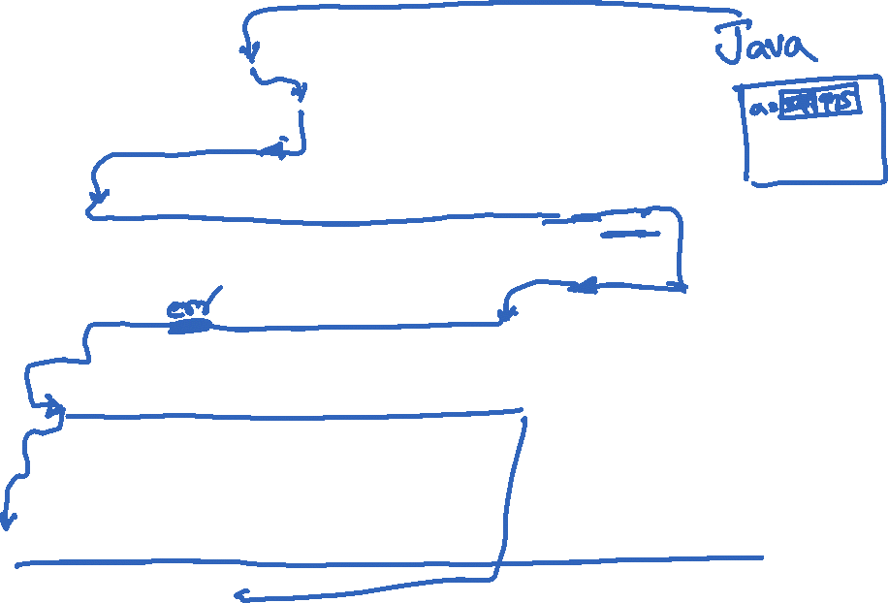
Example 1
import java.io.*;
public class ExcepTest{
public static void main(String args[]){
int a[] = {347, 975};
try{
System.out.println("Access element three :" + a[3]); // a[3] does not exist
System.out.println("a[0]=" + a[0]);
} catch(ArrayIndexOutOfBoundsException e){
System.out.println("Exception thrown :" + e);
}
System.out.println("Out of the try block");
}
}
Output of this program:
Exception thrown :java.lang.ArrayIndexOutOfBoundsException: 3
Out of the try block

Slide 19
Comments on the Previous Slide
This program tries to access element a[3]
System.out.println("Access element three :" + a[3]); // a[3] does not exist
An exception is thrown.
The program continues to run from
}catch(ArrayIndexOutOfBoundsException e){
There is no execution for
System.out.println("Access element three :" + a[3]); // a[3] does not exist
System.out.println("a[0]=" + a[0]);
3 in the output of the program means the value of the index for a[3].

Slide 20
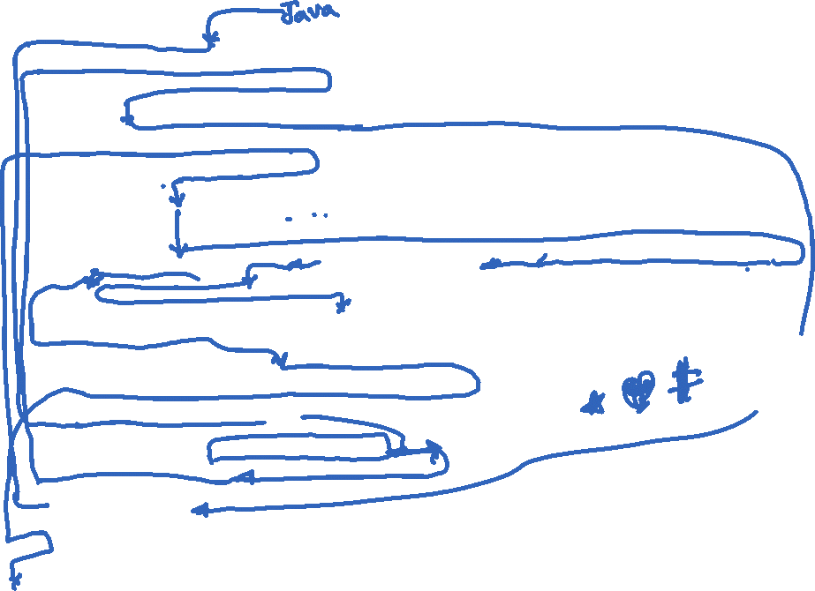
Example
import java.io.*;
public class TestException {
public void noNeedException() { // No need the exception handling
int i = 100;
System.out.println("i = " + 100); }
public void useTryCatch() {
String name ="";
System.out.print("What is your name? "); // The code needs exception handling
try {
BufferedReader charStream = new BufferedReader (new InputStreamReader(System.in));
name = charStream.readLine().trim();
System.out.println("Your name is " + name);
} catch(Exception e) {
System.out.println(“Exception: " + e ); }
System.out.println(“End of the TryCatch method"); }
public static void main(String[] args) {
TestException obj = new TestException();
obj.noNeedException();
obj.useTryCatch();
}
}

Slide 21
Comments on the example
The program try to read an input stream of characters (lines 10 and 11).
If the try block completed successfully (no exceptions) then: continue to line 15.
Lines 13 and 14 are skipped.
If an exception was thrown then: execute the catch block (lines 13 and 14), and then continue to line 15. The try block is aborted.
To simulate this exception, you may type Ctrl/z or Ctrl/d keys (depending on your OS) on your keyboard when running the program.

Slide 22
Keyword: finally
finally – This clause is executed always, either if an exception is thrown or not.
The finally block always comes after the last catch block.

Slide 23
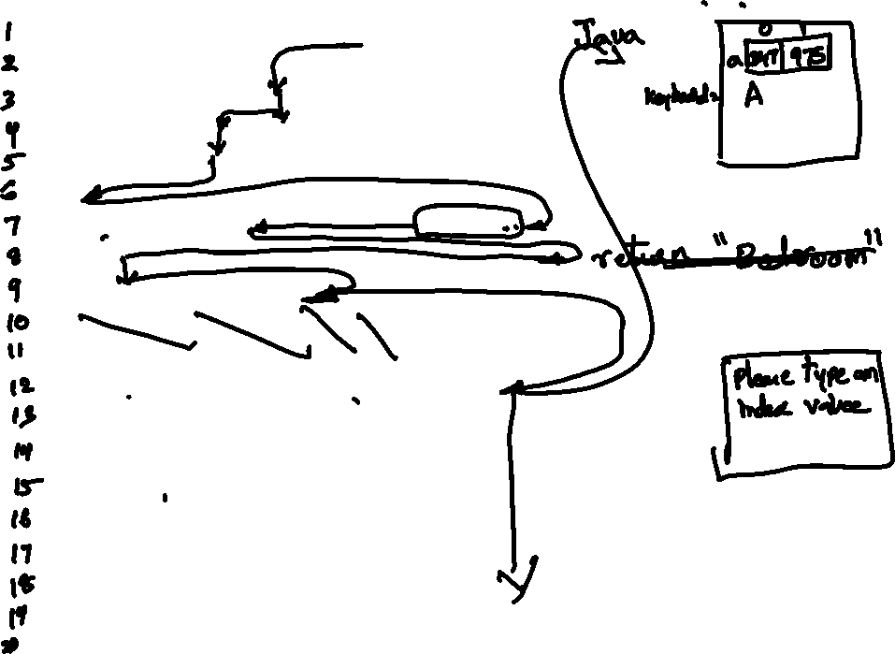
Example
import java.io.*;
import java.util.*;
public class ExcepTestFinally{
public static void main(String args[]){
int a[] = {347, 975};
try{
Scanner keyboard = new Scanner(System.in); // data on the keyboard
System.out.print("Please type an index value: ");
int i = keyboard.nextInt(); // getting an integer value from the keyboard
System.out.println("Access element "+ i + ":" + a[i]);
System.out.println("a[0]=" + a[0]);
} catch(ArrayIndexOutOfBoundsException e){
System.out.println("Exception thrown :" + e);
} finally{
a[0] = 6;
System.out.println("The finally statement is executed. a[0]= " +a[0 ]);
}
System.out.println("Out of the try block");
}
} // Output of this program see on the next slide

Slide 24
Comments on the Previous Slide
Output of the program:
text in red typed by the user; text in blue printed by the program
java ExceptionTestFinally
Please type an index value: 3
Exception thrown :java.lang.ArrayIndexOutOfBoundsException: 3
The finally clause is executed. a[0]=6
Out of the try block
Another run of the program:
java ExceptionTestFinally
Please type an index value: 1
Access element 1 :975
a[0]=347
The finally clause is executed. a[0]=6
Out of the try block

Slide 25
Comments on the Previous Slide
The first run of the program (with the inputted value = 3) resulted in throwing the exception and execution of the finally clause.
The second run (with the inputted value=1) resulted in the normal execution of the program and execution of the finally clause.

Slide 26
Keyword: finally
void mergeFiles( String f1, String f2, String f3) {
try {
data1 = readFile (f1) ; // step 1
data2 = readFile (f2) ; // step2
data3 = merge (data1, data2) ; // step3
writeFile (f3, data3); // step4
} catch (FileException e) {
/ / handle the exception
} catch (FormatException e) {
/ / handle the exception
} finally {
cleanup ( ) ;
}
}

Slide 27
try, catch, and finally
The finally clause is used to clean up internal state or to release non-object resources, such as open files stored in local variables.
public boolean searchFor (String file, String word) throws StreamException
{
Stream input = null;
try {
input = new Stream(file);
while (!input.eof())
if (input.next().equals(word)) return true;
return false; // not found
} finally {
if (input != null) input.close();
}
}

Slide 28
Specify exceptions thrown by the method
If a method does not catch any check exceptions that may occur within that method, it must state that the method may throw those exceptions.
Add a throws clause to specify that the method may throw an exception:
Example
public void writeList() throws IOException,
ArrayIndexOutOfBoundsException {
...
}

Slide 29
Specify exceptions thrown by the method
Example：
public void writeList(){
PrintWriter out = new PrintWriter(new FileWriter(“OutFile.txt”));
for ( int i = 0; i < SIZE; i++ ){
out.println(“Value at: “ + i + “ = “ + vector.elemetnAt(i));
}
out.close();
}
Compile Error
public void writeList() throws IOException,
ArrayIndexOutOfBoundsException {
PrintWriter out = new PrintWriter(new FileWriter(“OutFile.txt”));
for ( int i = 0; i < SIZE; i++ ){
out.println(“Value at: “ + i + “ = “ + vector.elemetnAt(i));
}
out.close();
}

Slide 30
Throwing Exception
To catch an exception, the exception must be thrown by some code before it is caught. Regardless of what throws the exception, the exception is always thrown by a throw statement.
public Object pop(){
Object obj;
if ( size == 0 ){
throw new EmptyStackException();
}
obj = objectAt(size – 1);
setObjectAt(size – 1, null);
size--;
return obj;
}
If the stack is empty, an EmptyStackException object is created and thrown.
Only objects inheriting from java.lang.Throwable can be thrown.
※Since EmptyStackException is not a check exception, there is no need to "specify the exception".

Slide 31
Throw your own exception
Your own exception class
public class NoSuchAttributeException extends Exception{
public final String attrName;
public NoSuchAttributeException(String name){
super(“No attribute named “ + name + “ found”);
attrName = name;
}
}
Extends Exception
message
A method to throw your own exception
...
public void replaceValue(String name, Object newValue) throws
NoSuchAttributeException{
Attr attr = find(name);
if(attr == null ){
throw new NoSuchAttributeException(name);
}
attr.setValue(newValue);
}
...

Slide 32
Catch your own exception
Catch NoSuchAttributeException：
...
Object value = new Integer(8);
try{
attributedObj.replaceValue(“Age”, value);
} catch (NoSuchAttributeException e){
Attr attr = new Attr(e.attrName, value);
attributedObj.add(attr);
}
...
When the method replaceValue() throws a NoSuchAttributeException, it is caught in a catch clause and the exception is handled in that catch block.

Slide 33
Example of Exception Chain
ExceptionTest.java
If an IOException is caught, a new BadDataException exception is generated with the exception of the cause appended, and the exception chain is passed on to a higher-level exception handler.
import java.io.*;
public class ExceptionTest{
public ExceptionTest(){
try{
readData();
} catch ( BadDataException e ){
System.out.println(e.getMessage());
}
}
private void readData() throws BadDataException {
FileInputStream in = null;
try{
in = new FileInputStream("data.txt");
// show data here
} catch (IOException e){
throw new BadDataException(“Bad data.", e);
}
}
public static void main(String[] args){
new ExceptionTest();
}
}
Failed to enter file
2
1
Holds the exception e raised by initCause. The exception is later retrieved by getCause.
Set e to the cause of the exception (cause).
BadDataException bde = new BadDataException(“Bad data.");
bde.initCause(e);
throw bde;

Slide 34
Example of Exception Chain
You own Exception class
BadDataException.java
public class BadDataException extends Exception{
public BadDataException(){}
public BadDataException(String details){
super(details);
}
public BadDataException(Throwable cause){
super(cause);
}
public BadDataException(String details, Throwable cause){
super(details, cause);
}
}

Slide 35
Exception Handler
DivideByZero.java
public class DivideByZero{
public DivideByZero(){
a();
}
private void a(){
b();
}
private void b(){
c();
}
private void c(){
d();
}
private void d(){
int i = 1;
int j = 0;
System.out.println( i/j );
}
public static void main(String[] args){
new DivideByZero();
}
}
Chain of method calls
Output
Exception in thread "main" java.lang.ArithmeticException: / by zero
at DivideByZero.d(DivideByZero.java:18)
at DivideByZero.c(DivideByZero.java:12)
at DivideByZero.b(DivideByZero.java:8)
at DivideByZero.a(DivideByZero.java:4)
at DivideByZero.<init>(DivideByZero.java:22)
at DivideByZero.main(DivideByZero.java:26)

Slide 36
Exception Handler
Divider.java
public class Divider{
public Divider(String[] args){
try{
System.out.println("Before Division");
int i = Integer.parseInt(args[0]);
int j = Integer.parseInt(args[1]);
System.out.println(i/j);
System.out.println("After Division");
} catch ( ArithmeticException e ){
System.out.println("ArithmeticException");
} catch ( ArrayIndexOutOfBoundsException e ){
System.out.println("ArrayIndexOutOfBoundsException");
} catch ( NumberFormatException e ){
System.out.println("NumberFormatException");
} finally {
System.out.println("Finally block");
}
}
public static void main(String[] args){
new Divider(args);
}
}

Slide 37
Execution Results of Divider
Result: java Divider 12 4
If the correct arguments are specified, it will execute normally.
Before Division
3
After Division
Finally block
Result: java Divider 1 0
Division by 0 raises an ArithmeticException.
Before Division
ArithmeticException
Finally block
Result: java Divider
No argument causes an ArrayIndexOutOfBoundsException because the array size is zero.
Before Division
ArrayIndexOutOfBoundsException
Finally block
Result: java Divider x y
NumberFormatException is occurred because the argument is not a number.
Before Division
NumberFormatException
Finally block

Slide 38
Create your own exception class
The Java platform offers many exceptions that can be used:
Please see API
On the other hand, you can define and use your own exception classes:
When useful data is to be added.
When the type of exception is important.
etc.

Slide 39
Example
ExceptionA.java
public class ExceptionA extends Exception{
public ExceptionA(String message){
super(message);
}
}
ExceptionSubclassTest.java
import java.util.Scanner;
public class ExceptionSubclassTest{
public static void main(String[] args){
new ExceptionSubclassTest();
}
public ExceptionSubclassTest(){
a();
}
void a(){
try{
b();
} catch (Exception e){
System.out.println("catch block of a()");
e.printStackTrace();
}
}
void b() throws ExceptionA{
try{
c();
} catch (ExceptionB e){
System.out.println("catch block of b()");
e.printStackTrace();
}
}
void c() throws ExceptionA, ExceptionB {
Scanner sc = new Scanner(System.in);
if ( sc.nextInt() % 2 == 0 ){
throw new ExceptionA("We have a problem");
} else {
throw new ExceptionB("We have a BIG problem");
}
}
}
ExceptionB.java
public class ExceptionB extends Exception{
public ExceptionB(String message){
super(message);
}
}
Exception
ExceptionA
ExceptionB
Define exception classes by inheriting from class Exception.

Slide 40
Results of ExceptionSubclassTest
If you enter an even number：
Result: java ExceptionSubclassTest
0
catch block of a()ExceptionA: We have a problem
at ExceptionSubclassTest.c(ExceptionSubclassTest.java:33)
at ExceptionSubclassTest.b(ExceptionSubclassTest.java:23)
at ExceptionSubclassTest.a(ExceptionSubclassTest.java:14)
at ExceptionSubclassTest.<init>(ExceptionSubclassTest.java:9)
at ExceptionSubclassTest.main(ExceptionSubclassTest.java:5)
If you enter an odd number：
Result: java ExceptionSubclassTest
1
catch block of b()ExceptionB: We have a BIG problem
at ExceptionSubclassTest.c(ExceptionSubclassTest.java:35)
at ExceptionSubclassTest.b(ExceptionSubclassTest.java:23)
at ExceptionSubclassTest.a(ExceptionSubclassTest.java:14)
at ExceptionSubclassTest.<init>(ExceptionSubclassTest.java:9)
at ExceptionSubclassTest.main(ExceptionSubclassTest.java:5)

Slide 41
Throw
ThrowDemo.java
public void a(){
try{
b();
} catch (ArithmeticException e ){
System.out.println("a(): " + e);
}
}
public void b(){
try{
c();
} catch (ArithmeticException e ){
System.out.println("b(): " + e);
}
}
public void c(){
try{
d();
} catch (ArithmeticException e ){
System.out.println("c(): " + e);
throw e;
}
}
public void d(){
try{
int i = 1;
int j = 0;
i = i/j;
} catch ( ArithmeticException e ){
System.out.println("d(): " + e);
throw e;
}
}
}
public class ThrowDemo{
public static void main(String[] args){
new ThrowDemo();
}
public ThrowDemo(){
try{
a();
} catch (ArithmeticException e){
System.out.println(
"ThrowDemo(): " + e);
}
}
2
Result: java ThrowDemo
d(): java.lang.ArithmeticException: / by zero
c(): java.lang.ArithmeticException: / by zero
b(): java.lang.ArithmeticException: / by zero
1

Slide 42
Other advantages of Exception
Propagate errors in the call stack
method1{
errorCodeType error;
error = call method2;
if(error)
doErrorProcessing;
else
proceed;
}
errorCodeTyepe method2{
errorCodeType error;
error = call method3;
if(error)
return error;
else
proceed;
}
errorCodeType method3{
errorCodeType error;
error = call readFile;
if(error)
return error;
else proceed;
}
C
method1{
try{
call method2;
} catch (exception){
doErrorProcessing;
}
}
method2 throws exception{
call method3;
}
method3 throws exception{
call readFile
}
Java

Slide 43
Other advantages of Exception
Grouping and Categorizing Error Types:
Specialized exception handler
General exception handler
最も一般的なハンドラ
Handles only one type of exception because it has no descendants = very specific.
catch (FileNotFoundException e) {
...
}
catch (IOException e) {
...
}
Since it is a superclass, it can catch a group of exceptions based on a type.
catch (Exception e) {
...
}
Handles any Exception.
You can create groups of exceptions to handle them comprehensively, or you can use specific types of exceptions to strictly categorize and handle them.

Slide 44
Summary
The Java language uses exceptions to provide for handling errors.
One advantage of using exceptions is that compiler will check to see if a possible error is being checked for.
Regular code and error handling code are separated.
A thrown exception can be caught by the caller of the method.
Exception raising and handling keywords are: try, catch, throw, throws, and finally.

