Slide 1
Revising Java-1
by
RAGE Uday Kiran

Slide 2
Outline
Declarations
Compiler Movement
Encapsulation
Polymorphism

Slide 3
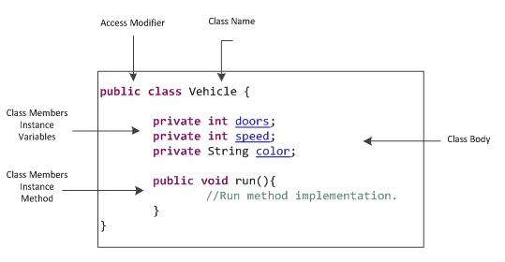
Declaration of Class

Slide 4
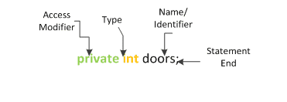
Declartion of Variables

Slide 5
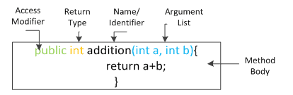
Declaration of Methods

Slide 6
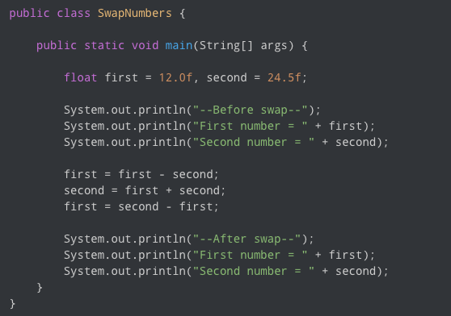
Compiler Movement
Top to Down
Statement after Statement

Slide 7
Compiler Movement
Top to Down
Statement after Statement
Right to left

Slide 8

Compiler Movement
Top to Down
Statement after Statement
Right to left
Main method
Entry point for Java compiler

Slide 9
Compiler Movement
Top to Down
Statement after Statement
Left to Right
exception of object creation
Main method
Entry point for Java compiler
Not a class method
you cannot call this method multiple times
Executed only once
Do not write logic in this method
only create instance of the class

Slide 10

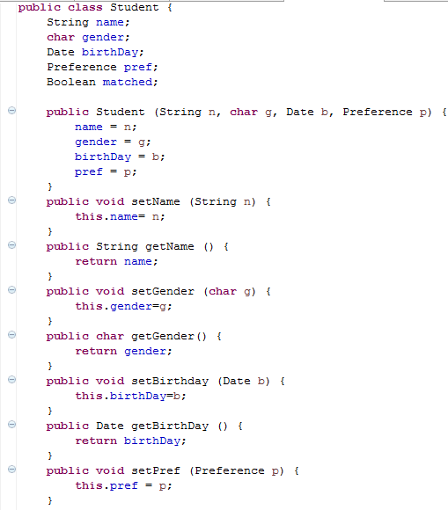
Compiler Movement
Constructors are the entry points for creating objects of a class
can be called only once.
purpose: initialization of variables
declaration
Initialization
Declaration declares the creation of variables.
Initialization assigns initial values to variables.
Invocation executes a piece of code.

Slide 11
Compiler Movement
Constructors are the entry points for creating objects of a class
can be called only once.
purpose: initialization of variables
Scope/Life of an object/Variable
braces define the scope
Garbage collector only cleans after scope has ended
declaration
Initialization
Declaration declares the creation of variables.
Initialization assigns initial values to variables.
Invocation executes a piece of code.

Slide 12
Compiler Movement
Compiler moves left to right

Slide 13
Class Exercise: Learning Optimizations
Calculator app development
public class Calculator{
int a, b;
Calculator(int x, int y){
this.a = x;
this.b =y;
}
public int getSum()
return this.a + this.b;
public static void main(String args[]){
System.out.println(new Calculator(Integer.parseInt(args[0]), Integer.parseInt(args[1])).getSum())
}
}

Slide 14
22:00 hours to 5:00 - Night
6:00 hours to 21:00 - Day
if hours value lies inbetween 22 to 5
print(Night)
else
print(day)
Temperature Sensor
Day/Night | Celcius
Night | 11
Night | 12
Night | 10
Night | 8
Night Day … | …
Night | 17
if hours value lies inbetween 6 to 21
print(Day)
else
print(Night)
TimeStamp | Celcius
00:00 | 11
01:00 | 12
02:00 | 10
03:00 | 8
… | …
23:00 | 17
a = {2,3,4,5,6,7,8}
b={5,6,10}
how do u do intersection?
for(every element in b){
for(every element in a){
if a == b
output a
break;
}
}

Slide 15
Encapsulation
Package One
Package Two
Alpha
Subclass
AlphaSub
Beta
Gamma
Gamma | AlphaSub | Beta | Alpha | Modifier
Y | Y | Y | Y | public
N | Y | Y | Y | protected
N | N | Y | Y | no modifier
N | N | N | Y | private

Slide 16
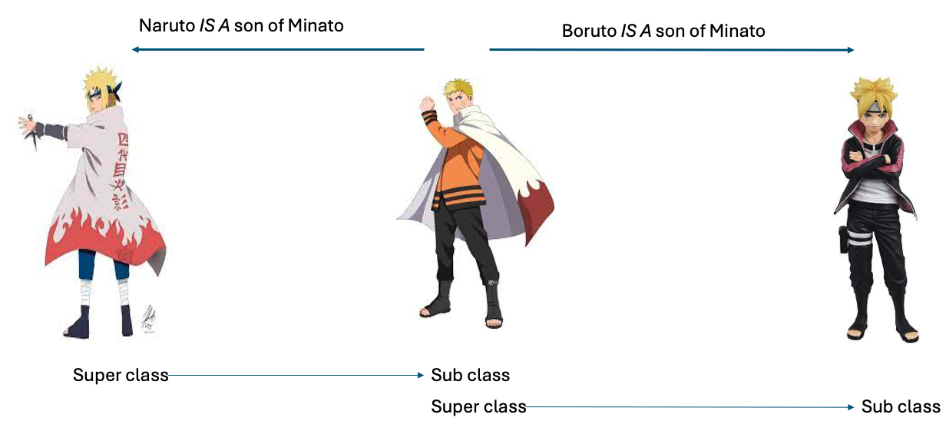
Inheritance
IS-A

Slide 17
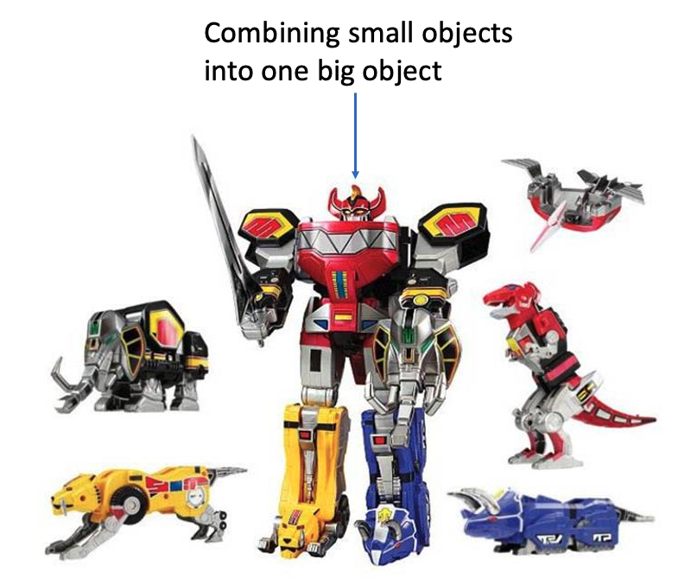
Inheritance
HAS-A
IS-A

Slide 18
Inheritance
Inherit the variables and methods of a super class

Slide 19
Polymorphism
Inherit the variables and methods of a super class
I can act as a sub-class

