Slide 1
Polymorphism (Part 1)
by
RAGE Uday Kiran

Slide 2
Outline
Compiler Movement in a Single Java Class
Compiler Movement in an Inheritance (IS-A hiearchy)
Polymorphism
Dynamic binding
Casting (Implicit and Explicit)

Slide 3
Outline
Compiler Movement in a Single Java Class
Compiler Movement in an Inheritance (IS-A hiearchy)
Polymorphism
Dynamic binding
Casting (Implicit and Explicit)

Slide 4
Abstract Representation Of a Java Class
class
public class Minato{
protected String hairColor=“yellow”;
String wife = “Kushina”;
protected String favWeapon=“Rasengan”;
Minto(){
}
protected String ability(){
return “FlyingThunderGodTechnique”;
}
}
Global variables
abstract
representation
Constructors
Constructor 1
Constructor 2
…
Constructor n
method 1
…
method k

Slide 5

Compiler Movement in a Java Class
class
public class Minato{
protected String hairColor=“yellow”;
String wife = “Kushina”;
protected String favWeapon=“Rasengan”;
Minto(){
}
protected String ability(){
return “FlyingThunderGodTechnique”;
}
}
Global variables
Constructors
Constructor 1
Java Compiler
Constructor 2
…
Constructor n
END
can be called in any order
can be called any number of times
object created.
cannot call constructor
again
method 1
if no method is called, then exist
…
method k

Slide 6
Outline
Compiler Movement in a Single Java Class
Compiler Movement in an Inheritance (IS-A hiearchy)
Polymorphism
Dynamic binding
Casting (Implicit and Explicit)

Slide 7



Inheritance
Naruto IS A son of Minato
Boruto IS A son of Minato
Reusing variables and methods of parent class
Super class
Sub class
Super class
Sub class

Slide 8
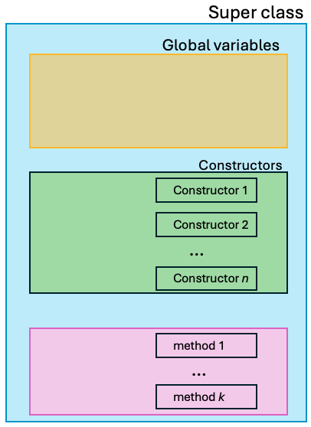
Abstract Representation of Super and Sub Classes
extends
Sub class
Global variables
public class Naruto extends Minato{
Naruto(){
}
}
Constructors
abstract
representation
Constructor 1
Constructor 2
…
Constructor n
method 1
…
method k

Slide 9
Compiler Movement in Super and Sub Classes
extends
Sub class
Global variables
…
public class Naruto extends Minato{
Naruto(){
}
}
Constructors
Constructor 1
Constructor 2
…
Java Compiler
Constructor n
method 1
…
method k

Slide 10
public class Minato{
protected String hairColor=“yellow”;
String wife = “Kushina”;
protected String favWeapon=“Rasengan”;
Minto(){
}
protected String ability(){
return “FlyingThunderGodTechnique”;
}
}
public class Naruto extends Minato{
Naruto(){
}
}
Java Compiler

Slide 11
Outline
Compiler Movement in a Single Java Class
Compiler Movement in an Inheritance (IS-A hiearchy)
Polymorphism
Dynamic binding
Casting (Implicit and Explicit)

Slide 12

Do not worry.
You are blessed with Polymorphism.
I am useless.
I was meant to die.
A scape goat ☹
You create objects of your sub-classes.
What is Polymorphism?
Do not worry. I will explain.
Super Class Crying

Slide 13
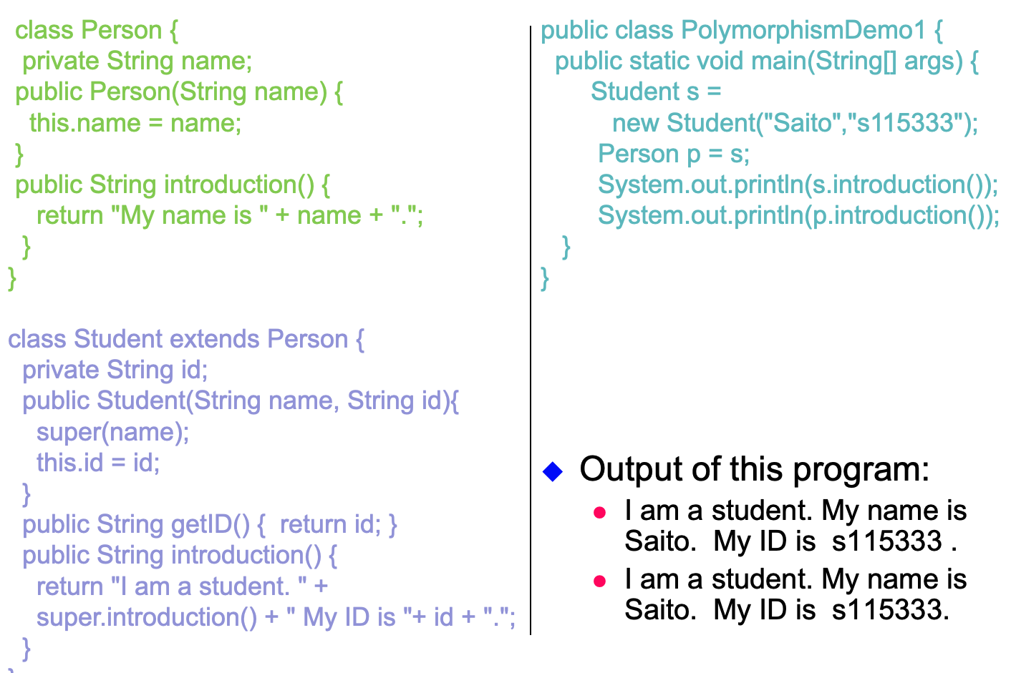
RAM
s
p
we r same objects

Slide 14
Outline
Compiler Movement in a Single Java Class
Compiler Movement in an Inheritance (IS-A hiearchy)
Polymorphism
Dynamic binding
Casting (Implicit and Explicit)

Slide 15
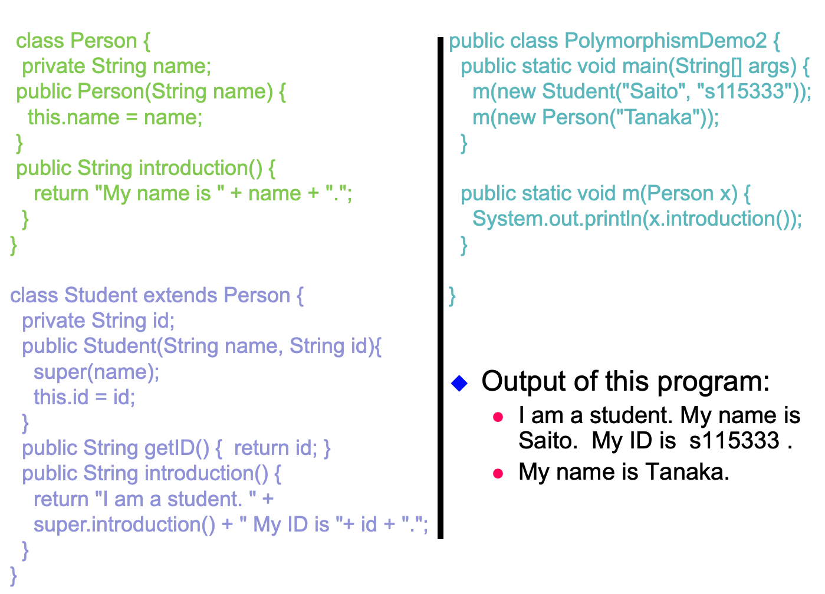
Observe the method m()
It accepts ONLY
Person objects
In main(), we are passing Student object to function m, whose input is a Person.
Will it raise bugs?
Yes or No

Slide 16
Answer is No.
Child can act as a parent object
This is called Dynamic binding.
Error checking happens during Runtime.
Advise: Do not use too many dynamic bindings. Difficult to know the cause of an error during runtime.
If possible, avoid during dynamic bindings by careful designing.

Slide 17
What happens in Dynamic Binding?
object = student
object = Person
RAM
p

Slide 18
Static and Dynamic Binding
Non-polymorphic methods (static methods) are “bound”
at compile time
called early binding or static binding.
Polymorphic methods are “bound”
at run time
called late binding or dynamic binding (also called dynamic dispatch).
Alternate views of polymorphism:
One objects sends a message to another object without caring about the type of the receiving object.
The receiving object responds to a message appropriately for its type.
Java methods are polymorphic by default
static or final (private methods are implicitly final) are bound at compile time.

Slide 19
Static variables and methods behave differently.
Let us look at them.
Keep in mind:
static = GOD
There can only be ONE copy

Slide 20
Note: Polymorphic Methods
public static void main(String[] args) {
Parent o1 = new Parent();
Parent o2 = new Child();
Child o3 = new Child();
Parent.myStaticMethod(); // A
Child.myStaticMethod(); // C
o1.myStaticMethod(); // A
o1.myInstanceMethod(); // B
o2.myStaticMethod(); // A
o2.myInstanceMethod(); // D
o3.myStaticMethod(); // C
o3.myInstanceMethod(); // D
myStaticMethod(); // C
myInstanceMethod();// Compiler Error
} // End of main method
} // End of the Child class
class Parent {
public static void myStaticMethod() {
System.out.println("A");
}
public void myInstanceMethod() {
System.out.println("B");
}
} // End of the Parent class
public class Child extends Parent {
public static void myStaticMethod() {
System.out.println("C");
}
public void myInstanceMethod() {
System.out.println("D");
}

Slide 21
Comments on the Previous Slide
Notice that o2.myStaticMethod invokes Parent.myStaticMethod(). If this method were truly overridden, we should have invoked Child.myStaticMethod, but we didn't. Rather, when you invoke a static method, even if you invoke it on an instance, you really invoke the method associated with the "compile-time type" of the variable. In this case, the compile-time type of o2 is Parent. Therefore, we invoke Parent.myStaticMethod().
However, when we execute the line o2.myInstanceMethod(), we really invoke the method Child.myInstanceMethod(). That's because, unlike static methods, instance methods CAN be overridden. In such a case, we invoke the method associated with the run-time type of the object. Even though the compile-time type of o2 is Parent, the run-time type (the type of the object o2 references) is Child. Therefore, we invoke Child.myInstanceMethod rather than Parent.myInstanceMethod().

Slide 22
Comments on the Previous Example
Why do the following lines produce the results as shown in comments:
public class Child extends Parent {
. . .
public static void main(String[] args) {
. . .
myStaticMethod(); // C
myInstanceMethod(); // Compiler Error
} // end of the mail method
} // end of the Child class
We invoke mystaticMethod() from the static main method, which is a member of the Child class. We invoke a static method from a static context. This is correct.
We tried to invoke myInstanceMethod() without a specification of the object. This invocation is done from the static main method, which is a member the Child class. This generates a compile-time error.

Slide 23
Outline
Compiler Movement in a Single Java Class
Compiler Movement in an Inheritance (IS-A hiearchy)
Polymorphism
Dynamic binding
Casting (Implicit and Explicit)

Slide 24
Minato
What do we observe from this tree?
Naruto
Child has only one parent.
But parent has many children.
Boruto
Himawari

Slide 25
Naruto IS A son of Minato
I am like my grand-father too
Boruto IS A son of Minato
I am like my Son
I am like my father
I am like my father
Super class
Sub class
Super class
Sub class
Minato min = new Naruto()
Naruto nar = new Boruto()
Minato min = new Boruto()
Naruto nar = new Minato()

Slide 26
Implicit Casting
DEMO
Minato
Naruto
Boruto
Himawari
Minato min = new Naruto()
Naruto nar = new Boruto()
Minato min = new Boruto()
a new object Naruto is being casted into Minato object
Since Naruto is a sub-class (or child) of the super-class Minato,
Java compiler easily perfoms the casting without a problem
Reason: Each child has only one parent
This is called implicit casting

Slide 27
Need for Explicit Casting
DEMO
Minato
Naruto
Boruto
Himawari
Naruto nar = new Boruto ()
Created Boruto Object and Casted into Naruto Object
Now, I want to convert the Naruto Object back to Boruto Object
What to do?
Boruto bor = nar
Create a Boruto Object and assign it to nar
Not possible: parent can have many children. So Compiler will get confused.
To eliminate confusion, we do explicit casting.

Slide 28
Explicit Casting
DEMO
Minato
Naruto
Boruto
Himawari
Incorrect approach
Incorrect approach
Naruto nar = new Boruto ()
Naruto nar = new Boruto ()
explicit casting
Boruto bor = nar
Boruto bor = (Naruto) nar

Slide 29
The instanceof Operator
Whoami?
Often you will get into a situation in which you need to rediscover the exact type of the object so you can access the extended methods of that type (see Example 2, slide 11):
Person p = new Student("Saito","s115333");
System.out.println(p.getID()); // Compile-time error:
// There is no the getID method in the Person class.
Use the instanceof operator to test whether an object is an instance of a class:
Person p = new Student("Saito","s115333");
if (p instanceof Student) {
System.out.println(“Student ID: " + ((Student)p).getID());
}

Slide 30
Casting-Dot Operator Precedence
The casting operator has lower precedence than the “.” (dot) operator:
((Student)p).getID()
Without the parentheses the cast is associated with the method (getID in our example) and attempts to change its return type:
(Student)p.getID()

Slide 31
Class Work: 1
Please take 5 minutes to print the answers
public class Naruto {
public static void familyName() {
System.out.println(”Uzumaki");
}
public void ability() {
System.out.println(”Rasengan");
}
} // End of the Parent class
public class Boruto extends Naruto{
public static void familyName() {
System.out.println(”Uzumaki-Hyuga");
}
public void ability() {
System.out.println(”Lightening Ransengan");
}
}
public class learning{
public static void main(String[] args) {
Naruto nar1 = new Naruto();
Naruto nar2 = new Boruto();
Boruto bor1 = new Boruto();
nar1.familyName();
nar1.ability();
nar2.familyName();
nar2.ability();
bor1.familyName();
bor1.ability();
}
}

Slide 32
L.H.S. vs. R. H.S.
No
Go to RHS Method
is calling static method?
Impure object
(dynamic binding)
No
check
LHS=RHS
Go to LHS Method
Yes
Yes
(pure object)
Go the object class

Slide 33
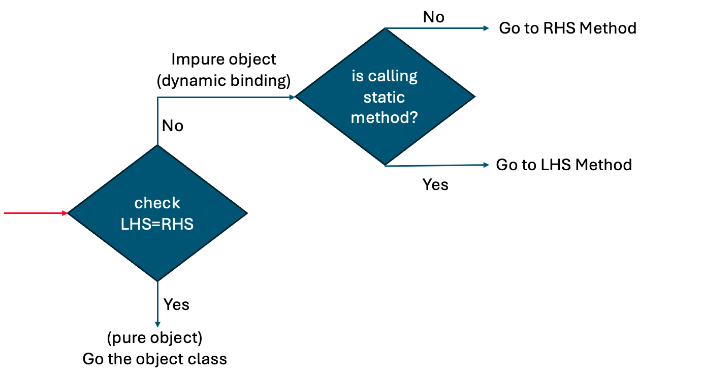
Class Work: 1
Please take 5 minutes to print the answers
public class Naruto {
public static void familyName() {
System.out.println(”Uzumaki");
}
public void ability() {
System.out.println(”Rasengan");
}
} // End of the Parent class
public class Boruto extends Naruto{
public static void familyName() {
System.out.println(”Uzumaki-Hyuga");
}
public void ability() {
System.out.println(”Lightening Ransengan");
}
}
public class learning{
public static void main(String[] args) {
Naruto nar1 = new Naruto();
Naruto nar2 = new Boruto();
Boruto bor1 = new Boruto();
nar1.familyName();
nar1.ability();
nar2.familyName();
nar2.ability();
bor1.familyName();
bor1.ability();
}
}

