Slide 1
Packages
by
RAGE Uday Kiran

Slide 2
Outline
What is a package?
How to create a package?
How to use a package?
Designing An Application: Calculator

Slide 3


What is a package?
Brother, I have created SUM, DIFF, MUL, DIV class files
Ok

Slide 4
What is a package?
How do I sell them to customers?
Create package

Slide 5
What is a package?
Package! What is it?
In Java, packages are used to group related classes.

Slide 6

What is a package?
Think of package as a special directory/folder to keep your programs
I do not understand.
make note of
special

Slide 7

What is a package?
mkdir calculator
mv SUM.java calculator/
mv DIFF.java calculator/
mv MUL.java calculator/
mv DIV.java calculator/
oh! Package is just a directory. Let me create a package.
I am making a package calculator and keeping all my java files in it

Slide 8
What is a package?
Told you so!
Package as a special directory and not a normal directory
Its not working
Also, you have to follow some rules

Slide 9
How to Create a package?
Please teach me how to create packages?
Sure! Let us do step-by-step

Slide 10
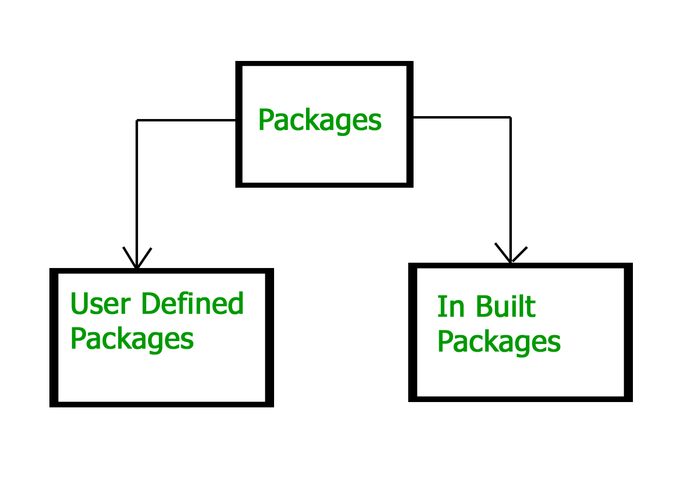
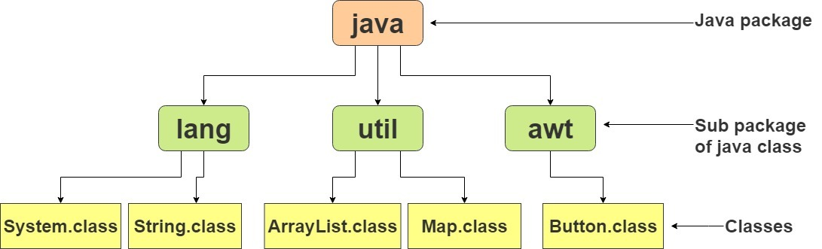
How to Create a package?
Packages are two types:
Built-in Packages
User-defined packages
we develop user-defined packages
Example of Built-in package

Slide 11
How to Create a package?
Step 1: Create a directory
mkdir calculator

Slide 12
How to Create a package?
SUM.JAVA
DIFF.JAVA
package calculator
public class SUM{
…
}
package calculator
public class DIFF{
…
}
…
Step 2: At the beginning of a Java program add
package packageName
Added the package packageName
at the beginning of every program.

Slide 13
How to Create a package?
mv SUM.java calculator/
mv DIFF.java calculator/
mv MUL.java calculator/
mv DIV.java calculator/
Step 3: Move the files into the package directory
Avoid this step if you are creating programs directly in this folder.

Slide 14
How to Create a package?
Step 4: Compile the entire package directory using
javac –cp package/*.java
javac –cp . calculator/*.java

Slide 15
How to Create a package?
Do not worry!
add those libraries to the classpath variable
or, execute the command as follows
javac –cp locationOfLibrary1.jar: locationOfLibrary2.jar
packageName/*.java
I am getting errors!
some libraries are not found

Slide 16
How to Create a package?
Let me try
javac -cp .:some_library.jar:lib/another_library.java calculator/*.java
My App is ready
It works :D

Slide 17


How to use a package?
Customers, use my Calculator App
Sure! Let me try.

Slide 18


How to use a package?
oh! God.
How to call the java files in a package?
Dexter, how to call my java programs?

Slide 19

How to use a package?
Its simple. Use
import keyword
Explain clearly?

Slide 20
How to use a package?
calUsage.JAVA
If you want to use a single file in a package use
import package.file
import calculator.SUM;
public class calUsage{
SUM sum;
…
}

Slide 21
How to use a package?
calUsage.JAVA
If you want to use all files in a package, then
import package.*
import calculator.*;
public class calUsage{
SUM sum;
DIFF diff;
MUL mul;
…
}

Slide 22
Controlling Access to Members of a Class (review of CHAPTER 4)
The first data column indicates whether the class itself has access to the member defined by the access level.
The second column indicates whether classes in the same package as the class (regardless of their parentage) have access to the member.
The fourth column indicates whether all classes have access to the member.
World | Subclass | Package | Class | Modifier
Y | Y | Y | Y | public
N | Y | Y | Y | protected
N | N | Y | Y | no modifier
N | N | N | Y | private

Slide 23
Visibility (review of CHAPTER 4)
Package One
Package Two
Alpha
Subclass
AlphaSub
Beta
Gamma
Gamma | AlphaSub | Beta | Alpha | Modifier
Y | Y | Y | Y | public
N | Y | Y | Y | protected
N | N | Y | Y | no modifier
N | N | N | Y | private
This table shows where members of the alpha class are visible for each of the
access modifiers that can be applied to them.

Slide 24
Summary of Creating and Using Packages
To create a package for a type, put a package statement as the first statement in the source file that contains the type (class or interface).
To use a public type that is in a different package, you have three choices:
use the fully qualified name of the type,
import the type, or
import the entire package of which the type is a member.
The path names for a package's source and class files mirror the name of the package.
You might have to set your CLASSPATH so that the compiler and the JVM can find the .class files for your types.

Slide 25
Class Work: Proper Designing of Calculator Application
Execution area
Let us create calculator application together.
It should support basic math calculations (SUM, DIFF, MUL, DIV, and ModDiv) and trigonometry (SIN, COS, and Tan).

Slide 26
Class Work: Proper Designing of Calculator Application
Execution area
org
Step 1: Designing the package hierarchy
Start the top-level package name with a domain/license type.
com – commerce
org – organization
net – network
edu – education
floss – open source
gnu - license type
https://en.wikipedia.org/wiki/List_of_Internet_top-level_domains

Slide 27
Class Work: Proper Designing of Calculator Application
Execution area
org
Step 1: Designing the package hierarchy
Start the top-level package name with a domain/license type.
Set the second-level of package name with institute/company.
uaizu
amazon
…
uaizu

Slide 28
Class Work: Proper Designing of Calculator Application
Execution area
org
Step 1: Designing the package hierarchy
Start the top-level package name with a domain/license type.
Set the second-level of package name with institute/company.
Specify the package name
You can skip above two steps.
But the package must start from the third step
uaizu
calculator

Slide 29
Class Work: Proper Designing of Calculator Application
Execution area
org
Step 1: Designing the package hierarchy
Start the top-level package name with a domain/license type.
Set the second-level of package name with institute/company.
Specify the package name
Look at the problem definition and create a hierarchy.
support basic math calculations (SUM, DIFF, MUL, DIV, and ModDiv) and trigonometry
uaizu
calculator
basic
trigonometry
Task: In five minutes, develop a hierarchy**

Slide 30
Class Work: Proper Designing of Calculator Application
Execution area
org
Step 1: Designing the package hierarchy
Start the top-level package name with a domain/license type.
Set the second-level of package name with institute/company.
Specify the package name
Look at the problem definition and create a hierarchy.
Note: hierarchy can also be unbalanced.
Mention the class files.
uaizu
calculator
basic
trigonometry
SUM
DIFF
MUL
DIV
MDIV
SIN
COS
TAN

Slide 31
Class Work: Proper Designing of Calculator Application
Execution area
org
Step 1: Designing the package hierarchy
Start the top-level package name with a domain/license type.
Set the second-level of package name with institute/company.
Specify the package name
Look at the problem definition and create a hierarchy.
Note: hierarchy can also be unbalanced.
Mention the class files.
Define abstract class & interfaces
uaizu
calculator
basic
trigonometry
SUM
DIFF
MUL
DIV
MDIV
abs
abs
SIN
COS
TAN

Slide 32
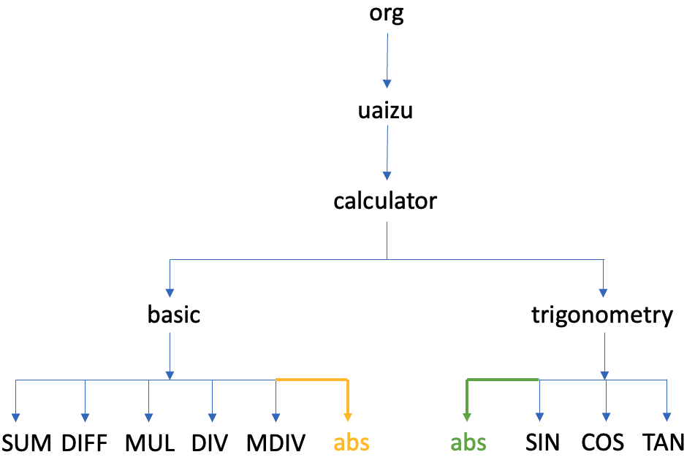
Class Work: Proper Designing of Calculator Application
Execution area
mkdir org
cd org
mkdir uaizu
cd uaizu
mkdir calculator
cd calculator
mkdir basic
mkdir trigonometry
Step 1: Designing the package hierarchy
Step 2: Create directories accordingly
Task: Create directories in two minutes**

Slide 33
Class Work: Proper Designing of Calculator Application
Execution area
cd basic
vim abs.java
Step 1: Designing the package hierarchy
Step 2: Create directories accordingly
Step 3: Prepare the abstract classes
Writing abs file for basic
package org.uaizu.calculator.basic;
public abstract class abs{
double var1, var2;
abs(double a, double b){
this.var1 = a;
this.var2 = b;
}
abs(int a, int b){
this.var1 = (double) a;
this.var2 = (double) b;
}
abstract double getValue();
}
Task: Write abstract class file in five minutes

Slide 34
Class Work: Proper Designing of Calculator Application
Execution area
cd ../trigonometry
vim abs.java
Step 1: Designing the package hierarchy
Step 2: Create directories accordingly
Step 3: Prepare the abstract classes
Writing abs file for basic
Writing abs file for trigonometry
package org.uaizu.calculator.trigonometry;
public abstract class abs{
double deg1;
abs(double a){
this.deg1 = a;
}
abs(int a){
this.deg1 = (double) a;
}
abstract double getValue();
}
Task: Write abstract class file in five minutes

Slide 35
Class Work: Proper Designing of Calculator Application
Execution area
cd ../basic
vim SUM.java
Step 1: Designing the package hierarchy
Step 2: Create directories accordingly
Step 3: Prepare the abstract classes
Writing abs file for basic
Writing abs file for trigonometry
Step 4: Writing writing the programs
Writing SUM file in basic
package org.uaizu.calculator.basic;
public class SUM extends abs{
SUM(int x, int y){
super(x,y);
}
public double getValue()
return this.var1 + this.var2;
}
…
Task: Write SUM class file in three minutes

Slide 36
Class Work: Proper Designing of Calculator Application
Execution area
cd ../trigonometry
vim SIN.java
Step 1: Designing the package hierarchy
Step 2: Create directories accordingly
Step 3: Prepare the abstract classes
Writing abs file for basic
Writing abs file for trigonometry
Step 4: Writing writing the programs
Writing SUM file in basic
Writing SIN file in trigonometry
package org.uaizu.calculator.trigonometry;
import java.lang.Math;
public class SIN extends abs{
SIN(int degree){
super(degree);
}
public double getValue()
return Math.sin(this.deg1);
}
…
Task: Write SIN class file in three minutes

Slide 37
Class Work: Proper Designing of Calculator Application
Execution area
Step 1: Designing the package hierarchy
Step 2: Create directories accordingly
Step 3: Prepare the abstract classes
Writing abs file for basic
Writing abs file for trigonometry
Step 4: Writing writing the programs
Writing SUM file in basic
Writing SIN file in trigonometry
Step 5: Compile the package
Go to top directory.
Execute the following command
javac -cp . /org/uaizu/calculator/basic/*.java –d .
javac -cp . /org/uaizu/calculator/trigonometry/*.java –d .

Slide 38
Thank you

