Slide 1
Self Introduction

Slide 2
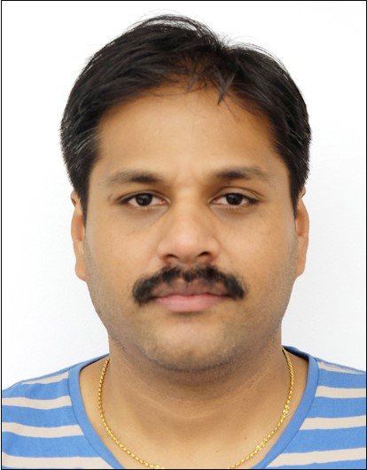

About Lecturer
Name: Prof. RAGE (ラゲ) Uday Kiran
Email: udayrage@u-aizu.ac.jp
Office: 145-A
Extension: 3115
Studied Book: Java for Dummies

Slide 3
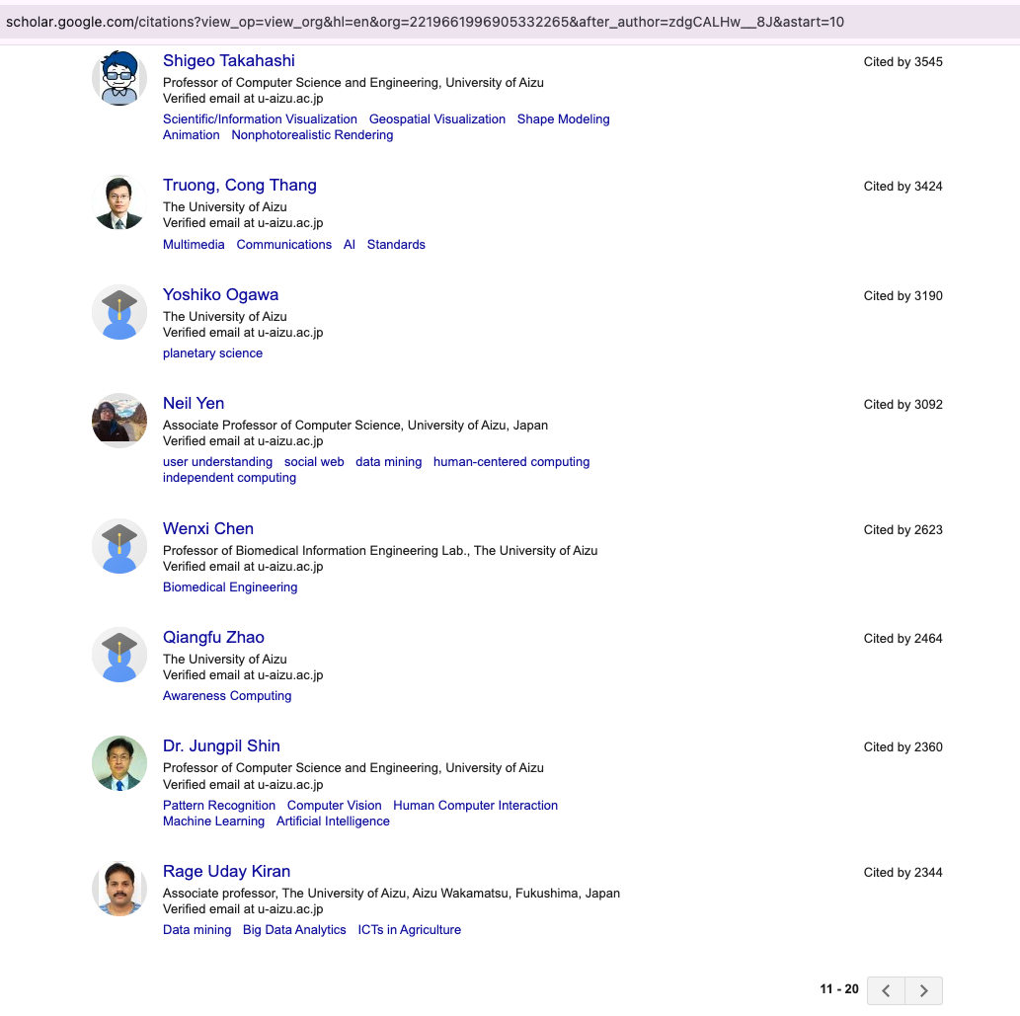
My Work
Areas of Research:
Artifical Intelligence
Database systems and
Data Science
Top-20 among all professors (past to present)

Slide 4
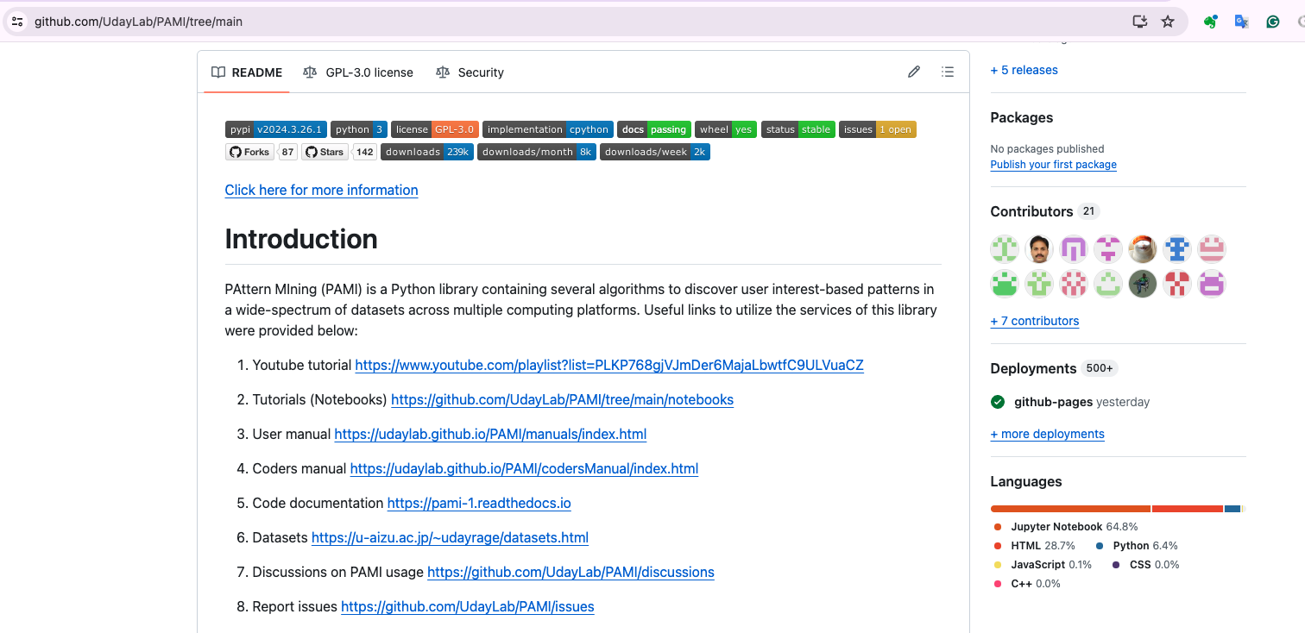
Software developed by our lab

