Slide 1



Basics: In-depth
Best Coding Practices
+
Examples
Notes:
Hello everyone,
Welcome to my channel on Data Analytics. I am your host Prof. RAGE Uday Kiran
In this video, we are going to talk about the four best coding practices the users can follow.

Slide 2
Outline
Four important rules to keep in mind to improve your coding process
Use words over letters for declarations
Following a casing type
Use “main” function only for class (or object) instantiation. Do not write logic in it.
use “setFunctionName()” and “getFunctionName()” to achieve your objectives.

Slide 3
Rule 1: Use words instead of letters

Slide 4
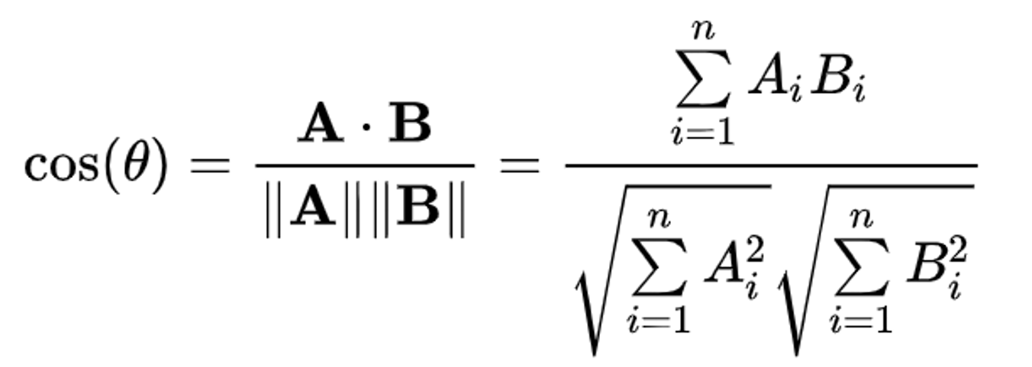
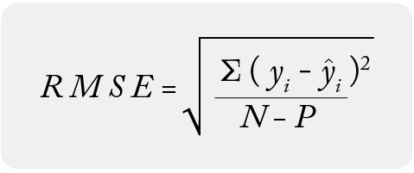
Rule 1: Use words instead of letters
Use proper words instead of letters for the variables.
int i =10 (wrong)
int height=10 (right)
For complex data structures, use the data type to the variable
String[] cars = {"Volvo", "BMW", "Ford", "Mazda"}; (wrong)
String[] strArrCars = {"Volvo", "BMW", "Ford", "Mazda"}; (right)
int[] A = {1,2,3,4,5}; (wrong)
int[] intArrA = {"Volvo", "BMW", "Ford", "Mazda"}; (right)

Slide 5
Rule 1: Use words instead of letters
Binary variables
Use flag variable when needed.
boolean A = true (wrong)
boolean flag = true (right)
boolean flagCondition1 = true (right)
Use “is” word before the non-flag variables
boolean javaEasy= true (wrong)
boolean isJavaEasy = true (right)

Slide 6
Rule 2: Coding with a particular case type

Slide 7
Rule 2: Coding with a particular case type
Sometimes you want to use multiple words for variables, functions, and classes.
We put multiple words together using a particular case type.
Popular case types:
camelCase - first word will be small letters and from second word, first character will be capitalized.
e.g., int tempVariable
snake_case- words are connected by an underscore
e.g., int temp_variable
PascalCase – same as camel case but first letter is capital.
e.g., int TempVariable

Slide 8
Rule 2: Coding with a particular case type
Follow only one case type for the entire project
If you are working in a team, inquire with your colleges and follow that case type.
Use case converters in IDEs to convert your variables from one case type to another.

Slide 9
Rule 3: Use “main” function only for class instantiation

Slide 10
Rule 3: Use “main” function only for class (or object) instantiation
public class javaClass{
javaClass(){
//Constructor
}
public static void main(String args[]){
//main function
}
}

Slide 11
Rule 3: Use “main” function only for class (or object) instantiation
public class javaClass{
javaClass(){
//Constructor
//Main entry into your program
//Allows only Java instance
}
public static void main(String args[]){
//main function
}
}

Slide 12

Rule 3: Use “main” function only for class (or object) instantiation
public class javaClass{
javaClass(){
//Constructor
//Main entry into your program
//Allows only Java instance
}
public static void main(String args[]){
//main function
}
}
allowed
How to enter?
not allowed

Slide 13
Rule 3: Use “main” function only for class (or object) instantiation
public class javaClass{
javaClass(){
//Constructor
//Main entry into your program
//Allows only Java instance
}
public static void main(String args[]){
//main function
//Converts into instances of the class
//Enters into a constructor and does the job
}
}
allowed

Slide 14
Rule 3: Use “main” function only for class (or object) instantiation
public class javaClass{
javaClass(){
//Constructor
//Main entry into your program
//Allows only Java instance
}
public static void main(String args[]){
//main function
//Converts into instances of the class
//Enters into a constructor and does the job
}
}
allowed

Slide 15
Rule 3: Use “main” function only for class (or object) instantiation
public class javaClass{
javaClass(){
//Constructor
//Main entry into your program
//Allows only Java instance
}
public static void main(String args[]){
//main function
//Converts into instances of the class
//Enters into a constructor and does the job
}
}
allowed

Slide 16
Rule 3: Use “main” function only for class (or object) instantiation
Am I allowed?
public class javaClass{
javaClass(){
//Constructor
//Main entry into your program
//Allows only Java instance
}
public static void main(String args[]){
//main function
}
}
allowed?

Slide 17
Rule 3: Use “main” function only for class (or object) instantiation
Am I allowed?
public class javaClass{
javaClass(){
//Constructor
//Main entry into your program
//Allows only Java instance
}
public static void main(String args[]){
//main function
}
}
allowed?
Answer is NO
Thus, we should not write logic in the main
Write to print statements and
object creation statements in main

Slide 18
Rule 4: use “setFunctionName()” and “getFunctionName()”

Slide 19
Rule 4: use “setFunctionName()” and “getFunctionName()”
public class javaClass{
int varA, varB, value;
javaClass(){
//Constructor
}
public int run(int var1, int var2){
return this.varA + this.varB;
}
public static void main(String args[]){
//main function
}
}

Slide 20
Rule 4: use “setFunctionName()” and “getFunctionName()”
public class javaClass{
int varA, varB, value;
javaClass(){
//Constructor
}
public int run(int var1, int var2){
return this.varA + this.varB;
}
public static void main(String args[]){
//main function
}
}
Giving hit about your code

Slide 21
A magician never reveals his secrets
A coder never reveals his logic

Slide 22
public class javaClass{
int varA, varB, value;
javaClass(){
//Constructor
}
public void setValues(int var1, int var2){
this.varA = var1;
this.varB = var2;
}
public void run()
value = this.varA + this.varB;
public int getValue()
return value;
public static void main(String args[]){
//main function
}
}
takes slightly more memory and time
but may be beneficial in the long run
Life lesson:
Right way may not always be an easy way

Slide 23
Take Aways

Slide 24
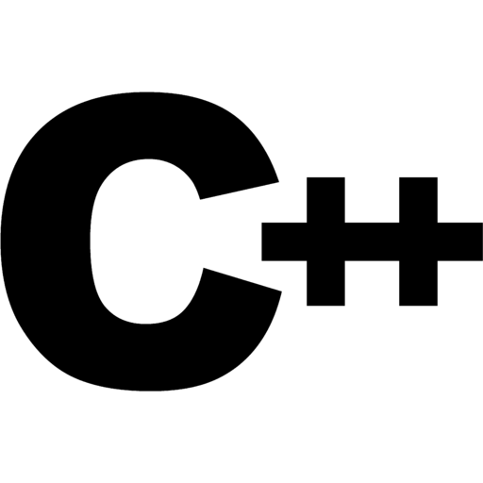




Four important Coding Practices
…
Declarations:
words over letters
Naming Style:
Follow a parcticular casing style
Main() usage:
Only for initialization
Not for writing logic
set and get functions:
setFunctionName – to pass values
getFunctionName – to get values
Example:
int i=10
int size=10
Example:
int i=10
int minSize=10
Example:
value(int var1){…}
setValue(int var1){…}
Programing language

