Slide 1

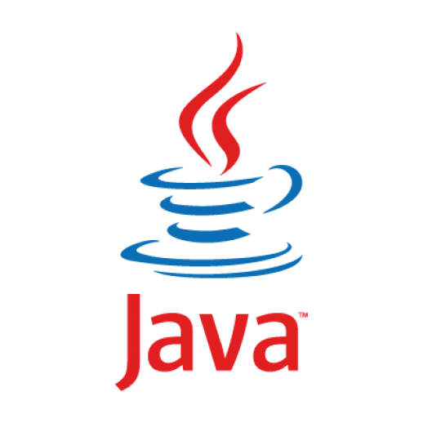

Basics: In-depth
Lecture -1
Java’s Popularity:
Platform Independence
Notes:
Hello everyone,
Welcome to my channel on Data Analytics. I am your host, Prof. RAGE Uday Kiran
In this video, we are going to learn the key reason behind the Java’s popularity. That is, platform independence.

Slide 2
Preface
Object Oriented Programming (OOPs) concepts existed before Java
C++ and other OOPs based programing languages existed long before Java
So keep in mind that OOPs did not made Java popular (or widely adopted)
Platform independence (or portability) is the main ingredient for the popularity
Code once and deploy it anywhere
OOPs was just a catalyst
OOPs backfired in database systems
World adopts only those technologies that have real value
In this lecture, we will talk about the main ingredient that is behind the Java’s popularity

Slide 3
Outline
Heterogenity
Portability Issue
Idea of Virtual Machines
Java

Slide 4
Outline
Heterogenity
Three main parts of a computing device
Communication process
Complexity
Portability Issue
Idea of Virtual Machines
Java

Slide 5
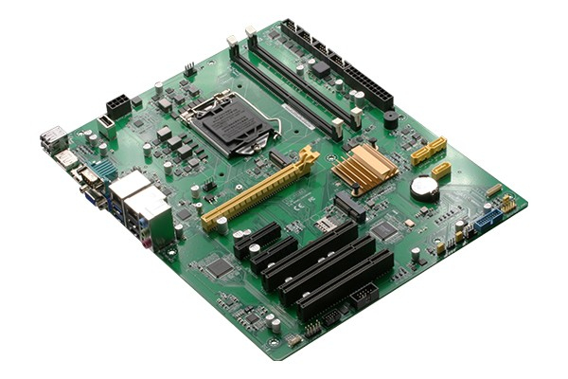
Three main parts of a computing device
Part 1
Mother Board

Slide 6
Three main parts of a computing device
Part 1
Concept
Example
Peripherals
Examples:
Keyboard, monitor, disks, mouse, printer, wifi, etc
connected
Mother Board

Slide 7
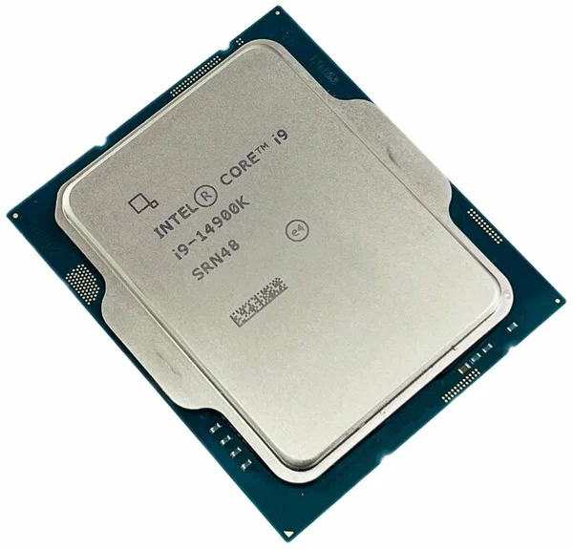
Three main parts of a computing device
Part 2
Concept
Example
CPUs
Peripherals
Examples:
Keyboard, monitor, disks, mouse, printer, wifi, etc
connected
Mother Board

Slide 8
Three main parts of a computing device
Part 2
Concept
Example
CPUs
Do CPU directly communicates with a mother board?
Peripherals
Examples:
Keyboard, monitor, disks, mouse, printer, wifi, etc
connected
Mother Board

Slide 9
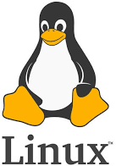
Three main parts of a computing device
Part 3
Concept
Example
CPUs
Operating System
Kernal
Peripherals
Examples:
Keyboard, monitor, disks, mouse, printer, wifi, etc
connected
Mother Board

Slide 10
Three main parts of a computing device
Concept
Example
CPUs
Main parts
Operating System
Kernal
Mother Board

Slide 11

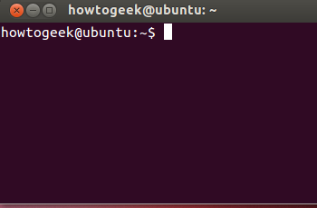
2. Communication process
Concept
Example
CPUs
Applications
Operating System
Kernal
users
Mother Board

Slide 12
2. Communication process
Concept
Example
Q) How do applications interact with OS kernal?
CPUs
Applications
Operating System
Kernal
users
Mother Board

Slide 13
2. Communication process
Concept
Example
Q) How do applications interact with OS kernal?
CPUs
system calls
Applications
Operating System
Kernal
users
Mother Board

Slide 14
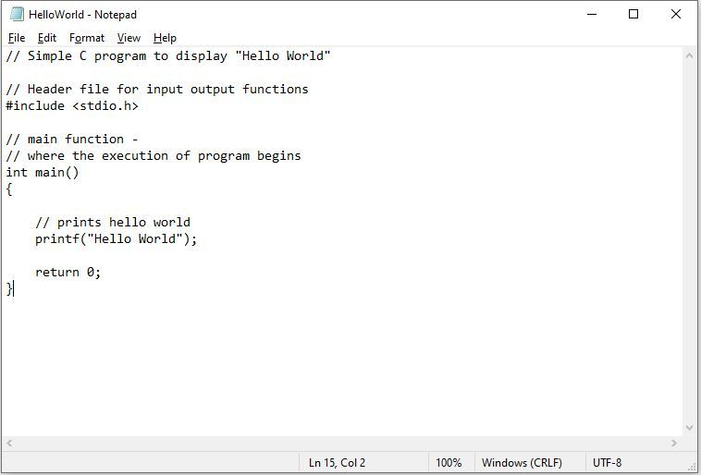
System calls: Illustration
Do you guys think an OS understands your printf function?
No
Then, What actually happens with printf function?
https://stackoverflow.com/questions/3866217/how-can-i-make-the-system-call-write-print-to-the-screen

Slide 15

System calls: Illustration
calls printf function in stdio.h file
stdio.h uses libc header to use system calls
Linux
libc header
https://stackoverflow.com/questions/54228202/what-system-calls-does-printf-use-inorder-to-write-data-to-the-console-in-wi
https://stackoverflow.com/questions/3866217/how-can-i-make-the-system-call-write-print-to-the-screen

Slide 16
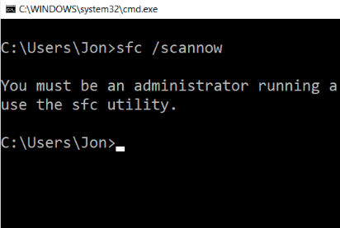

3. Complexity
(Simplistic way)
Q) Do system calls (or kernal) remains same across the operating systems?
E.g., Do Windows 11 and Ubuntu 24.04 will have the same set of system calls?
=

Slide 17
3. Complexity
(Simplistic way)
Q) Do system calls (or kernal) remains same across the operating systems?
E.g., Do Windows 11 and Ubuntu 24.04 will have the same set of system calls?
not the same
=

Slide 18
3. Complexity
(Simplistic way)
Q) Do system calls (or kernal) remains same across the operating systems?
E.g., Do Windows 11 and Ubuntu 24.04 will have the same set of system calls?
not the same
=
monolithic kernal (single file)
Sacrifise space to achieve speed
micro-kernal (multiple files using DLLs)
Sacrifise speed to save space
DLL: dynamic link library

Slide 19
Heterogenity in System calls: Illustration
calls printf function in stdio.h file
stdio.h code may be different for each OS
Linux
libc header
https://stackoverflow.com/questions/54228202/what-system-calls-does-printf-use-inorder-to-write-data-to-the-console-in-wi
https://stackoverflow.com/questions/3866217/how-can-i-make-the-system-call-write-print-to-the-screen

Slide 20

Heterogenity in System calls: Illustration
calls printf function in stdio.h file
stdio.h code may be different for each OS
Linux
libc header
Windows
a bit complicated
https://stackoverflow.com/questions/54228202/what-system-calls-does-printf-use-inorder-to-write-data-to-the-console-in-wi
https://stackoverflow.com/questions/3866217/how-can-i-make-the-system-call-write-print-to-the-screen

Slide 21
Outline
Heterogenity
Portability Issue
Idea of Virtual Machines
Java

Slide 22
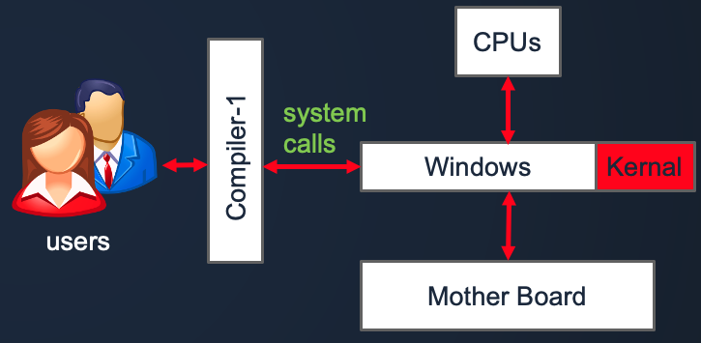
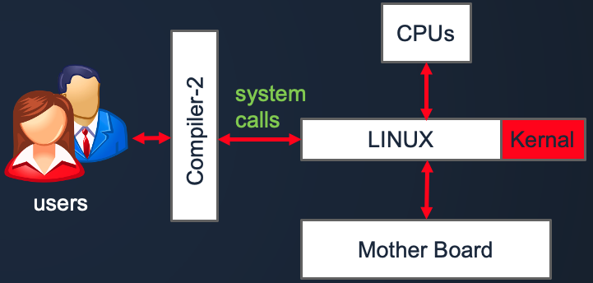
Portability Issue
Since the system calls are different for each Operating System, we cannot use the same (or only one) compiler to create machine language.
When the compilers change, APIs (or input functions or libraries) may change as well -> bugs
CPUs
system calls
Applications
Operating System
Kernal
users
Mother Board

Slide 23
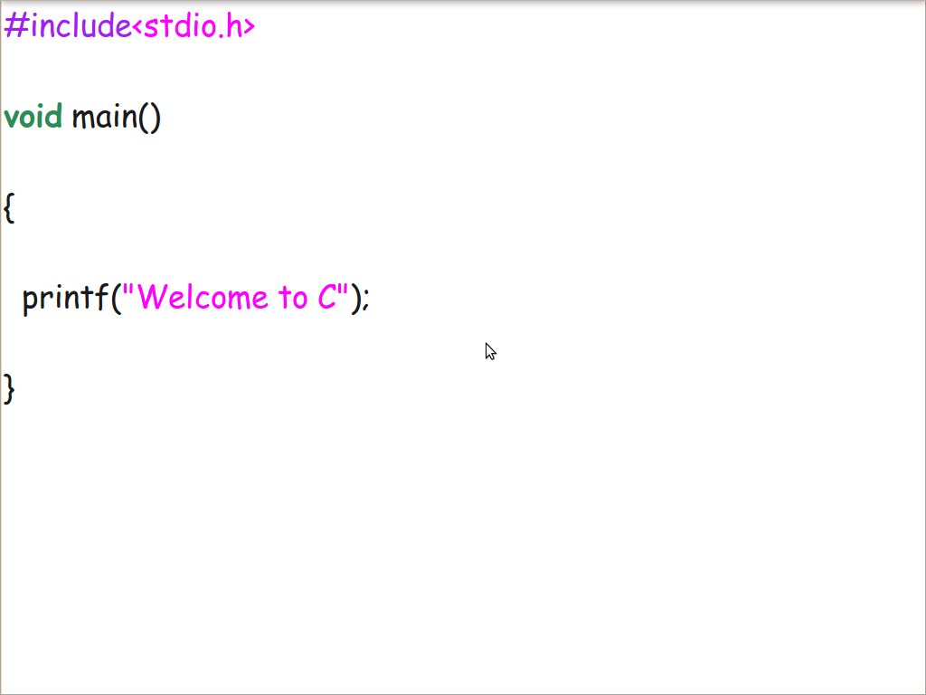
Issues: Illustration
Writing a C program in Windows and Linux
bugs will araise
Windows
Linux
bugs will araise

Slide 24
Outline
Heterogenity
Issues
Idea of Virtual Machines
Java

Slide 25
Reason for the portability issue
Computing environment = execution environment
Meaning: Developers must consider the execution environment while writing their code.
vi fileName.c
gcc fileName.c
./a.out
write a file on a machine, M
compile the file on the same machine
execute it on the same machine

Slide 26
Solution
Abstraction and Divide and Conquer
Computing environment = Developer environment + execution environment (abstraction)
All developers will work on only one theoretical machine (abstraction)
This theoretical machine MAGICALLY converts the developer’s code to OS’ Machine Language
Theoretical machine is called Virtual Machine

Slide 27
Solution
Abstraction and Divide and Conquer
Computing environment = Developer environment + execution environment (abstraction)
All developers will work on only one theoretical machine (abstraction)
This theoretical machine MAGICALLY converts the developer’s code to OS’ Machine Language
Theoretical machine is called Virtual Machine
Actual machine=
Windows,
Linux,
MacOS,
…
execution
Virtual Machine-1
give
Magic
Writing code for this machine
ignore it completely
…
Developers

Slide 28
Outline
Heterogenity
Portability Issue
Idea of Virtual Machines
Java
Java virtual Machine
Architecture
Q & A’s
OOPs concepts

Slide 29
Java Virtual Machine
Abstraction and Divide and Conquer
Computing environment = Developer environment + execution environment (abstraction)
All developers will work on only one theoretical machine (abstraction)
This theoretical machine MAGICALLY converts the developer’s code to OS’ Machine Language
Theoretical machine is called Virtual Machine
Actual machine=
Windows,
Linux,
MacOS,
…
execution
Virtual Machine-1
give
Magic
(Java Runtime Environment)
Writing code for this machine
ignore it completely
…
Developers

Slide 30
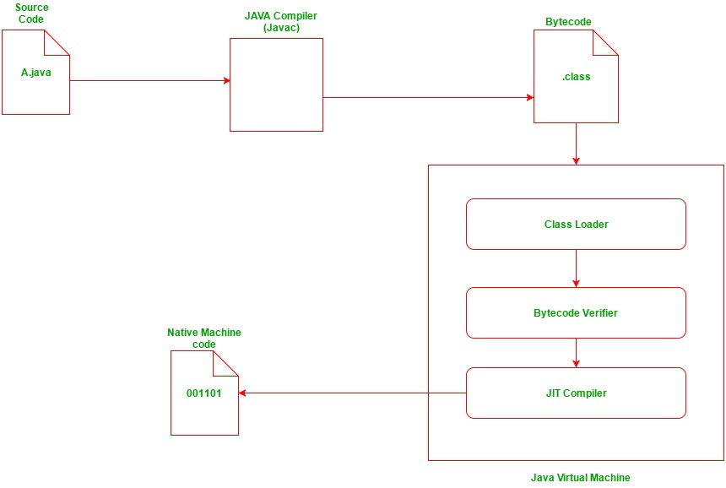
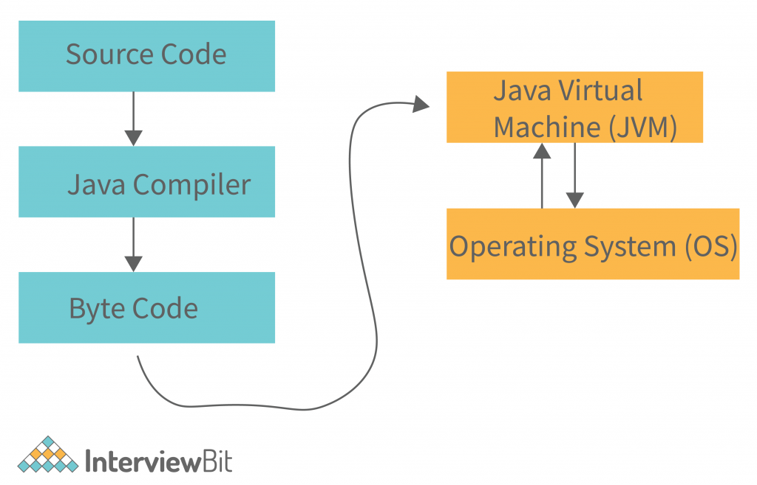
Architecture
Magic
https://www.geeksforgeeks.org/compilation-execution-java-program/

Slide 31
Key Question and Answers
Actual machine=
Windows,
Linux,
MacOS,
…
execution
Virtual Machine-1
give
Magic
(Java Runtime Environment)
Writing code for this machine
ignore it completely
…
Developers
Q1) Is Java Developoment Kit (JDK) different for the coders of Windows, Linux, and MacOS?
Ans) Yes or No?
look at the above figure and try to answer it

Slide 32
Key Question and Answers
Actual machine=
Windows,
Linux,
MacOS,
…
execution
Virtual Machine-1
give
Magic
(Java Runtime Environment)
Writing code for this machine
ignore it completely
…
Developers
Q1) Is Java Developoment Kit (JDK) different for the coders of Windows, Linux, and MacOS?
Ans) No. JDK remains the same for the coders of Windows, Linux, and MacOS

Slide 33
Key Question and Answers
Actual machine=
Windows,
Linux,
MacOS,
…
execution
Virtual Machine-1
give
Magic
(Java Runtime Environment)
Writing code for this machine
ignore it completely
…
Developers
Q2) Is Java Virtual Machine (JVM) different for the coders of Windows, Linux, and MacOS?
Ans) Yes or No?
look at the above figure and try to answer it

Slide 34
Key Question and Answers
Actual machine=
Windows,
Linux,
MacOS,
…
execution
Virtual Machine-1
give
Magic
(Java Runtime Environment)
Writing code for this machine
ignore it completely
…
Developers
Q2) Is Java Virtual Machine (JVM) different for the coders of Windows, Linux, and MacOS?
Ans) Yes, each JVM as to call different systems calls as per the operating system.

Slide 35
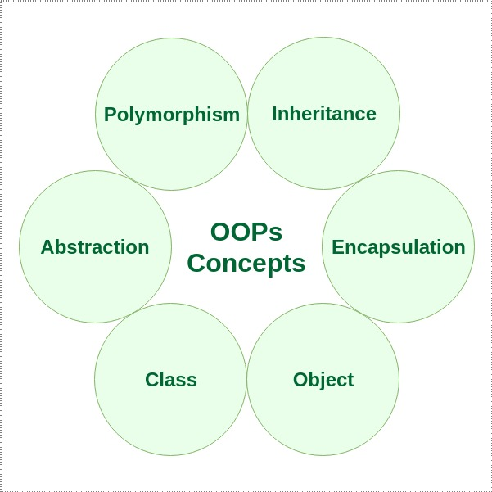
Properties of Java (OOPs)
Explained in subsequent class or videos

Slide 36
Thank You

