Slide 1



Basics – Bird’s Eye View
Lecture: 2
Object Oriented Programming
Concepts

Slide 2
Outline
History
Structural vs. Object oriented
Class and Objects

Slide 3
Outline
History
Structural vs. Object oriented
Class and Objects

Slide 4
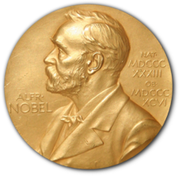
Top-most price in the world
Name: Nobel price
Areas:
Physics,
Chemistry,
Physiology or Medicine,
Literature,
Economics and
Peace.

Slide 5
Top-most price in the world
Name: Nobel price
Areas:
Physics,
Chemistry,
Physiology or Medicine,
Literature,
Economics and
Peace.
Computer Science?

Slide 6
Key Question?
What is the top-most price given to the scientists of computer science field?

Slide 7

Key Question?
What is the top-most price given to the scientists of computer science field?

Slide 8

Key Question?
What is the top-most price given to the scientists of computer science field?
Allan Turing
Turing machine
Turing machine is a mathematical abstraction representing a computational model that manipulates symbols on a tape following a set of rules. Despite its simplicity, this model is capable of executing any computer algorithm.
https://medium.com/@shreyanshagarwal2022/turing-the-man-who-invented-the-computer-and-challenged-the-limits-of-thinking-f2854f45e03d

Slide 9

Movie based on Allan Turing

Slide 10
Food for Thought?
Are the computers equivalent to Turning Machines?
Yes or No ?
Search in Web and find out the answer by yourself.

Slide 11
Timeline
Lambda calculus
Turning machines
(Theory of computation)
Low level languages came into existence
Machine code and
Assembly language
High level languages Originated
FORTRON
COBOL, etc.
Imperative/Functional/Structural languages Originated
ALGOL
Introduction to C
Birth(ALGOL) = C
1930
1940
1950
1960
1970
https://medium.com/javascript-scene/the-forgotten-history-of-oop-88d71b9b2d9f
(my version of explanation is slightly deviates as history is blurred)
https://unstop.com/blog/history-of-c-language

Slide 12
Timeline
Let us ignore this event for some time as the concepts of structured programming language were explored in 1960.
Lambda calculus
Turning machines
(Theory of computation)
Low level languages came into existence
Machine code and
Assembly language
High level languages Originated
FORTRON
COBOL, etc.
Imperative/Functional/Structural languages Originated
ALGOL
Introduction to C
Birth(ALGOL) = C
1930
1940
1950
1960
1970
https://medium.com/javascript-scene/the-forgotten-history-of-oop-88d71b9b2d9f
(my version of explanation is slightly deviates as history is blurred)
https://unstop.com/blog/history-of-c-language

Slide 13
Timeline
Alan Kay introduced the concepts of “Object Oriented Programing”
To perform distributed computation
Focus:
message passing across machine
Encapsulation (Hiding the code)
Dynamic binding
Lambda calculus
Turning machines
(Theory of computation)
Low level languages came into existence
Machine code and
Assembly language
High level languages Originated
FORTRON
COBOL, etc.
Imperative/Functional/Structural languages Originated
ALGOL
1930
1940
1950
1960
1966
https://medium.com/javascript-scene/the-forgotten-history-of-oop-88d71b9b2d9f
(my version of explanation is slightly deviates as history is blurred)
https://unstop.com/blog/history-of-c-language

Slide 14
Timeline
Lambda calculus
Turning machines
(Theory of computation)
Low level languages came into existence
Machine code and
Assembly language
High level languages Originated
FORTRON
COBOL, etc.
Imperative/Functional/Structural languages Originated
ALGOL
Introduction to C
Birth(ALGOL) = C
1930
1940
1950
1960
1966
1970
1967
1995
OOPs
Simula
…
Java
https://medium.com/javascript-scene/the-forgotten-history-of-oop-88d71b9b2d9f
(my version of explanation is slightly deviates as history is blurred)
https://unstop.com/blog/history-of-c-language

Slide 15
Outline
History
Structural vs. Object oriented
Class and Objects

Slide 16
How to Capture reality?
Universe of Discourse (Set Theory)
In model-theoretical semantics, a universe of discourse is the set of entities that a model is based on.
A set is a collection of elements.
E.g., A={a,b,c,d}
Function rule that defines a relationship between one variable (the independent variable) and another variable (the dependent variable)
E.g., f: A -> B
Real-world can be captured using sets and functions

Slide 17
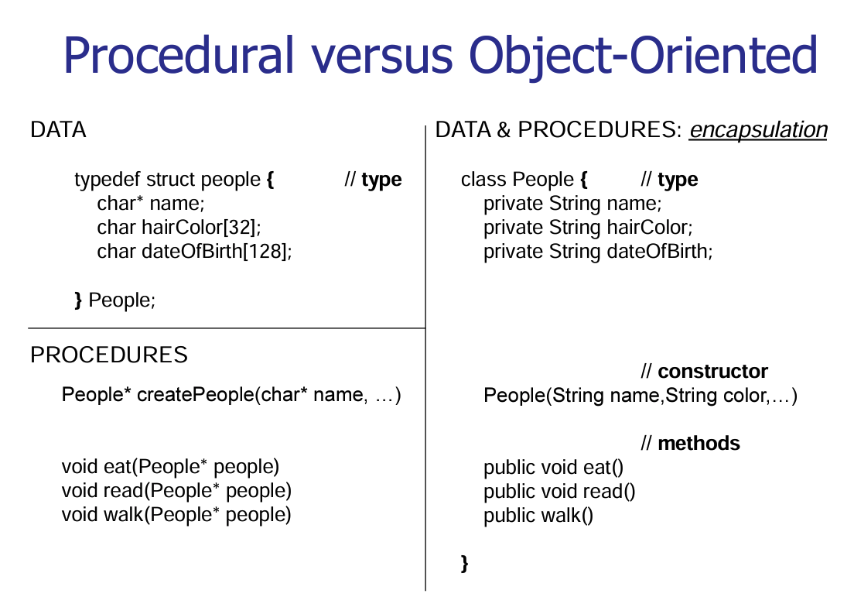
Attributes (or Elements) are seperate
Elements and procedures are separate
Functions are seperate
The original data may easily get corrupted

Slide 18
Elements and procedures are separate
Elements and procedures are in unison
The original data may easily get corrupted
The data and the functions, which are supposed to have the access to the data, are put into one box known as an object.
There are no chances of any unauthorized access to the data

Slide 19
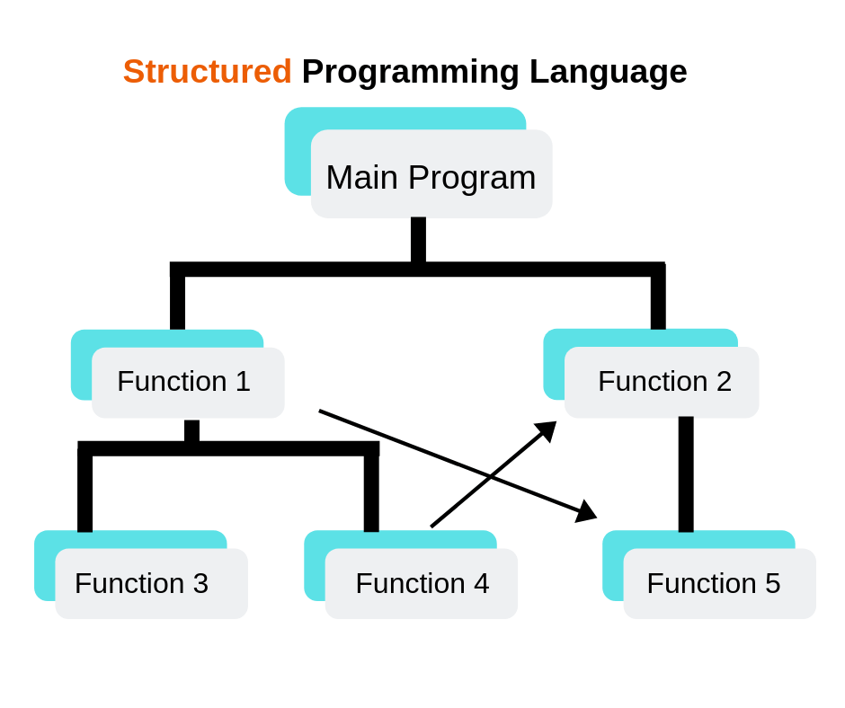
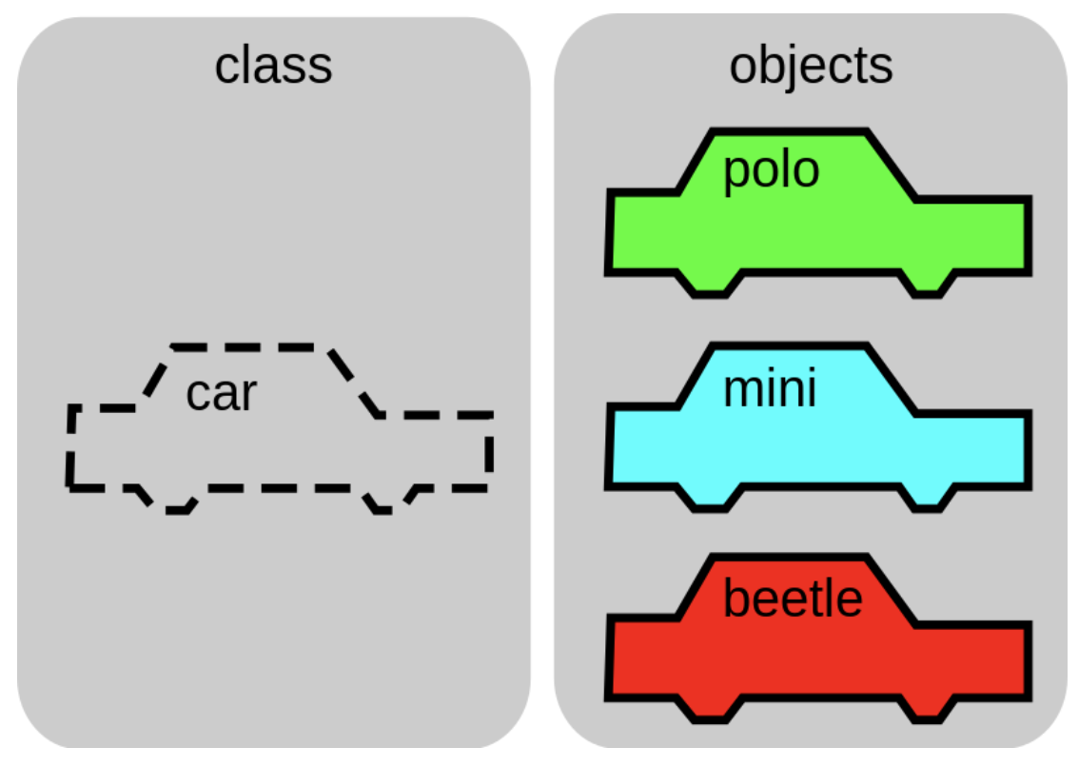
Structural vs. Object oriented
Direct access to functions and memory locations using pointers is not a best practice

Slide 20
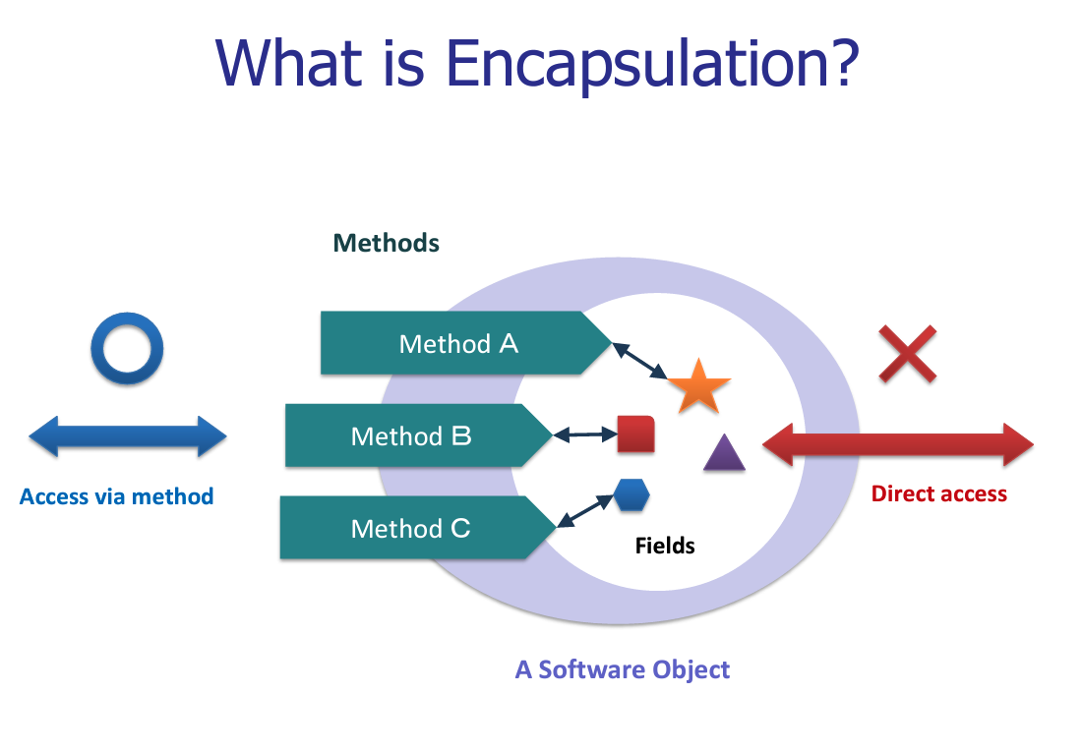

Slide 21
Outline
History
Structural vs. Object oriented
Class and Objects

Slide 22
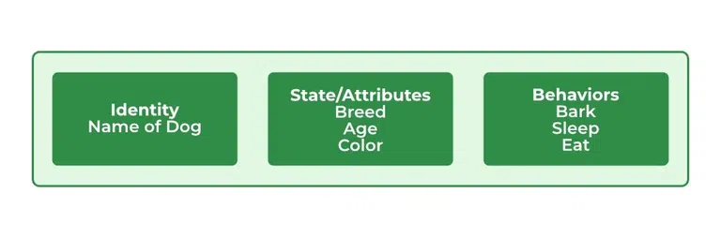
A class
Reality can be represented using classes and objects in OOPs
The class represents a group of objects having similar properties and behavior.
Example: Student is a class while s123000 represents an object of Student class
A class in Java is a set of objects which shares common characteristics/ behavior and common properties/ attributes.
Class

Slide 23
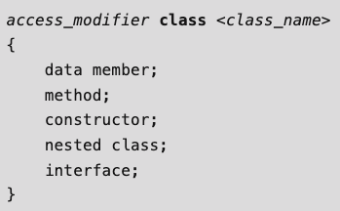
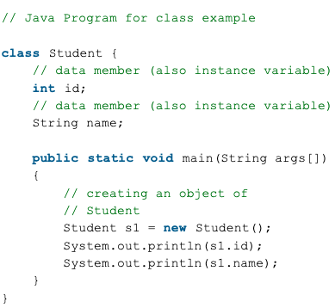
Properties and Declaration of a Java Class
Class declaration
Properties
Class is not a real-world entity. It is just a template or blueprint or prototype from which objects are created.
Class does not occupy memory.
Class is a group of variables and methods.
A Class in Java can contain:
Data member
Method
Constructor
Nested Class
Interface
Example
https://www.geeksforgeeks.org/classes-objects-java/

Slide 24
An Object
An object in Java is a basic unit of OOPs.
An object represents real-life entities.
Objects are the instances of a class that are created to use the attributes and methods of a class.
An object consists of :
State: It is represented by attributes of an object. It also reflects the properties of an object.
Behavior: It is represented by the methods of an object. It also reflects the response of an object with other objects.
Identity: It gives a unique name to an object and enables one object to interact with other objects.
Class
Object
new attribute with unique values will be created.

Slide 25
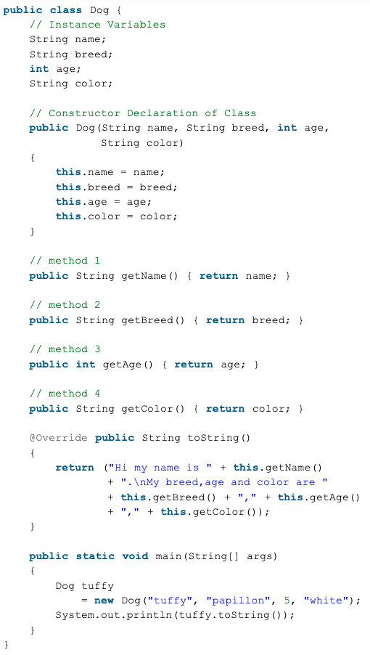
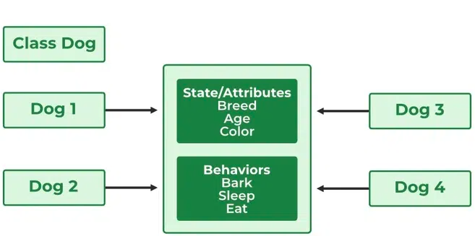
Illustration of an Object
Sample Code
Class
Object
Instances of a class

Slide 26
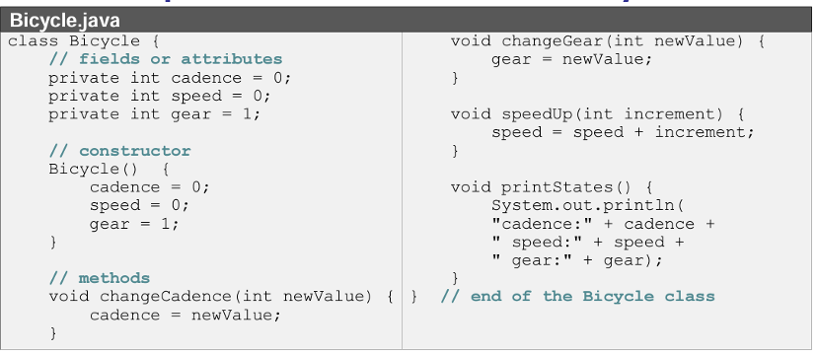
Compiler Movement
Class
Entry Point

Slide 27
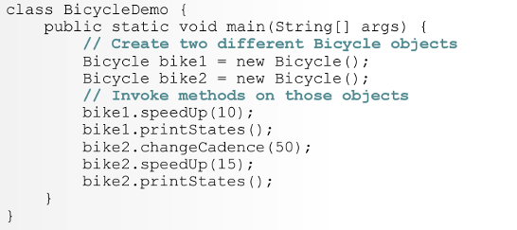
Compiler Movement
Class
Entry Point
Program to create Objects

Slide 28
Compiler Movement
How to execute the programs?
Class
Entry Point
Program to create Objects

Slide 29
Compiler Movement
How to execute the programs?
Class
Cannot enter into this java program as main() is missing
Entry Point
Program to create Objects

Slide 30
Compiler Movement
creates an object, bike1
cadence=0
speed=0
gear=1
creates attributes
How to execute the programs?
Class
goes down
enters
Entry Point
Perform steps
exit
Program to create Objects

Slide 31
Compiler Movement
creates an object, bike1
cadence=0
speed=10
gear=1
creates attributes
How to execute the programs?
Class
creates an object, bike2
cadence=50
speed=15
gear=1
How to execute the programs?

Slide 32
Thank you
Good reading material: Compilation steps of a Java Program
https://stackoverflow.com/questions/32779189/internal-architecture-of-java-compiler

Slide 33
