Slide 1



Basics: In-depth
Lecture: 3
Java Basics
Notes:
Hello everyone,
Welcome to my channel on Data Analytics.
Real-world enterprises naturally store their data in database management systems. Thus, it is important for the data analytics to learn SQL so that he or she can gather the necessary data easily from the enterprise data repositories.
In this context, this video covers the basic topics of SQL from the bird's eye view. Ample number of examples were provided for ease of learning of SQL.
We also provide a demo in which we run the SQL commands on a PostGres database and gather the data. The code was written in Python executed in the Jupyter Notebook.
URL: https://www.hiclipart.com/free-transparent-background-png-clipart-iyomg

Slide 2
Outline
Variables
Data types
Assigning operator
Operators
Expressions, Statements, and Blocks
Control Flow Statements

Slide 3
Outline
Variables
Data types
Assigning operator
Operators
Expressions, Statements, and Blocks
Control Flow Statements

Slide 4

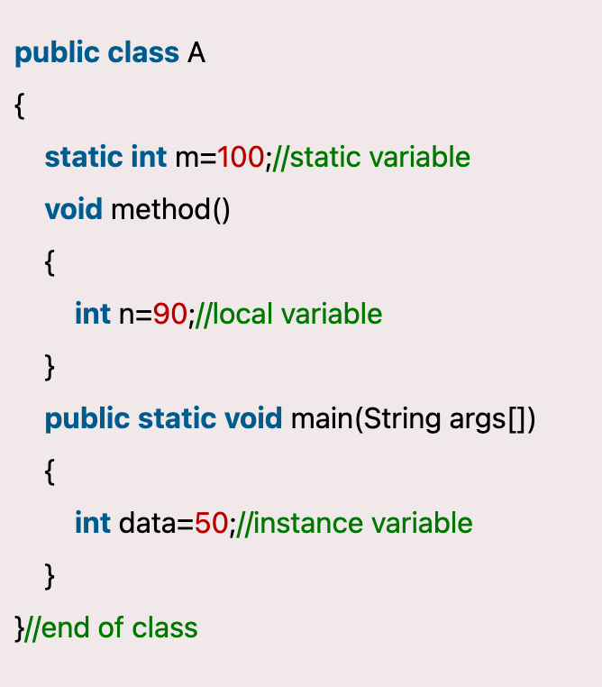
Variables
int a= 10
RAM
Variables are containers for storing data values.
It represents the name of a reserved area allocated in memory.
Types
Local variables – variables declared in a method
Parameters and local variables are same (do not get confused)
Instance variables - A variable declared inside the class but outside the body of the method
Static variables –
A variable that is declared as static is called a static variable.
You can create a single copy of the static variable
a
10
Parameters

Slide 5
Outline
Variables
Data types
Assigning operator
Operators
Expressions, Statements, and Blocks
Control Flow Statements

Slide 6
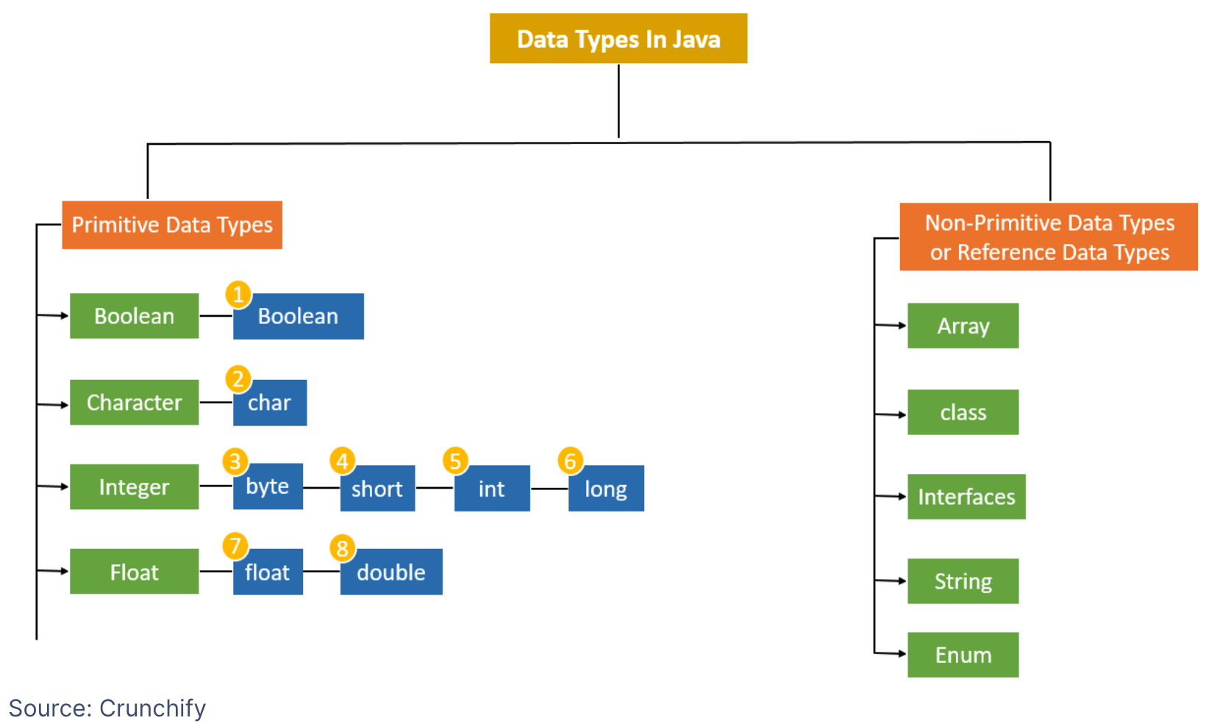
Data Types
Data types specify how memory stores the values of the variable.
Data type decides the value the variable will hold.
E.g., int height variable can hold only integer values
Types
Primitive data types
Primitive data types specify the size and type of variable values.
building blocks of data manipulation and cannot be further divided into simpler data types.
Non-primitive data types
Data types referring to instances or objects.
They cannot store the value of a variable directly in memory
They store a memory address of the variable.

Slide 7
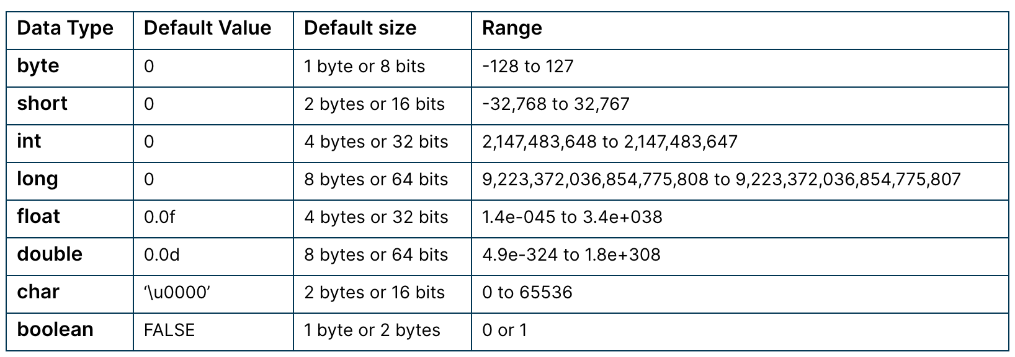
Primitive Types

Slide 8
Non-primitive types (Discussion on Arrays and List)
int[] myArray = {1, 2, 3};
RAM
myArray
1
2
3
Address=2000
What is the time complexity to measure the length of an array?
System.out.println(myArray.length)

Slide 9
Outline
Variables
Data types
Assigning operator
Operators
Expressions, Statements, and Blocks
Control Flow Statements

Slide 11
Assigning Operator*
Assigning operator works differently in C and Java **
For primitive data types, assigning operator works similarity as in C language
For non-primitive data types, assigning operator works completely different from C language

Slide 12
Behavior of Assigning Operator for Primitive data types
int height = 10
RAM
height
10
Address=1000

Slide 13
Behavior of Assigning Operator for Primitive data types
int height = 10
int width = height
RAM
height
width
10
copies
10
Address=1000
Address=1100

Slide 14
Behavior of Assigning Operator for Primitive data types
int height = 10
int width = height
height = 20
System.out.println(height + “ “+ width)
20 10
RAM
height
width
20
independent
10
Address=1000
Address=1100
Same as in C language

Slide 15
Behavior of Assigning Operator for Non-Primitive data types
int[] myArray = {1, 2, 3};
RAM
myArray
1
2
3
Address=2000

Slide 16
Behavior of Assigning Operator for Non-Primitive data types
int[] myArray = {1, 2, 3};
int[] newArray = myArray
RAM
myArray
1
2
3
Address=2000
newArray
1
2
3
Address=3000

Slide 17
Behavior of Assigning Operator for Non-Primitive data types
int[] myArray = {1, 2, 3};
int[] newArray = myArray
RAM
myArray
1
2
3
Address=2000
newArray
Address=3000

Slide 18
Behavior of Assigning Operator for Non-Primitive data types
int[] myArray = {1, 2, 3};
int[] newArray = myArray
myArray[0] = 5
RAM
myArray
5
2
3
Address=2000
newArray
Address=3000
System.out.println(myArray[0] + “ and “ + newArray[0])
Output: 5 and 5

Slide 19
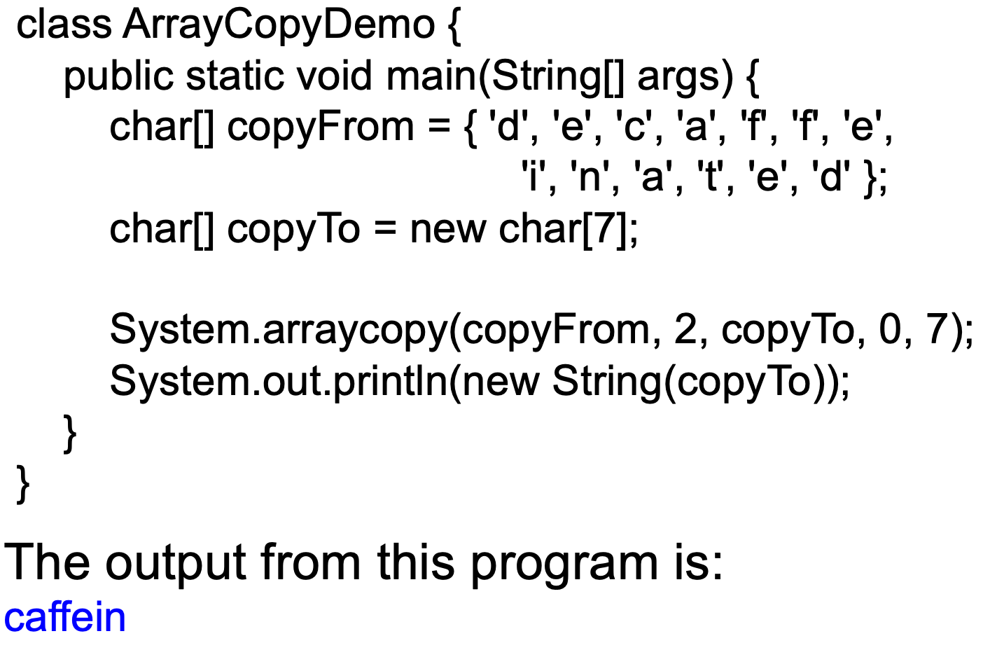
Key Question
How to copy only the data of non-primitive data types?
Ans) System.arraycopy() and clone()

Slide 20
Outline
Variables
Data types
Assigning operator
Operators
Expressions, Statements, and Blocks
Control Flow Statements

Slide 21
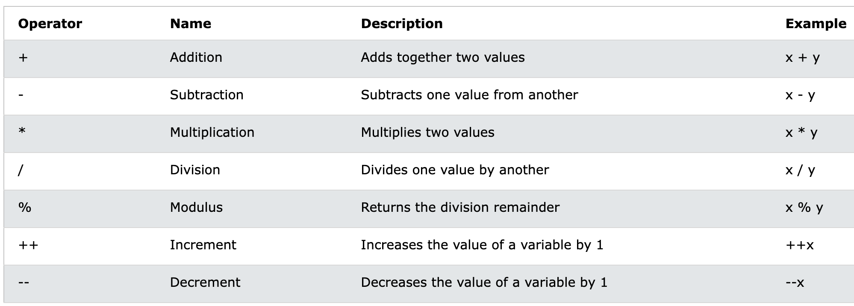
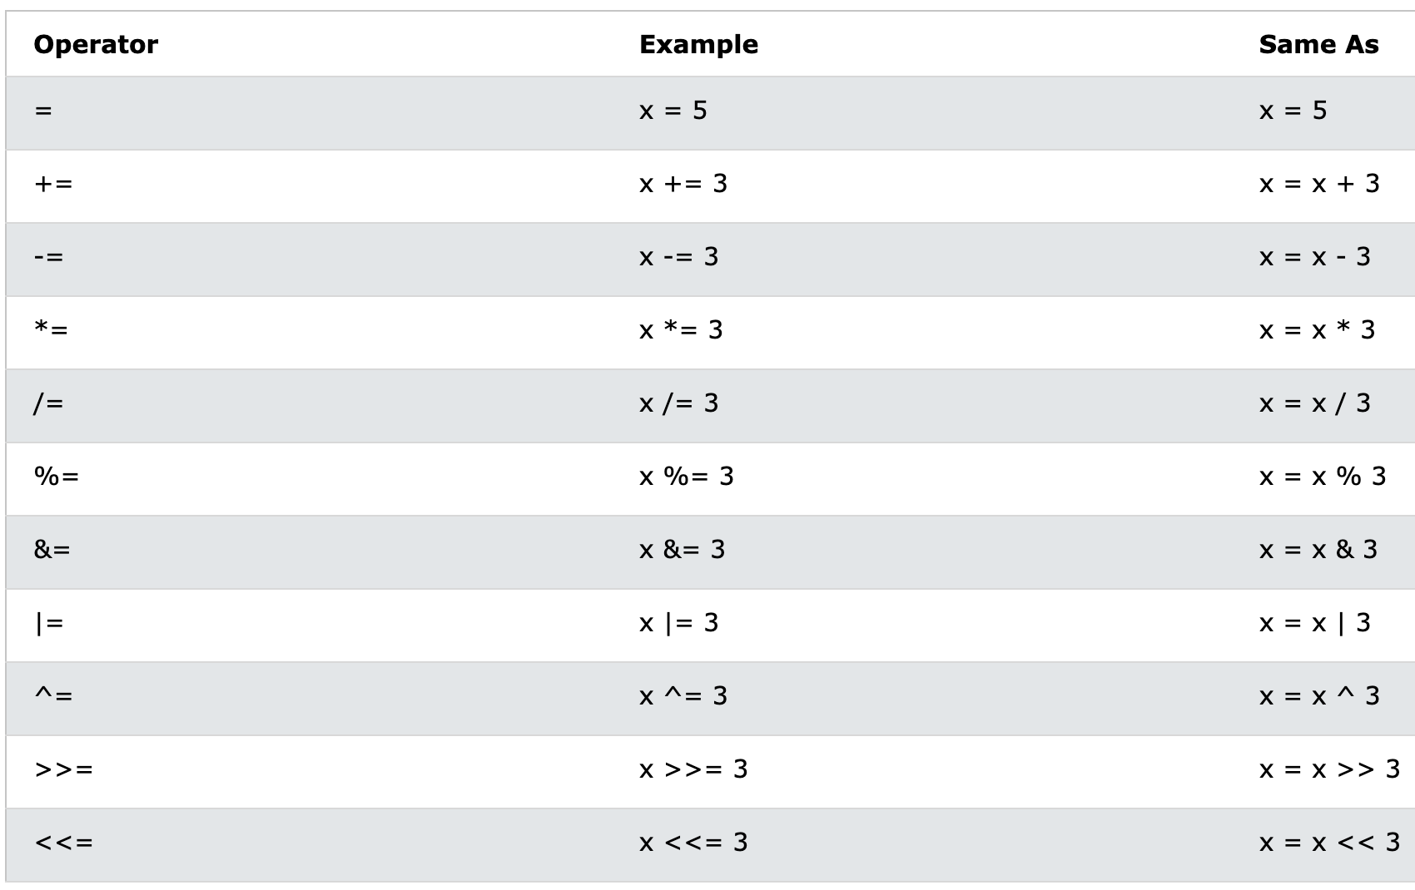
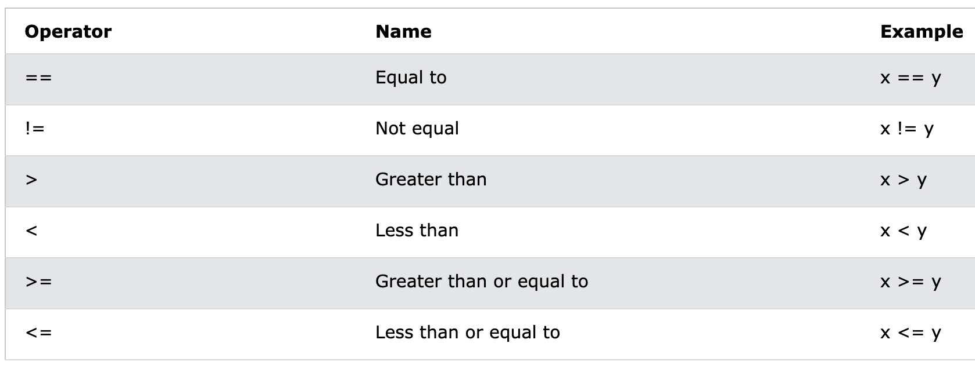
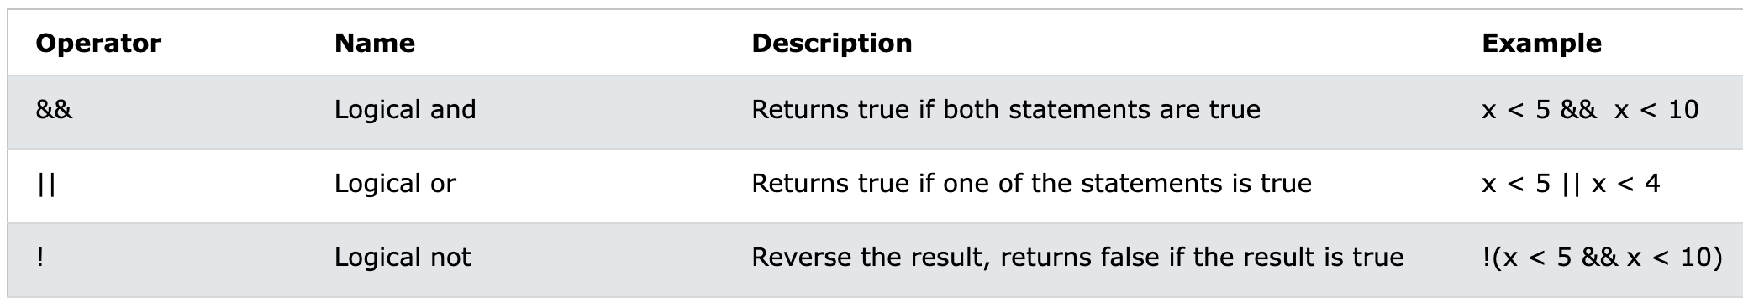
Operators
Operators are used to perform operations on variables and values.
Types:
Arithmetic operators
Assigning operators
Comparison operators
Logical operators

Slide 22
Outline
Variables
Data types
Assigning operator
Operators
Expressions, Statements, and Blocks
Control Flow Statements

Slide 23
Expressions and Statements
An expression is a construct that consists of variables, operators, and method invocations.
Examples are in a blue color below:
int a = 1;
int b = 2;
int c = a * b + 3;
Statements are equivalent to sentences in natural languages. A statement forms a complete unit of execution.
Examples:
aValue = 4;
Car c = new Car();
double db = 4.;
Thumb rule: Initialization of a variable is an expression.
Everything else is a statement

Slide 24
Blocks
A block is a group of zero or more statements between balanced braces.
Blocks can be used anywhere a single statement is allowed.
class BlockDemo {
public static void main(String[] args) {
boolean condition = true;
if (condition) { // begin block 1
System.out.println("Condition is true.");
} // end block one
else { // begin block 2
System.out.println("Condition is false.");
} // end block 2
}
}

Slide 25
Outline
Variables
Data types
Assigning operator
Operators
Expressions, Statements, and Blocks
Control Flow Statements

Slide 26
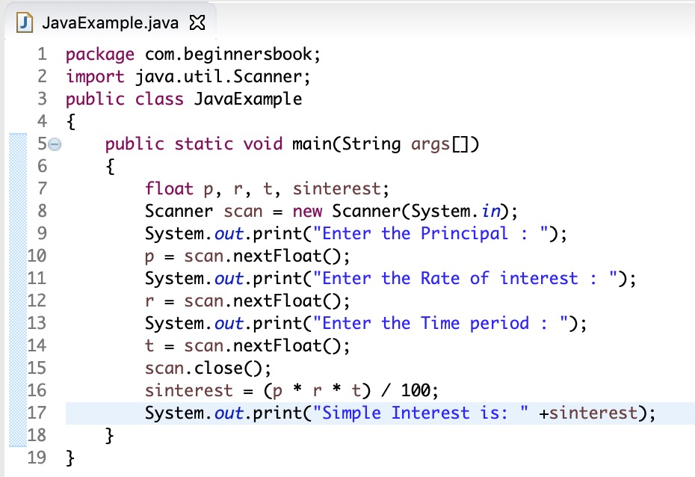
Movement of a compiler
Rule 1: Compiler moves from top to bottom
compiler movement

Slide 27
Movement of a compiler
Rule 2: One statement at a time
statement: anything between the semi-colons
compiler movement

Slide 28
Movement of a compiler
Rule 3:
Movement of a compiler can be altered only using control flow statements
Control flow statements break up the flow of execution via:
Decision making – if, if-else, switch
Looping – for, while, do-while
Branching – break, continue, return

Slide 29
The if-then Statement
The if-then statement instructs the computer to execute a certain section of code only if a particular test evaluates to true.
An example:
int a = 4;
int c = 9;
if (a < 5) {
a++;
c = a + 4;
}
if the expression is true

Slide 30
The if-else Statement
The if-else statement provides a secondary path of execution when an if clause evaluates to false.
For example:
if (a < 5) {
…
}
else {
…
}
if the expression is true
if the expression is false

Slide 31
Multiple ‘else if’ blocks
An example: Assigning a grade based on the value of testscore
class IfElseDemo {
public static void main(String[] args) {
int testscore = 76;
char grade;
if (testscore >= 90) { grade = 'A';
} else if (testscore >= 80) { grade = 'B';
} else if (testscore >= 70) { grade = 'C';
} else if (testscore >= 60) { grade = 'D';
} else { grade = 'F';
}
System.out.println("Grade = " + grade); // Output: Grade =C
}
}

Slide 32
The switch Statement
The switch statement allows any number of possible execution paths.
A switch works with the following data types: byte, short, char, and int.
A switch works with some other types (e.g., Integer, Short, enumerated types, etc.):
Integer is a wrapper class for the type int
Short is a wrapper class for the type short
final int month = 2;
String name;
switch (month) {
case 1:
name = “january”;
break;
case 2:
name = “february”;
break;
default:
name = “”;
break;
}
System.out.println(name);
// output: february

Slide 33
Example: switch
final Integer month = 4;
String name;
switch (month) {
case 1:
name = “january”;
break;
case 2:
name = “february”;
break;
default:
name = “”;
break;
}
System.out.println(name);
// output: an empty string
Short month = new Short(2);
String name;
switch (month) {
case 1:
name = “january”;
break;
case 2:
name = “february”;
break;
default:
name = “”;
break;
}
System.out.println(name);
// output february

Slide 34
Example: switch And if-else if
int month = 10;
String name;
switch (month) {
case 1:
name = “january”;
break;
case 2:
name = “february”;
break;
default:
name = “”;
break;
}
final int month = 10;
String name;
if (month == 1)
name = “january”;
else if (month == 2)
name = “february”;
else
name = “”;
System.out.println(name);
checks
one by one
jumps
directly

Slide 35
Example: A fall-through switch
int month = 1;
switch (month) {
case 1:
case 3:
case 5:
days = 31;
break;
case 2:
days = 28;
break;
case 4:
days = 30;
break;
}

Slide 36
The while Statement
The while loop continually executes a block of statements as long as a particular condition is true:
while (condition is true) {
…
}
An example:
int i = 1;
while (i < 5) {
System.out.println(i++);
}
An infinite loop as a while block:
// loops forever
while (true) {
…
}
This loop never runs:
while (false) {
…
}
skip

Slide 37
The do-while Statement
The do-while loop checks its condition of termination after its block has executed:
do {
… // statements
} while (condition);
A do-while loop executes at least once
A while loop may or may not execute
loops while the condition is true

Slide 38
Example: do-while
Correct:
int[] array = new int[2];
int i = 0;
do {
array[i] = i;
++i;
} while (i < array.length);
Incorrect:
int[] array = new int[2];
int i = array.length;
do {
array[i] = i;// error: i = 2
--i;
} while (i >= 0);

Slide 39
The for Statement
The for loop executes repeatedly until a termination condition is not satisfied:
for (initialization ; condition_of_termination ; increment) {
…
}
For example:
for (int i = 0;i < 10;++i) {
System.out.println(i); // prints 10 lines
}
An infinite loop can be expressed as:
for (;;) {
…
}

Slide 40
Example: for And do-while
int[] array = new int[2];
int i = array.length;
for (;i < ai.length;) {
ai[i] = i;
++i;
}
int[] array = new int[2];
int i = array.length;
do {
--I;
ai[i] = i;
} while (i < ai.length);
skip
no skip

Slide 41
The break Statements
The break statement has two forms: labeled, and unlabeled
An unlabeled break can be used to terminate a for, while, or do-while loop, and a switch
A labeled break statement terminates an outer statement
int i = 0;
while (true)
if (i > 5)
break;
else
++i;
labeled_break:
for (i = 1;i < 5;i++)
for (j = 2;j < 5;++j)
if (…)
break labeled_break;
1. terminates the
labeled statement
2. skips the block upon termination

Slide 42
The continue Statement
It skips the current iteration of a for, while, or do-while loop.
The unlabeled form skips to the end of the innermost loop’s body.
A labeled continue statement skips the current iteration of an outer loop marked with the given label.
for (int i = 1;i < 10;++i) {
if (i > 5)
continue;
System.out.println(i);
}
label :
for (int i = 1;i < 10;++i) {
for (int j = 0;j < 5;j++)
if (i > 5)
continue label;
System.out.println(i);
}

Slide 43
The return Statement
The return statement exits from the current method, and control flow returns to where the method was invoked.
A return statement may or may not return a value, for example:
return;
return 5;
void method1()
{
int i = method2();
return; // no return value
}
int method2()
{
int i = 0;
i += 5;
return i; // must return an int
}

Slide 44
Summary of Control Flow Statements
The if-then statement tells your program to execute a certain section of code only if a particular test evaluates to true.
The if-then-else statement provides a secondary path of execution when an "if" clause evaluates to false.
The switch statement allows for any number of possible execution paths.
The while and do-while statements continually execute a block of statements while a particular condition is true.
The for statement provides a compact way to iterate over a range of values.

Slide 45
Thank you

