Slide 1
Lecture 1: For Java Dummies
by
RAGE Uday Kiran

Slide 2
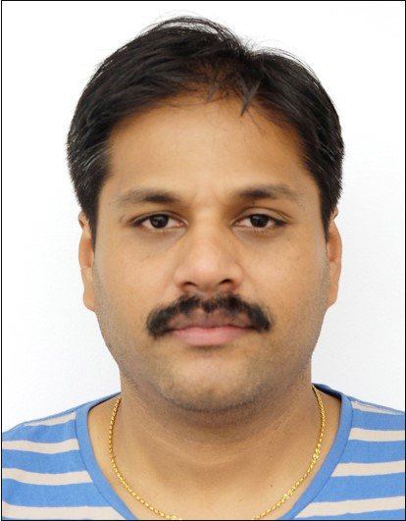

About Lecturer
Name: Prof. RAGE (ラゲ) Uday Kiran
Email: udayrage@u-aizu.ac.jp
Office: 145-A
Extension: 3115
Studied Book: Java for Dummies

Slide 3
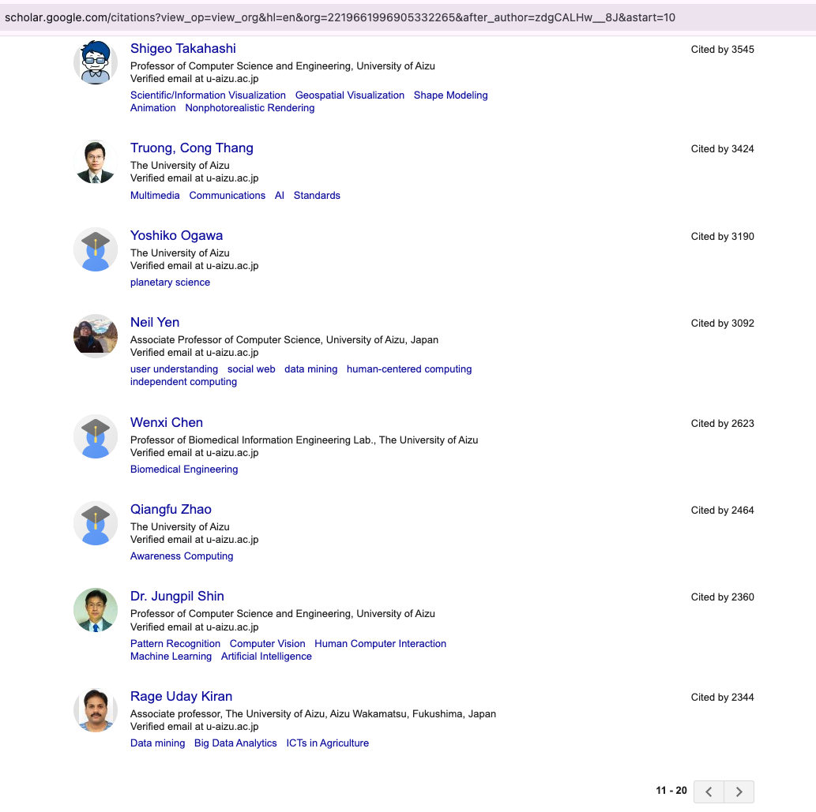
My Work
Areas of Research:
Artifical Intelligence
Database systems and
Data Science
Top-20 among all professors (past to present)

Slide 4
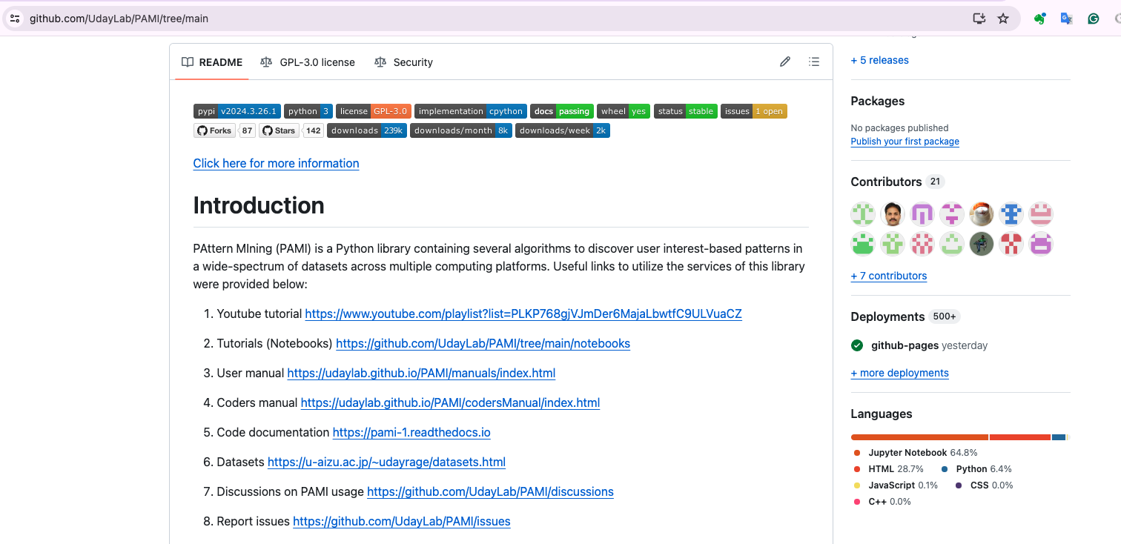
Software developed by our lab

Slide 5

Camel Casing and Coding Practices
By
Rage Uday Kiran

Slide 6
Camel Casing
Camel case is the practice of writing phrases without spaces or punctuation,
Words are separated with a single capitalized letter, and the first word starting with either case.
Examples
iPhone
javaScript/JavaScript
eBay
eCommerce
All of my students will be writing their code only in camel case.

Slide 7
Does and Do not in Coding
Does
use camel case for declaring variables, functions, and classes
minSup = 0.1
def getFrequentPatterns()
class frequentPatternTree
Maintain consistency of variables between various programs
minimum support variable in all frequent pattern mining algorithms must be written as minSup
Do not
do not use abbreviations for declaring variables, functions, and classes
ms to represent minimum support
do not use underscore (_) unless needed

Slide 8
Entering into a Java Program

Slide 9
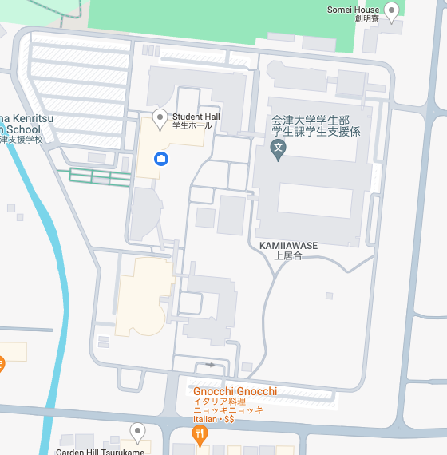
small entrance
Main entrance
Entering into our university

Slide 10
small entrance
class hello{
hello(){
//Constructor or small entrance
}
public static void main(String args[]){
//main entrance for terminal
}
}
Main entrance
Entering into our university

Slide 11
class hello{
hello(){
//Constructor or small entrance
var1 = 10
var2 = 5
}
public static void main(String args[]){
//main entrance for terminal
system.out.println(“Hello world!”);
//purpose
create object of the hello class
}
}
JAVA Compiler

Slide 12
setValues(var1,var2){
int value1 = var1;
int value2 = var2;
}
getPredictions(){
return mySecretCode()
}
setFunctionName(var1,var2)
getFunctionName()

Slide 13
add(){
int var1, var2;
{
int var3;
var1= 2
var2=4
var3 = 10
print(var1 + var2 + var3)
}
print(var1+var2+var3)
}
add(){int var1, var2; {int var3; var1= 2; var2=4; var3 = 10
print(var1 + var2 + var3)
}
print(var1+var2+var3)
}
SCOPE

