Slide 1
Introduction to Pandas Library
by
RAGE Uday Kiran

Slide 2
Overview
Pandas library
Series
Data frames
Managing Data frames
Panel

Slide 3
Pandas
Pandas is one of the most popular libraries in Python.
Pandas provide an easy way to create, manipulate and wrangle the data.
Pandas is used to manage large and complex data using various data structures like Series, Data frames, and Panels.

Slide 4
Advantages of Pandas:
Easily handles the missing data
Provides an efficient way to slice the data.
Provides a flexible way to merge, concatenate or reshape the data.

Slide 5
Data structures in Pandas:
A data structure is a way to arrange the data in such a way that it can be accessed quickly and can perform various operations on the data, like retrieval, deletion, modification, etc.
Pandas provides three data structures:
Series
Data Frames
Panel

Slide 6
Characteristics of Series:
A series is a one-dimensional array that can hold any data.
Data of Series is mutable (can be changed).
But the size of a series is immutable (cannot be changed).
Row Labels in Series are known as Index.

Slide 7
Series:
Series is a one-dimensional array like structure with homogenous data, which can be used to handle and manipulate data.
Consists two main components:
Data
Index
Index | Data
0 | 10
1 | 20
2 | 30
3 | 40

Slide 8
Creating a Series:
import pandas as pd
S = pd.Series(data=[12,23,34], index=[“a”, “b”, “c”])
Indexing the data inserted in Series
Values to be inserted in Series

Slide 9
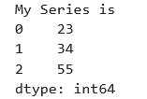
Example: Creating a Series with default index
import pandas as pd
S = pd.Series([23, 34, 55])
print(S)

Slide 10
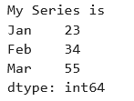
Example: Creating a Series with labelled index
import pandas as pd
S = pd.Series([23, 34, 55], index=[“Jan”, “Feb”, “Mar”])
print(S)

Slide 11

Creating Series object using Dictionary
import pandas as pd
D = {“A”:234, “B”:210, “C”:80}
S = pd.Series(d)
print(S)

Slide 12
Creating Series object using List
import pandas as pd
section = [‘A’, ‘B’, ‘C’]
students = [40, 50, 45]
S = pd.Series(students, index=section)
print(S)

Slide 13
Attributes of Series:
Attribute | Description
S.index | Returns index of Series object
S.values | Returns series as nparray
S.shape | Returns size of series object as tuple
S.size | Returns no of element of Series
S.hasnans | Returns True if any Nan value exists in Series
S.empty | Returns True if Series object has no element
S.dtype | Returns the data type of Series object

Slide 14
Data Frames:
It is a 2D (Two dimensional) data structure.
Used to manage large and complex data in tabular (row and columns) format.
It contains index for both rows and columns.
Used to represent most common data structure similar to spreadsheet.
Column
Column Label/Index
 | Name | ID | Subject | Marks
S1 | Akira | 15 | Data Science | 85
S2 | Hana | 21 | Data Science | 67
S3 | Jack | 26 | Database | 50
S4 | Liam | 54 | Database | 70
Element/ Value/ Entry
Row
Row Label/Index

Slide 15
Features of DataFrame:
It can store any data type of data.
It is both size, and value mutable.
Both row and column indexes can be labelled.
Indexes can be any types of values such as int, number, string or boolean value.
Indexes of dataframe can be referred as “axis”, axis=0 refers to row index, and axis=1 refers to the column index.
Dataframe can be created from various data structures like List, Tuple, Dictionary, Numpy array, Series.

Slide 16
Creating a Dataframe:
Values to be passed in data frame. It can be any type
Used to define the data type for columns (optional)
import pandas as pd
df = pd.Dataframe(data, index, columns, dtype)
Used to label index for columns. Optional. Default index is from 0 to n-1
Used to label index for rows. Optional. Default index is from 0 to n-1

Slide 17
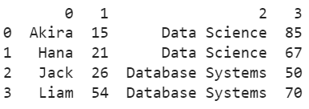
Creating a dataframe
import pandas as pd
row1 = ["Akira", 15, "Data Science", 85]
row2 = ["Hana", 21, "Data Science", 67]
row3 = ["Jack", 26, "Database Systems", 50]
row4 = ["Liam", 54, "Database Systems", 70]
df = pd.DataFrame([row1, row2, row3, row4])
print(df)

Slide 18
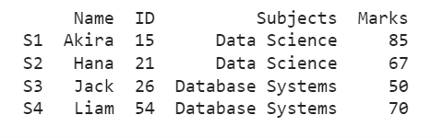
Creating a dataframe with labelled indexes for rows and columns
import pandas as pd
row1 = ["Akira", 15, "Data Science", 85]
row2 = ["Hana", 21, "Data Science", 67]
row3 = ["Jack", 26, "Database Systems", 50]
row4 = ["Liam", 54, "Database Systems", 70]
df = pd.DataFrame([row1, row2, row3, row4], index=["S1", "S2", "S3", "S4"], columns = ["Name", "ID", "Subjects", "Marks"])
print(df)

Slide 19
Dataframe Attributes
Attributes | Description
Index | Returns row labels of a dataframe
Columns | Returns column labels of a dataframe
Axes | Returns both row and column indexes
Size | Returns total no of elements of a dataframe including missing values.
Shape | Returns total no of rows and columns of a dataframe as a tuple
Values | Returns dataframe as a numpy array
Empty | Returns true if dataframe is empty
T | Transpose the dataframe’s index and columns
Notes:
Tra

Slide 20
Reading a .csv file into a dataframe
import pandas as pd
df = pd.read_csv('File Name')
print(df)

Slide 21
Loading a Dataframe from a Excel file
workbook = pd.ExcelFile('sample.xlsx')
dictionary = {}
for sheet_name in workbook.sheet_names:
df = workbook.parse(sheet_name)
dictionary[sheet_name] = df

Slide 22
Loading PSQL query into a dataframe
import psycopg2 as pg
import pandas.io.sql as psql
connection = pg.connect(database=’DatabaseName’, user='User Name', password='password', host='IP address', port= '5432')
df = psql.read_sql('query', connection)
print(df)

Slide 23
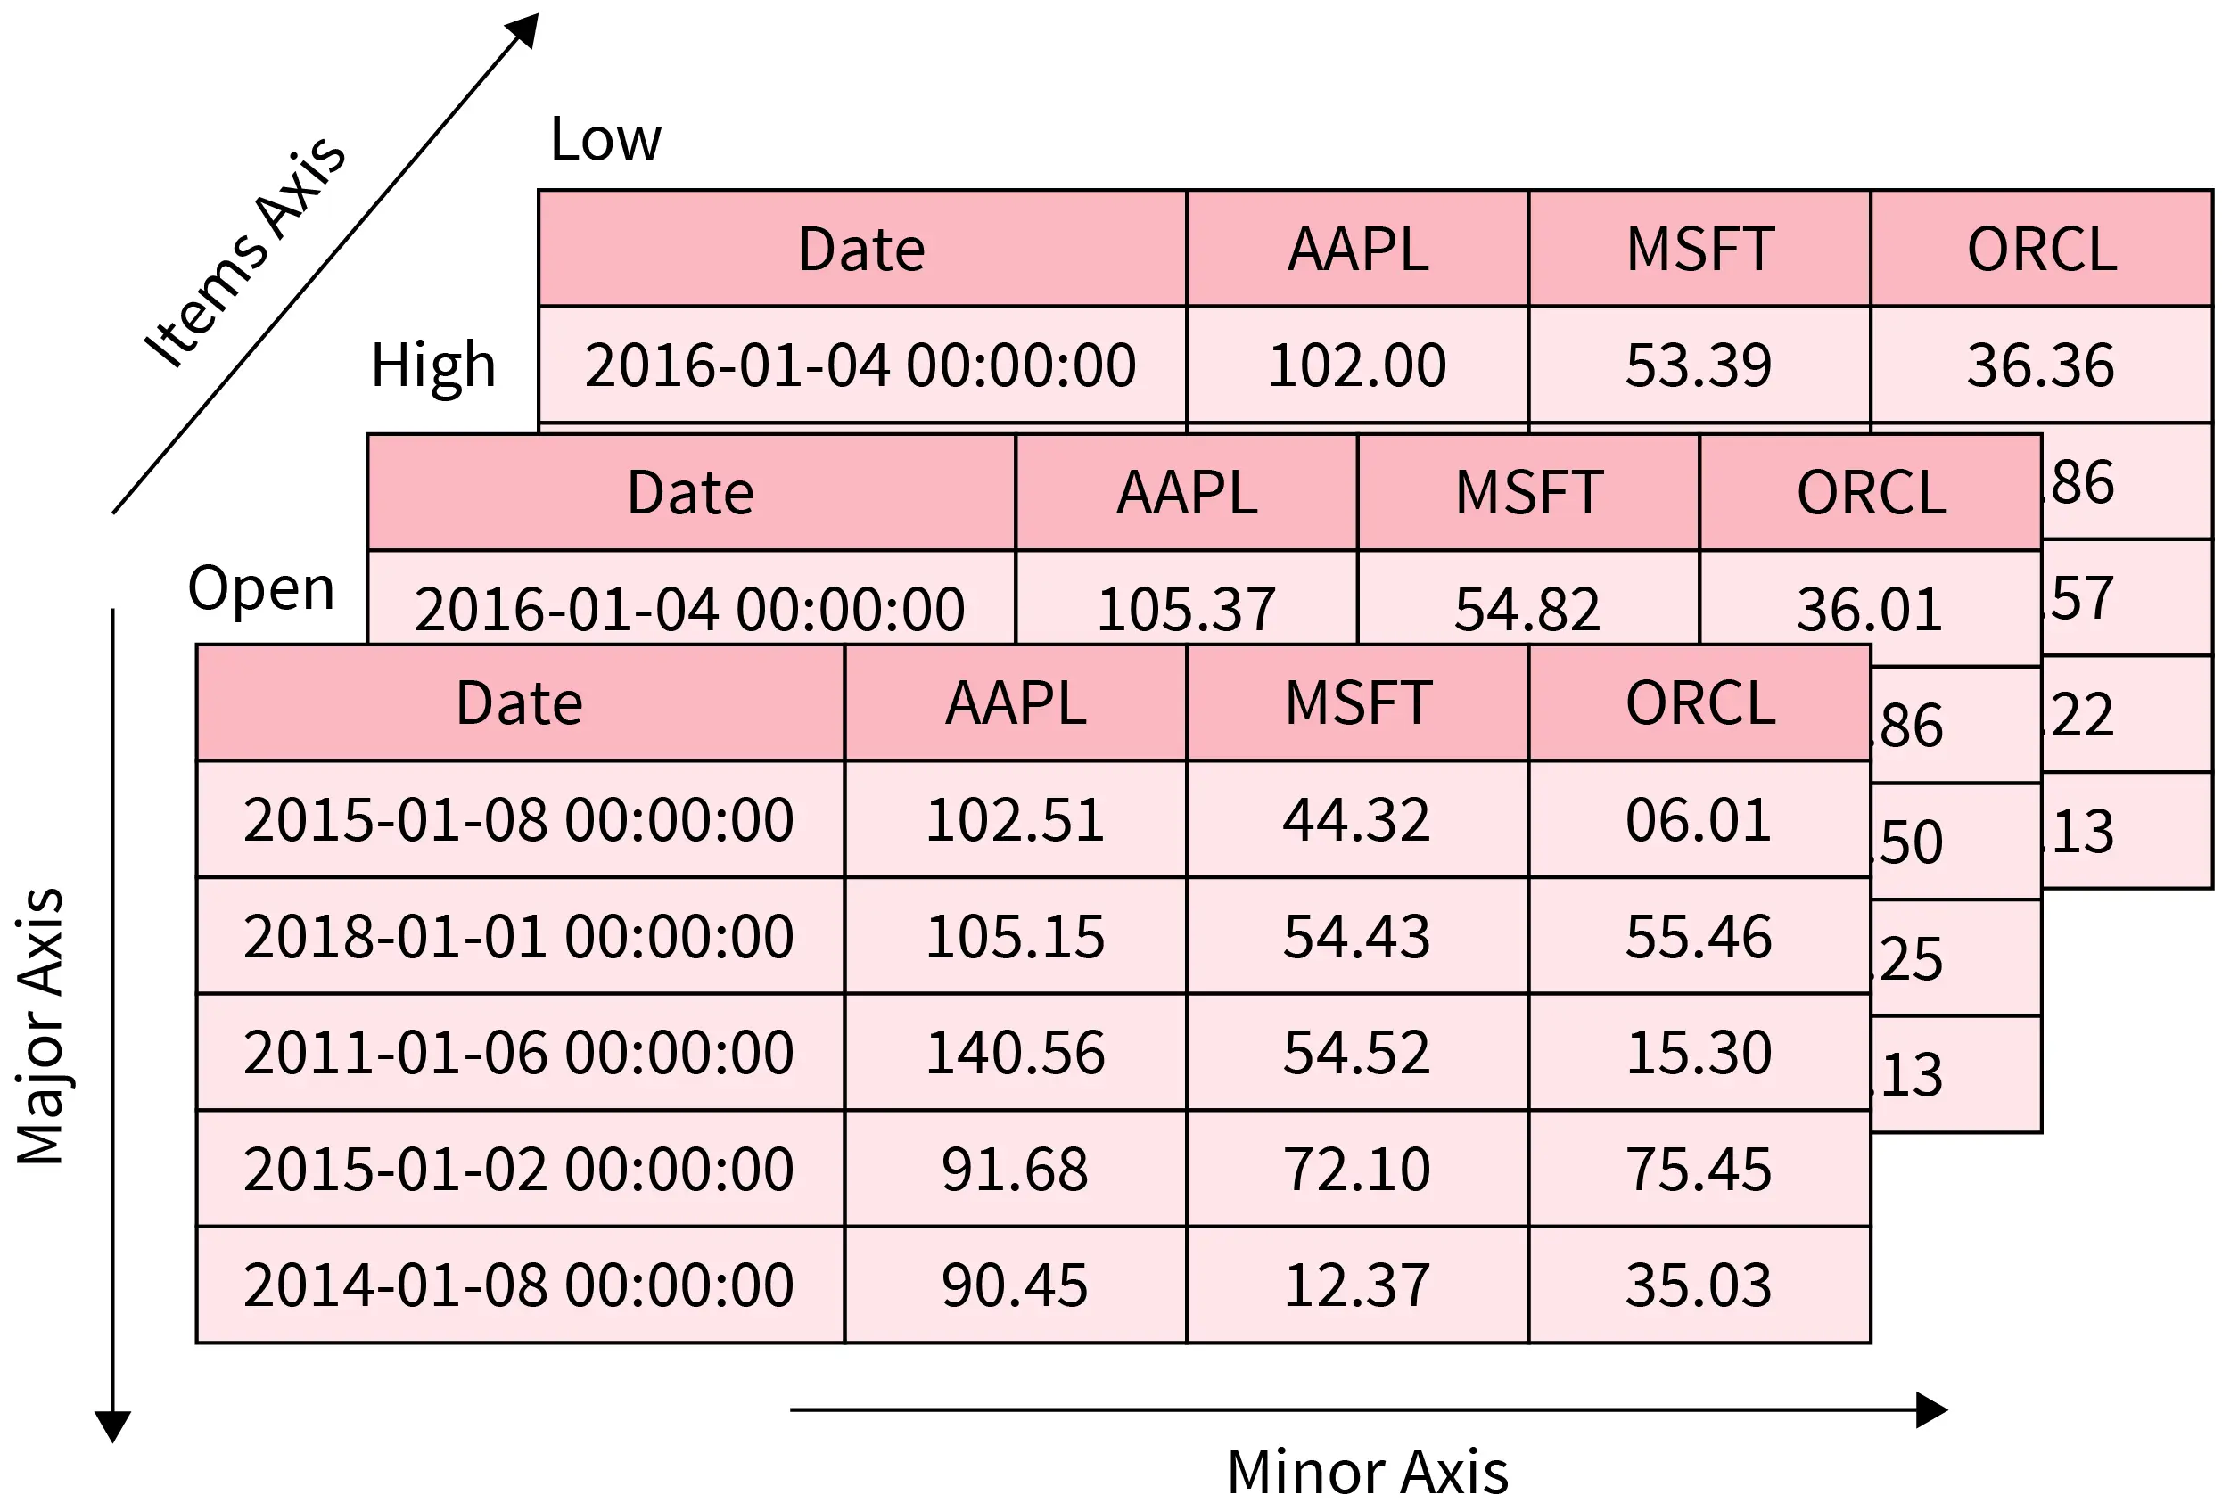
Panels in Pandas
A panel is a 3D container of data.
The term Panel data is derived from econometrics and is partially responsible for the name pandas − pan(el)-da(ta)-s.
The names for the 3 axes are intended to give some semantic meaning to describing operations involving panel data. They are −
items − axis 0, each item corresponds to a DataFrame contained inside.
major_axis − axis 1, it is the index (rows) of each of the DataFrames.
minor_axis − axis 2, it is the columns of each of the DataFrames.
pandas.Panel(data, items, major_axis, minor_axis, dtype, copy)

Slide 24
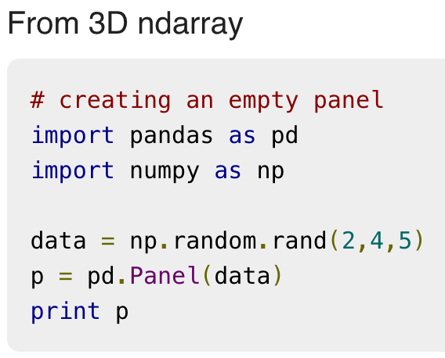
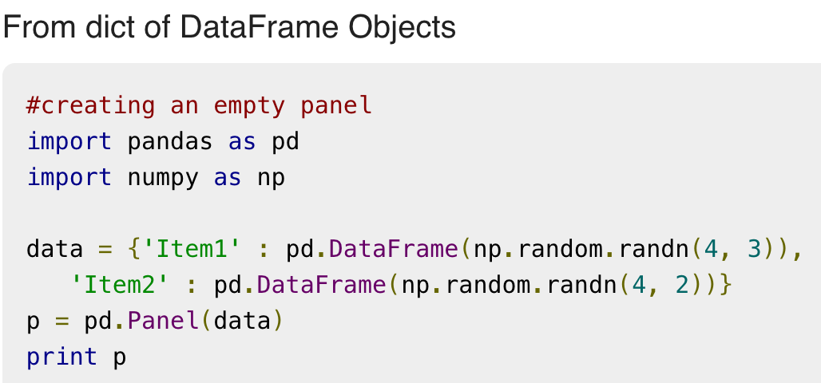
Creation of Panels
A Panel can be created using multiple ways, such as
using ndarrays
using dict of DataFrames
More info: https://www.tutorialspoint.com/python_pandas/python_pandas_panel.htm

