Slide 1
Introduction to Pattern Mining
AI for Data Science - I
By
Rage Uday Kiran

Slide 2
Outline
Origin of Data Science
Knowledge Discovery in Databases Process
Frequent Pattern Mining and
Association Rule Mining

Slide 3
Outline
Origin of Data Science
voluminous data
Data rich – information poor
Data Science
Knowledge Discovery in Databases Process
Frequent Pattern Mining and
Association Rule Mining

Slide 4
Generation of Voluminous Data
Source: Australian Bureau of Statistics, 2015

Slide 5
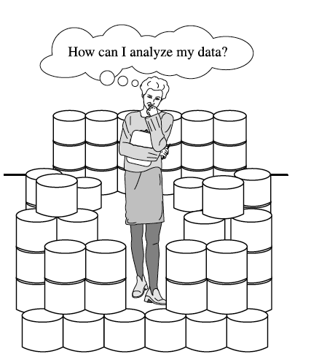
Important Question?
Data Rich - Information Poor (DRIP)

Slide 6
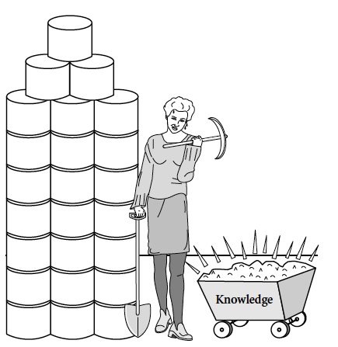
Solution
Data Science

Slide 7
Outline
Origin of Data Science
Knowledge Discovery in Databases Process
steps in KDD
Illustration with an example
Frequent Pattern Mining and
Association Rule Mining

Slide 8
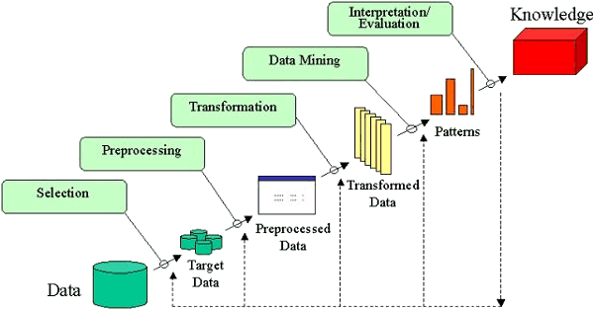
Process of Knowledge Discovery in Databases (KDD)

Slide 9
Illustration of KDD process
a, b, c, d, e, f, g, h
Assume a toy shop is selling the following items:
a – aeroplane
b – ball
c – cards
d – doll
e – elephant toy
f – fan
g – girafee toy
h - hat

Slide 10
Illustration of KDD process
a, b, c, d, e, f, g, h
Assume a toy shop is selling the following items:
Customer-1 purchased the items a and b
TID | Items
1 | a, b

Slide 11
Illustration of KDD process
a, b, c, d, e, f, g, h
Assume a toy shop is selling the following items:
Customer-1 purchased the items a and b
Customer-2 purchased the items a, e and f
TID | Items
1 | a, b
2 | a, e, f

Slide 12
Illustration of KDD process
a, b, c, d, e, f, g, h
Assume a toy shop is selling the following items:
Customer-1 purchased the items a and b
Customer-2 purchased the items a, e and f
Customer-3 purchased the items c and d
TID | Items
1 | a, b
2 | a, e, f
3 | c,d

Slide 13
Illustration of KDD process
a, b, c, d, e, f, g, h
Assume a toy shop is selling the following items:
Customer-1 purchased the items a and b
Customer-2 purchased the items a, e and f
Customer-3 purchased the items c and d
TID | Items
1 | a, b
2 | a, e, f
3 | c, d
4 | a, b, h
5 | c, d
6 | a, c
7 | a, b
8 | e, f
9 | c, d, g
10 | a, b
TID | Items
11 | a, b
12 | a, c
13 | a, b
14 | b, e, f, g
15 | c, d
16 | a, b, d
17 | c, d
18 | a, c
19 | a, b, e
20 | c, d
TID | Items
21 | a, b
22 | a, c
23 | a, b
24 | b, e, f, g
25 | c, d
26 | a, b, d
27 | c, d
28 | a, c
29 | a, b, e
30 | c, d
.
.
.
Transactional database

Slide 14
Illustration of KDD process
Useful information is hidden in this data.
TID | Items
1 | a, b
2 | a, e, f
3 | c, d
4 | a, b, h
5 | c, d
6 | a, c
7 | a, b
8 | e, f
9 | c, d, g
10 | a, b
TID | Items
11 | a, b
12 | a, c
13 | a, b
14 | b, e, f, g
15 | c, d
16 | a, b, d
17 | c, d
18 | a, c
19 | a, b, e
20 | c, d
TID | Items
21 | a, b
22 | a, c
23 | a, b
24 | b, e, f, g
25 | c, d
26 | a, b, d
27 | c, d
28 | a, c
29 | a, b, e
30 | c, d

Slide 15
Illustration of KDD process
TID | Items
1 | a, b
2 | a, e, f
3 | c, d
4 | a, b, h
5 | c, d
6 | a, c
7 | a, b
8 | e, f
9 | c, d, g
10 | a, b
TID | Items
11 | a, b
12 | a, c
13 | a, b
14 | b, e, f, g
15 | c, d
16 | a, b, d
17 | c, d
18 | a, c
19 | a, b, e
20 | c, d
TID | Items
21 | a, b
22 | a, c
23 | a, b
24 | b, e, f, g
25 | c, d
26 | a, b, d
27 | c, d
28 | a, c
29 | a, b, e
30 | c, d

Slide 16
Illustration of KDD process
TID | Items
1 | a, b
2 | a, e, f
3 | c, d
4 | a, b, h
5 | c, d
6 | a, c
7 | a, b
8 | e, f
9 | c, d, g
10 | a, b
TID | Items
11 | a, b
12 | a, c
13 | a, b
14 | b, e, f, g
15 | c, d
16 | a, b, d
17 | c, d
18 | a, c
19 | a, b, e
20 | c, d
TID | Items
21 | a, b
22 | a, c
23 | a, b
24 | b, e, f, g
25 | c, d
26 | a, b, d
27 | c, d
28 | a, c
29 | a, b, e
30 | c, d
Choosing top-20 transactions

Slide 17
Illustration of KDD process
TID | Items
1 | a, b
2 | a, e, f
3 | c, d
4 | a, b, h
5 | c, d
6 | a, c
7 | a, b
8 | e, f
9 | c, d, g
10 | a, b
TID | Items
11 | a, b
12 | a, c
13 | a, b
14 | b, e, f, g
15 | c, d
16 | a, b, d
17 | c, d
18 | a, c
19 | a, b, e
20 | c, d
word count
h appeared only once

Slide 18
Illustration of KDD process
TID | Items
1 | a, b
2 | a, e, f
3 | c, d
4 | a, b, h
5 | c, d
6 | a, c
7 | a, b
8 | e, f
9 | c, d, g
10 | a, b
TID | Items
11 | a, b
12 | a, c
13 | a, b
14 | b, e, f, g
15 | c, d
16 | a, b, d
17 | c, d
18 | a, c
19 | a, b, e
20 | c, d
prune h

Slide 19
Illustration of KDD process
TID | Items
1 | a, b
2 | a, e, f
3 | c, d
4 | a, b, h
5 | c, d
6 | a, c
7 | a, b
8 | e, f
9 | c, d, g
10 | a, b
TID | Items
11 | a, b
12 | a, c
13 | a, b
14 | b, e, f, g
15 | c, d
16 | a, b, d
17 | c, d
18 | a, c
19 | a, b, e
20 | c, d
extract patterns

Slide 20
Outline
Origin of Big Data Analytics
Knowledge Discovery in Databases Process
Frequent Pattern Mining and
Mathematical model
Search space
Apriori property
Apriori algorithm
Association Rule Mining

Slide 21
Model of Frequent Patterns
Toy shop
I ={i₁,i₂,…,i_{n}}, be a set of items
E.g., I={a, b, c, d, e, f, g, h}
TID | Items
1 | a, b
2 | a, e, f
3 | c, d
4 | a, b, h
5 | c, d
6 | a, c
7 | a, b
8 | e, f
9 | c, d, g
10 | a, b
TID | Items
11 | a, b
12 | a, c
13 | a, b
14 | b, e, f, g
15 | c, d
16 | a, b, d
17 | c, d
18 | a, c
19 | a, b, e
20 | c, d
Table 1: Transactional database

Slide 22
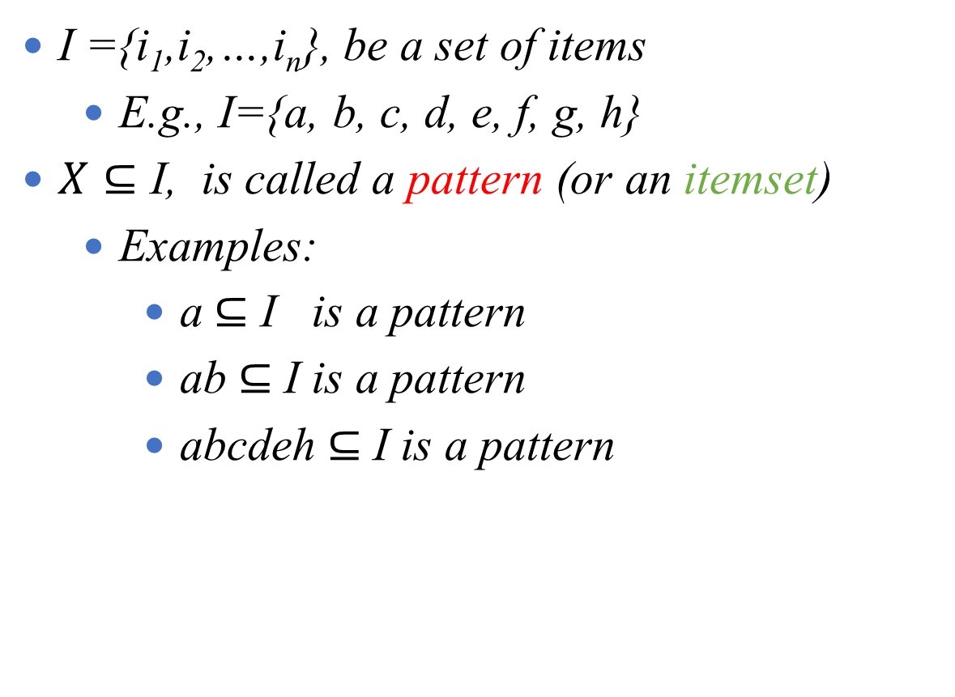
Model of Frequent Patterns
TID | Items
1 | a, b
2 | a, e, f
3 | c, d
4 | a, b, h
5 | c, d
6 | a, c
7 | a, b
8 | e, f
9 | c, d, g
10 | a, b
TID | Items
11 | a, b
12 | a, c
13 | a, b
14 | b, e, f, g
15 | c, d
16 | a, b, d
17 | c, d
18 | a, c
19 | a, b, e
20 | c, d
I ={i₁,i₂,…,i_{n}}, be a set of items
E.g., I={a, b, c, d, e, f, g, h}
$X⊆$ I, is called a pattern (or an itemset)
Examples:
a $⊆$ I is a pattern
ab $⊆$ I is a pattern
abcdeh $⊆$ I is a pattern
Table 1: Transactional database

Slide 23

Model of Frequent Patterns
TID | Items
1 | a, b
2 | a, e, f
3 | c, d
4 | a, b, h
5 | c, d
6 | a, c
7 | a, b
8 | e, f
9 | c, d, g
10 | a, b
TID | Items
11 | a, b
12 | a, c
13 | a, b
14 | b, e, f, g
15 | c, d
16 | a, b, d
17 | c, d
18 | a, c
19 | a, b, e
20 | c, d
I ={i₁,i₂,…,i_{n}}, be a set of items
E.g., I={a, b, c, d, e, f, g, h}
$X⊆$ I, is called a pattern (or an itemset)
E.g., ab $⊆$ I is a pattern
A transaction, t=(tid, X)
Table 1: Transactional database

Slide 24
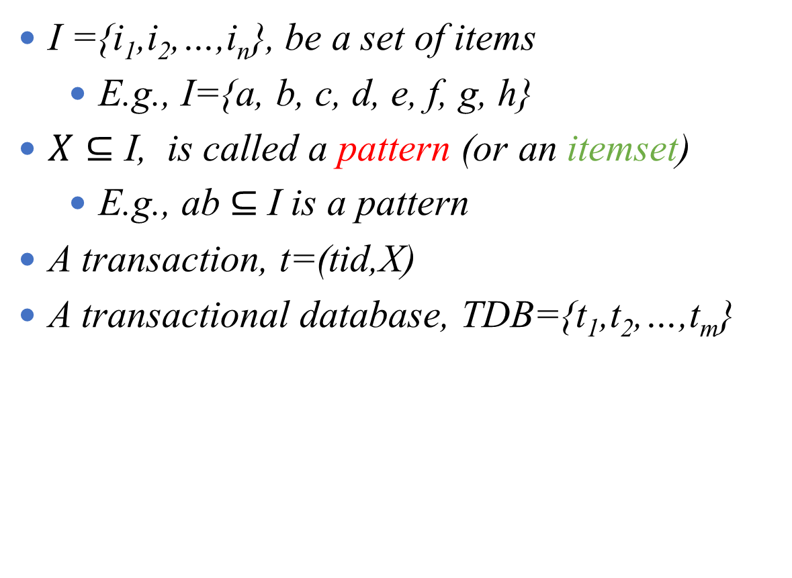
Model of Frequent Patterns
TID | Items
1 | a, b
2 | a, e, f
3 | c, d
4 | a, b, h
5 | c, d
6 | a, c
7 | a, b
8 | e, f
9 | c, d, g
10 | a, b
TID | Items
11 | a, b
12 | a, c
13 | a, b
14 | b, e, f, g
15 | c, d
16 | a, b, d
17 | c, d
18 | a, c
19 | a, b, e
20 | c, d
I ={i₁,i₂,…,i_{n}}, be a set of items
E.g., I={a, b, c, d, e, f, g, h}
$X⊆$ I, is called a pattern (or an itemset)
E.g., ab $⊆$ I is a pattern
A transaction, t=(tid,X)
A transactional database, TDB={t₁,t₂,…,t_{m}}
Table 1: Transactional database

Slide 25
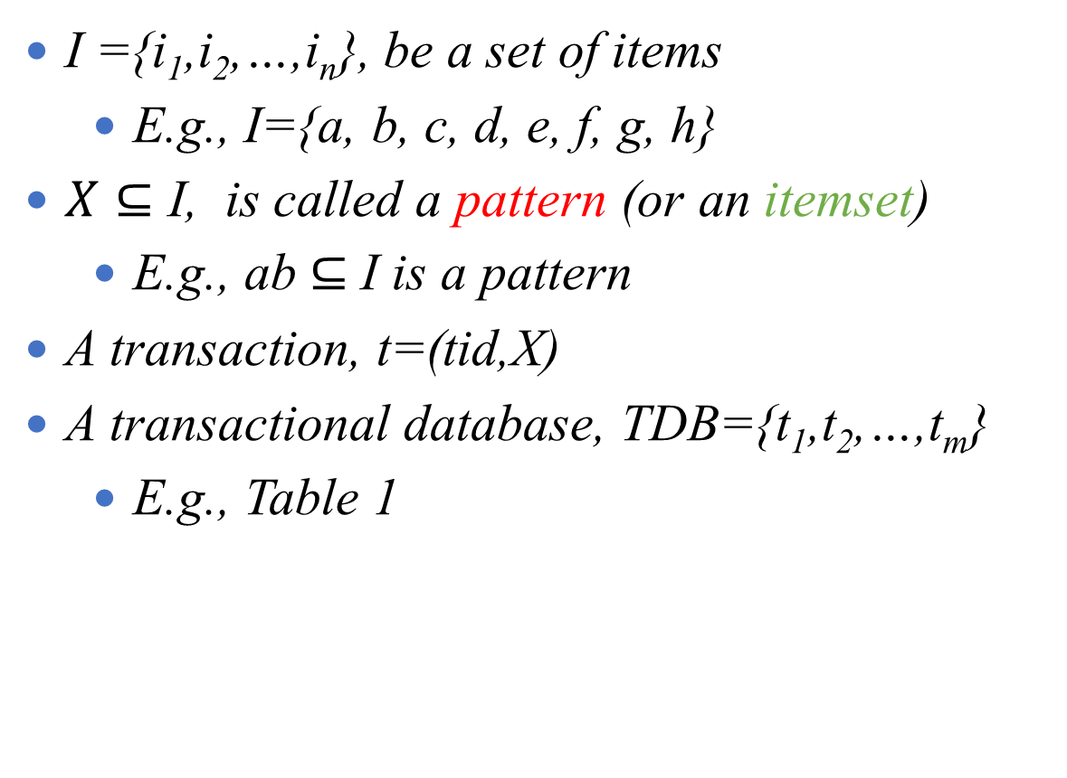
Model of Frequent Patterns
TID | Items
1 | a, b
2 | a, e, f
3 | c, d
4 | a, b, h
5 | c, d
6 | a, c
7 | a, b
8 | e, f
9 | c, d, g
10 | a, b
TID | Items
11 | a, b
12 | a, c
13 | a, b
14 | b, e, f, g
15 | c, d
16 | a, b, d
17 | c, d
18 | a, c
19 | a, b, e
20 | c, d
I ={i₁,i₂,…,i_{n}}, be a set of items
E.g., I={a, b, c, d, e, f, g, h}
$X⊆$ I, is called a pattern (or an itemset)
E.g., ab $⊆$ I is a pattern
A transaction, t=(tid,X)
A transactional database, TDB={t₁,t₂,…,t_{m}}
E.g., Table 1
Table 1: Transactional database

Slide 26
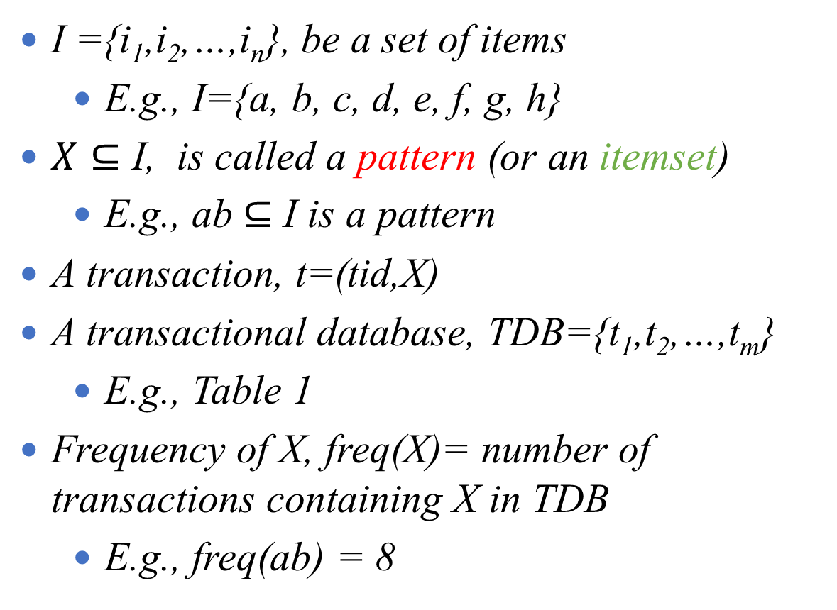
Model of Frequent Patterns
I ={i₁,i₂,…,i_{n}}, be a set of items
E.g., I={a, b, c, d, e, f, g, h}
$X⊆$ I, is called a pattern (or an itemset)
E.g., ab $⊆$ I is a pattern
A transaction, t=(tid,X)
A transactional database, TDB={t₁,t₂,…,t_{m}}
E.g., Table 1
Frequency of X, freq(X)= number of transactions containing X in TDB
E.g., freq(ab) = 8
TID | Items
1 | a, b
2 | a, e, f
3 | c, d
4 | a, b, h
5 | c, d
6 | a, c
7 | a, b
8 | e, f
9 | c, d, g
10 | a, b
TID | Items
11 | a, b
12 | a, c
13 | a, b
14 | b, e, f, g
15 | c, d
16 | a, b, d
17 | c, d
18 | a, c
19 | a, b, e
20 | c, d
Table 1: Transactional database

Slide 27
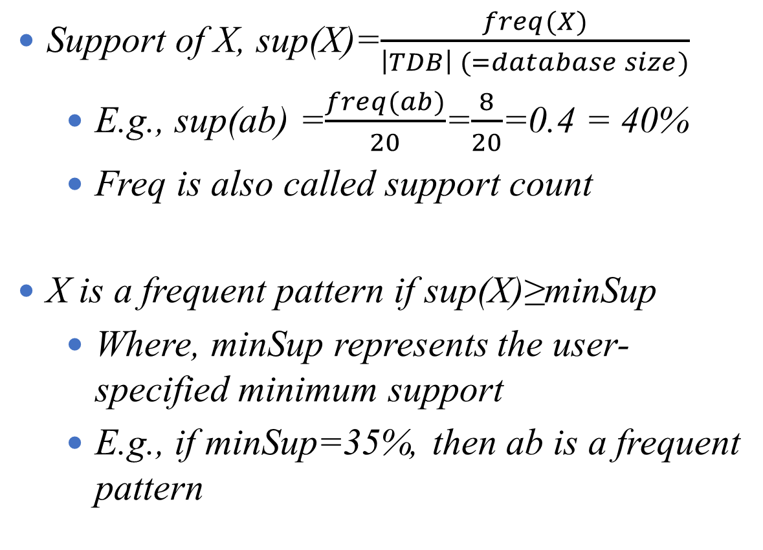
Model of Frequent Patterns
TID | Items
1 | a, b
2 | a, e, f
3 | c, d
4 | a, b, h
5 | c, d
6 | a, c
7 | a, b
8 | e, f
9 | c, d, g
10 | a, b
TID | Items
11 | a, b
12 | a, c
13 | a, b
14 | b, e, f, g
15 | c, d
16 | a, b, d
17 | c, d
18 | a, c
19 | a, b, e
20 | c, d
Support of X, sup(X)=$\frac{freq(X)}{\left|TDB\right| (=database size)}$
E.g., sup(ab) =$\frac{freq(ab)}{20}$=$\frac{8}{20}$=0.4 = 40%
Freq is also called support count
X is a frequent pattern if sup(X)≥minSup
Where, minSup represents the user-specified minimum support
E.g., if minSup=35%, then ab is a frequent pattern
Table 1: Transactional database

Slide 28
Model of Frequent Patterns
Definition
Given a transactional database (TDB) and the user-specified minimum support (minSup), find all patterns in TDB that have support no less than minSup.

Slide 29
Search Space
{}
a
b
c
d
1-patterns
ab
ac
ad
bc
bd
cd
2-patterns
abc
abd
acd
bcd
3-patterns
abcd
4-patterns
Figure 1: Search space illustration using the items a, b, c and d.

Slide 30
Problem of Frequent Pattern Mining
{}
Problem:
Huge search space
2^{n}-1, n represents number of items
a
b
c
d
1-patterns
ab
ac
ad
bc
bd
cd
2-patterns
abc
abd
acd
bcd
3-patterns
abcd
4-patterns
Figure 1: Search space illustration using the items a, b, c and d.

Slide 31

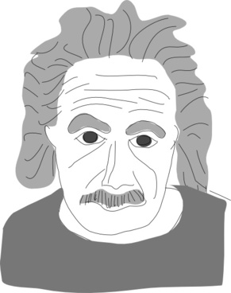

Downward Closure (or Apriori) Property
Example
Previous week, I attended school for 4 days
Previous week, I attended school 5 days
Find maximum number of days both have attend the school together?
Minimum attendance
Min(4,5)=4

Slide 32
Downward Closure Property
Definition: If a pattern satisfy minsup, then all its non-empty subsets will also satisfy minsup.
Example
Previous week, I attended school for 4 days
Previous week, I attended school 5 days
If minSup=5, do both kids attend the school frequently?
Nope
As the boy fails the test

Slide 33
Downward Closure Property
Definition: If a pattern satisfy minsup, then all its non-empty subsets will also satisfy minsup.
Example
The Support(ab) ≥ minsup if and only if
Support(a) ≥ minsup and
Support(b) ≥ minsup.

Slide 34
Illustration of Downward Closure Property
{}
a
b
c
d
1-patterns
infrequent
ab
ac
ad
bc
bd
cd
2-patterns
infrequent
abc
abd
acd
bcd
ab
3-patterns
abcd
4-patterns
Figure 2: Downward Closure Property illustration using the items a, b, c and d.

Slide 35
Techniques to Reduce the Search Space
Breadth-first search algorithms (Apriori)
{}
a
b
c
d
depth-first search algorithms (FP-growth)
ab
ac
ad
bc
bd
cd
abc
abd
acd
bcd
abcd

Slide 36
Apriori algorithm
Apriori employs candidate generate and test approach to discover frequent patterns.
Frequent patterns of size k are used to find frequent patterns of size k+1, where k ≥ 1.
Steps in Apriori algorithm:
Join step: To find frequent k-patterns (L_{k}), a set of candidate k-patterns (C_{k}) is generated by joining L_{k-1} with itself.
Prune step: C_{k} is the superset of L_{k}. A scan on the database to determine the count of each candidate in C_{k} would result in finding L_{k}.

Slide 37
The Illustration of Apriori Algorithm
Let minsup count =3.
TID | Items
1 | a, b
2 | a, e, f
3 | c, d
4 | a, b, h
5 | c, d
6 | a, c
7 | a, b
8 | e, f
9 | c, d, g
10 | a, b
TID | Items
11 | a, b
12 | a, c
13 | a, b
14 | b, e, f, g
15 | c, d
16 | a, b, d
17 | c, d
18 | a, c
19 | a, b, e
20 | c, d
Step 1: generating candidate 2-patterns
Step 2: find frequent 1-patterns
Items | sup/freq
ab | 8
ac | 3
ad
ae
af
bc
bd
be
bf
…
Items | sup/freq
a | 12
b | 9
c | 9
d | 7
e | 4
f | 3
apply
Apriori
Table 1: Transactional database

Slide 38
The Illustration of Apriori Algorithm
Let minsup count =3.
Scan the database and find Candidate 1-patterns (C₁)
From C₁ find frequent 1-patterns( L₁)
TID | Items
1 | a, b
2 | a, e, f
3 | c, d
4 | a, b, h
5 | c, d
6 | a, c
7 | a, b
8 | e, f
9 | c, d, g
10 | a, b
TID | Items
11 | a, b
12 | a, c
13 | a, b
14 | b, e, f, g
15 | c, d
16 | a, b, d
17 | c, d
18 | a, c
19 | a, b, e
20 | c, d
C₁
Items | S
a | 12
b | 9
c | 9
d | 7
e | 4
f | 3
g | 2
h | 1
L₁
Items | S
a | 12
b | 9
c | 9
d | 7
e | 4
f | 3
minsup
Table 1: Transactional database
S = support count of the patterns.

Slide 39
Apriori Algorithm: Illustration
Generate C₂ by joining L₁ with itself.
Scan the database and measure their support.
Find L₂ from C₂.
Repeat this process until no more L_{k} are found or C_{k} cannot be generated.
C₂
(=L₁ L₁)
C₂
L₂
Items | S
ab
ac
ad
ae
af
bc
bd
be
Items | S
bf
cd
ce
cf
de
df
ef
Items | S
ab | 8
ac | 3
ad | 1
ae | 2
af | 1
bc | 0
bd | 1
be | 2
Items | S
bf | 1
cd | 6
ce | 0
cf | 0
de | 0
df | 0
ef | 3
Items | S
ab | 8
cd | 6
ef | 3
ac | 3
No more C₃
minsup

Slide 40
Dictionary
{key, value} ->. {item, bitString}
Key
Value
TID | Items
1 | a, b
2 | a, e, f
3 | c, d
4 | a, b, h
5 | c, d
6 | a, c
7 | a, b
8 | e, f
9 | c, d, g
10 | a, b
TID | Items
11 | a, b
12 | a, c
13 | a, b
14 | b, e, f, g
15 | c, d
16 | a, b, d
17 | c, d
18 | a, c
19 | a, b, e
20 | c, d
a
11010110011110010110
b
10010010011011010010
.
.
.
ab
11010110011110010110
AND
10010010011011010010
= 10010010011010010010
cardinarlity( ) = 8
10010010011010010010

Slide 41
Outline
Origin of Big Data Analytics
Knowledge Discovery in Databases Process
Frequent Pattern Mining and
Association Rule Mining

Slide 42
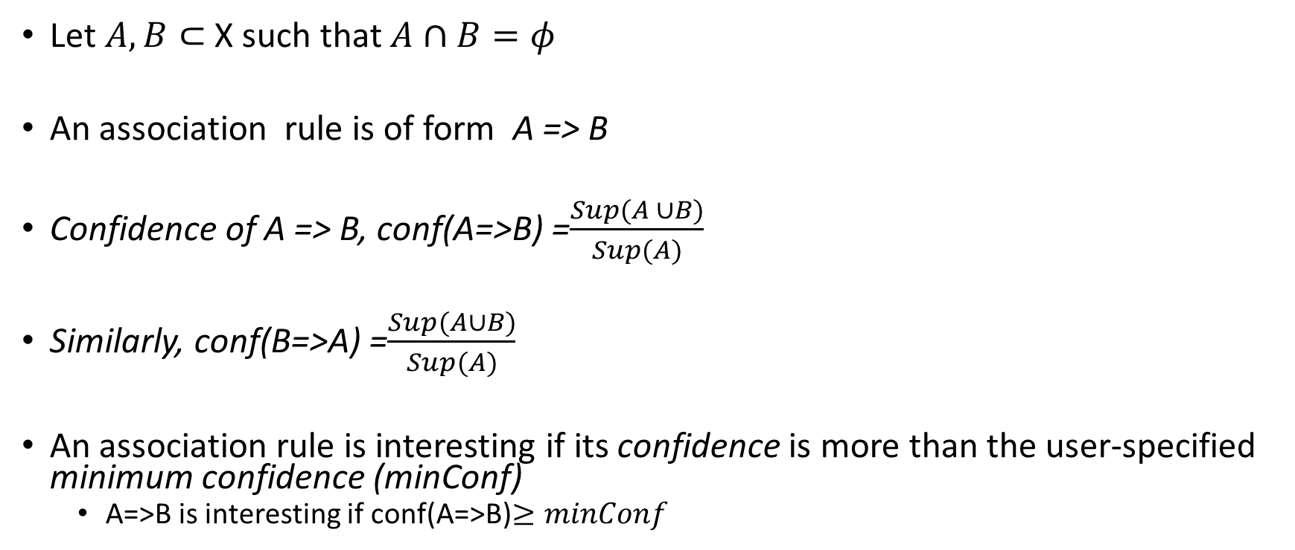
Generating Association Rules From Frequent Patterns
Let $A,B⊂$ X such that $A∩B=φ$
An association rule is of form A => B
Confidence of A => B, conf(A=>B) =$\frac{Sup(A ∪B)}{Sup(A)}$
Similarly, conf(B=>A) =$\frac{Sup(A∪B)}{Sup(A)}$
An association rule is interesting if its confidence is more than the user-specified minimum confidence (minConf)
A=>B is interesting if conf(A=>B)$≥minConf$

Slide 43
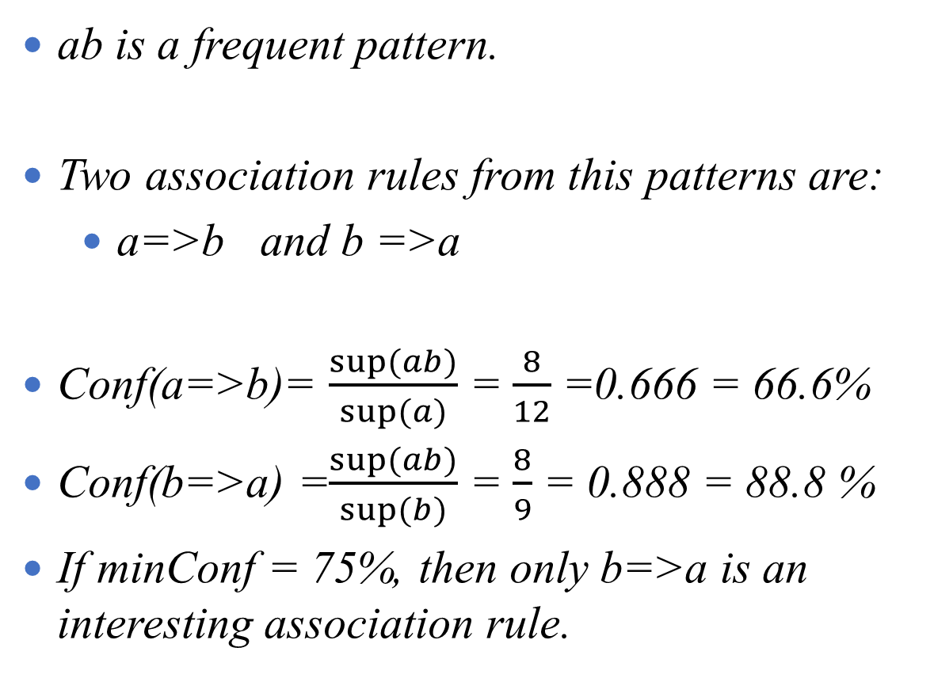
Generating Association Rules From Frequent Patterns
ab is a frequent pattern.
Two association rules from this patterns are:
a=>b and b =>a
Conf(a=>b)= $\frac{sup⁡(ab)}{sup⁡(a)}$ = $\frac{8}{12}$ =0.666 = 66.6%
Conf(b=>a) =$\frac{sup⁡(ab)}{sup⁡(b)}$ = $\frac{8}{9}$ = 0.888 = 88.8 %
If minConf = 75%, then only b=>a is an interesting association rule.
TID | Items
1 | a, b
2 | a, e, f
3 | c, d
4 | a, b, h
5 | c, d
6 | a, c
7 | a, b
8 | e, f
9 | c, d, g
10 | a, b
TID | Items
11 | a, b
12 | a, c
13 | a, b
14 | b, e, f, g
15 | c, d
16 | a, b, d
17 | c, d
18 | a, c
19 | a, b, e
20 | c, d
Table 1: Transactional database

Slide 44
END Any Questions?

